Slide 1
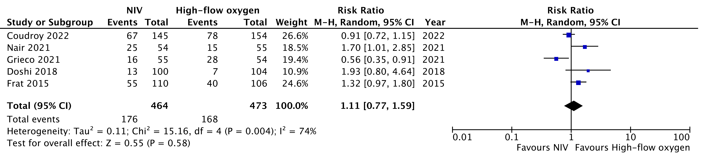
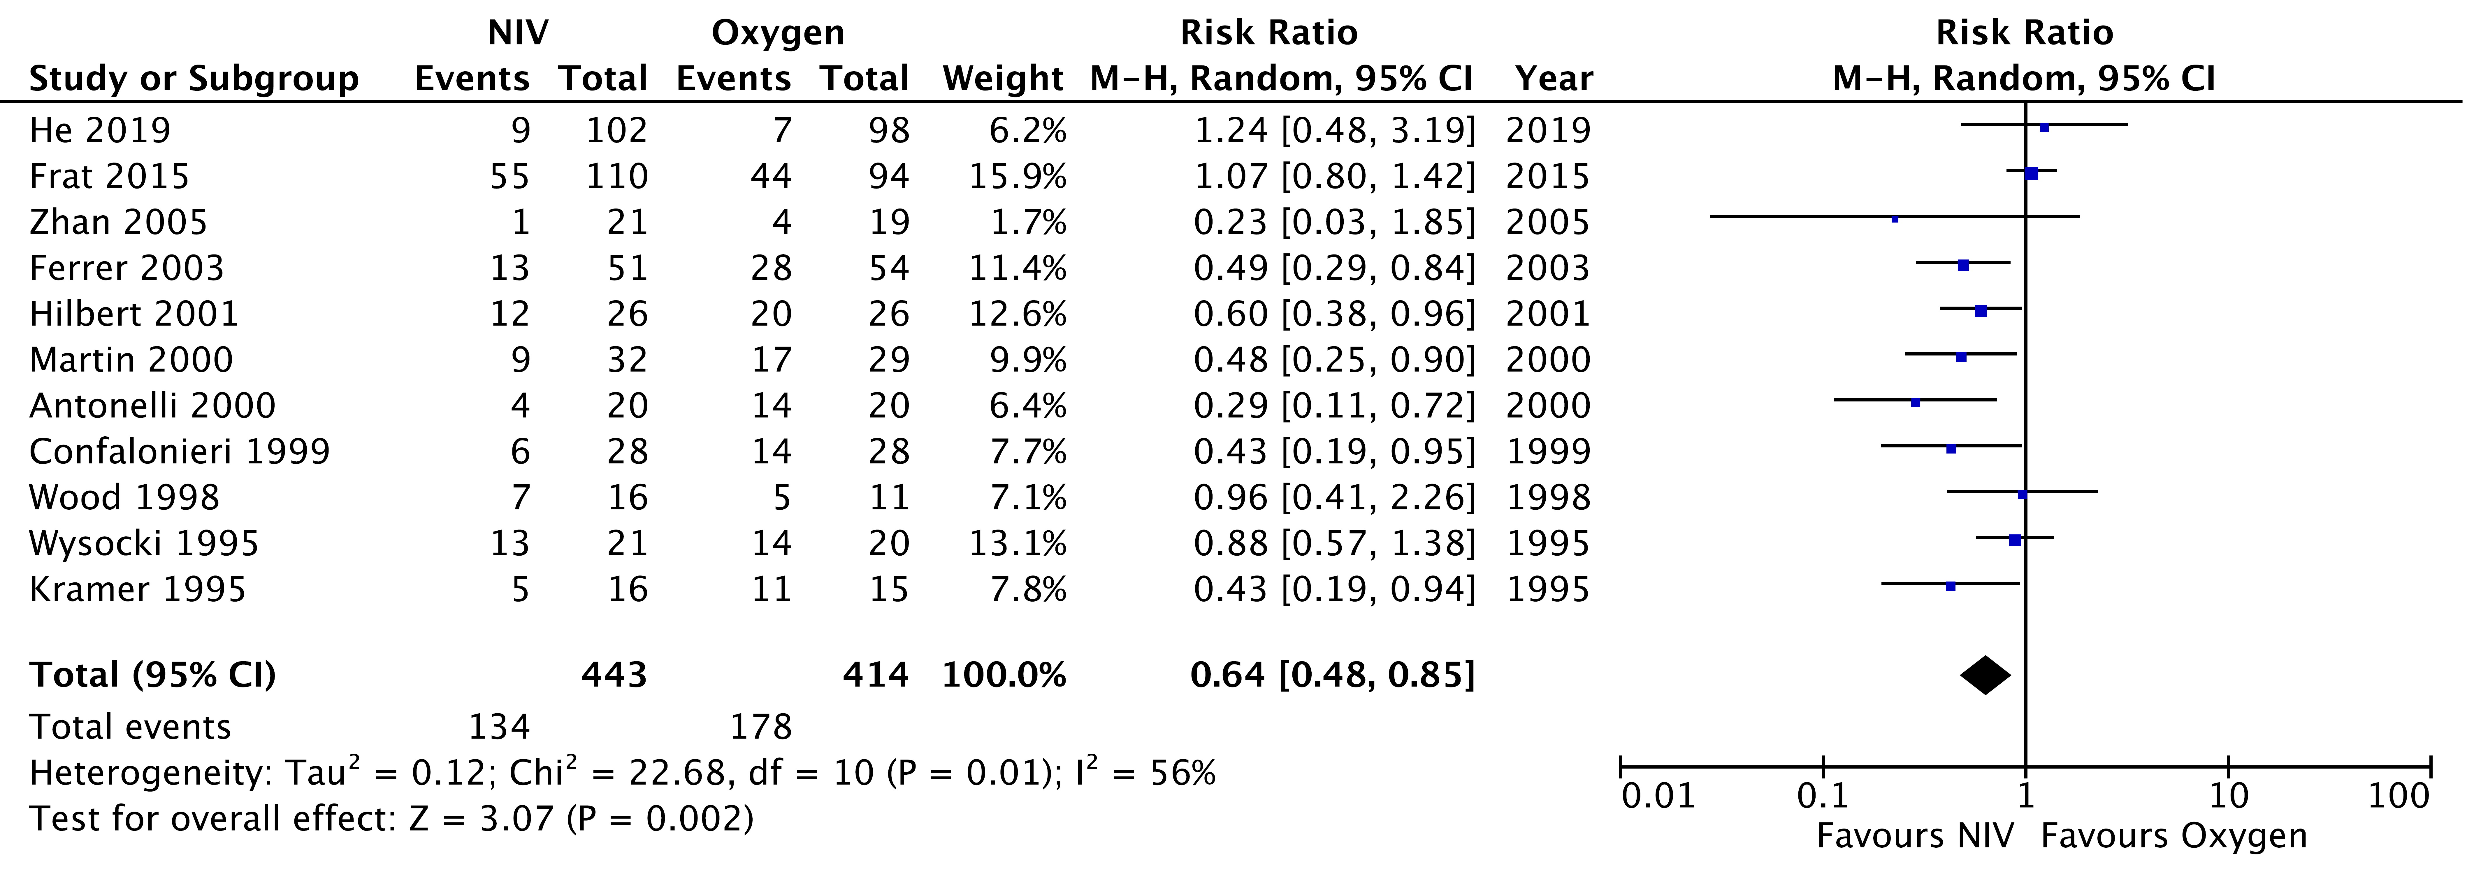
Intubation
NIV vs. HFNC
Intubation
NIV vs. O2

