Slide 1
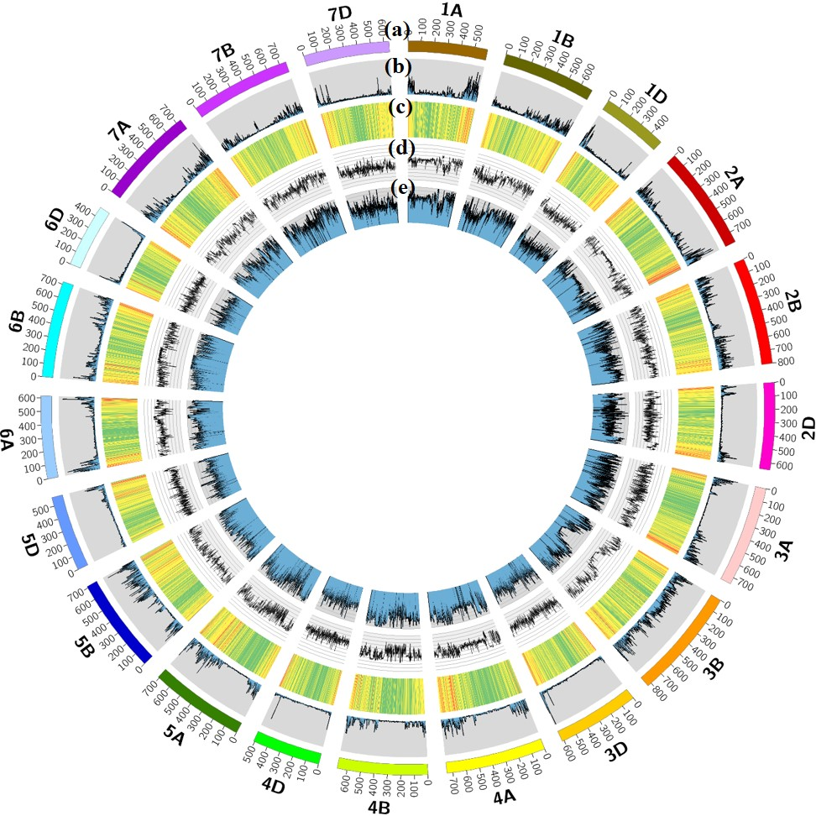
Figure S1
Figure S1 Circos diagram showing genome-wide physical distributions of filtered single nucleotide polymorphisms (SNPs) from the wheat 660K SNP array and average nucleotide diversity in each chromosome. (a) The outer track is the physical size of each chromosome. Wheat chromosomes are represented in different colors. (b) SNP distribution represented by SNP numbers in 1-Mb windows of each chromosome. (c) Heatmap representing the numbers of matched high-confidence genes in 10-Mb windows in each chromosome. Average nucleotide diversity was estimated by polymorphism information content (d) and expected heterozygosity (e) using a sliding window size of 1 Mb along the chromosome.

Slide 2
Figure S2
Figure S2 Genome-wide average linkage disequilibrium (LD) decay over physical distances. Plots of pair-wise single-nucleotide polymorphism LD r² values as a function of inter-marker map distance (Mb) within three subgenomes (a) and each chromosome corresponding to subgenomes A (b), B (c), and D (d) based on IWGSC RefSeq v.1.0. The black bold dashed line represents the population-specific critical r² value (0.1) beyond which LD is likely due to linkage.

Slide 3
Figure S3
Figure S3 Box plot distributions of seedling infection type (IT) for six Pst races.

Slide 4
Figure S4
Figure S4 Phenotypic distribution of the stripe rust responses of different wheat accessions. Box plot distributions of infection type (IT) (a) and disease severity (DS) (b) across multiple environments (BLUP, the best linear unbiased predictions; JY, Jiangyou; TS, Tianshui; YL, Yangling). Solid horizontal lines show medians. The half violin plots show the adult plant resistance density distribution in different environments. The raw data points overlying the box plots display the frequency of different tests. (c) Regression plot, histograms, and Pearson correlation coefficients (P = 0.01) among different survey indicators or environments. Boxplot of IT (d) and DS (e) for different sub-populations in the diversity panel.

Slide 5
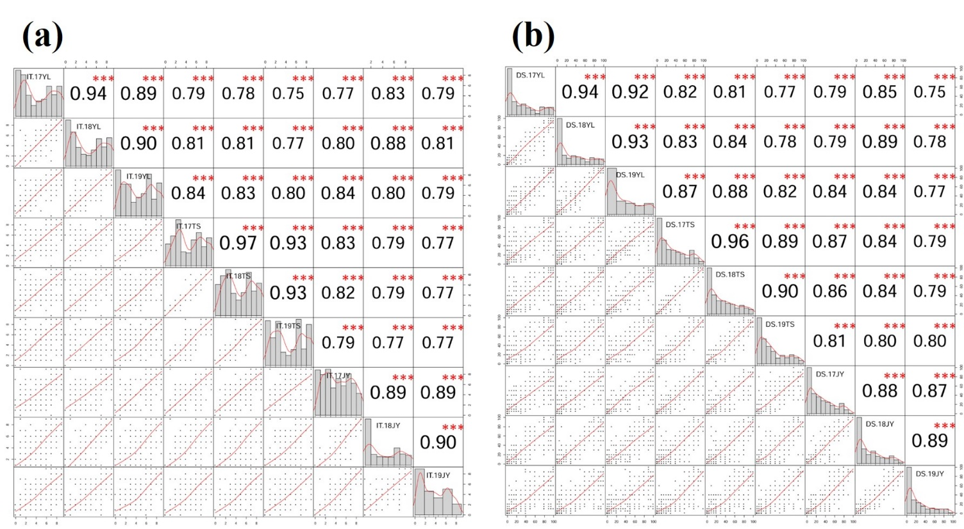
Figure S5
Figure S5 Regression plot, histograms and Pearson correlation coefficients (P = 0.01) for infection type (IT) and disease severity (DS) among different environments (YL, Yangling; TS, Tianshui; JY, Jingyou; 17, 18, 19 represented 2016-2017, 2017-2018, 2018-2019 cropping seasons, respectively).

Slide 6
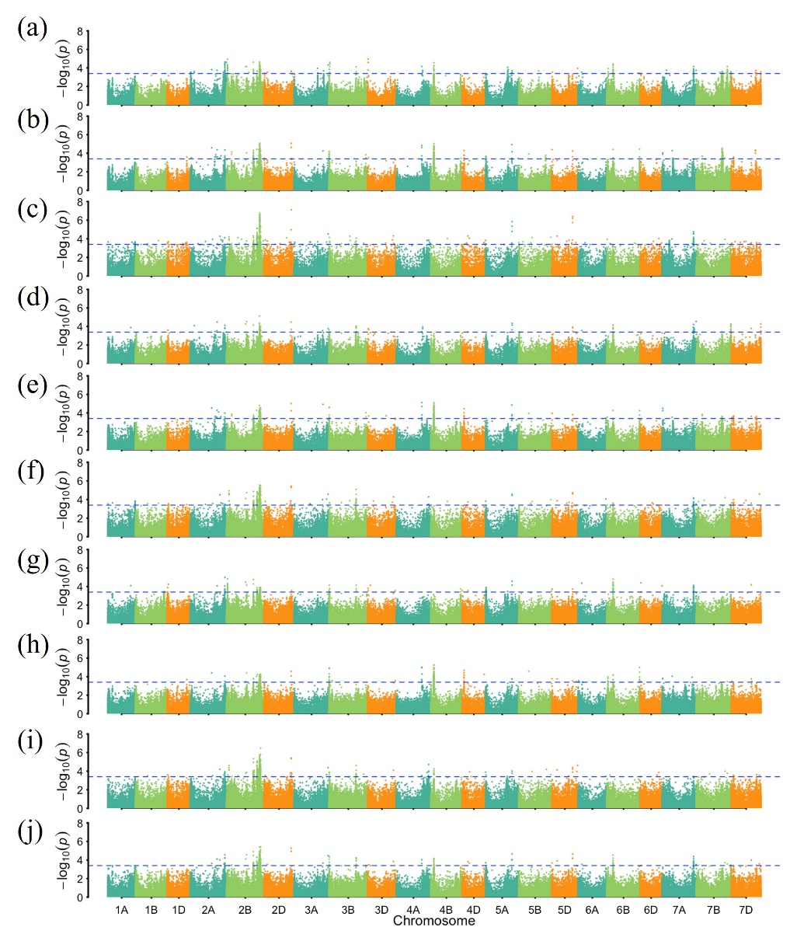
Figure S6
Figure S6 Genome-wide association analysis results for stripe rust infection types across ten tested environments including (a) 2017-Jiangyou, (b) 2017-Tianshui, (c) 2017-Yanlging, (d) 2018-Jiangyou, (e) 2018-Tianshui, (f) 2018-Yanlging, (g) 2019-Jiangyou, (h) 2019-Tianshui, (i) 2019-Yanlging, and (j) BLUP. The horizontal line shows the genome-wide significance threshold –log10 (P) value of 3.4. The A, B, and D genomes are in blue-green, pale green, and orange, respectively.

Slide 7
Figure S7
Figure S7 Chromosome positions of QTL identified in this study relative to previously mapped stripe rust resistance genes/QTL. Chromosome lengths were based on the physical Chinese Spring map. QTL-tagged SNPs identified in this study were labeled as “SNP”. Those with red fonts were potentially novel but require confirmation; those with blue fonts possibly correspond to previously reported Yr genes (Table 2).

Slide 8
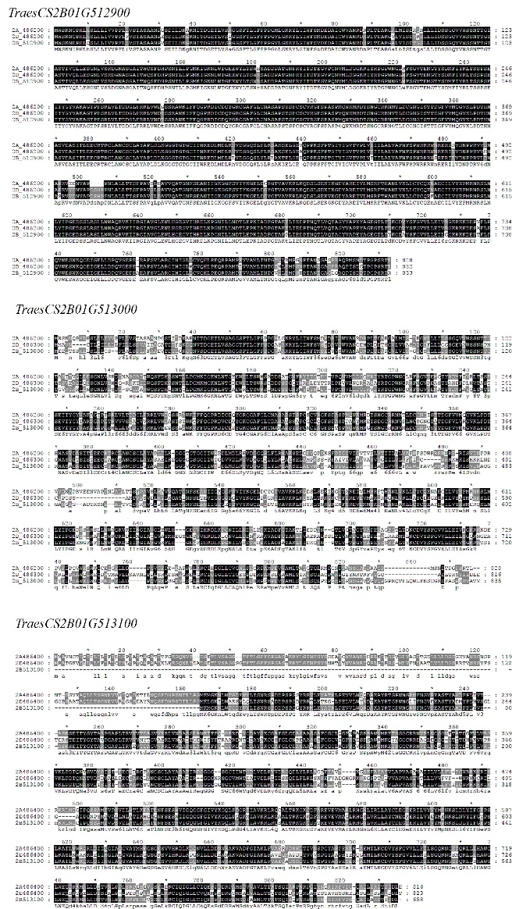
Figure S8
Figure S8 Sequence alignment of TraesCS2B01G513100, TraesCS2B01G513000, and TraesCS2B01G512900 complete gene sequences to those alleles in other subgenomes.

Slide 9
Figure S9
Figure S9 The relative expression levels of all high-confidence genes in the candidate region in two cultivars (AvS and XZ9104) with extremely opposite YR phenotypes using qRT-PCR. Each bar represents the mean ± SD of three biological replicates.

Slide 10
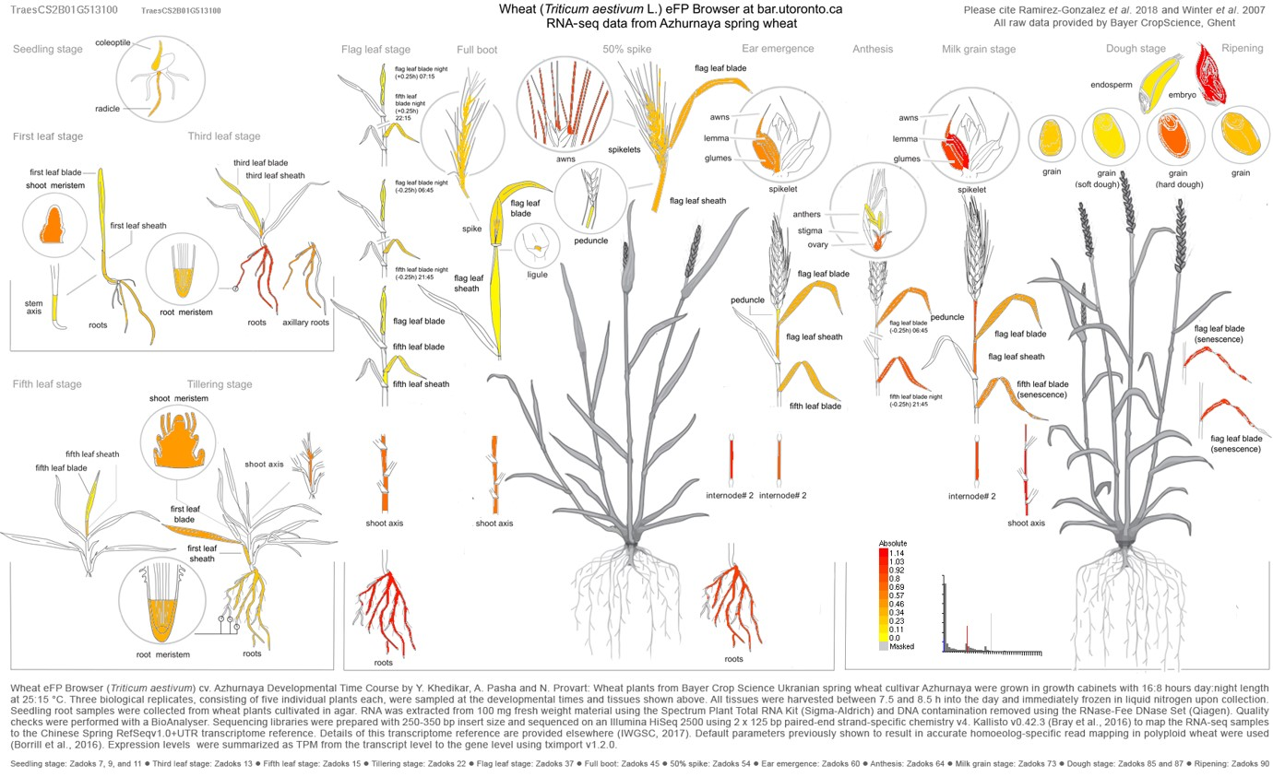
Figure S10
Figure S10 The expression profile of TraesCS2B01G513100 in different tissues and organs of wheat. The picture was generated by Wheat eFP Browser (http://bar.utoronto.ca/efp_wheat/cgi-bin/efpWeb.cgi)

