Slide 1
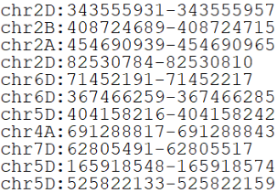
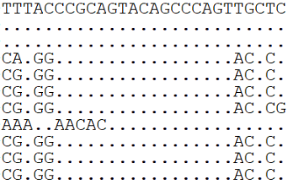
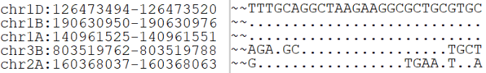


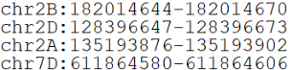
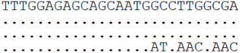
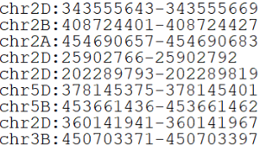
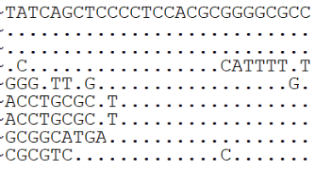
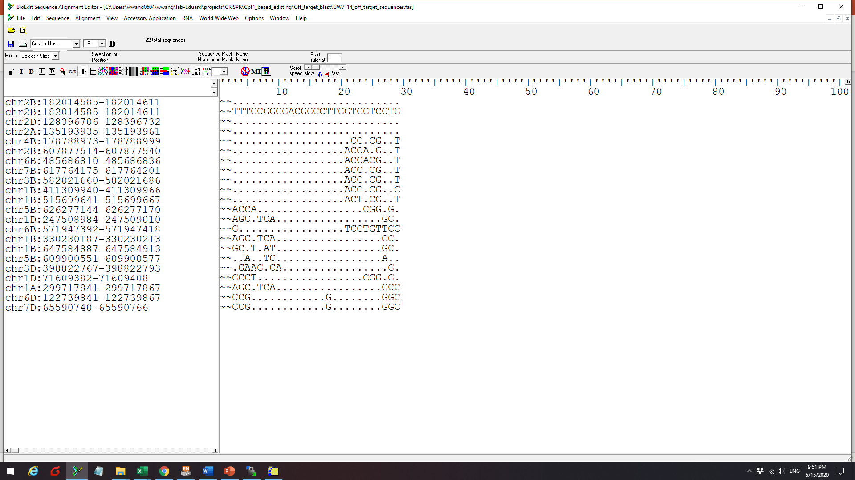
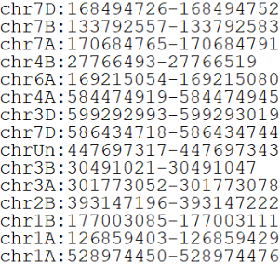
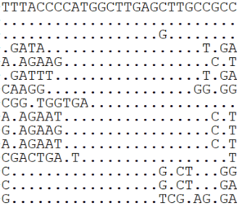
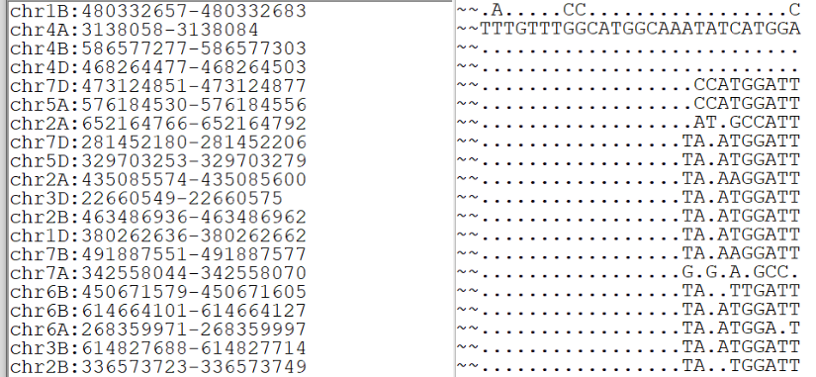
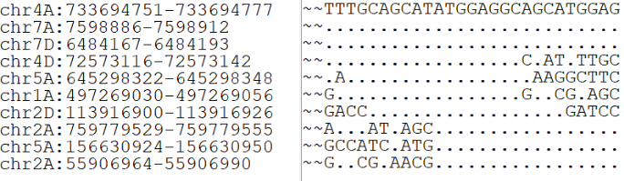
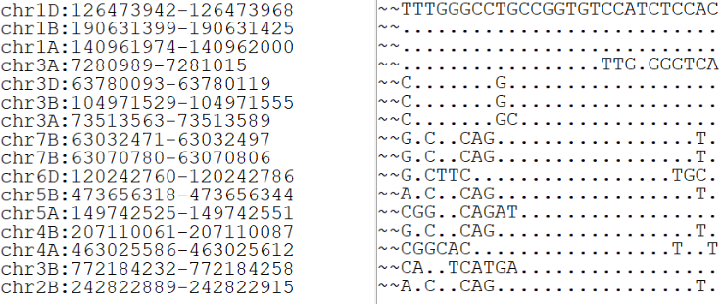
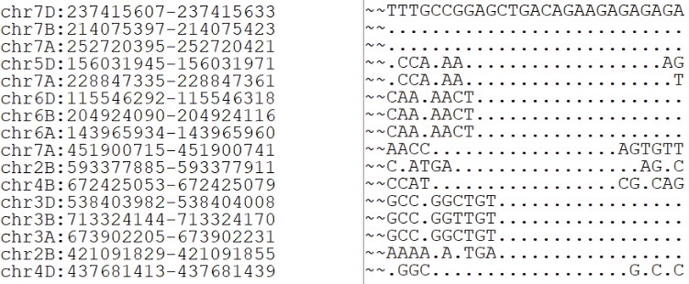
An1T11
GSE5T10
GW2T6
An1T12
GW7T13
An1T13
GW7T14
GASR7T2
PDST16
GS3T11
GSE5T9
SPL16T2
Notes:
Figure S5. The alignment of off-target sequences with 12 LbCpf1 targets selected based on Chinese Spring RefSeqv1.0. The top three sequences for each target correspond to three homoeologous genomes. The PAM sequence TTTV is included on the 5’ end. The consensus nucleotides compared to the first designed target are shown as “.”. Only those sequences that contain the TTTV PAM are shown for targets PDST16, GW7T13, GW2T6 and An1T12.

