Slide 1
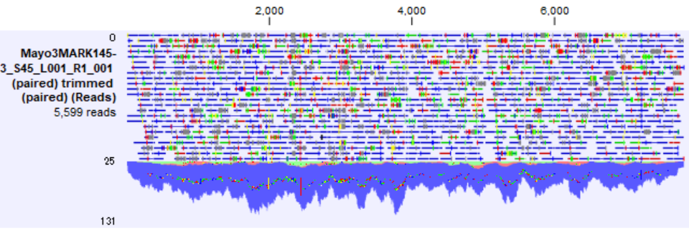
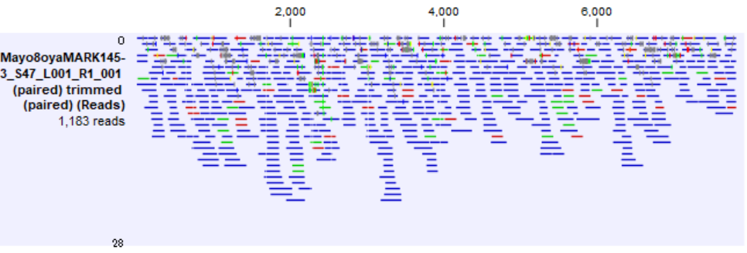
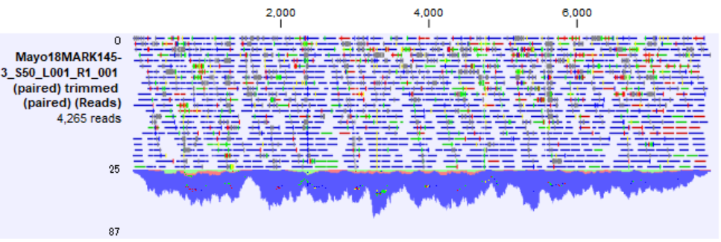
(A)
(B)
(C)
Supplementary Fig. 1. Coverage read depth of the contigs of (A) Mayo4, (B) Mayo8oya, and (C) Mayo18. The horizontal axis indicates the length of the contigs, and the vertical axis indicates the coverage depth of the mapped read.
Supplementary Fig. 1. Oba et al.

