Slide 1
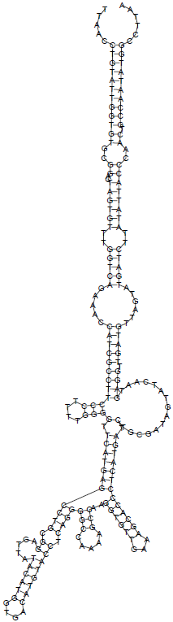
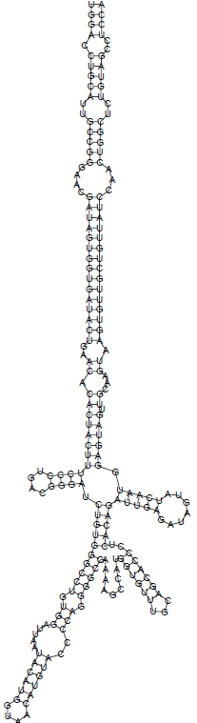
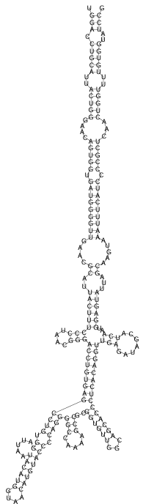
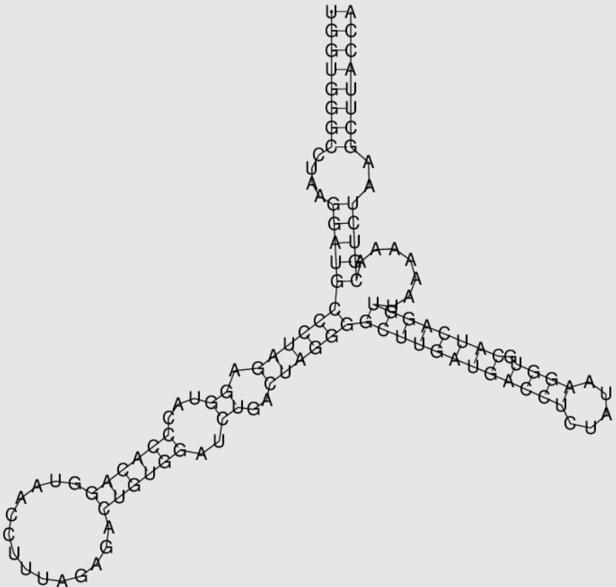
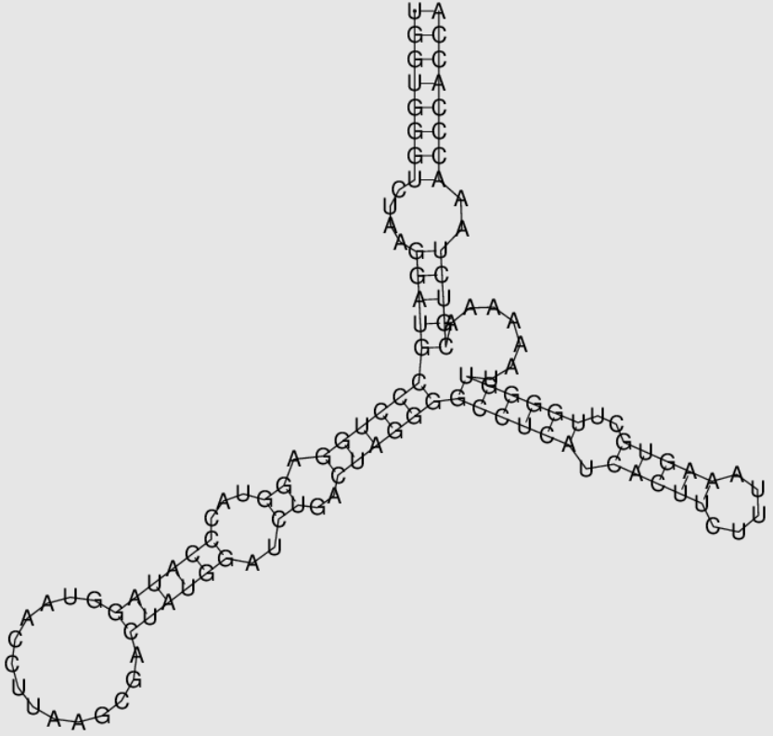
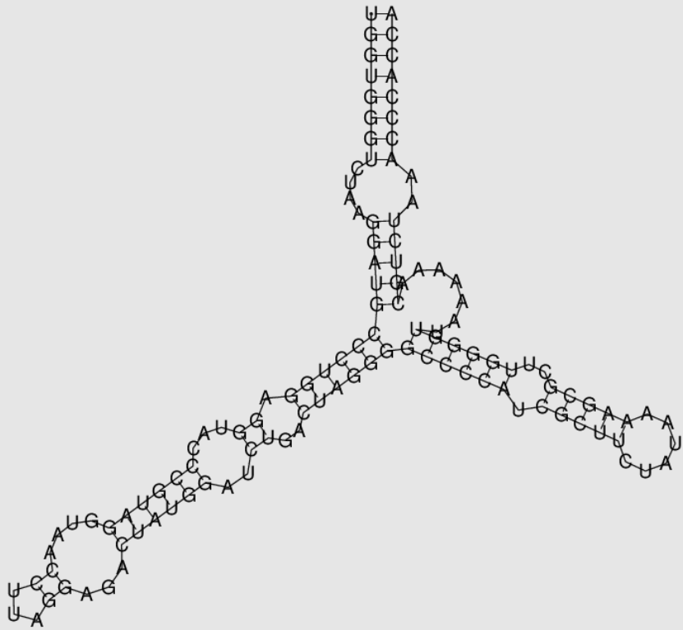
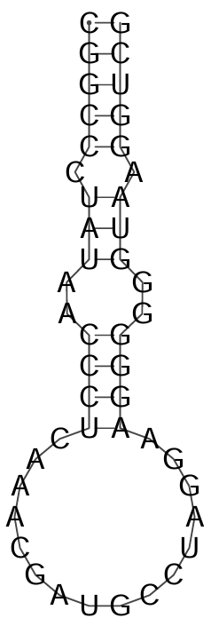
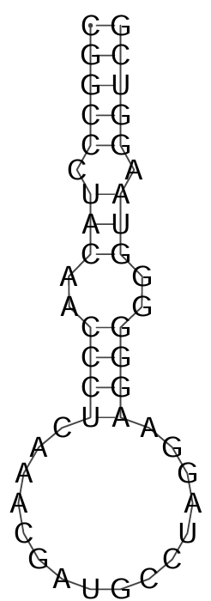
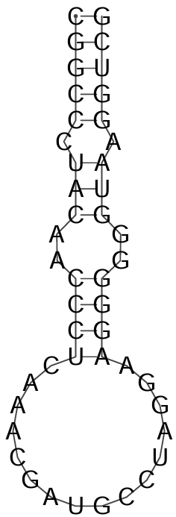
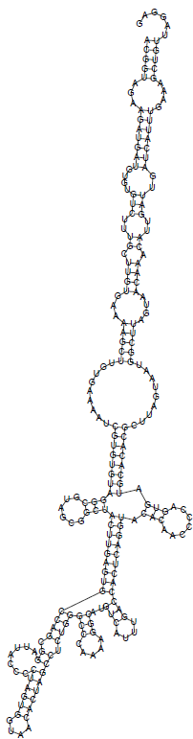
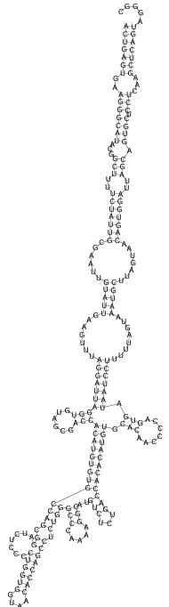
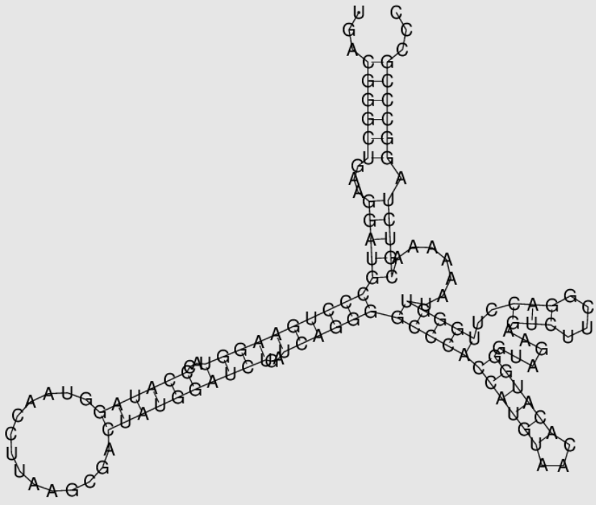
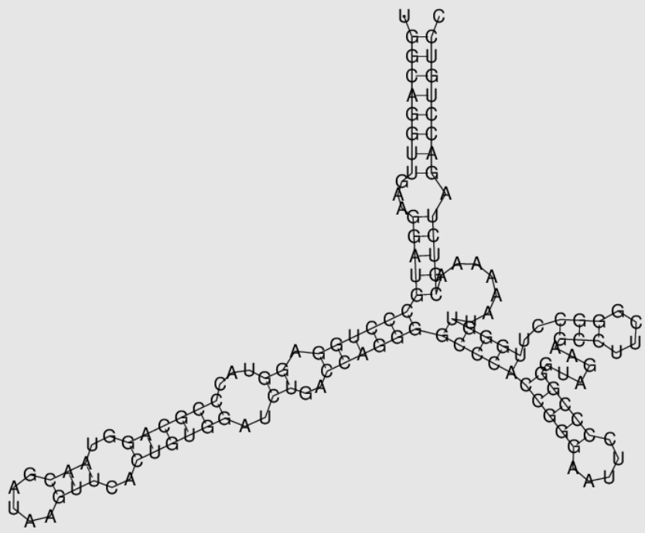
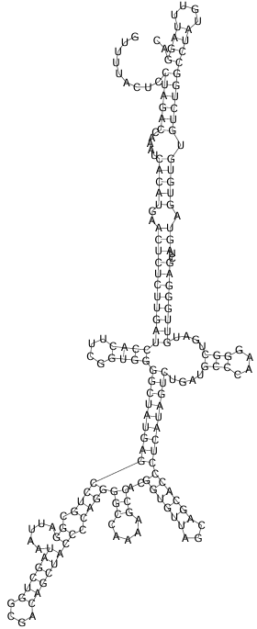
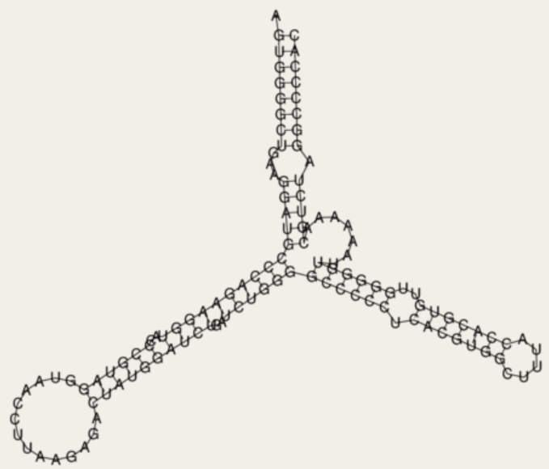
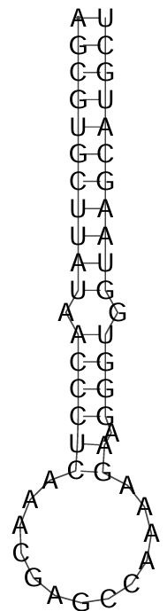
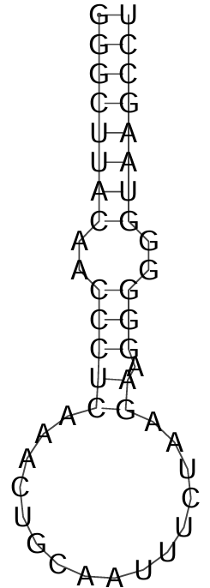
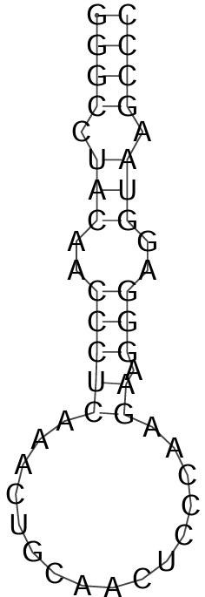
Domain J
Domain J
Domain J
Domain K
Domain K
Domain K
Domain I
Domain I
cre
Domain I
cre
cre
LC790729
Bo ParV/Mayo3/2022/JPN
LC650808
Bo ParV/Den1/2021/JPN
LC740524
Bo ParV/CEP128/2022/JPN
Domain J
Domain J
Domain J
Domain K
Domain K
Domain K
Domain I
cre
Domain I
cre
Domain I
cre
NC_003976 ParV-B/LV-1/bank voles/87-012/SWE
EU854568 ParV-B/LV-4/64-7855/USA
KY645497 ParV-E/Falcon/2014/HUN
Supplementary Fig. 4. Oba et al. Secondary structure prediction of the internal ribosomal entry site (IRES) domain I, J, and K within the 5′ UTR and putative cis-replication element (cre) (indicated in an open box) of Bo ParV/Mayo3/2022/JPN, Bo ParV/Den1/2021/JPN, Bo ParV/CEP128/2022/JPN, ParV-B/LV-1/bank, ParV-B/LV-1/bank voles/87-012/SWE, B/LV-4/64-7855/USA, and ParV-E/Falcon/2014/HUN. Secondary structure analysis was performed using RNAfold programme [9].

