Slide 1
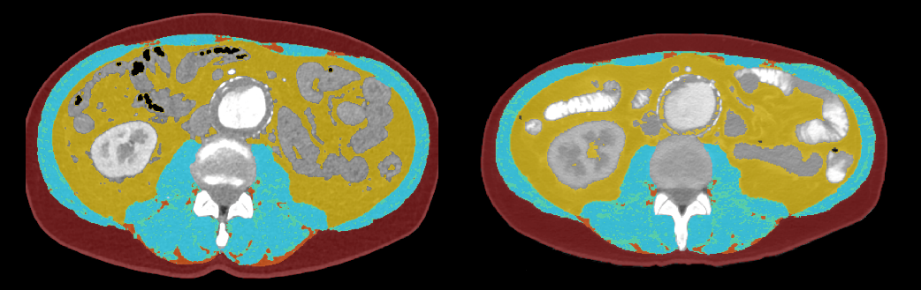
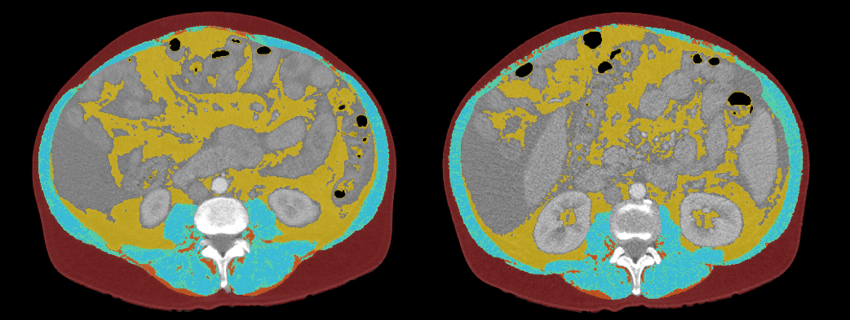
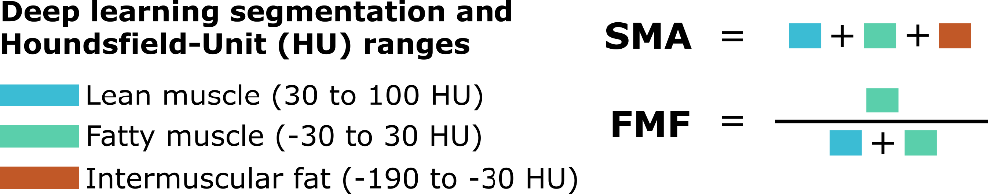
Figure S1
A
B

Slide 2
Table S2
Fat Free Muscle Fraction
Muscle Status |  | Fat Free Muscle Fraction
No Muscle loss | Median | 0.6271250
 | Minimum | 0.52586
 | Maximum | 0.77346
 | Mean value | 0.6426133
 | Std. deviation | 0.11336398
Muscle loss | Median | 0.5782800
 | Minimum | 0.32019
 | Maximum | 0.74515
 | Mean value | 0.5652780
 | Std. deviation | 0.12227334
Overall | Median | 0.5782800
 | Minimum | 0.32019
 | Maximum | 0.77346
 | Mean value | 0.5873738
 | Std. deviation | 0.12231099
P=0.198

