Slide 1
Applied Microbiology and Biotechnology
Random mutagenesis and disulfide bond formation improved thermostability in microbial transglutaminase
Mototaka Suzuki¹, Masayo Date¹, Tatsuki Kashiwagi¹, Kazutoshi Takahashi¹, Akira Nakamura², Masaru Tanokura², Eiichiro Suzuki^{1##}, and Keiichi Yokoyama^{1#}
1. Institute for Innovation, Ajinomoto Co., Inc., 1-1, Suzuki-cho, Kawasaki-shi, Kanagawa 210-8681, Japan
2. Department of Applied Biological Chemistry, Graduate School of Agricultural and Life Sciences, The University of Tokyo, 1-1-1 Yayoi, Bunkyo-ku, Tokyo 113-8657, Japan.
## Present address: Kihara Memorial Yokohama Foundation for the Advancement of Life Sciences Yokohama Bio Industry Center, 1-6 Suehiro-cho, Tsurumi-ku, Yokohama, 230-0045, Japan
Corresponding author: Keiichi Yokoyama; #Present address: R&B Planning Dept., Ajinomoto Co., Inc., Tokyo 104-8315, Japan; E-mail: keiichia.yokoyama.d7e@asv.ajinomoto.com
Tatsuki Kashiwagi; E-mail: kashiwagi.tatsuki@cocoa.plala.or.jp

Slide 2
Fig S1
The flowchart shows the process of adding mutation points. Letters and numbers in the square boxes indicate amino acid substitutions in wild-type MTG in each of the site-directed mutagenesis.

Slide 3
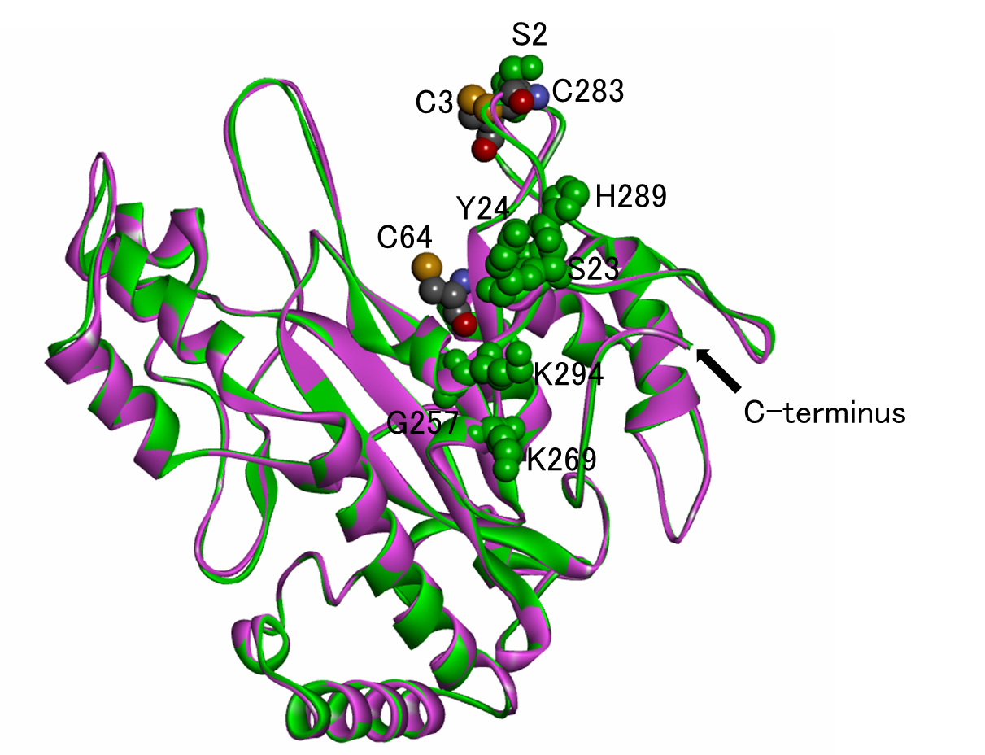
Fig S2
Seven mutation points where mutants with improved thermostability are
obtained by random mutagenesis of wild-type MTG (Marx et al. 2008)
The structures of wild-type MTG and D3C/G283C MTG are shown in green and purple ribbon models, respectively.
Overall structures (rear views) of the MTG molecules B in both crystal structures are superimposed.
The residues C3 and C283 in D3C/G283C MTG and the catalytic residue C64 in wild-type MTG are shown with
sphere models colored by atom species. The residues at which mutants with improved thermostability are obtained
by random mutagenesis of wild-type MTG are shown with green sphere models.

Slide 4
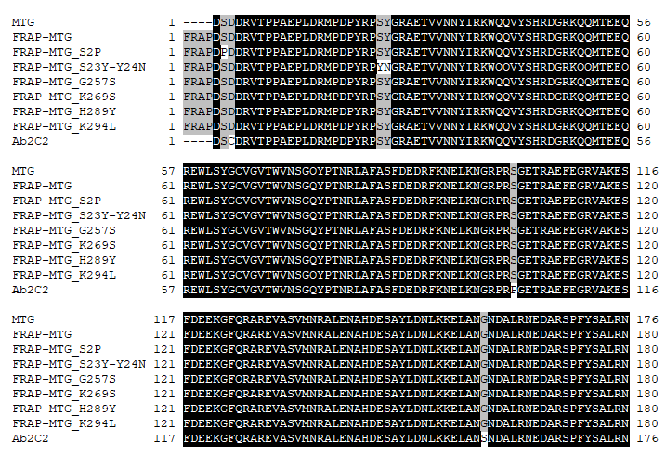
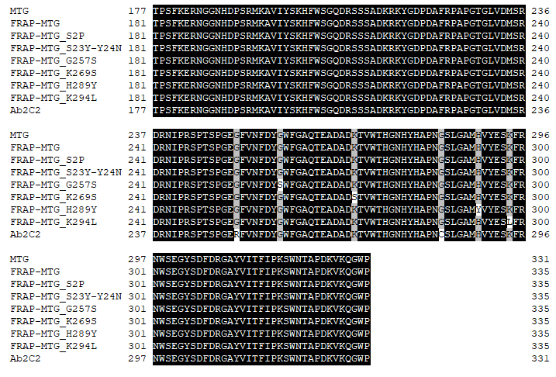
Fig S3
The amino acid alignment data of the mutants with a FRAP and the Ab2c2 mutant

Slide 5
Table S1
Data collection and crystallographic refinement statistics of D3C/G283C MTG
Data collection and crystallographic refinement statistics of D3C/G283C MTG.
# XDS (Kabsch. 1993), § Refmac5 (Murshudov et al. 1997), $ PROCHECK (Winn et al. 2011).
The numerical value in parentheses indicates the value of the outer shell.
** The numerical value in parentheses indicates the weight.

Slide 6
Table S2
Effect of the crystal packing of MTG on the structure around the mutation sites
(residues 2-4 and 282-284)
Numerical values for the crystal structure of wild-type MTG and for the crystal structure of D3C/G283C MTG are described in the region on the upper right side of the diagonal and in the region on the lower left side of the diagonal, respectively.
The number of atomic contacts of less than 3.4 Å between the non-hydrogen atoms contained in residues 2-4 and 282-284 of the MTG molecule X and the non-hydrogen atoms of neighboring MTG molecules in the crystal structure is described in the X = Y cell. The RMSD value of Cα displacement for the residues 2-4 and 282-284 between MTG molecules X and Y is described in the X ≠ Y cell. The values in the parenthesis are the RMSD values of Cα displacement for all residues of MTG.

