Slide 1
Clinical utility of an intervertebral motion metric for deciding on the addition
of instrumented fusion in degenerative spondylolisthesis.
Supplemental Digital Content 1
Two examples of stabilized flexion-extension radiographs including the participants’ baseline degree of vertebral rotation (deg), percentage of translation (%) and resulting Sagittal Plane Shear Index (SPSI).
Note: animated GIFs play in presenter mode only

Slide 2
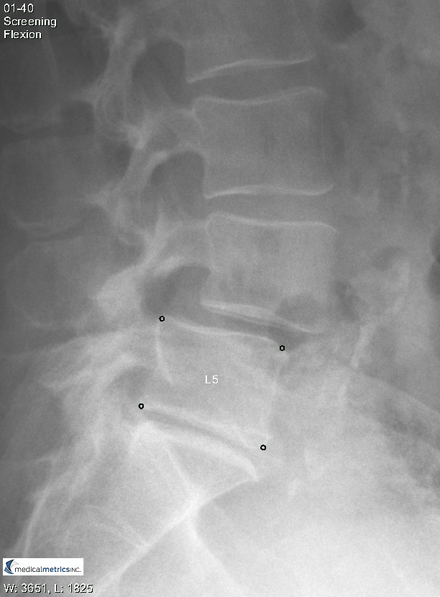
Example 1
In this example participant, translation-per-degree-of-rotation (TPDR) was more than 1.96 standard deviations (95% confidence interval) above the average for radiographically normal levels in asymptomatic volunteers.
Rotation (deg): 5
Translation (%): 4.6
SPSI at L4-L5: 3.2

Slide 3
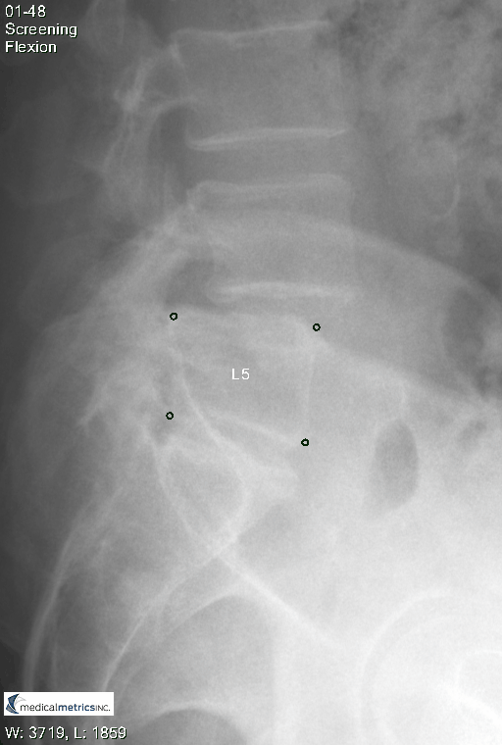
Example 2
In this example participant, TPDR was close to the average for radiographically normal levels in asymptomatic volunteers.
Rotation (deg): 8.6
Translation (%): 5
SPSI at L4-L5: 0.4

