Slide 1
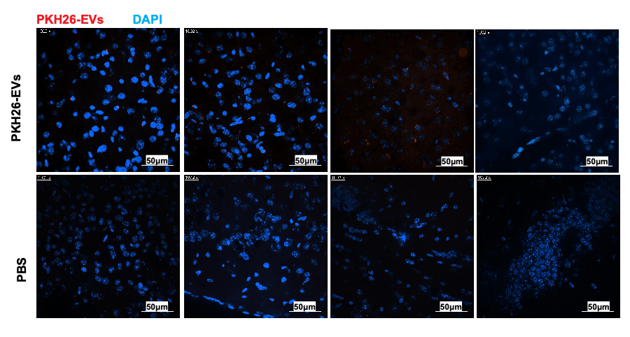
Figure S1 The brain images without fluorescent antibody staining following IV injection of PKH26-293EVs.
The nuclei are stained with DAPI in the mounting medium. The images were taken using a confocal microscope (Ti2, Nikon, Japan). PBS: PBS injection, PKH26-EVs: HEK293T EVs labeled with red fluorescent dye PKH26.

Slide 2
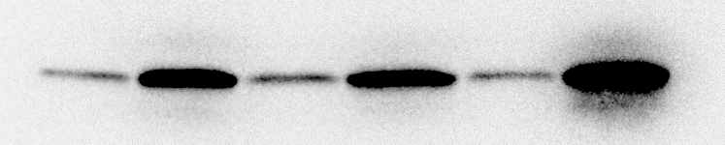
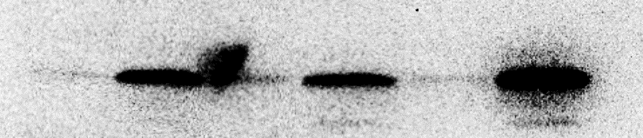
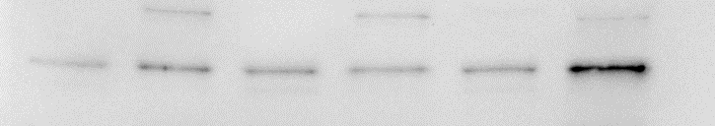
S1 C1 S2 C2 S3 C3
31K
24K
17K
CD81
31K
24K
17K
CD9
GAPDH
Figure S2 Western blot analysis of plasma EVs from mice.
Plasma-derived EVs from sham or CLP mice were fractionated by SDS-PAGEs, and blotted with specific antibodies for EV markers. Rabbit monoclonal anti-CD81 (Cell Signaling) and rabbit monoclonal anti-CD9 (Abcam)were employed. In each lane, 2x10⁷ particles of EVs isolated from different mice were loaded. S: sham EVs, C: CLP EVs

Slide 3
A
Brain cells
Singlet
Live cells
SSC
FSC-H
FSC-A
FSC
FSC-A
Zombie-Red
Myeloid cells
Microglia
Monocyte
BV480-CD11b
PE- Ly6C
Myeloid cells
Neutrophil
eFluor-450-CD45
BV421 Ly6G
B
Hippocampus
Figure S3 Gating strategy for various cell populations by flow cytometry. A At designated time points, mice were euthanized and whole body carefully perfused. Brain cells were collected following enzyme digestion and percoll gradient centrifuge. Live cells were gated as Zombie negative population. The following markers were used to differentiate specific cell populations. Microglia: CD45^{low} CD11b⁺; Myeloid cell : CD45^{high} CD11b⁺; Monocyte : CD45^{high} CD11b⁺Ly6C⁺Ly6G⁻; Neutrophil : CD45^{high} CD11b⁺Ly6C⁺Ly6G⁺ B. Cytokine gene expression in the hippocampus. n=5/group
.

Slide 4
A
B
Figure S4 Fluorescence intensity analysis of Annexin V
A. The area of FITC-positive cells in each image of Figure 5D was calculated using Fiji Image J. CM: conditioned media. Baf: bafilomycin A1 (Baf). n=4-10/group. B. The count of Annexin V-positive cells in each group. n=4-10/group.

Slide 5
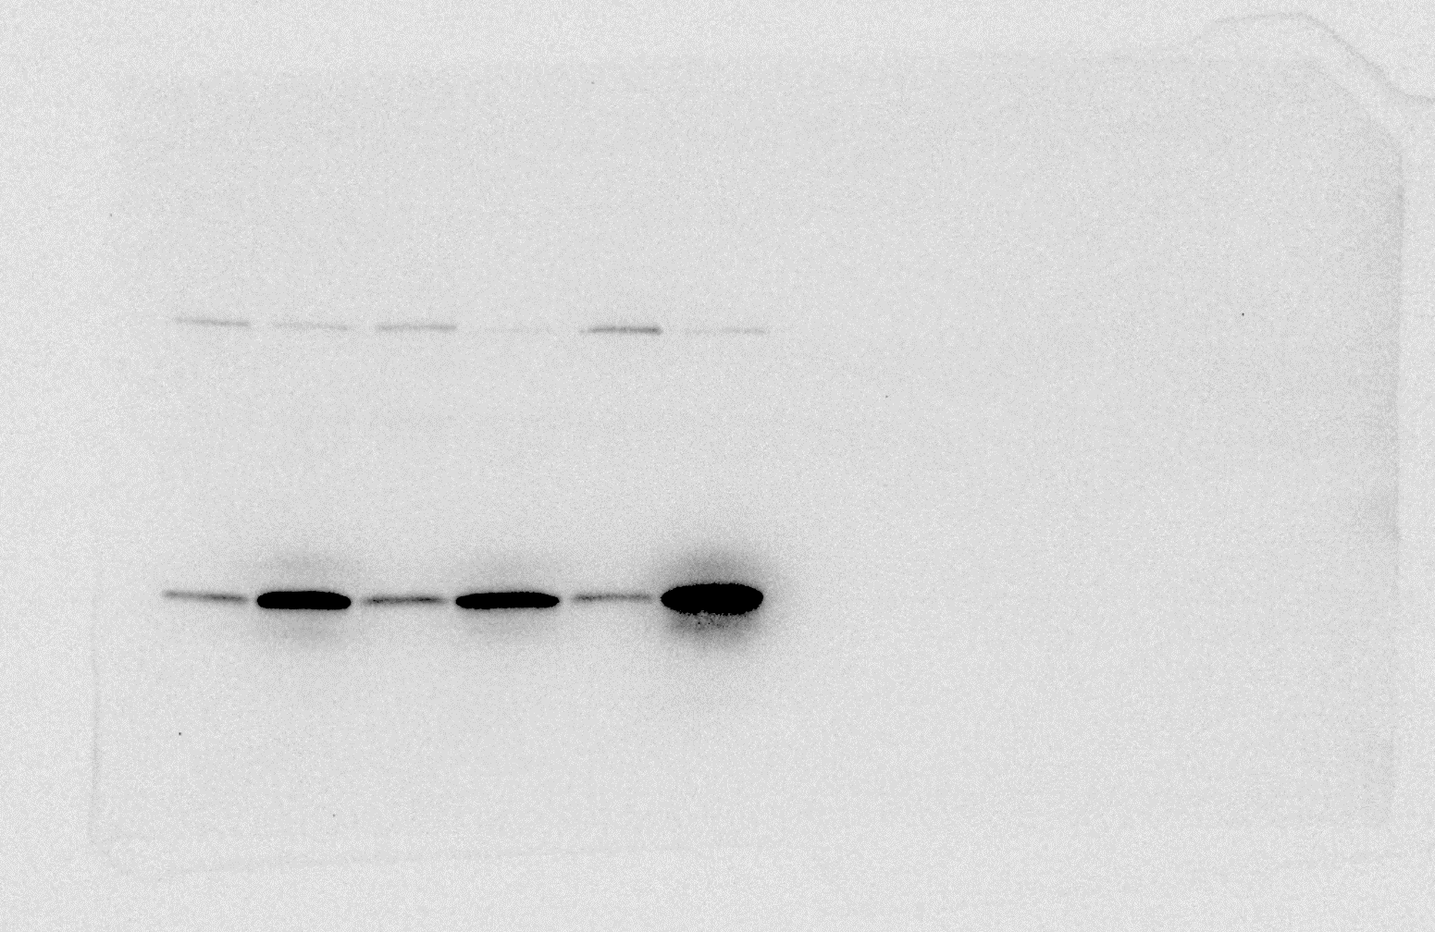
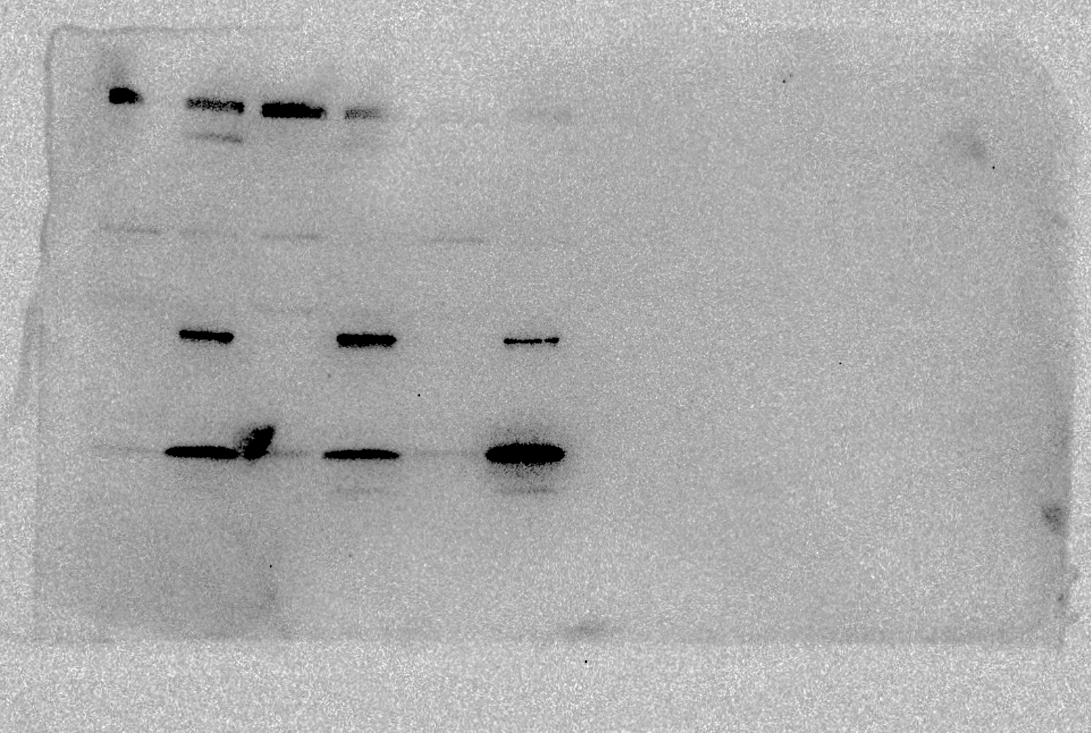
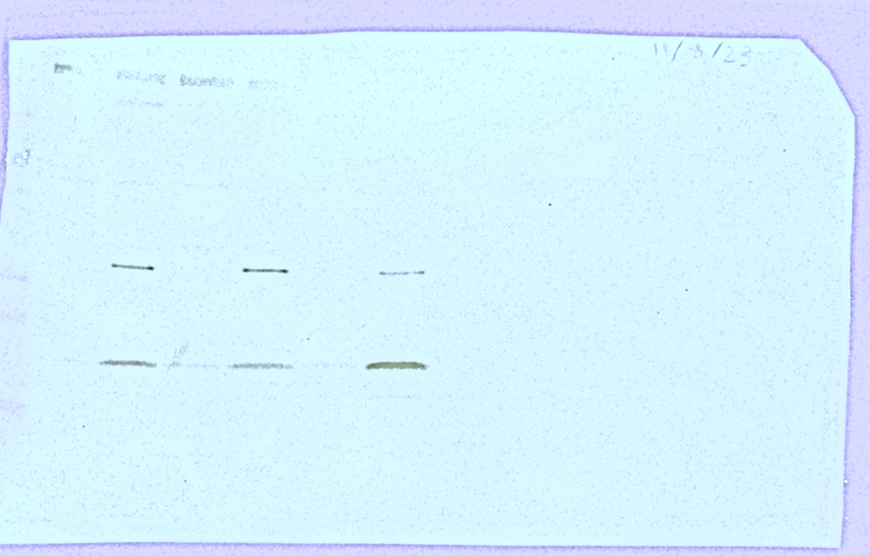
Original blot of Figure S2
GAPDH
GAPDH
38KDa
GAPDH
37KDa
S1
C1
S2
C2
S3
C3
GAPDH
37KDa
CD81
S1
C1
S2
C2
S3
C3
31K
24K
17K
CD9
S1
C1
S2
C2
S3
C3
31K
24K
17K
31K
24K
17K

Slide 6
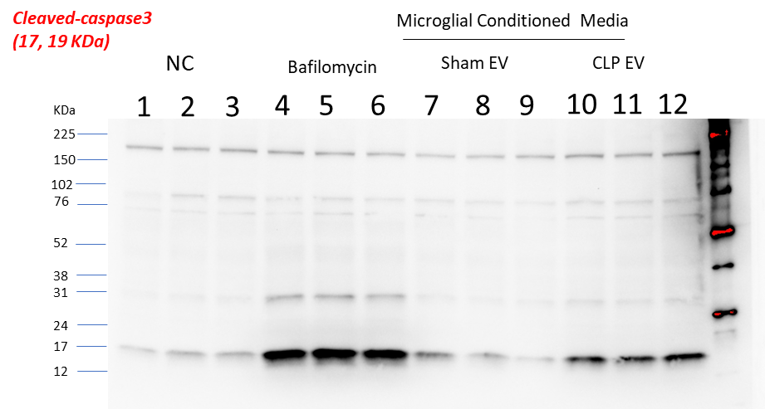
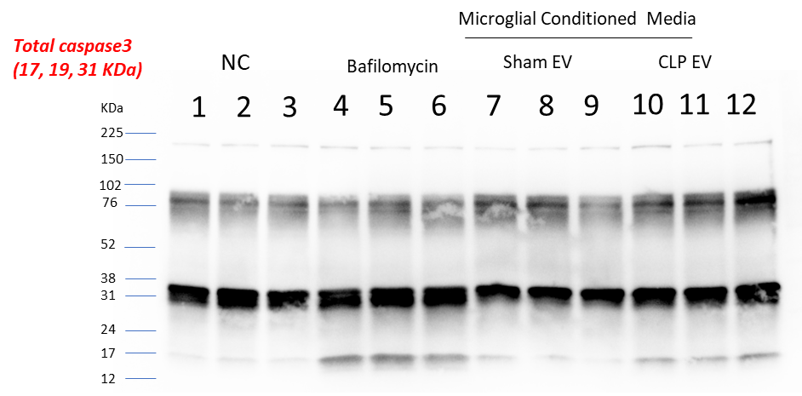
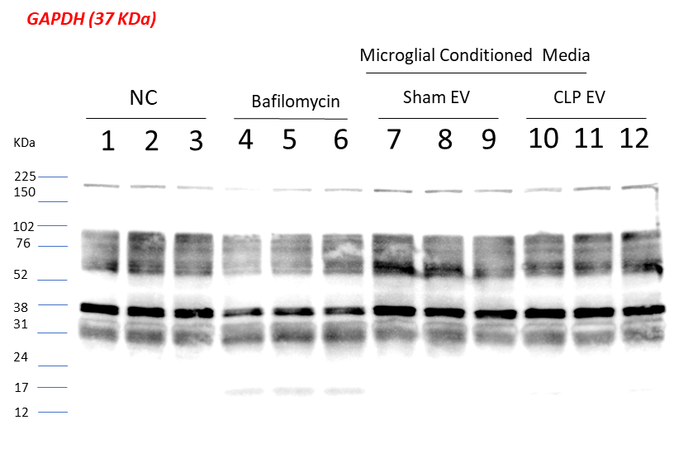
Original blot of Figure 5B
1st

Slide 7
2nd

Slide 8
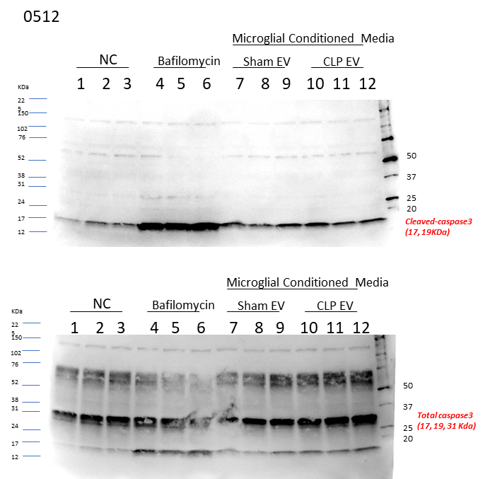
3rd

