Slide 1
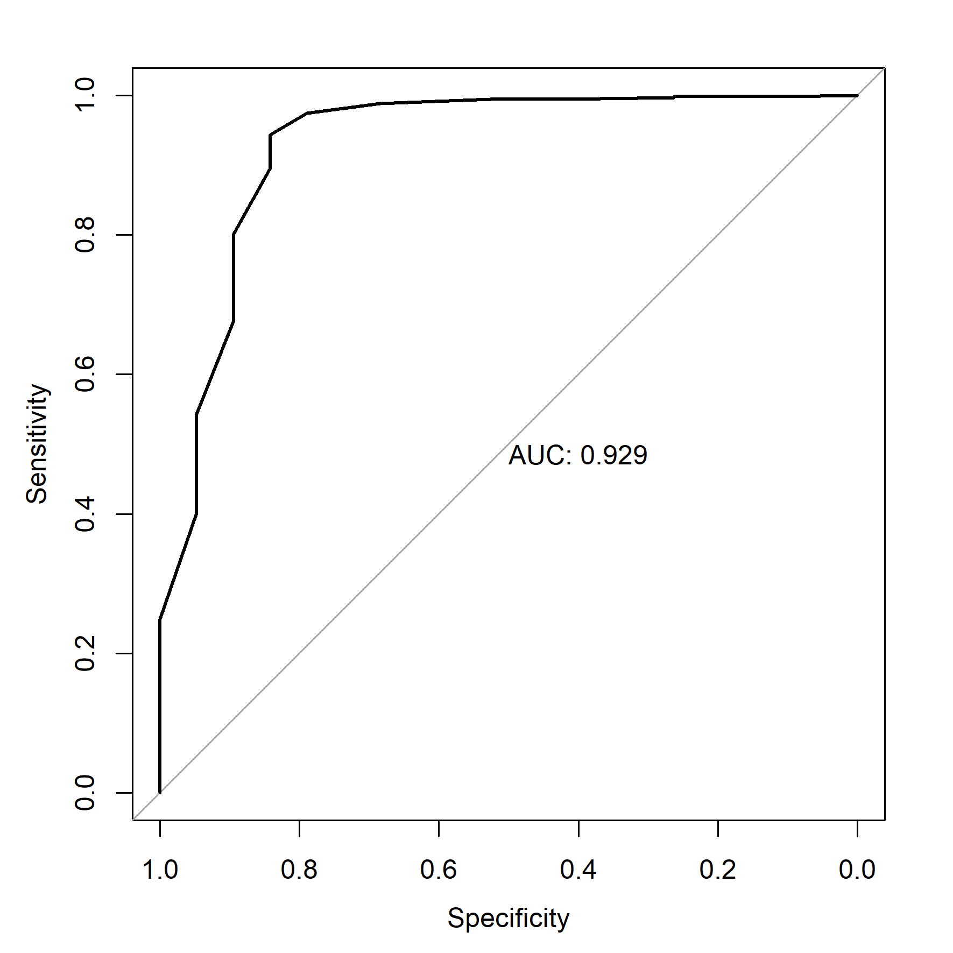
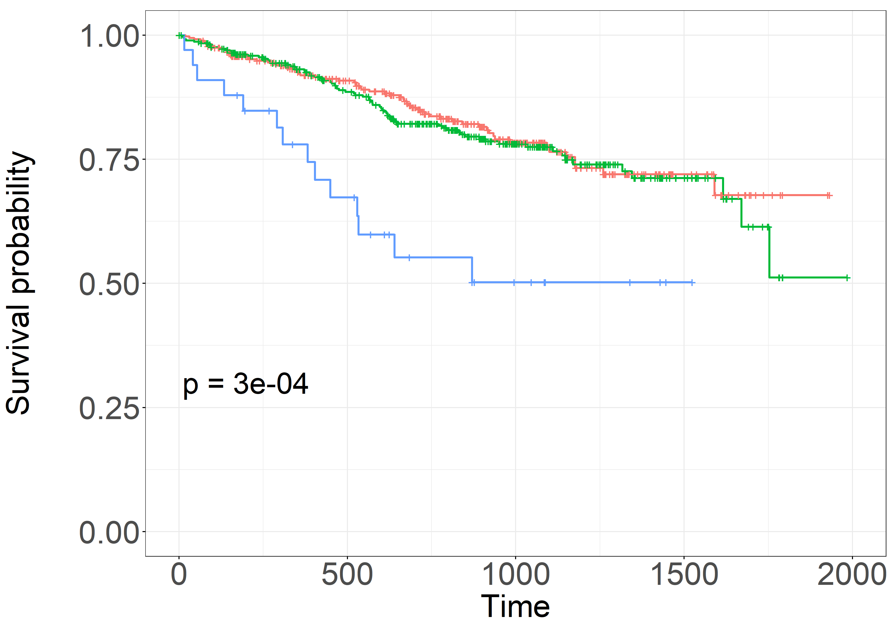
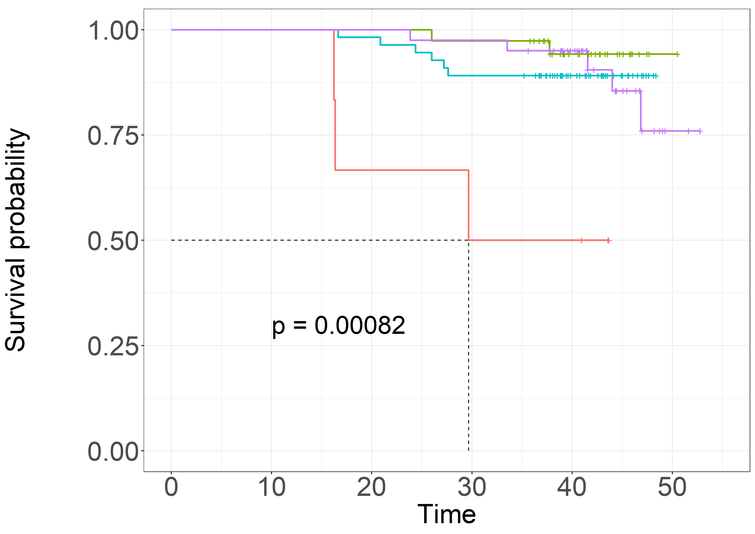
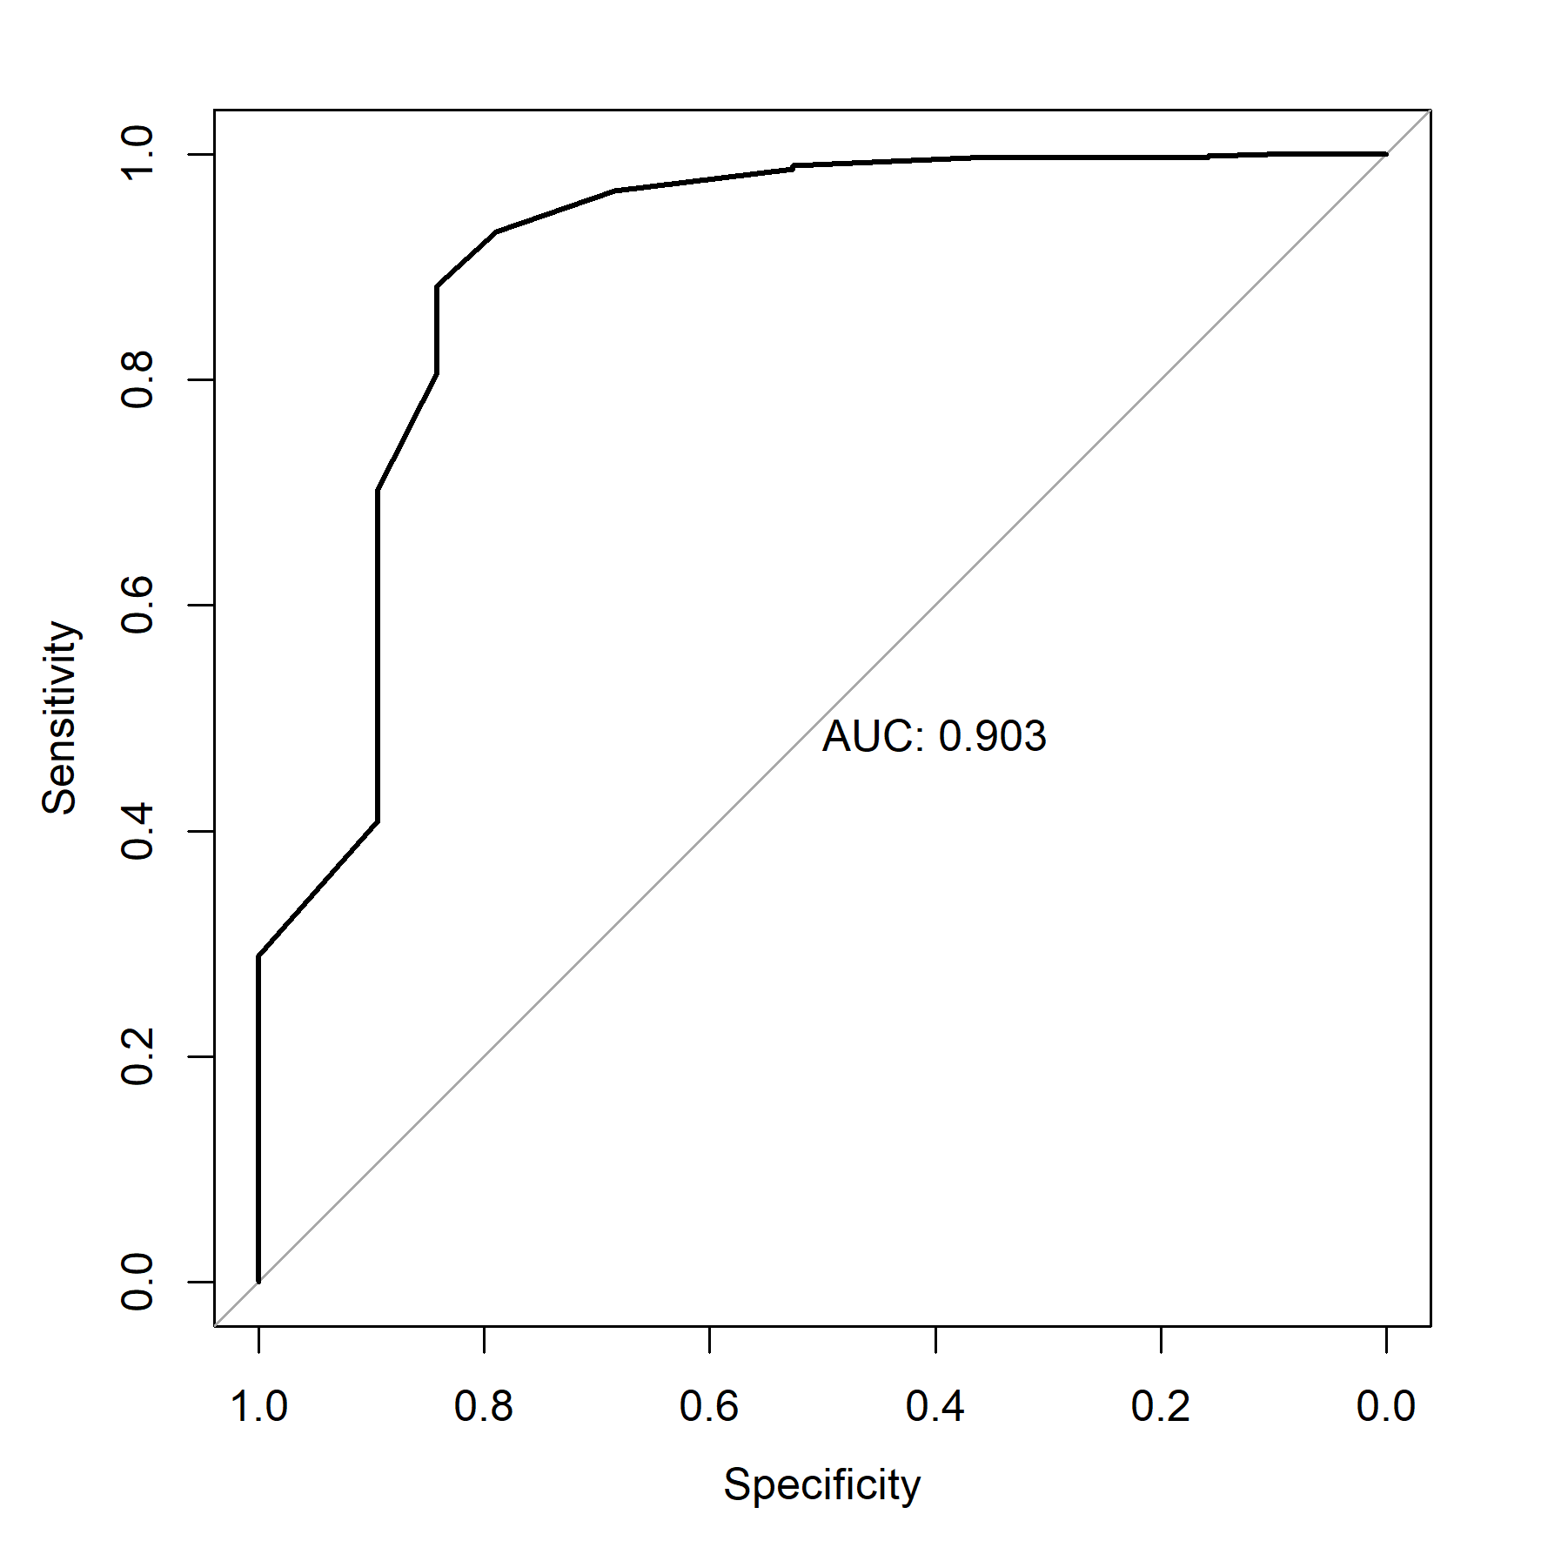
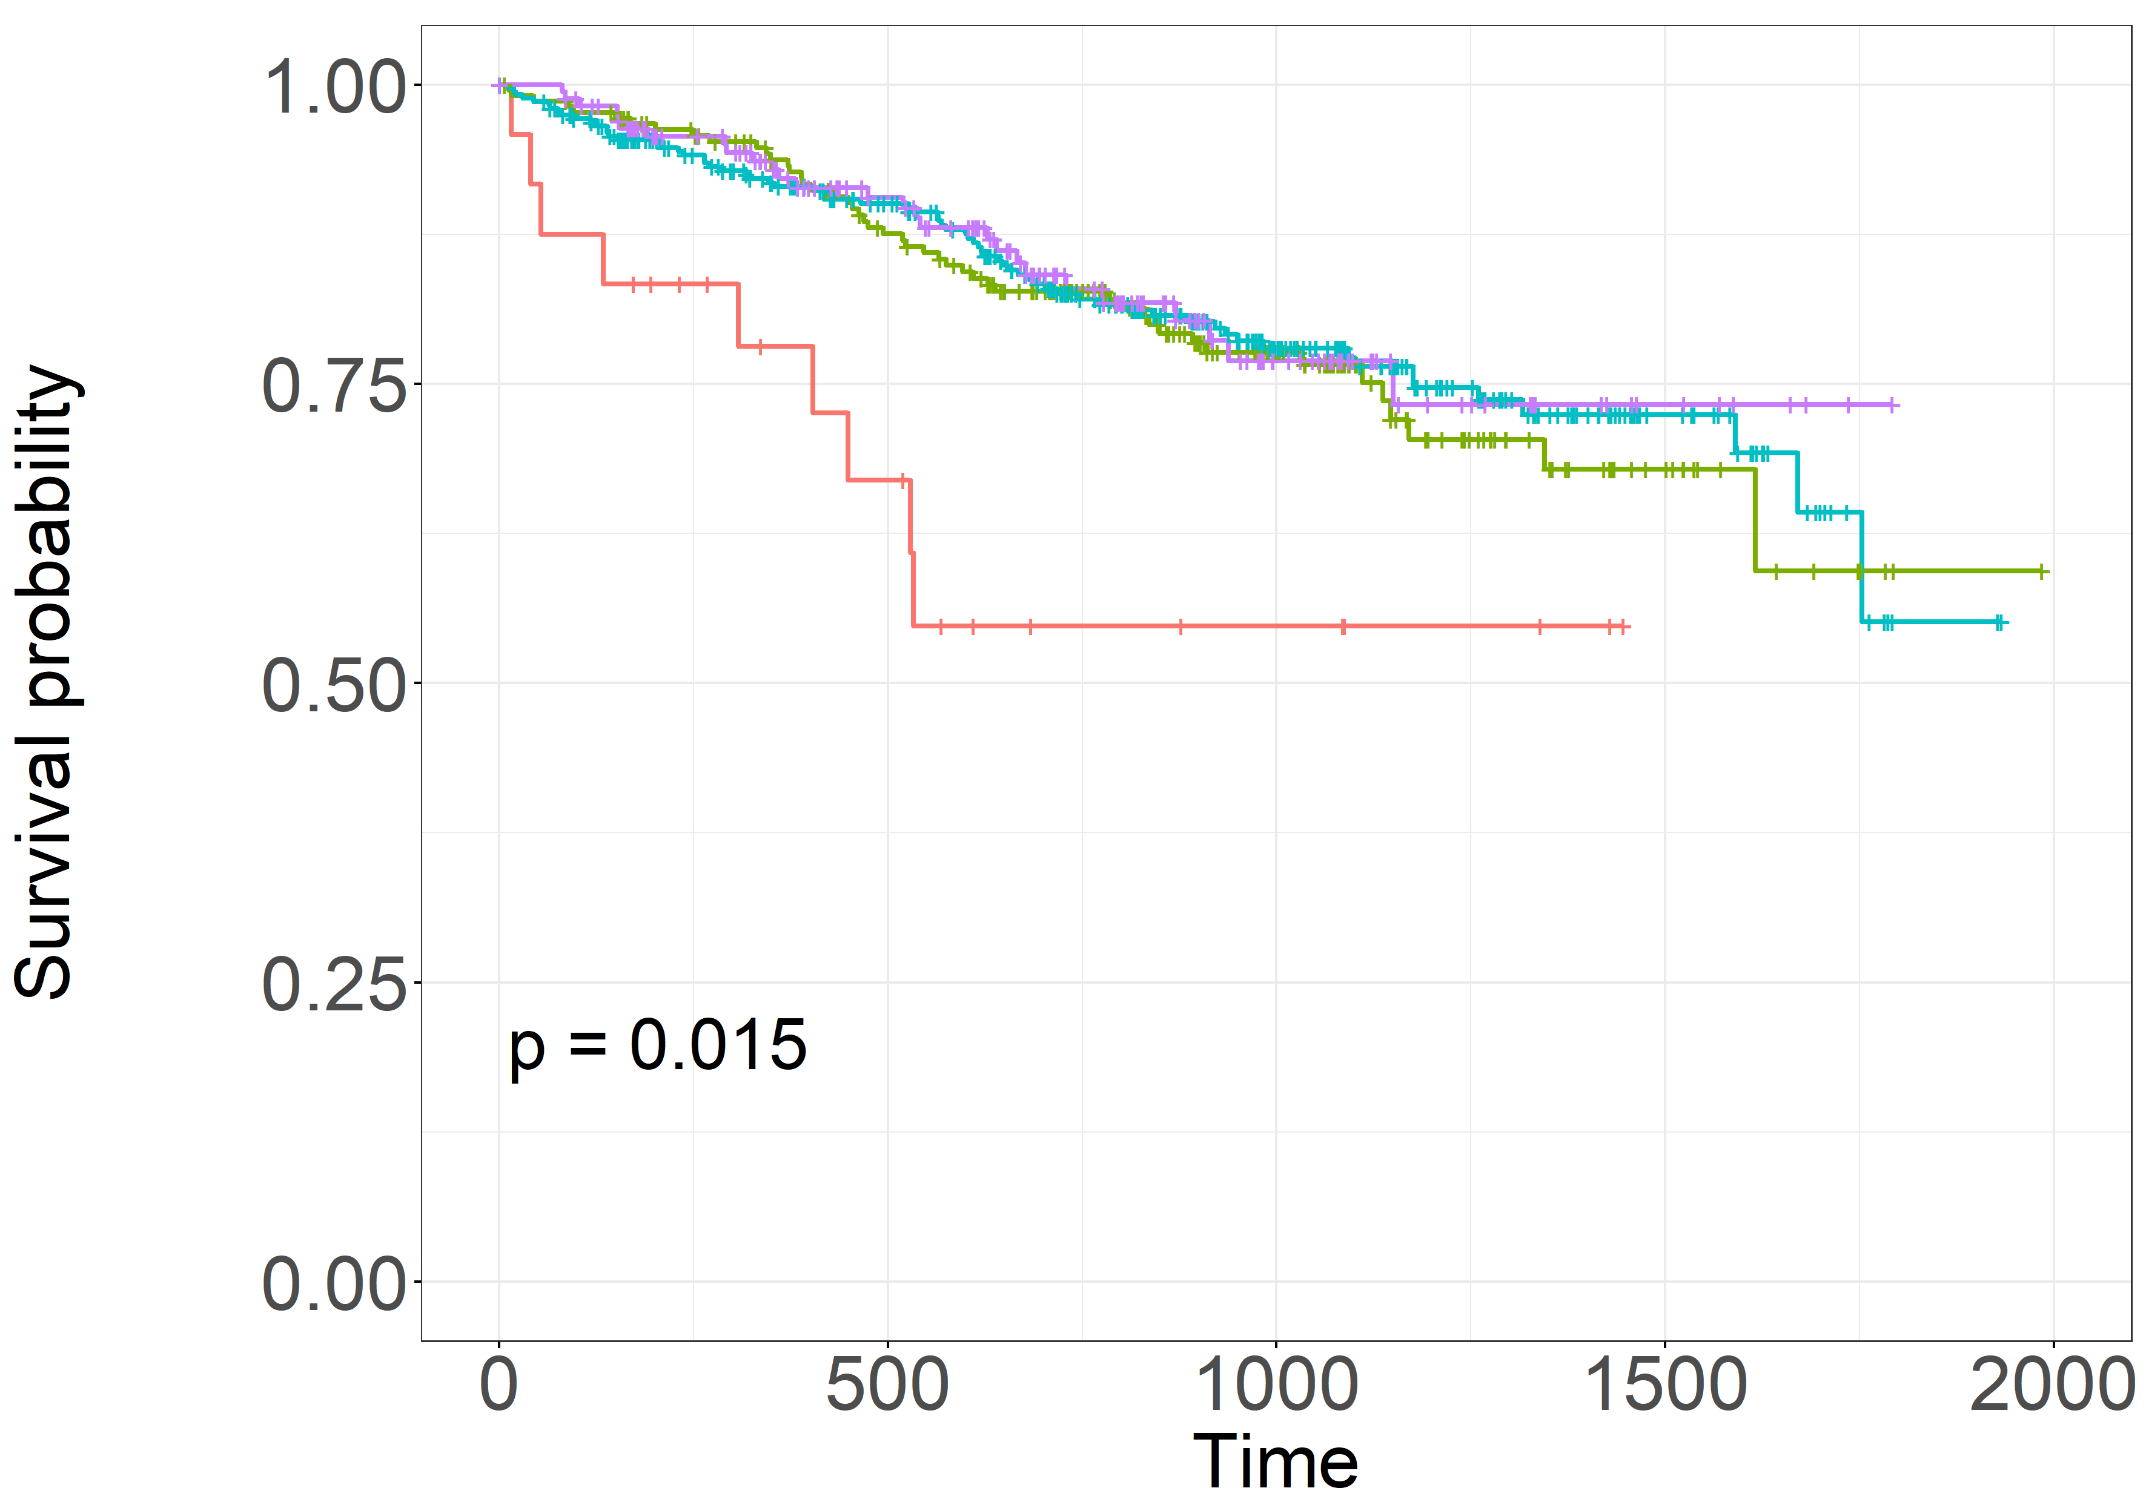
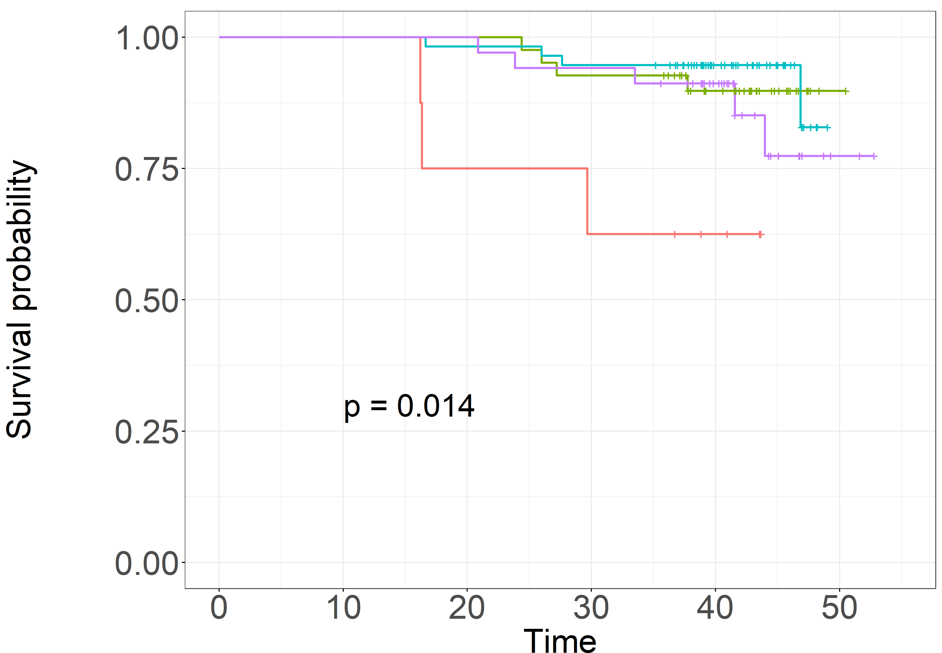
A
Cancer cell lines (DepMap portal)
B
NCI-H929 and XG7 isogenic clones
C
MMRF-CoMMpass
D
MMRF-CoMMpass
CASSIOPEIA
8-gene score
int low
int
int high
high
low
high
low
High 373 269 134 28 0
Int 358 253 108 23 0
Low 33 19 7 1 0
High 40 40 40 39 29 2
Int H 55 55 54 49 31 0
Int l 38 38 38 37 20 1
Low 6 6 4 3 3 0
13-gene score
int low
int high
int low
high
low
high
int high
low
High 218 167 81 15 0
Int H 354 252 125 30 0
Int l 168 110 38 7 0
Low 24 12 5 0 0
High 34 34 34 32 22 0
Int H 56 56 55 53 33 0
Int l 41 41 41 38 24 1
Low 8 8 6 8 3 0
Figure S1. The 8- and 13-gene p53 scores hve similar efficacy to identify cancer cells with TP53 hits
Violon plots represent the 8- or 13-gene p53 score values in 1,104 cancer cell lines (A), in isogenic NCI-H929 and XG7 isogenic clones treated or not with nutlin3a for 24h (B), and in 684 patient samples from the MMRF-CoMMpass (C). Statistical analyses were performed using the Kruskal-Wallis with Dunn’s multiple comparison test or the Mann-Whitney test. ROC curves (C right panels) represent the specificity and sensitivity of score threshold (0.3635 and 0.3665 for 8-gene or 13-gene score, respectively) to identify cells with double invalidation of TP53 gene. (D): the statistical significance of the 8-or 13-gene score values on the overall survival was determined using the log-rank (Mantel-Cox) test in 764 patients in the MMRF-CoMMpass cohort and in 139 patients in the CASSIOPEIA cohort (the number of patient group was established using Nbclust package in R and k-means method to assign patients to the group). Int=intermediate, H=high, L=low

