Slide 1
Supplemental Tables & Figures

Slide 2
 | none (N=80) | mPARPi (N=50) | Total (N=120) | p value
Year of Tx Initiation |  |  |  | < 0.001
2015 | 23 (28.8%) | ≤5 | 24 (18.5%)
2016 | 15 (18.8%) | 0 (0.0%) | 15 (11.5%)
2017 | 18 (22.5%) | ≤5 | 20 (15.4%)
2018 | 17 (21.2%) | ≤5 | 21 (16.2%)
2019 | ≤5 | 12 (24.0%) | 15 (11.5%)
2020 | ≤5 | 7 (14.0%) | 8 (6.2%)
2021 | ≤5 | 17 (34.0%) | 18 (13.8%)
2022 | ≤5 | 7 (14.0%) | 9 (6.9%)
Ancestry |  |  |  | 0.497
AFR | 9 (11.2%) | ≤5 | 11 (8.5%)
AMR | 6 (7.5%) | 5 (10.0%) | 11 (8.5%)
EAS | ≤5 | ≤5 | ≤5
EUR | 62 (77.5%) | 39 (78.0%) | 101 (77.7%)
SAS | ≤5 | ≤5 | ≤5
Age |  |  |  | 0.339
Median (Q1, Q3) | 61.0 (53.8, 68.2) | 65.0 (55.2, 70.8) | 64.0 (54.0, 69.8)
Practice Type |  |  |  | 0.193
Academic | 16 (20.0%) | 15 (30.0%) | 31 (23.8%)
Community | 64 (80.0%) | 35 (70.0%) | 99 (76.2%)
ECOG |  |  |  | 0.707
0 | 33 (41.2%) | 17 (34.0%) | 50 (38.5%)
1 | 22 (27.5%) | 13 (26.0%) | 35 (26.9%)
2+ | 7 (8.8%) | 7 (14.0%) | 14 (10.8%)
Unknown | 18 (22.5%) | 13 (26.0%) | 31 (23.8%)
BMI |  |  |  | 0.239
Median (Q1, Q3) | 26.8 (23.2, 30.3) | 24.4 (22.1, 29.6) | 25.9 (22.4, 30.2)
N-Miss | 2 | 0 | 2
Stage at Diagnosis |  |  |  | 0.157
Stage III | 51 (63.8%) | 35 (70.0%) | 86 (66.2%)
Stage IV | 15 (18.8%) | 12 (24.0%) | 27 (20.8%)
Unknown/not documented | 14 (17.5%) | 3 (6.0%) | 17 (13.1%)
Histology |  |  |  | 0.917
Epithelial NOS | 6 (7.5%) | 4 (8.0%) | 10 (7.7%)
Serous | 74 (92.5%) | 46 (92.0%) | 120 (92.3%)
Extent of Debulking |  |  |  | 0.128
Optimal | 60 (75.0%) | 39 (78.0%) | 99 (76.2%)
Suboptimal | 6 (7.5%) | 0 (0.0%) | 6 (4.6%)
Unknown/not documented | 14 (17.5%) | 11 (22.0%) | 25 (19.2%)
Residual Disease Status |  |  |  | 0.247
No residual disease | 35 (43.8%) | 26 (52.0%) | 61 (46.9%)
Residual disease | 25 (31.2%) | 9 (18.0%) | 34 (26.2%)
Unknown/not documented | 20 (25.0%) | 15 (30.0%) | 35 (26.9%)
TP53 Alteration |  |  |  | 0.26
Negative | 2 (2.5%) | 0 (0.0%) | 2 (1.5%)
Positive | 78 (97.5%) | 50 (100.0%) | 128 (98.5%)
BRCA group |  |  |  | 0.423
BRCA1 | 52 (65.0%) | 29 (58.0%) | 81 (62.3%)
BRCA2 | 28 (35.0%) | 21 (42.0%) | 49 (37.7%)
gLOH Level |  |  |  | 0.905
High | 53 (84.1%) | 34 (85.0%) | 87 (84.5%)
Low | 10 (15.9%) | 6 (15.0%) | 16 (15.5%)
N-Miss | 17 | 10 | 27
HRDsig |  |  |  | 0.896
(+) | 71 (88.8%) | 44 (88.0%) | 115 (88.5%)
(-) | 9 (11.2%) | 6 (12.0%) | 15 (11.5%)
Time of tissue collection |  |  |  | < 0.001
Before platinum therapy initiation | 0 (0.0%) | 4 (8.0%) | 4 (3.1%)
After platinum therapy initiation | 45 (56.2%) | 11 (22.0%) | 56 (43.1%)
After maintenance initiation | 35 (43.8%) | 35 (70.0%) | 70 (53.8%)
Supplemental Table S1. BRCAalt patients baseline clinical and demographic characteristics
Caption: BMI: body mass index; Chemo: chemotherapy; ECOG: Eastern Cooperative Oncology Group performance status; gLOH: genome-wide loss of heterozygosity; HRD: homologous repair deficiency; NOS: not otherwise specified; PARPi: poly (ADP-ribose) polymerase inhibitor; Tx: therapy.

Slide 3
Supplemental Table S2. Site of biopsy collection.
Site / Tissue of origin | N (%)
Ovary, Fallopian Tube, Peritoneal fluid or Peritoneum | 252 (37.4%)
Gyn structures (uterus, vagina, cervix, pelvis, omentum) | 182 (27.0%)
Lymph node | 45 (6.7%)
Other | 194 (28.8%)

Slide 4
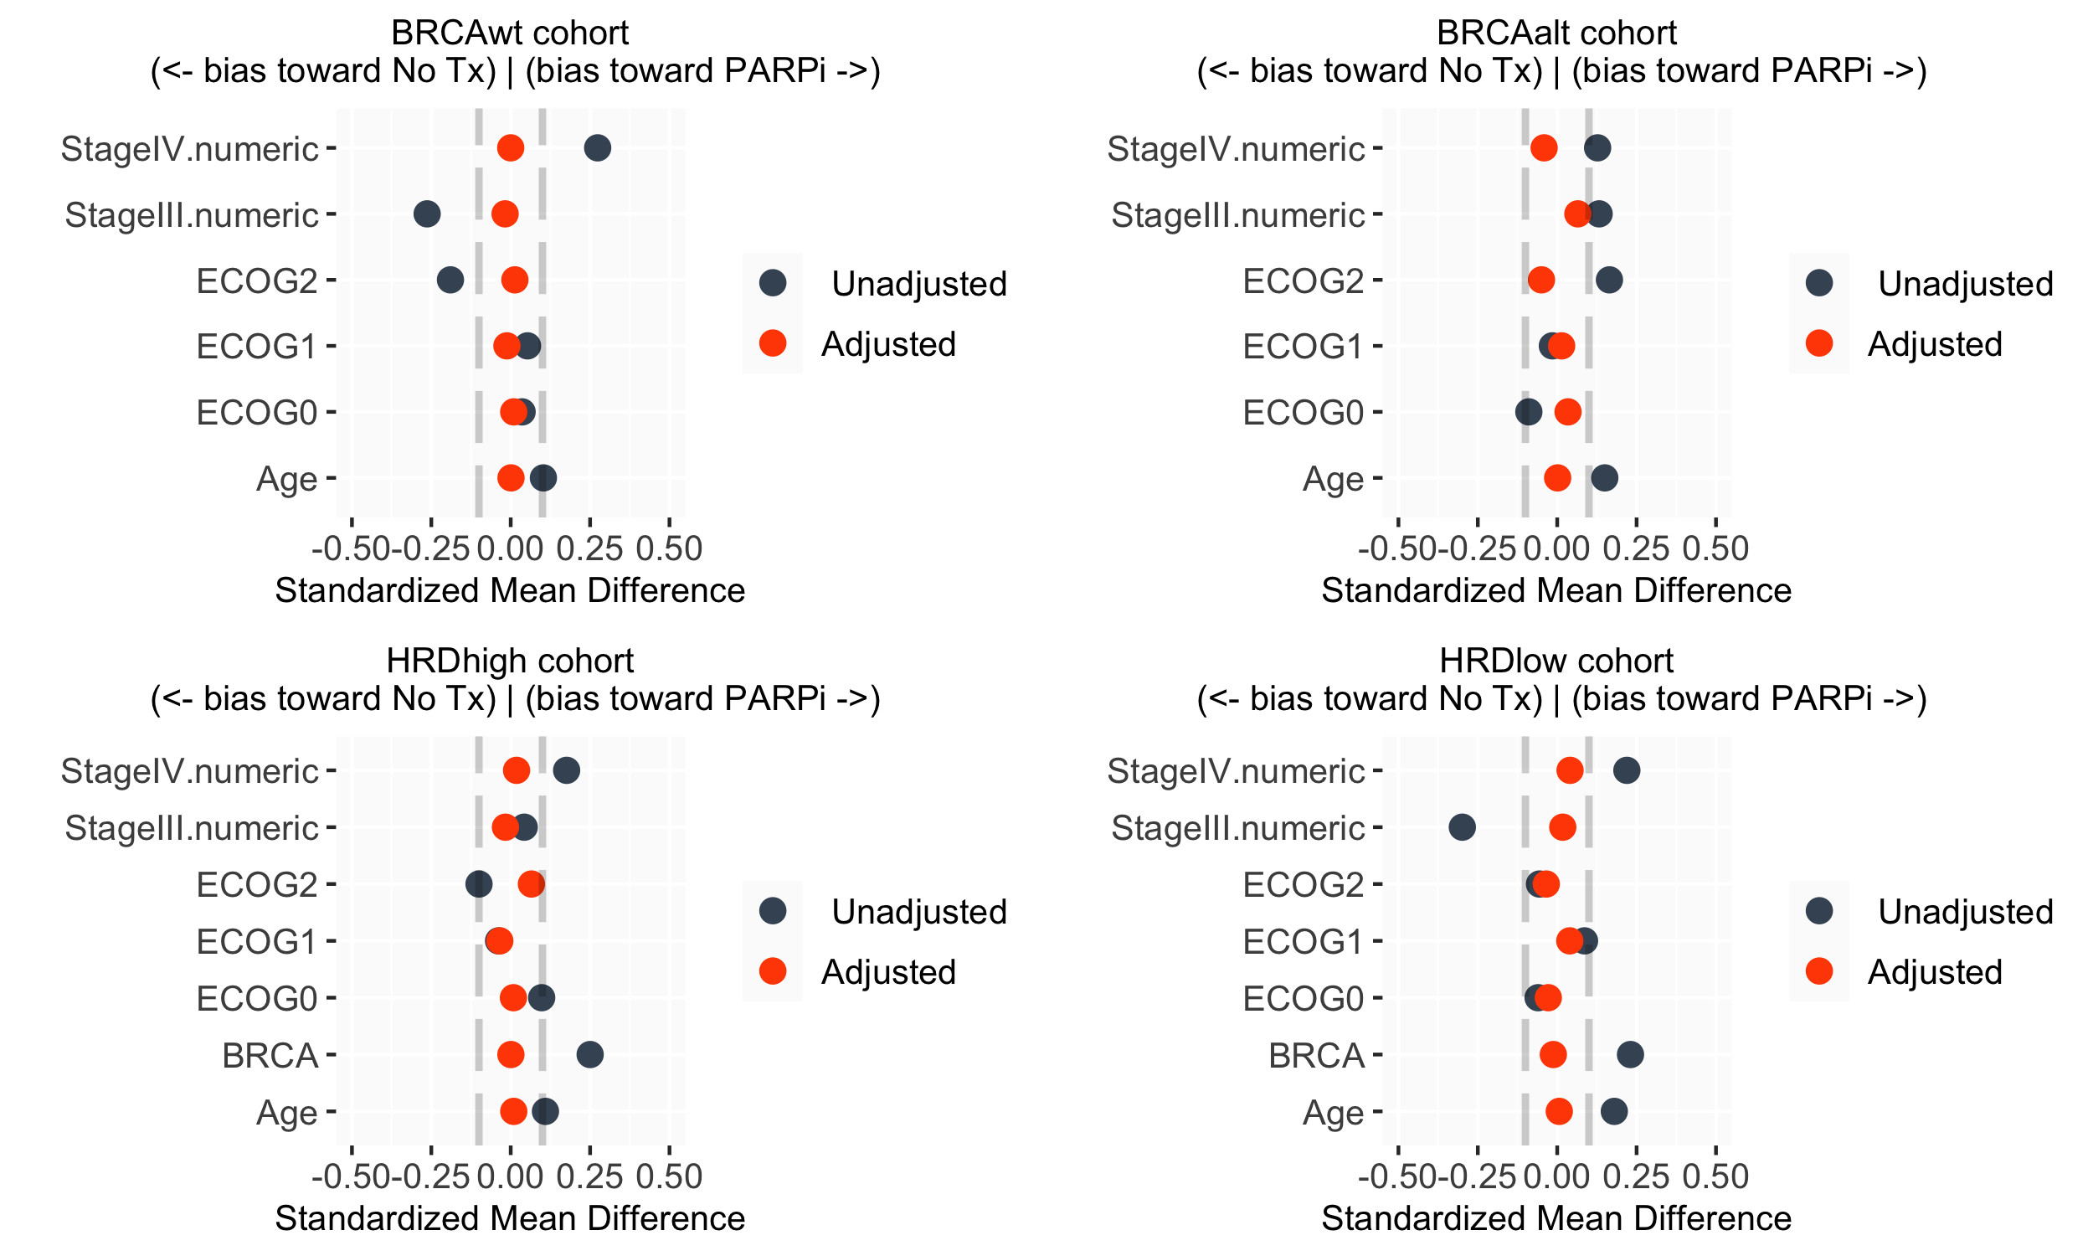
(A)
(B)
  Supplemental Figure S1. Propensity Weighting. Cohort balance was assessed before and after propensity weights were applied for (A) BRCAwt cohort, (B) BRCA altered cohort, (C) HRD signature high (HRDsig(+)) cohort and (D) HRD signature low (HRDsig(-)) cohort. Dashed lines indicate 10% standardized mean difference.
(C)
(D)

Slide 5
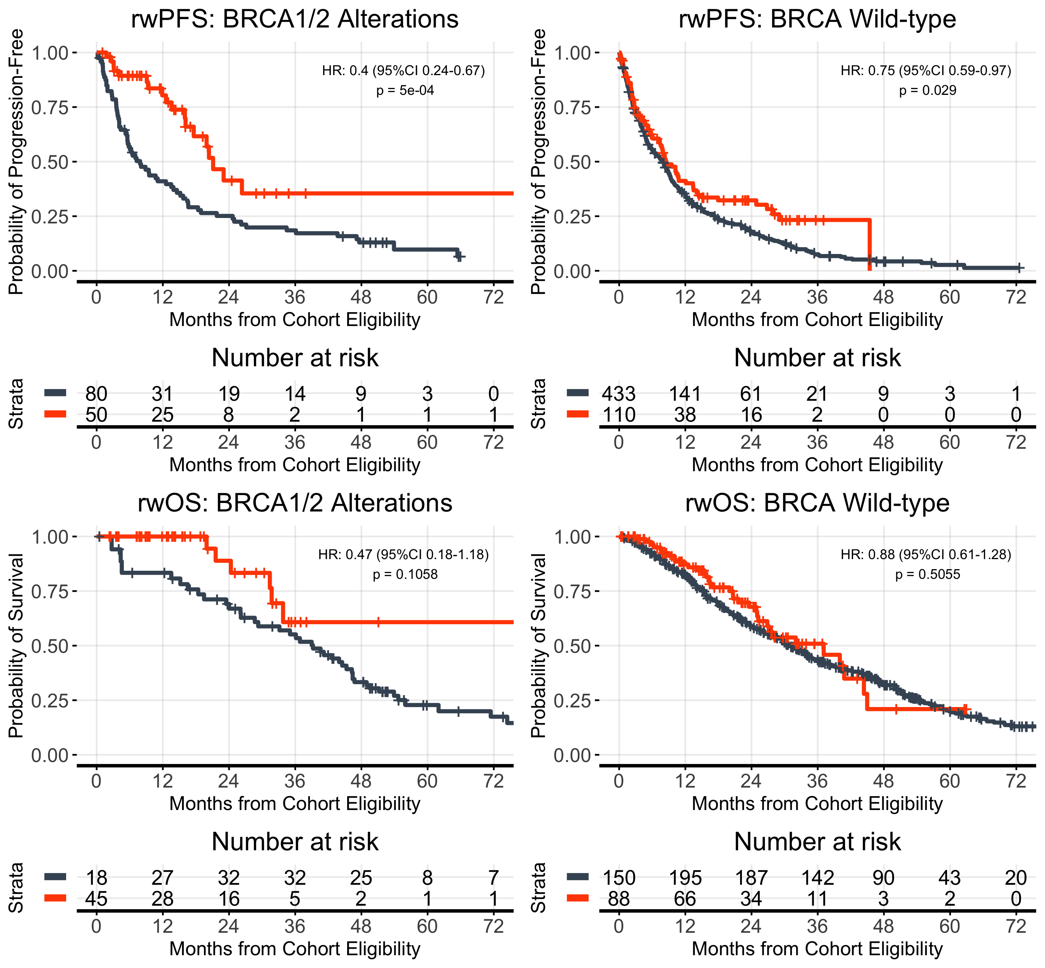
(A)
(B)
 | mPARPi (n=50) | No maintenance (n=80)
Events, n (%) | 18 (36.0%) | 64 (80.0%)
Median PFS, months | 21.1 | 7.9
 | mPARPi (n=110) | No maintenance (n=443)
Events, n (%) | 72 (65.4%) | 383 (86.4%)
Median PFS, months | 8.5 | 7.9
(C)
(D)
 | mPARPi (n=50) | No maintenance (n=80)
Events, n (%) | 6 (12%) | 41 (51.2%)
Median OS, months | NR | 39.2
 | mPARPi (n=110) | No maintenance (n=443)
Events, n (%) | 34 (30.9%) | 228 (51.5%)
Median OS, months | 37.1 | 30.9
Supplemental Figure S2. Patients receiving maintenance PARPi had more favorable outcomes when BRCAalt but not BRCAwt (unadjusted for imbalances). rwPFS is shown by maintenance therapy received for (A) BRCA altered, and (B) BRCA wild-type. rwOS is shown by maintenance therapy received for (C) BRCA altered, and (D) BRCA wild-type. rwOS estimates are risk set adjusted to account for delayed entry to at-risk table (see Methods).

Slide 6
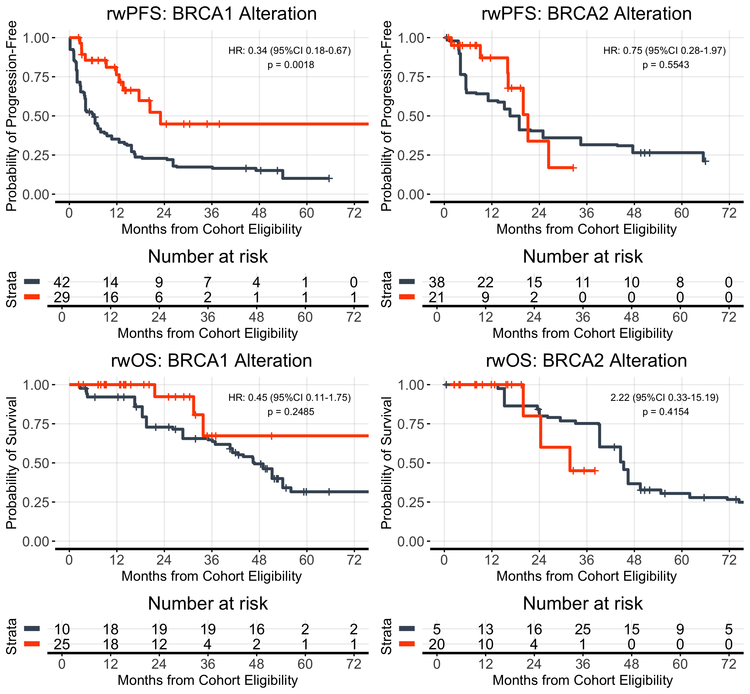
(A)
(B)
 | mPARPi (n=29) | No maintenance (n=52)
Events, n (%) | 11 (37.9%) | 35 (67.3%)
Median PFS, months | 23.0 | 6.3
 | mPARPi (n=21) | No maintenance (n=38)
Events, n (%) | 7 (33.3%) | 28 (73.7%)
Median PFS, months | 21.1 | 16.6
(C)
(D)
 | mPARPi (n=29) | No maintenance (n=52)
Events, n (%) | 3 (10.3%) | 17 (33.3%)
Median OS, months | NR | 46.7
 | mPARPi (n=21) | No maintenance (n=38)
Events, n (%) | 3 (14.3%) | 23 (60.5%)
Median OS, months | 31.7 | 45.3
Figure S3. Patients receiving maintenance PARPi had more favorable outcomes when BRCA1alt but not BRCA2alt (adjusted for imbalances). rwPFS is shown by maintenance therapy received for (A) BRCA1 altered, and (B) BRCA2 altered. rwOS is shown by maintenance therapy received for (C) BRCA1 altered, and (D) BRCA2 altered. rwOS estimates are risk set adjusted to account for delayed entry to at-risk table (see Methods). Kaplan-Meier curves are adjusted by propensity weights.

Slide 7
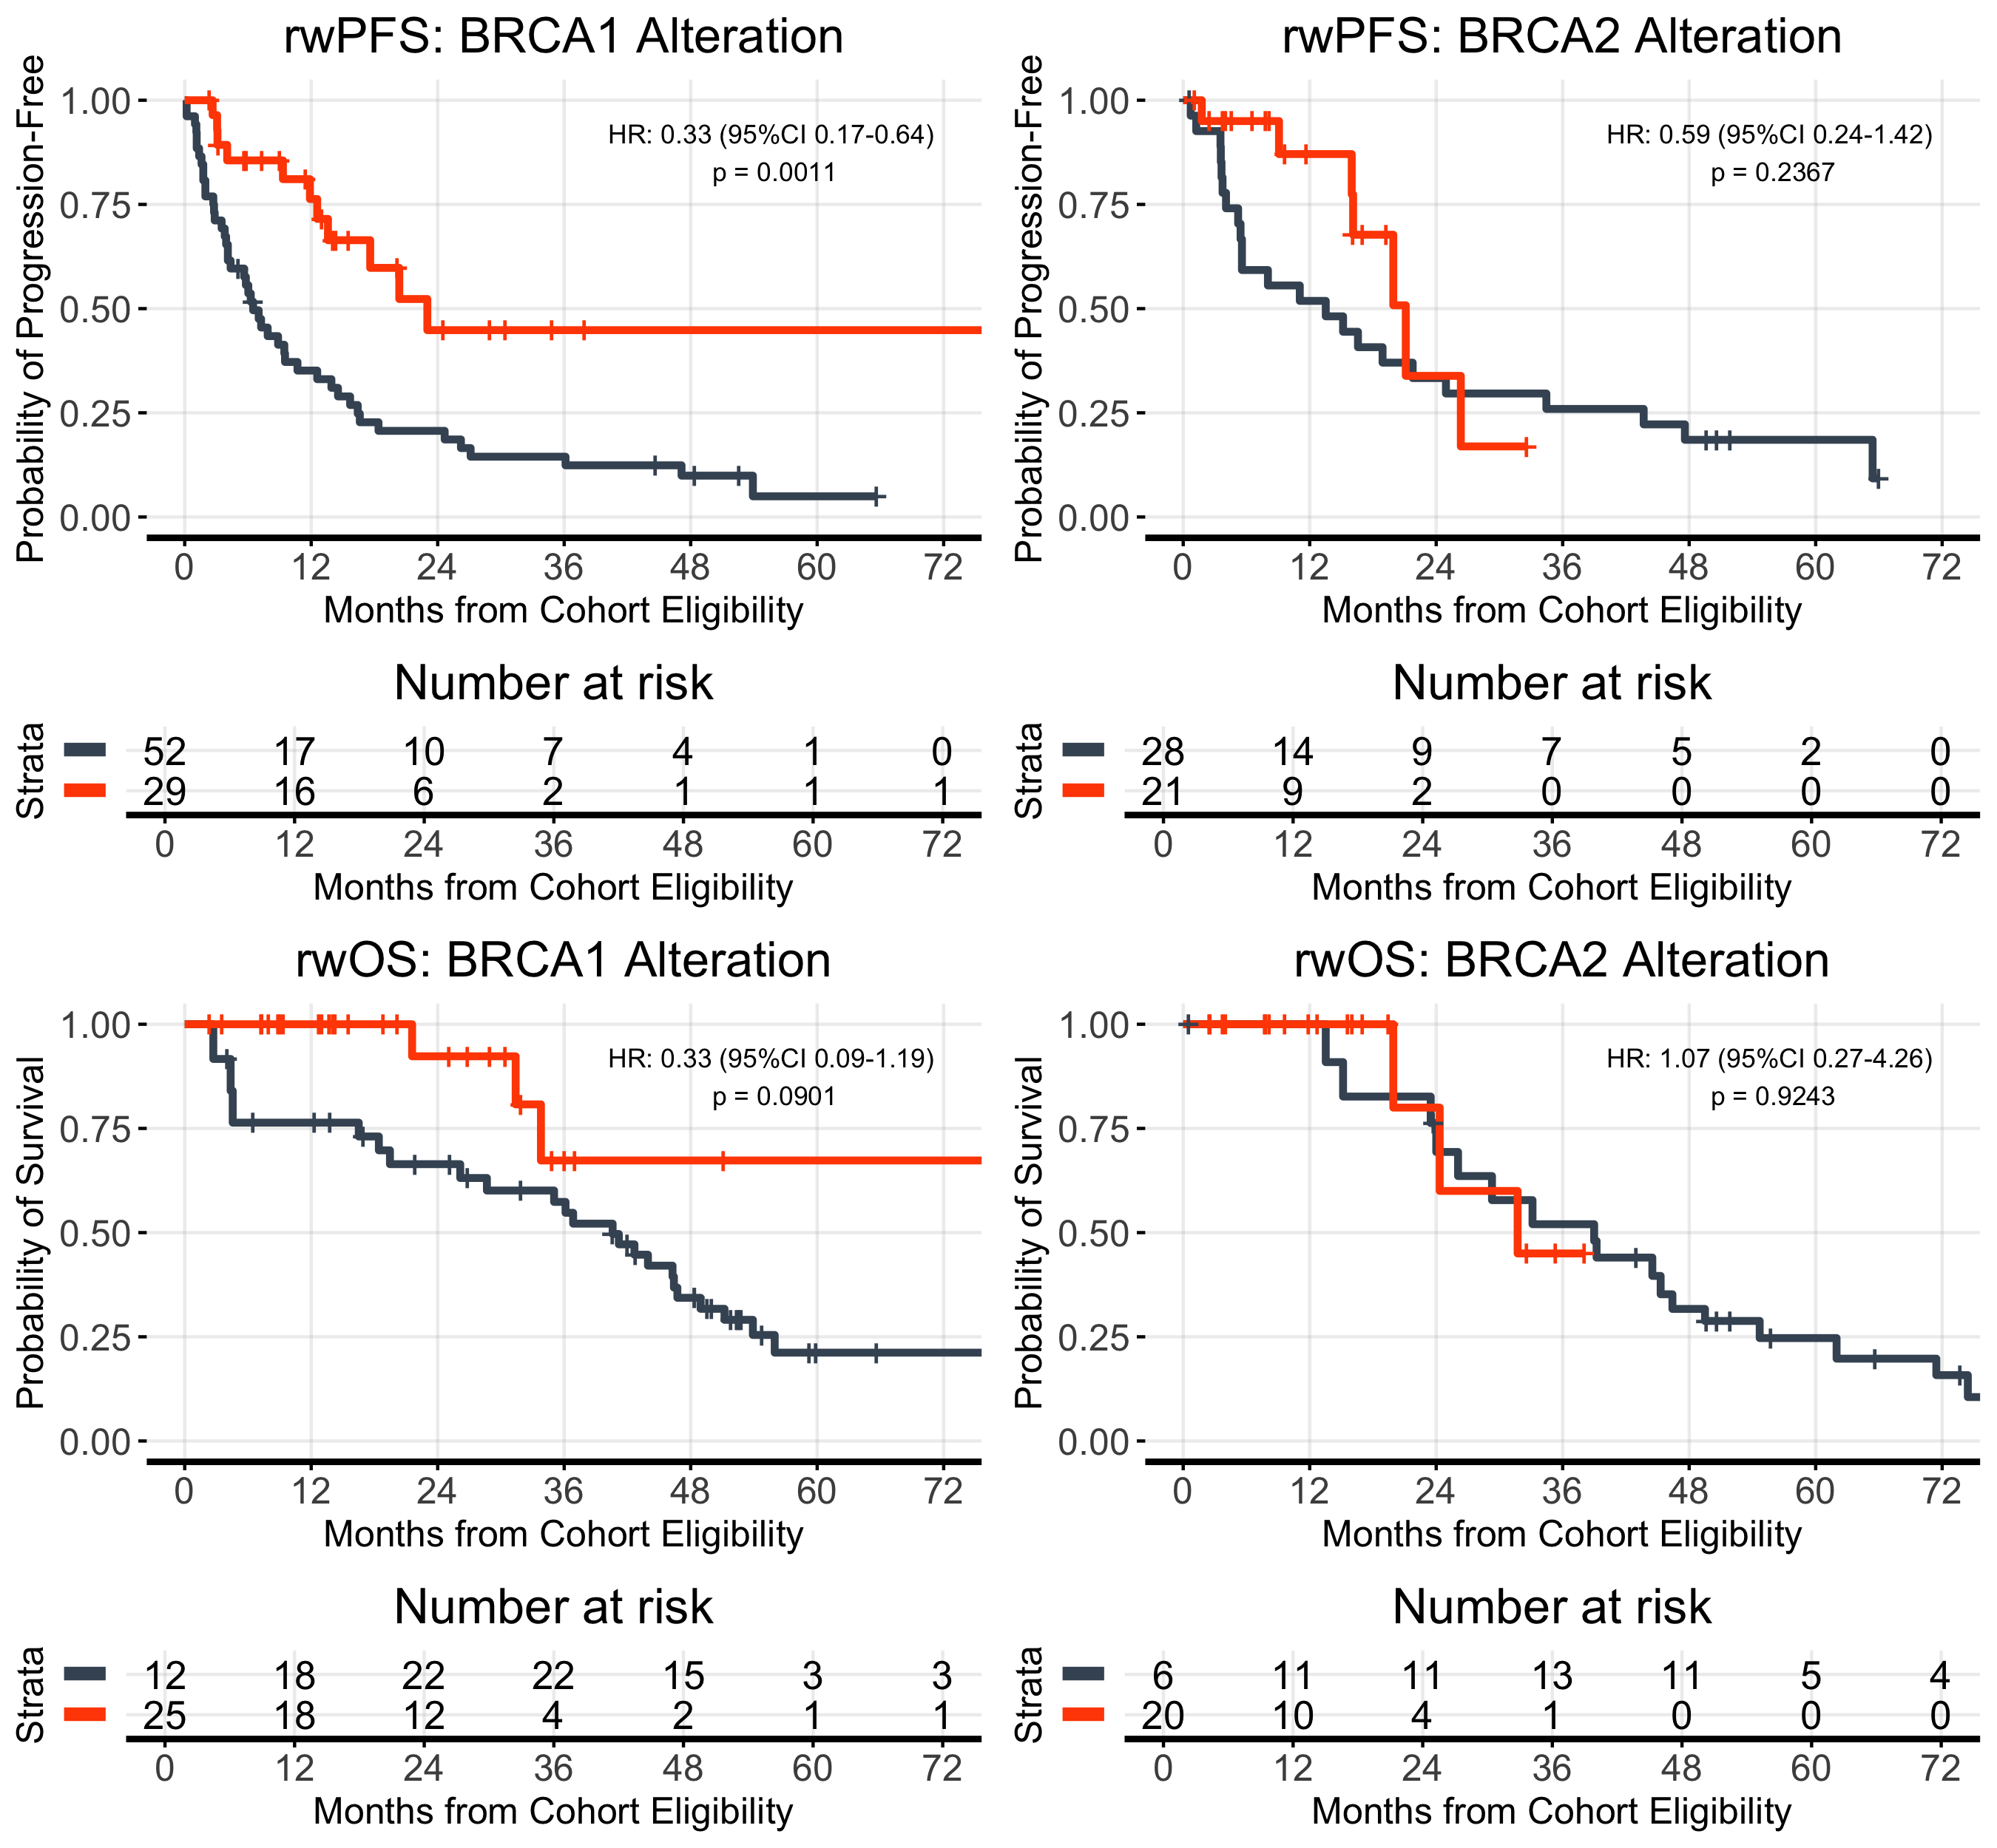
(A)
(B)
 | mPARPi (n=29) | No maintenance (n=52)
Events, n (%) | 11 (37.9%) | 46 (88.5%)
Median PFS, months | 23.0 | 6.5
 | mPARPi (n=21) | No maintenance (n=38)
Events, n (%) | 7 (33.3% | 23 (60.5%)
Median PFS, months | 21.1 | 13.5
(C)
(D)
 | mPARPi (n=29) | No maintenance (n=52)
Events, n (%) | 3 (10.3%) | 12
Median OS, months | NR | 40.6
 | mPARPi (n=21) | No maintenance (n=38)
Events, n (%) | 3 (14.3%) | 18 (47.4%)
Median OS, months | 31.7 | 39.0
Figure S4. Patients receiving maintenance PARPi had more favorable outcomes when BRCA1alt but not BRCA2alt (unadjusted for imbalances). rwPFS is shown by maintenance therapy received for (A) BRCA1 altered, and (B) BRCA2 altered. rwOS is shown by maintenance therapy received for (C) BRCA1 altered, and (D) BRCA2 altered. rwOS estimates are risk set adjusted to account for delayed entry to at-risk table (see Methods). Kaplan-Meier curves are adjusted by propensity weights.

Slide 8
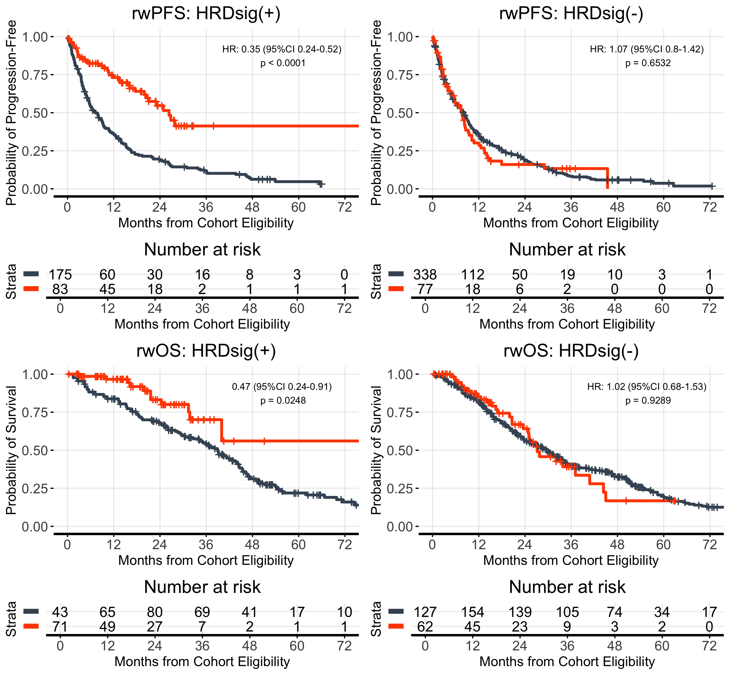
(A)
(B)
 | mPARPi (n=83) | No maintenance (n=175)
Events, n (%) | 33 (39.7%) | 158 (90.3%)
Median PFS, months | 26.3 | 7.25
 | mPARPi (n=77) | No maintenance (n=338)
Events, n (%) | 57 (74.0%) | 294 (87.0%)
Median PFS, months | 7.71 | 8.20
(C)
(D)
 | mPARPi (n=83) | No maintenance (n=175)
Events, n (%) | 11 (13.2%) | 89 (50.8%)
Median OS, months | NR | 39.0
 | mPARPi (n=77) | No maintenance (n=338)
Events, n (%) | 29 (37.7%) | 180 (53.2%)
Median OS, months | 27.2 | 23.9
Supplemental Figure S5. Patients receiving maintenance PARPi had more favorable outcomes when HRDsig(+) but not HRDsig(-) (unadjusted for imbalances). rwPFS is shown by maintenance therapy received for (A) HRDsig(+), and (B) HRDsig(-). rwOS is shown by maintenance therapy received for (C) HRD high, and (D) HRD low. rwOS estimates are risk set adjusted to account for delayed entry to at-risk table (see Methods).

Slide 9
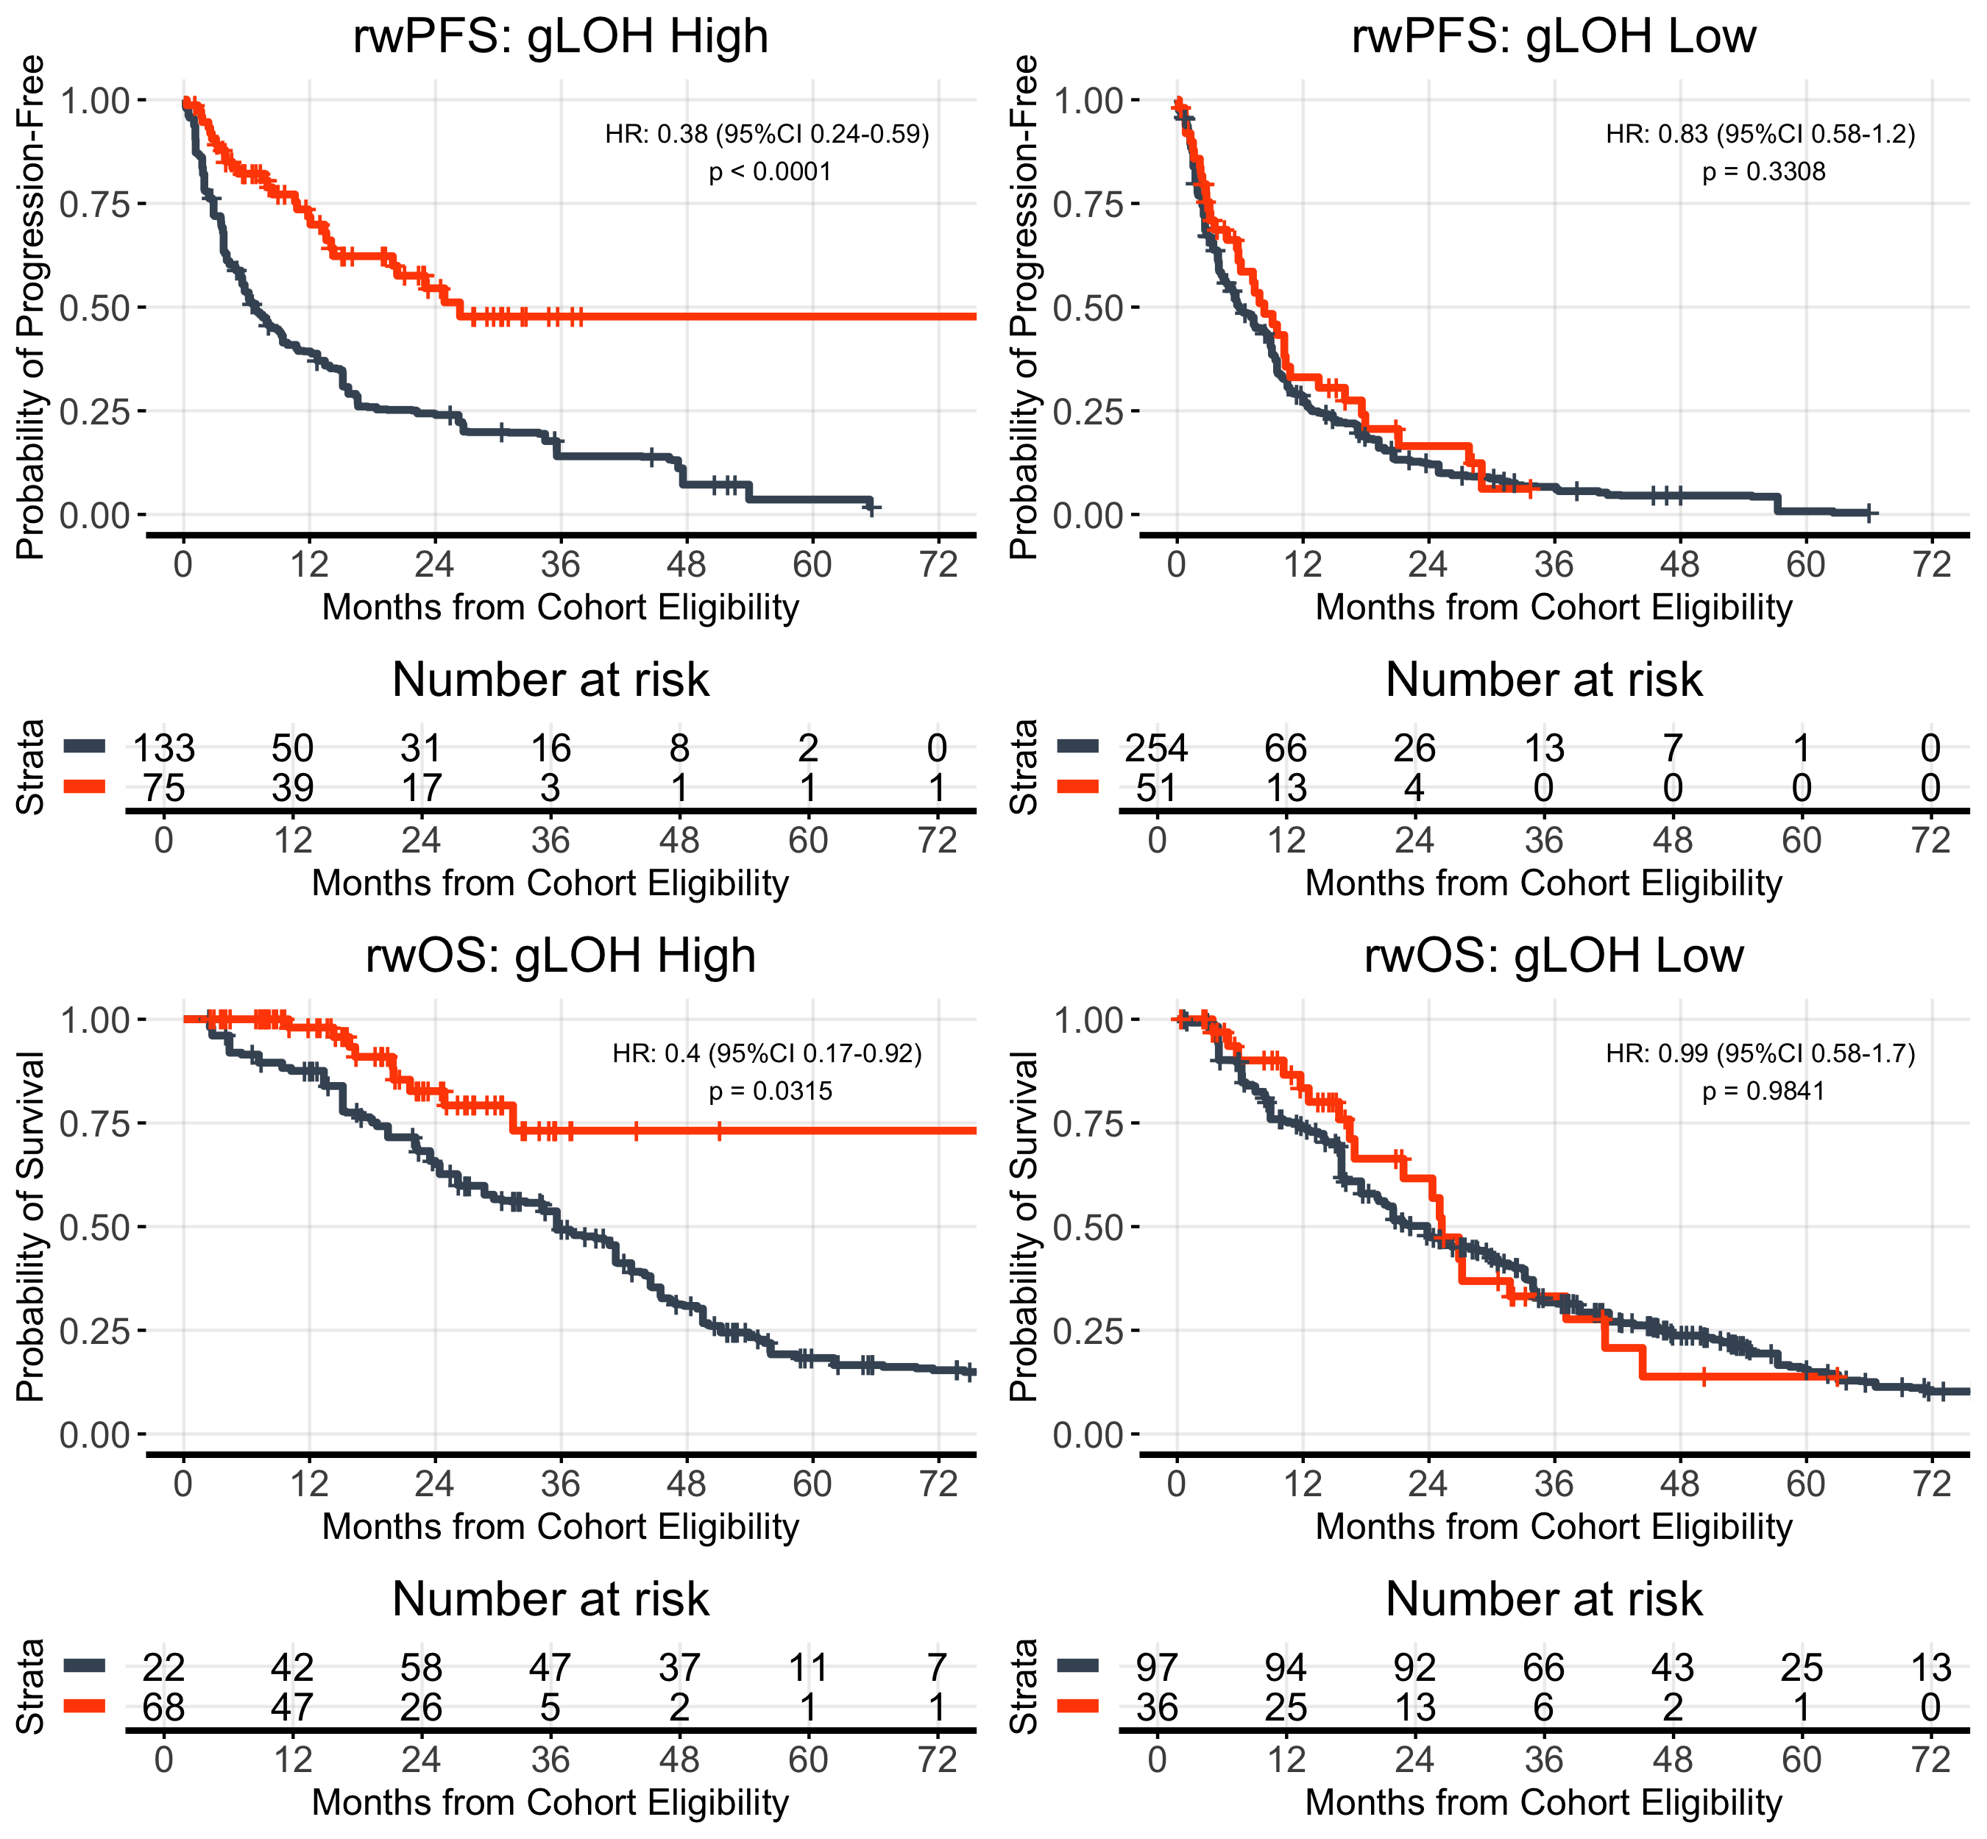
(A)
(B)
 | mPARPi (n=75) | No maintenance (n=136)
Events, n (%) | 29 (38.7%) | 121 (89.0%)
Median PFS, months | 26.3 | 6.8
 | mPARPi (n=51) | No maintenance (n=247)
Events, n (%) | 36 (70.6%) | 235 (95.1%)
Median PFS, months | 8.3 | 5.9
(C)
(D)
 | mPARPi (n=75) | No maintenance (n=136)
Events, n (%) | 9 (12.0%) | 71 (52.2%)
Median OS, months | NR | 35.6
 | mPARPi (n=51) | No maintenance (n=247)
Events, n (%) | 19 (37.2%) | 140 (56.7%)
Median OS, months | 25.2 | 23.8
Supplemental Figure S6. Patients receiving maintenance PARPi had more favorable outcomes when gLOH high but not gLOH low (adjusted for unbalances). rwPFS is shown by maintenance therapy received for (A) gLOH high, and (B) gLOH low. rwOS is shown by maintenance therapy received for (C) gLOH high, and (D) gLOH low. rwOS estimates are risk set adjusted to account for delayed entry to at-risk table (see Methods). Kaplan-Meier curves are adjusted by propensity weights. Analyses unadjusted for propensity weights have similar results.

Slide 10
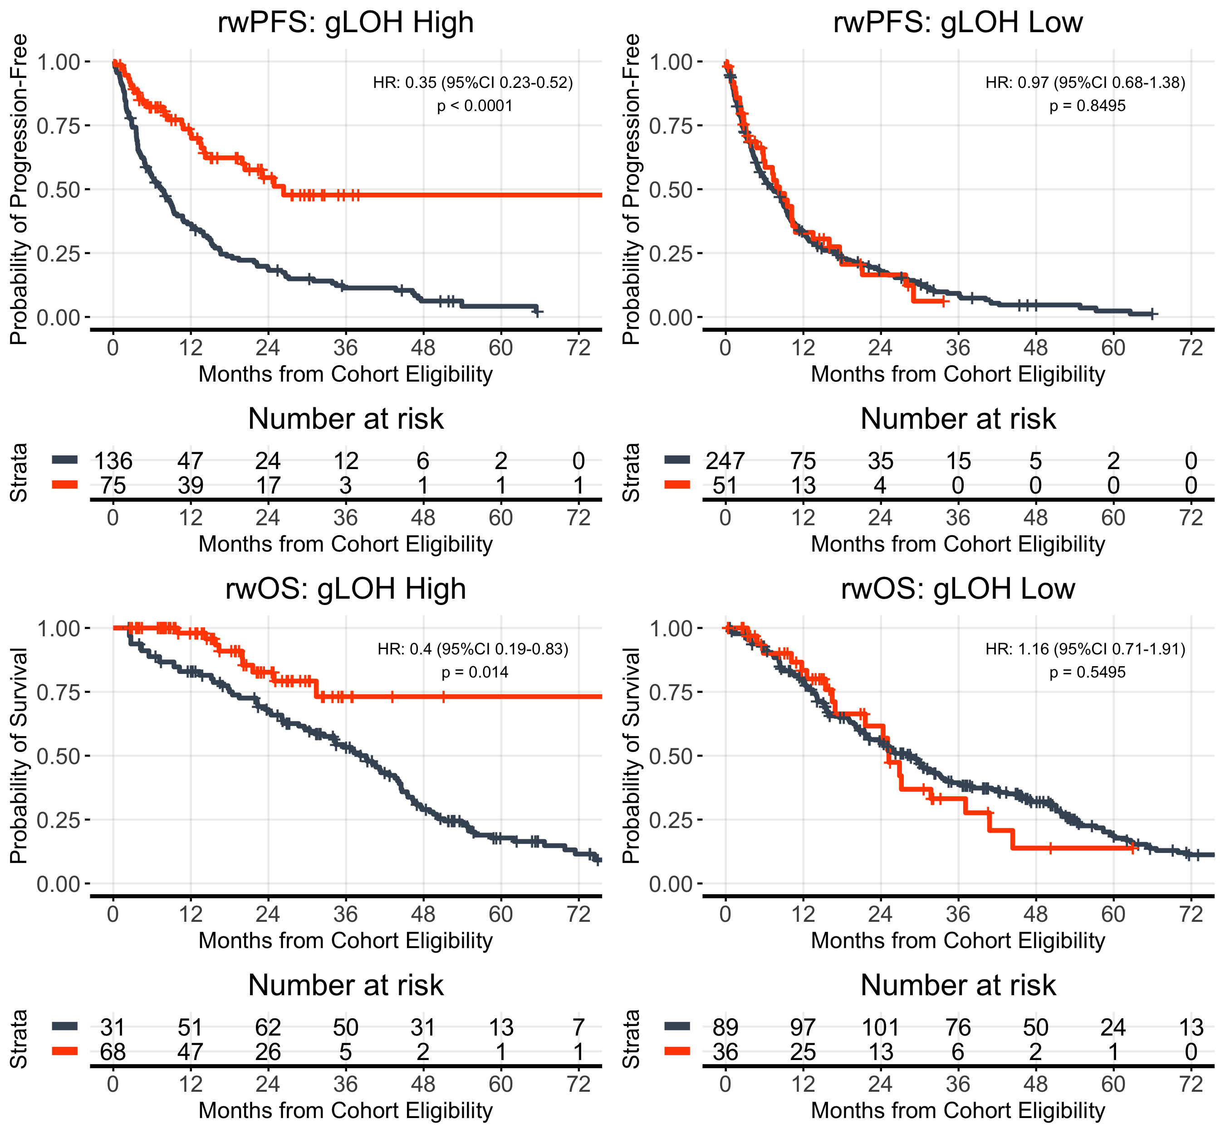
(A)
(B)
 | mPARPi (n=75) | No maintenance (n=136)
Events, n (%) | 29 (38.7%) | 123 (90.4%)
Median PFS, months | 26.3 | 7.5
 | mPARPi (n=51) | No maintenance (n=247)
Events, n (%) | 36 (70.6%) | 219 (88.7%)
Median PFS, months | 8.3 | 7.3
(C)
(D)
 | mPARPi (n=75) | No maintenance (n=136)
Events, n (%) | 9 (12.0%) | 73 (53.7%)
Median OS, months | NR | 39.1
 | mPARPi (n=51) | No maintenance (n=247)
Events, n (%) | 19 (37.2%) | 128 (51.8%)
Median OS, months | 25.2 | 28.6
Supplemental Figure S7. Patients receiving maintenance PARPi had more favorable outcomes when gLOH high but not gLOH low (unadjusted for imbalances). rwPFS is shown by maintenance therapy received for (A) gLOH high, and (B) gLOH low. rwOS is shown by maintenance therapy received for (C) gLOH high, and (D) gLOH low. rwOS estimates are risk set adjusted to account for delayed entry to at-risk table (see Methods).

Slide 11
(A) rwPFS BRCA
(B) rwOS BRCA
Variable | HR | p-value
BRCA (alt vs. wt) | 0.62 (0.37-1.02) | 0.0608
PARPi maintenance vs. not | 0.75 (0.56-1) | 0.0466
Interaction: BRCAalt on PARPi | 0.69 (0.34-1.39) | 0.2954
Variable | HR | p-value
BRCA (alt vs. wt) | 0.82 (0.43-1.53) | 0.5247
PARPi maintenance vs. not | 1.05 (0.69-1.6) | 0.8114
Interaction: BRCAalt on PARPi | 0.46 (0.16-1.34) | 0.1537
Supplemental Figure S8. Interaction models for the full cohort (n=673) of BRCAalt and HRDsig.
(C) rwPFS HRDsig
(D) rwOS HRDsig
Variable | HR | p-value
HRD (+) vs. (-) | 0.95 (0.7-1.29) | 0.7421
PARPi maintenance vs. not | 1.04 (0.74-1.45) | 0.8383
Interaction: HRD(+) on PARPi | 0.34 (0.2-0.57) | <0.001
Variable | HR | p-value
HRD (+) vs. (-) | 0.96 (0.61-1.49) | 0.8402
PARPi maintenance vs. not | 0.99 (0.62-1.59) | 0.9754
Interaction: HRD(+) on PARPi | 0.36 (0.16-0.83) | 0.016
(E) rwPFS HRDsig (BRCAwt)
(F) rwOS HRDsig (BRCAwt)
Variable | HR | p-value
HRD (+) vs. (-) | 0.95 (0.69-1.29) | 0.7248
PARPi maintenance vs. not | 0.98 (0.71-1.36) | 0.9073
Interaction: HRD(+) on PARPi | 0.37 (0.19-0.71) | 0.003
Variable | HR | p-value
HRD (+) vs. (-) | 0.65 (0.38-1.1) | 0.1104
PARPi maintenance vs. not | 0.91 (0.58-1.43) | 0.6718
Interaction: HRD(+) on PARPi | 0.57 (0.2-1.61) | 0.2875

Slide 12
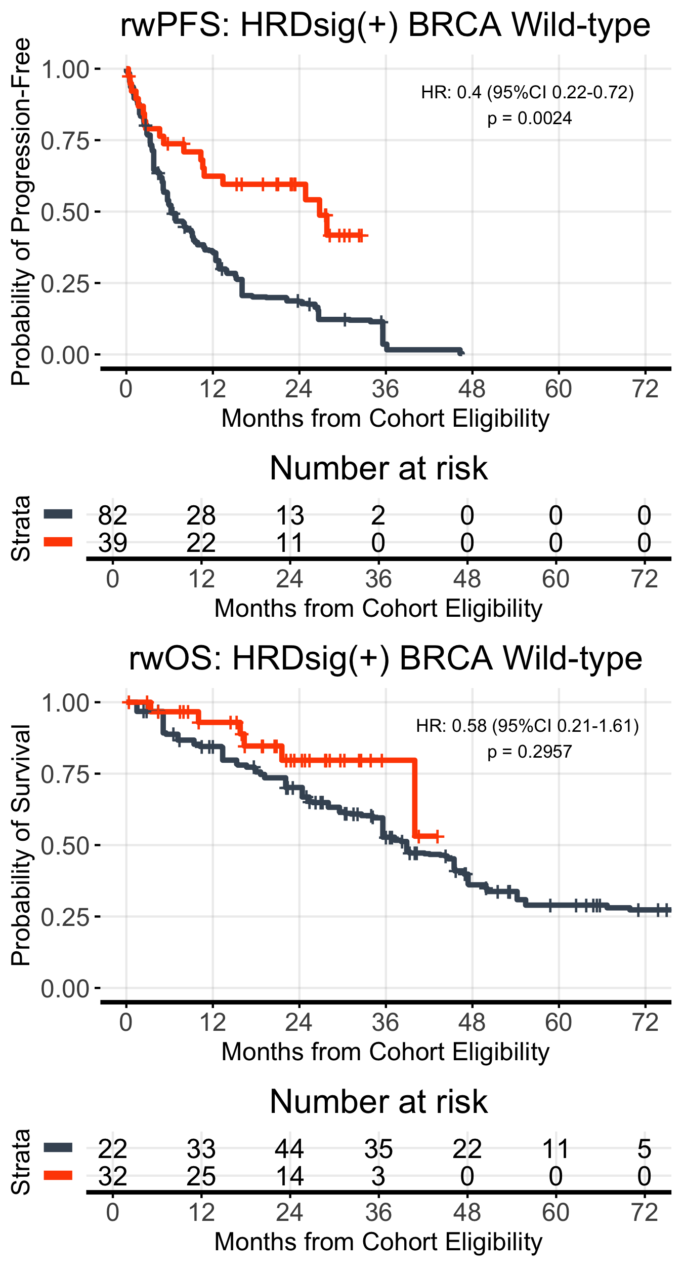
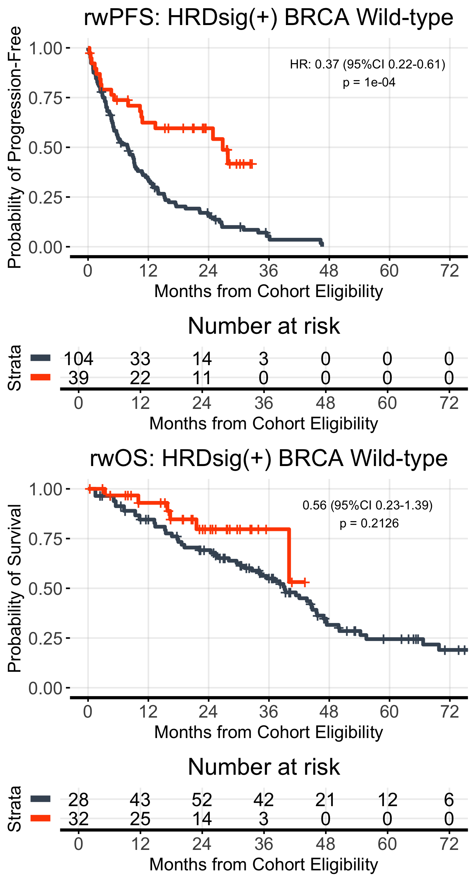
(A)
(B)
 | mPARPi (n=39) | No maintenance (n=104)
Events, n (%) | 18 (46.1%) | 75 (72.1%)
Median PFS, months | 26.8 | 6.2
 | mPARPi (n=39) | No maintenance (n=104)
Events, n (%) | 18 (46.1%) | 95 (91.3%)
Median PFS, months | 26.8 | 7.9
(C)
(D)
 | mPARPi (n=39) | No maintenance (n=104)
Events, n (%) | 6 (15.4%) | 38 (36.5%)
Median OS, months | NR | 38.9
 | mPARPi (n=39) | No maintenance (n=104)
Events, n (%) | 6 (15.4%) | 50 (48.1%)
Median OS, months | NR | 39.1
Supplemental Figure S9. Patients HRDsig positive and BRCA wild-type had more favorable outcomes when receiving maintenance PARPi vs. no maintenance (unadjusted and adjusted for imbalances). rwPFS is shown by maintenance therapy received for (A) adjusted, and (B) unadjusted. rwOS is shown by maintenance therapy received for (C) adjusted, and (D) unadjusted. rwOS estimates are risk set adjusted to account for delayed entry to at-risk table (see Methods).

Slide 13
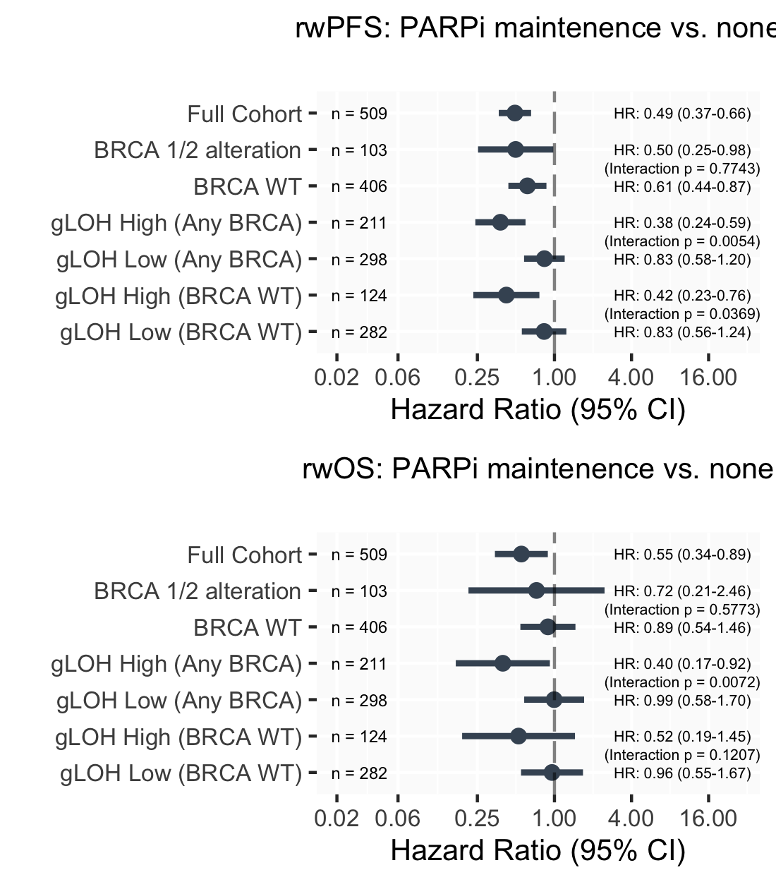
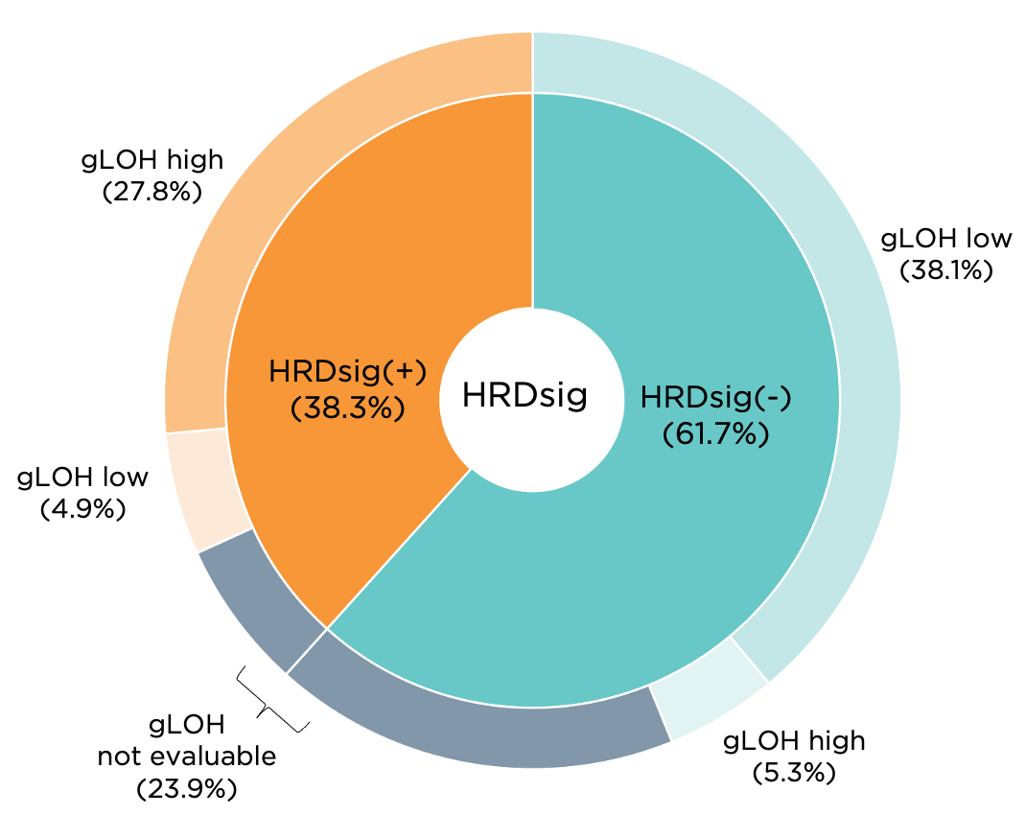
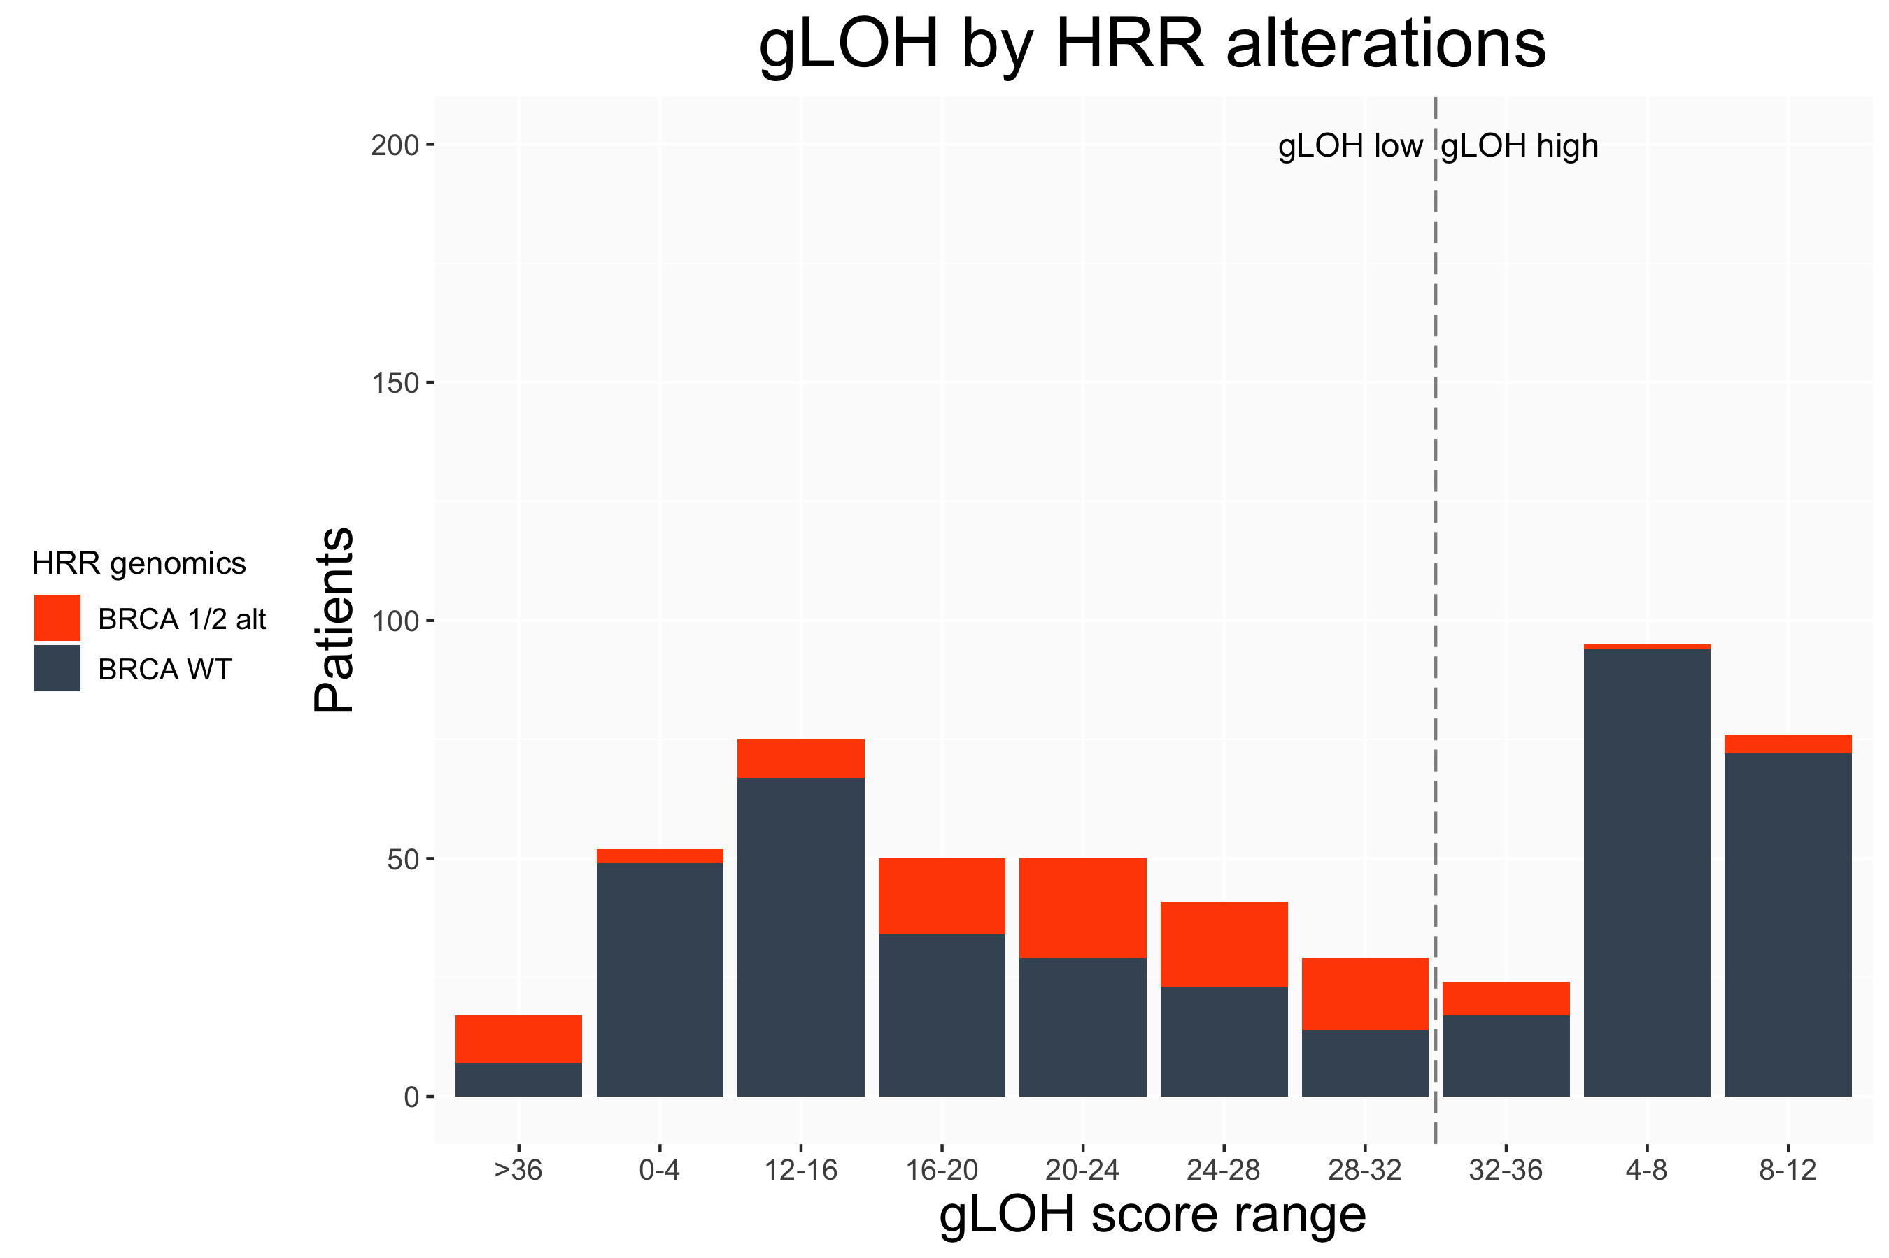
(A)
Favors PARPi
maintenance
Favors no
maintenance
(C)
(B)
(D)
Favors PARPi
maintenance
Favors no
maintenance
Supplemental Figure S10. gLOH level is superior to BRCA alone for enrichment of favorable rwPFS and rwOS. (A) rwPFS and (B) rwOS is shown by cohort subgroup, defined by BRCA and/or gLOH status. Interaction p-values reflect models containing the two adjacent groups. Full interaction models are available in Supplemental Figure S8. (C) Prevalence of HRDsig and gLOH in the CGDB cohort (n=673). (D) Distribution of gLOH score and overlap with BRCAalt status.

Slide 14
(A) rwPFS BRCA
(B) rwOS BRCA
Variable | HR | p-value
BRCA (alt vs. wt) | 0.55 (0.31-0.97) | 0.0381
PARPi maintenance vs. not | 0.61 (0.43-0.85) | 0.0039
Interaction: BRCAalt on PARPi | 0.89 (0.4-1.98) | 0.7743
Variable | HR | p-value
BRCA (alt vs. wt) | 0.66 (0.33-1.34) | 0.2548
PARPi maintenance vs. not | 0.91 (0.55-1.49) | 0.6974
Interaction: BRCAalt on PARPi | 0.7 (0.2-2.43) | 0.5773
Supplemental Figure S11. Full Interaction models for the subcohort of patients with gLOH assessment (n=509) of BRCAalt and gLOH.
(C) rwPFS gLOH
(D) rwOS gLOH
Variable | HR | p-value
gLOH (high vs. low) | 0.77 (0.55-1.08) | 0.1339
PARPi maintenance vs. not | 0.84 (0.58-1.19) | 0.3239
Interaction: gLOHhigh on PARPi | 0.44 (0.25-0.78) | 0.0054
Variable | HR | p-value
gLOH (high vs. low) | 0.85 (0.52-1.38) | 0.5075
PARPi maintenance vs. not | 1.06 (0.61-1.84) | 0.8464
Interaction: gLOHhigh on PARPi | 0.28 (0.11-0.71) | 0.0072
(E) rwPFS gLOH (BRCAwt)
(F) rwOS gLOH (BRCAwt)
Variable | HR | p-value
gLOH (high vs. low) | 0.86 (0.59-1.26) | 0.4403
PARPi maintenance vs. not | 0.84 (0.56-1.25) | 0.3885
Interaction: gLOHhigh on PARPi | 0.48 (0.24-0.96) | 0.0369
Variable | HR | p-value
gLOH (high vs. low) | 0.65 (0.36-1.2) | 0.1677
PARPi maintenance vs. not | 0.96 (0.55-1.68) | 0.8876
Interaction: gLOHhigh on PARPi | 0.42 (0.14-1.25) | 0.1207

Slide 15
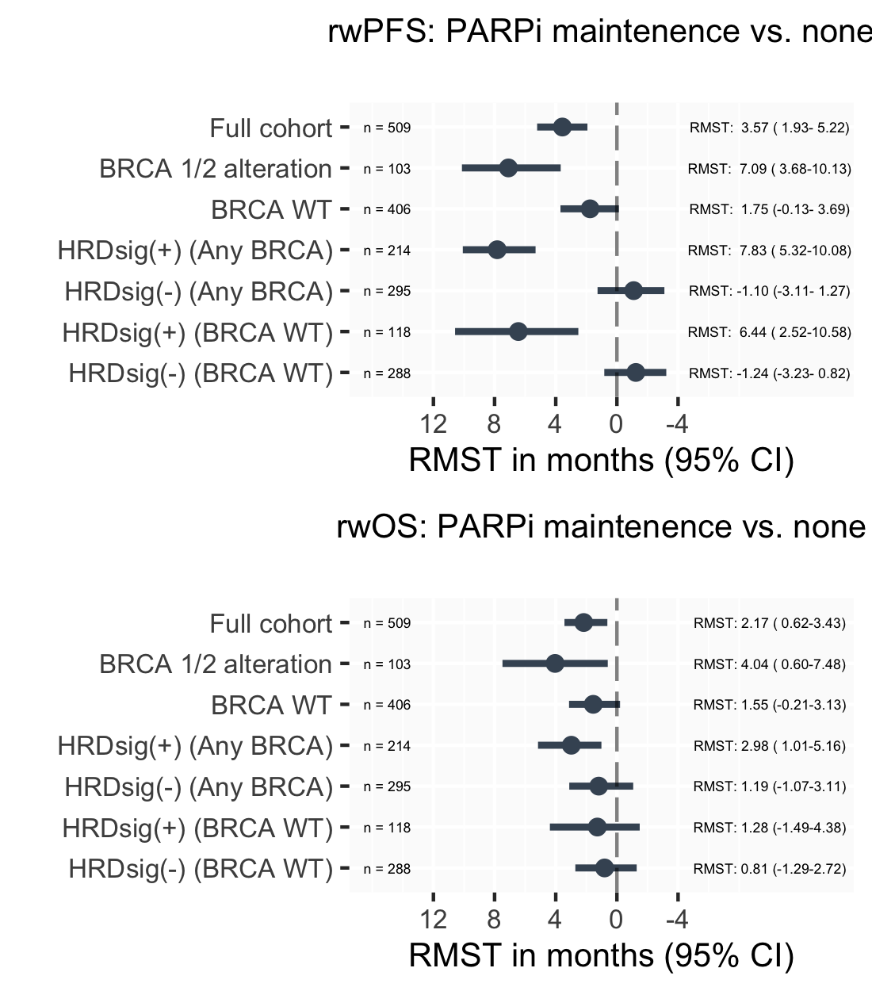
(A)
Favors PARPi
maintenance
Favors no maintenance
Supplemental Figure S12. Restricted mean survival time (RMST) of HRD signature is superior to BRCA alone for enrichment of favorable rwPFS and rwOS. (A) rwPFS and (B) rwOS is shown by cohort subgroup, defined by BRCA and/or HRD signature. RMST calculated based on 24-months outcomes.
(B)
Favors PARPi
maintenance
Favors no maintenance

Slide 16
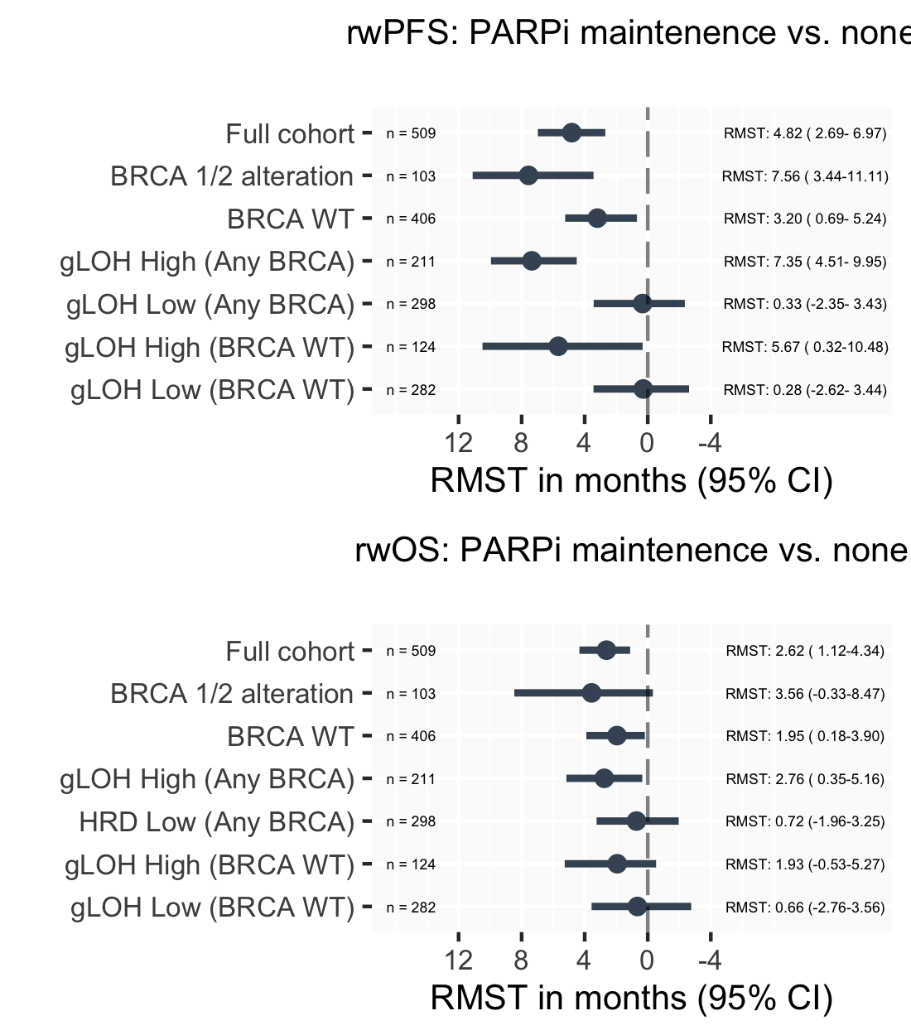
(A)
Favors PARPi
maintenance
Favors no maintenance
(B)
Supplemental Figure S13. Restricted mean survival time (RMST) of gLOH signature is superior to BRCA alone for enrichment of favorable rwPFS and rwOS. (A) rwPFS and (B) rwOS is shown by cohort subgroup, defined by BRCA and/or gLOH signature. RMST calculated based on 24-months outcomes.
Favors PARPi
maintenance
Favors no
maintenance

Slide 17
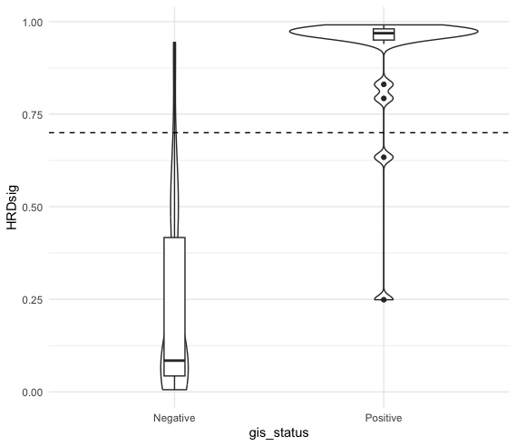
(A)
(B)
GIS
 | Negative | Positive
Negative | 63 | 2
Positive | 4 | 19
HRDsig score
HRDsig
Agreement=0.93
Negative
Positive
Supplemental Figure S14. Comparison between HRDsig and Myriad MyChoice genomic instability score (GIS) results. (A) HRDsig score distribution by GIS result. The dashed line represents the 0.7 cut-off for HRDsig(+) (B) Agreement for HRDsig and GIS results.
GIS result

