Slide 1
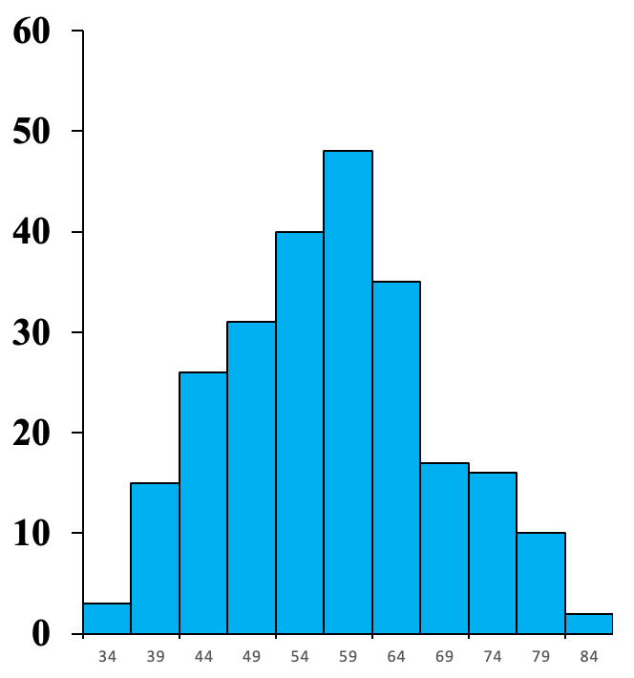
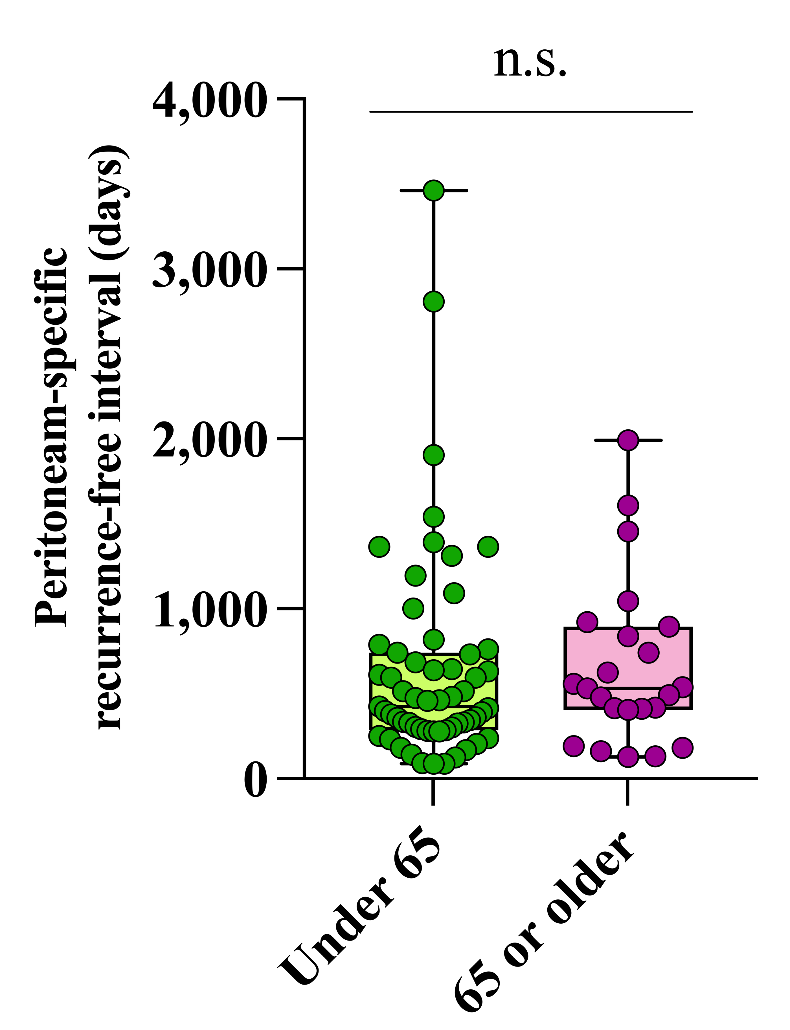
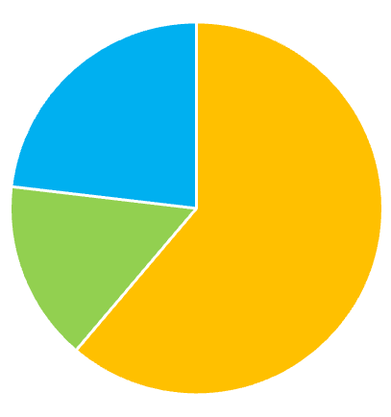
A
B
C
Distant or other
metastasis (23.1%)
Frequency (n)
Lymph node alone
(15.7%)
Peritoneum
(61.2%)
30
40
50
60
70
80
Age (years)
Figure S1. (A) The distribution of age and (B) pie chart of the distribution of recurrent site. (C) Plot of peritoneum-specific recurrent-free interval of the two age groups.

