Slide 1
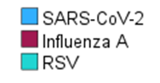
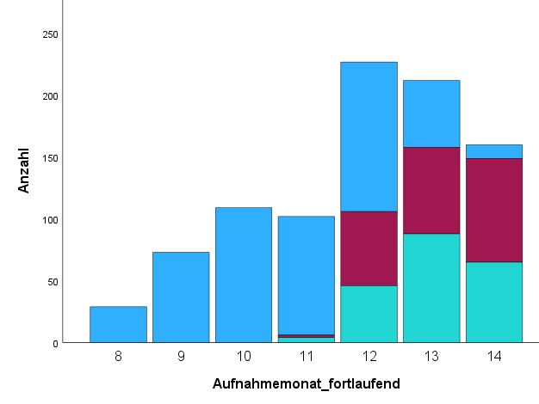
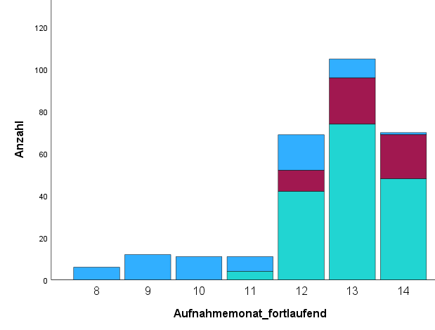
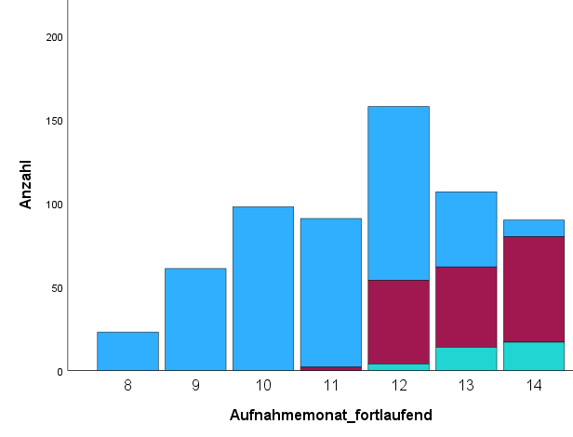
Time course of infections
All
< 18 years of age
≥ 18 years of age
Number
Number
Number
8/23 9/23 10/23 11/23 12/23 1/24 2/24
8/23 9/23 10/23 11/23 12/23 1/24 2/24
8/23 9/23 10/23 11/23 12/23 1/24 2/24
Month of admission
Month of admission
Month of admission
Supplemental Figure 1: Numbers of patients stratified according to type of infections versus month of admission. Absolute numbers are shown.

