Slide 1
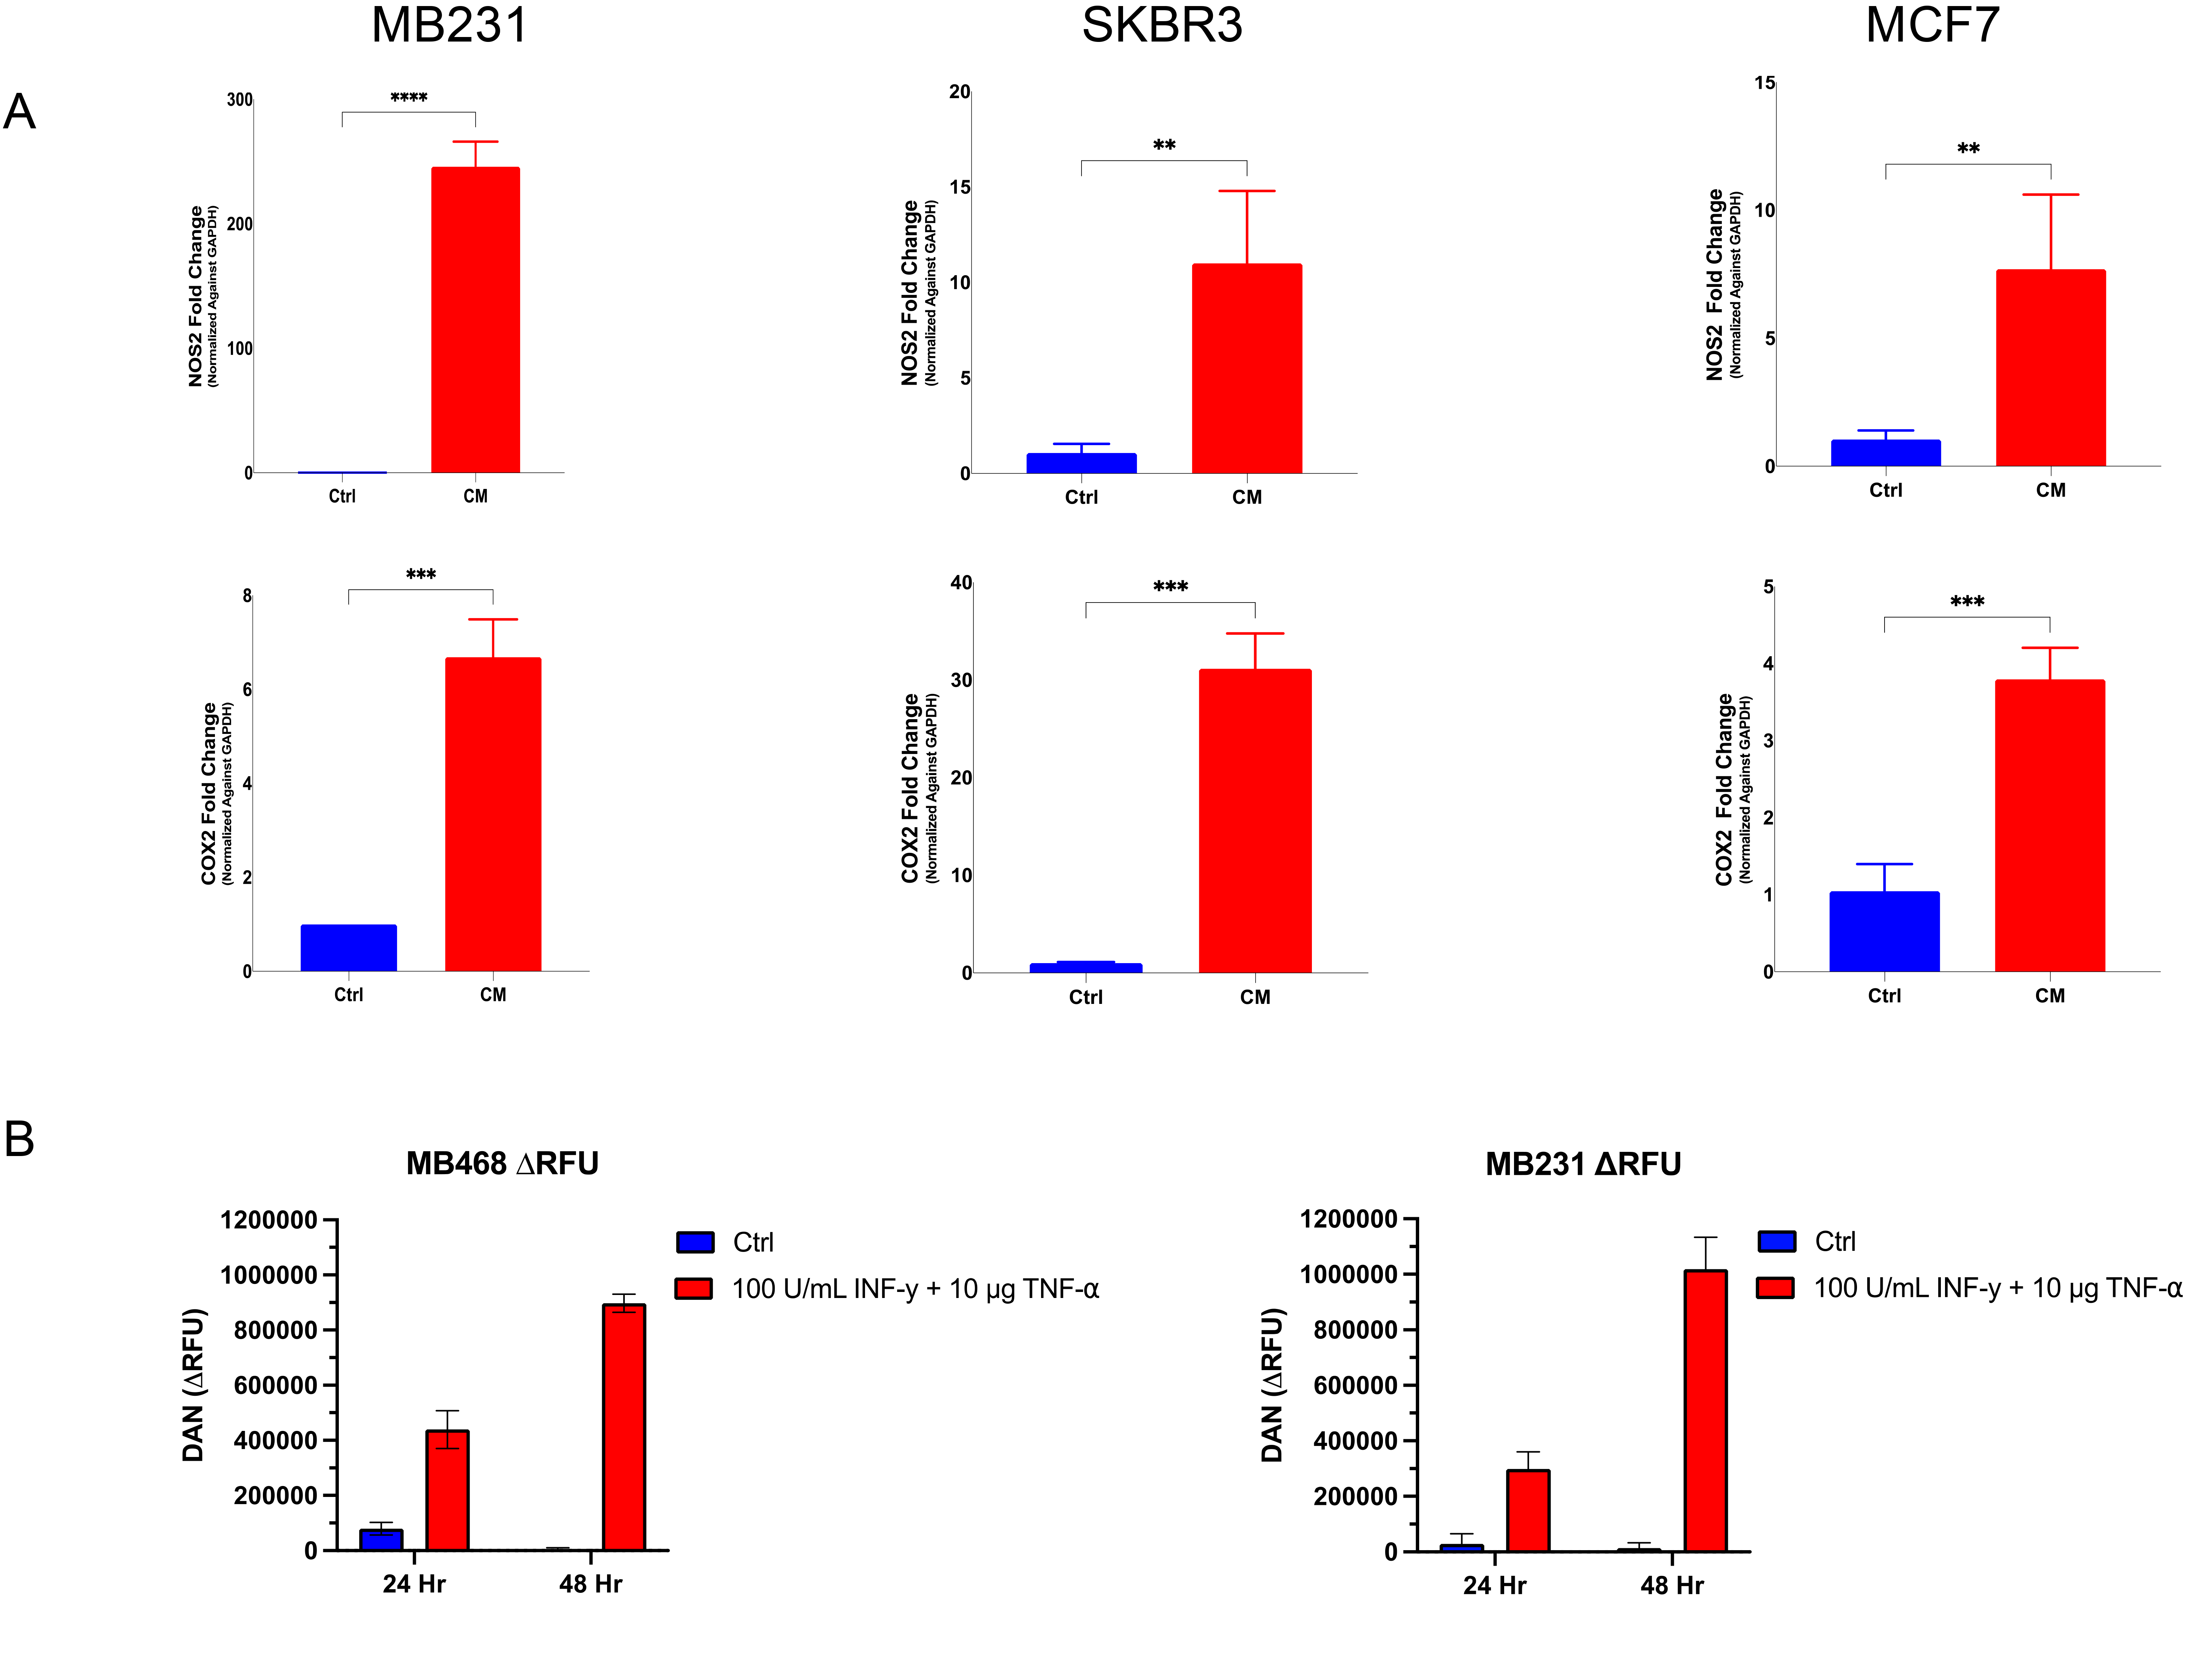
Supplementary Fig. 1. Tumor NOS2 and COX2 expression induced by IFNγ and TNFα.
A) MB231 (TNBC), SKBR3 (HER2+) and MCF7 (ER+) cells were treated with 100U/ml IFNγ and 10ng/ml TNFα for 24hr. NOS2 and COX2 expression was then measured by realtime pcr reported as fold change normalized to GAPDH. B) Nitric oxide levels were measured in control and cytokine stimulated cells using the diaminonaphthalene (DAN) fluorescence assay for nitrite in the presence of the NO trap PTIO as described in Materials and Methods.

