Slide 1
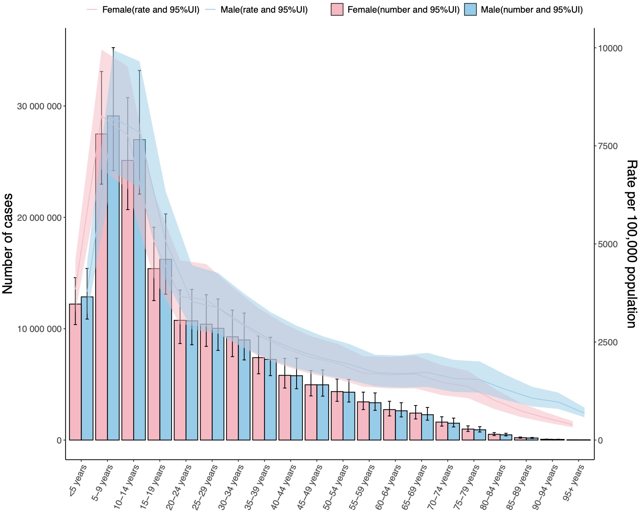
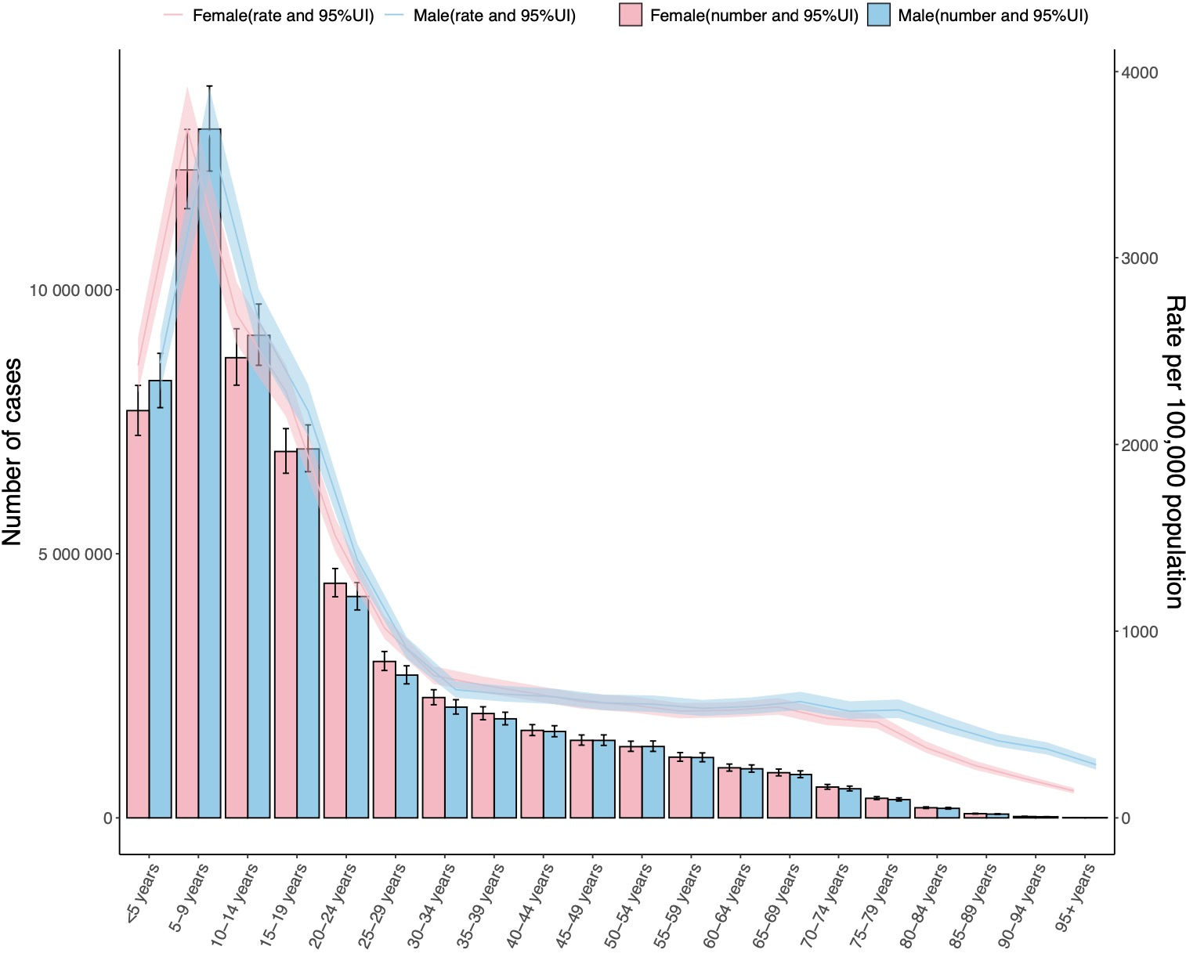
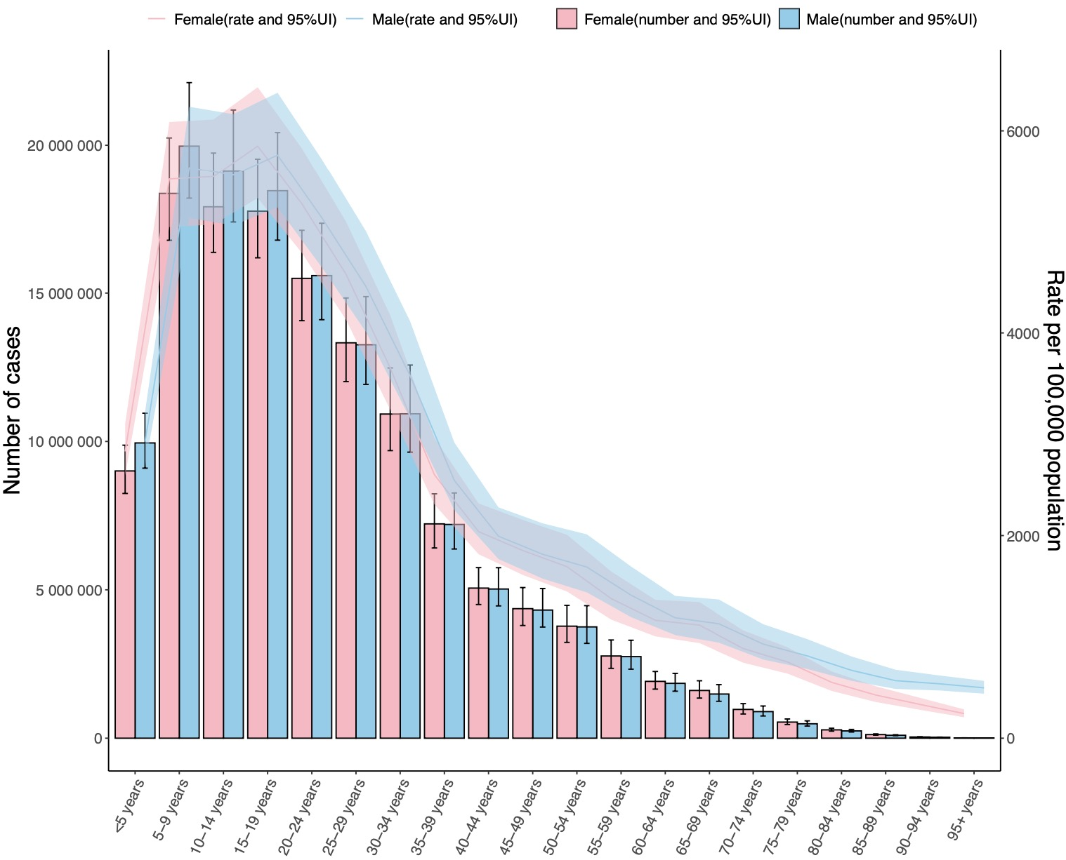
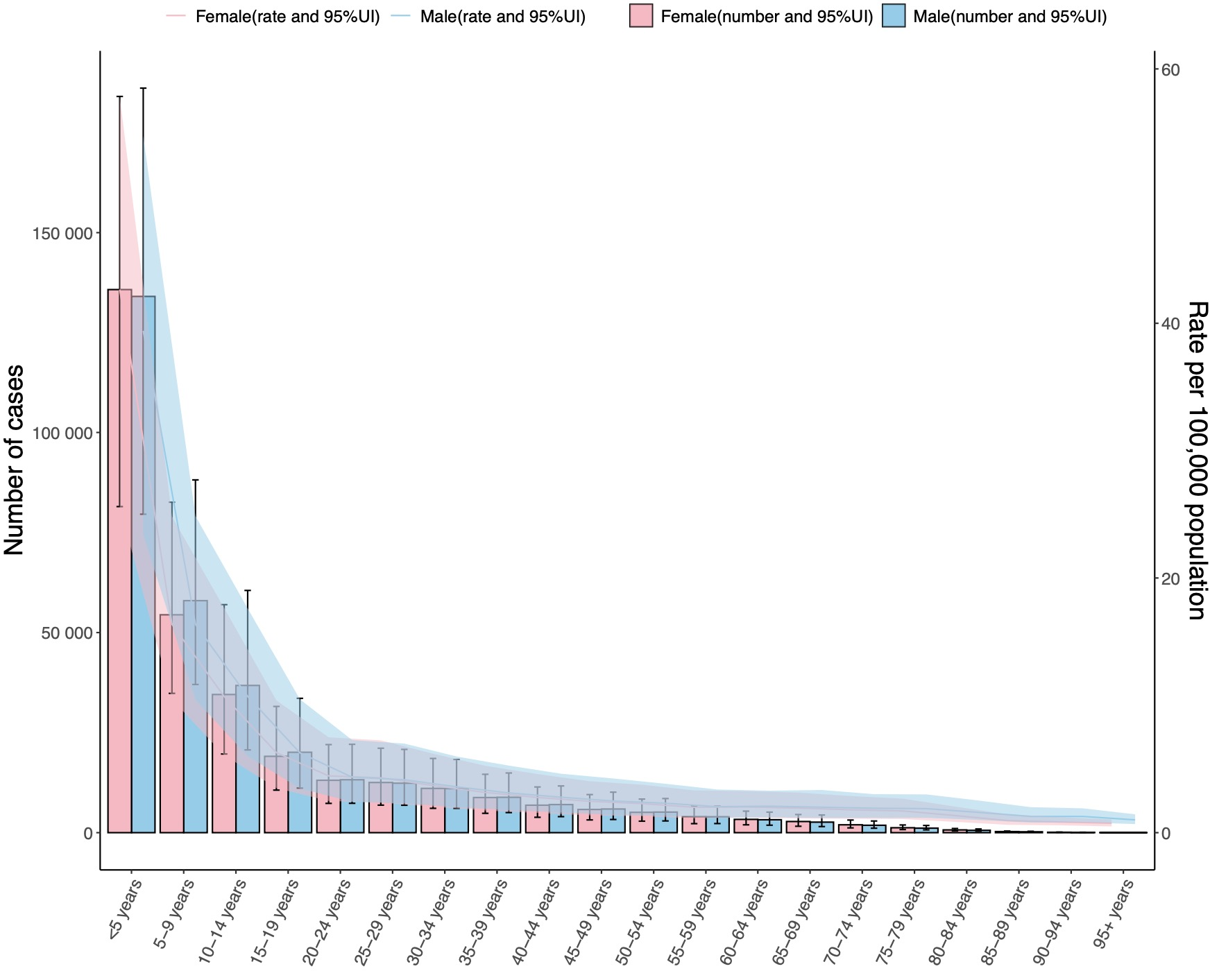
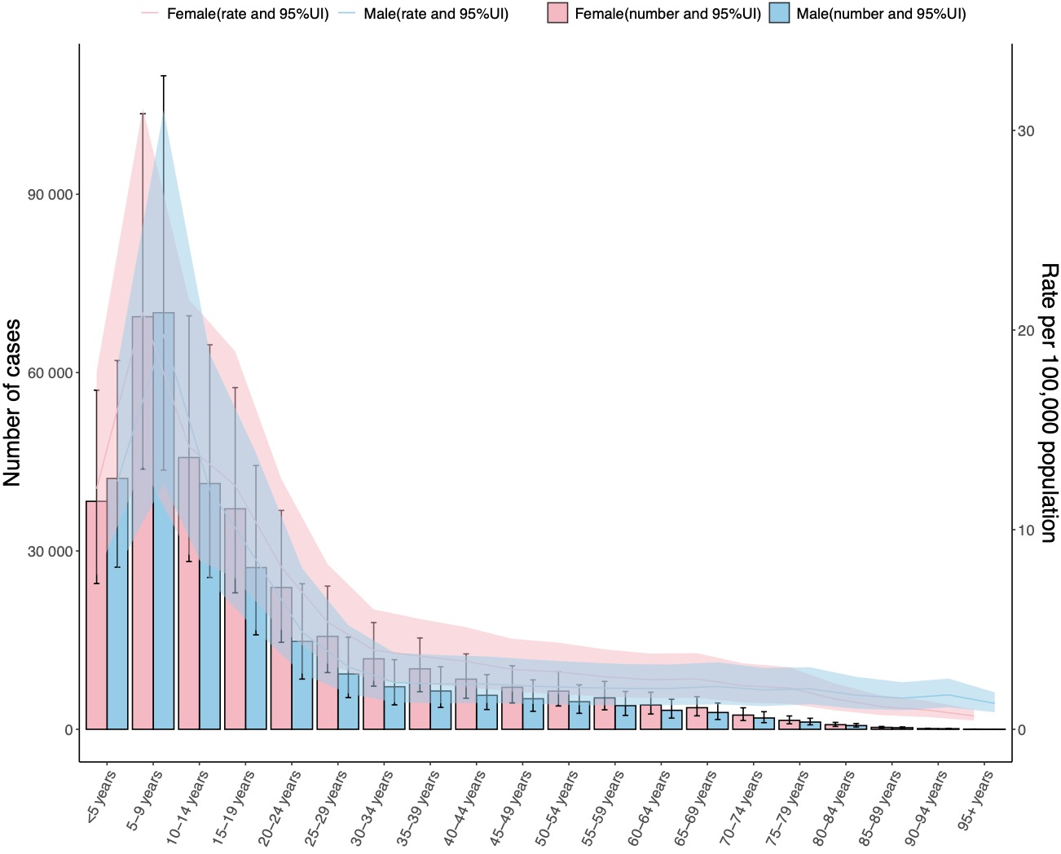
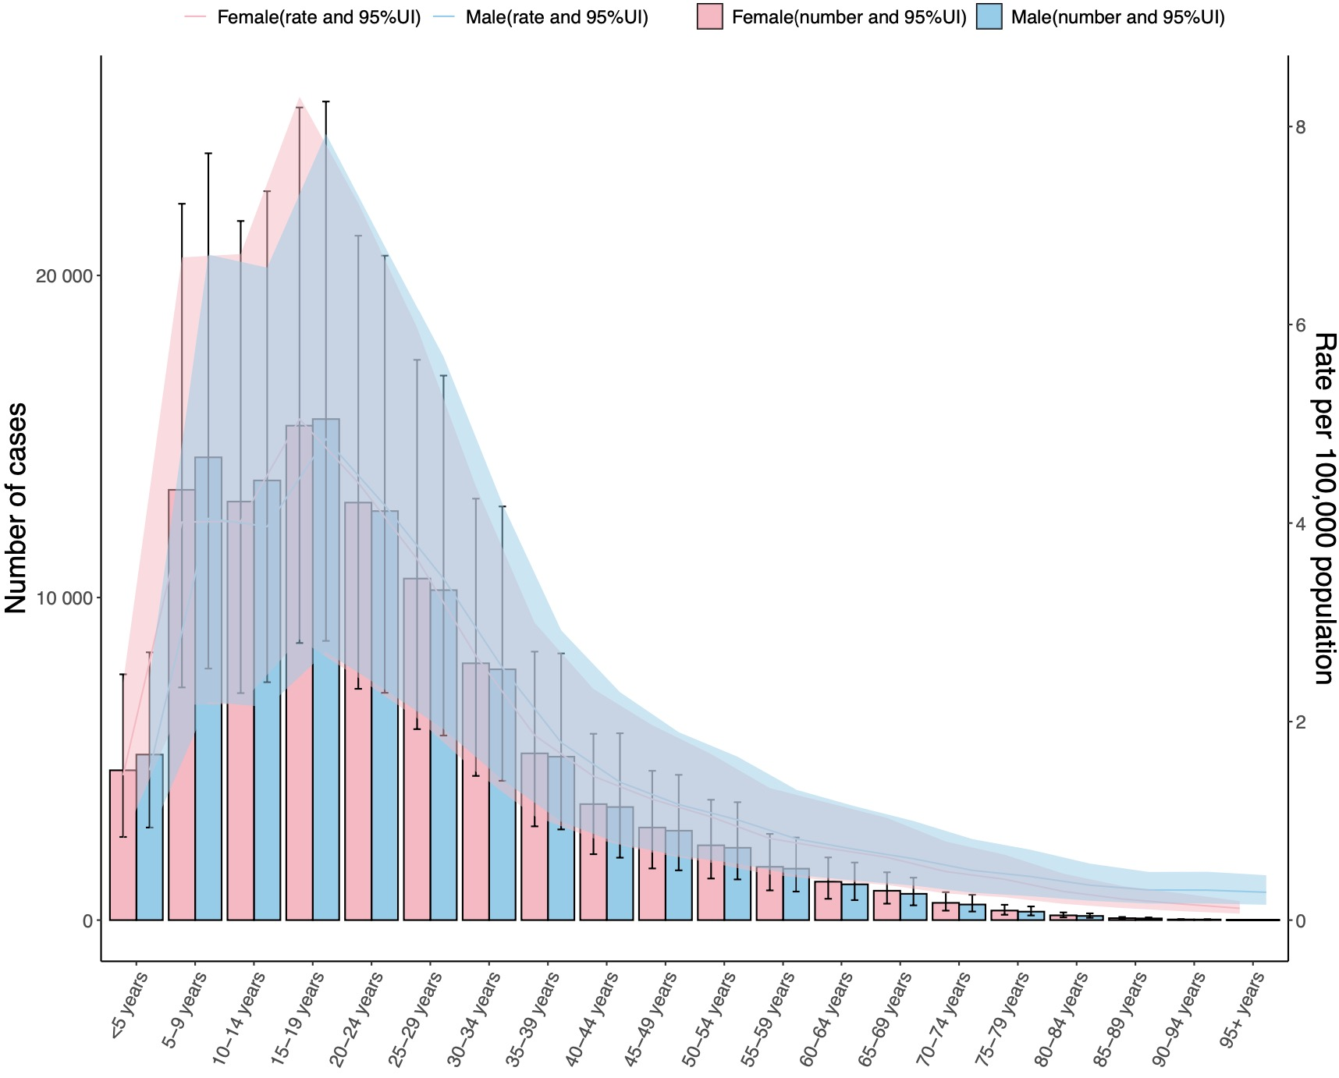
a
b
c
d
e
f
Notes:
Supplementary Figure 2 Age and gender difference in STH-IDPs and specific species infections. a. ASPR of ascariasis, b. ASPR of hookworm disease, c. ASPR of trichuriasis; d. ASR of ascariasis DALYs lost, e. ASR of hookworm disease DALYs lost, f. ASR of trichuriasis DALYs lost.

Slide 2
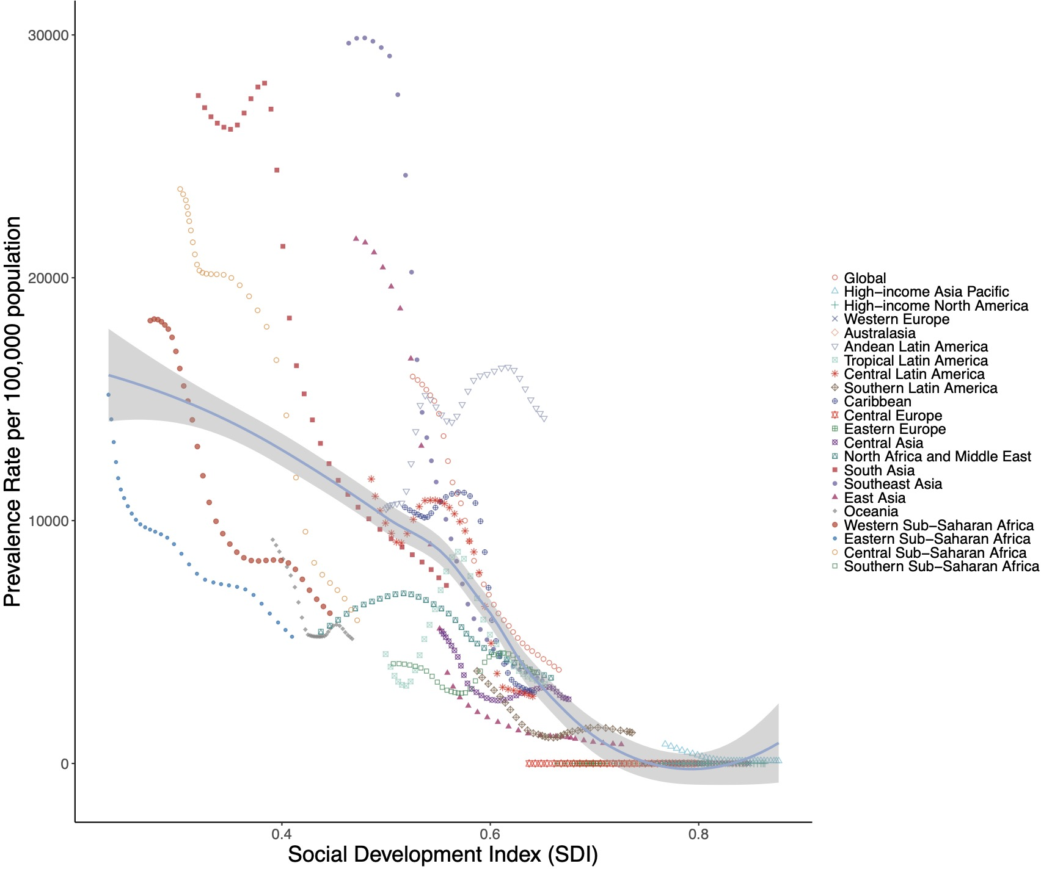
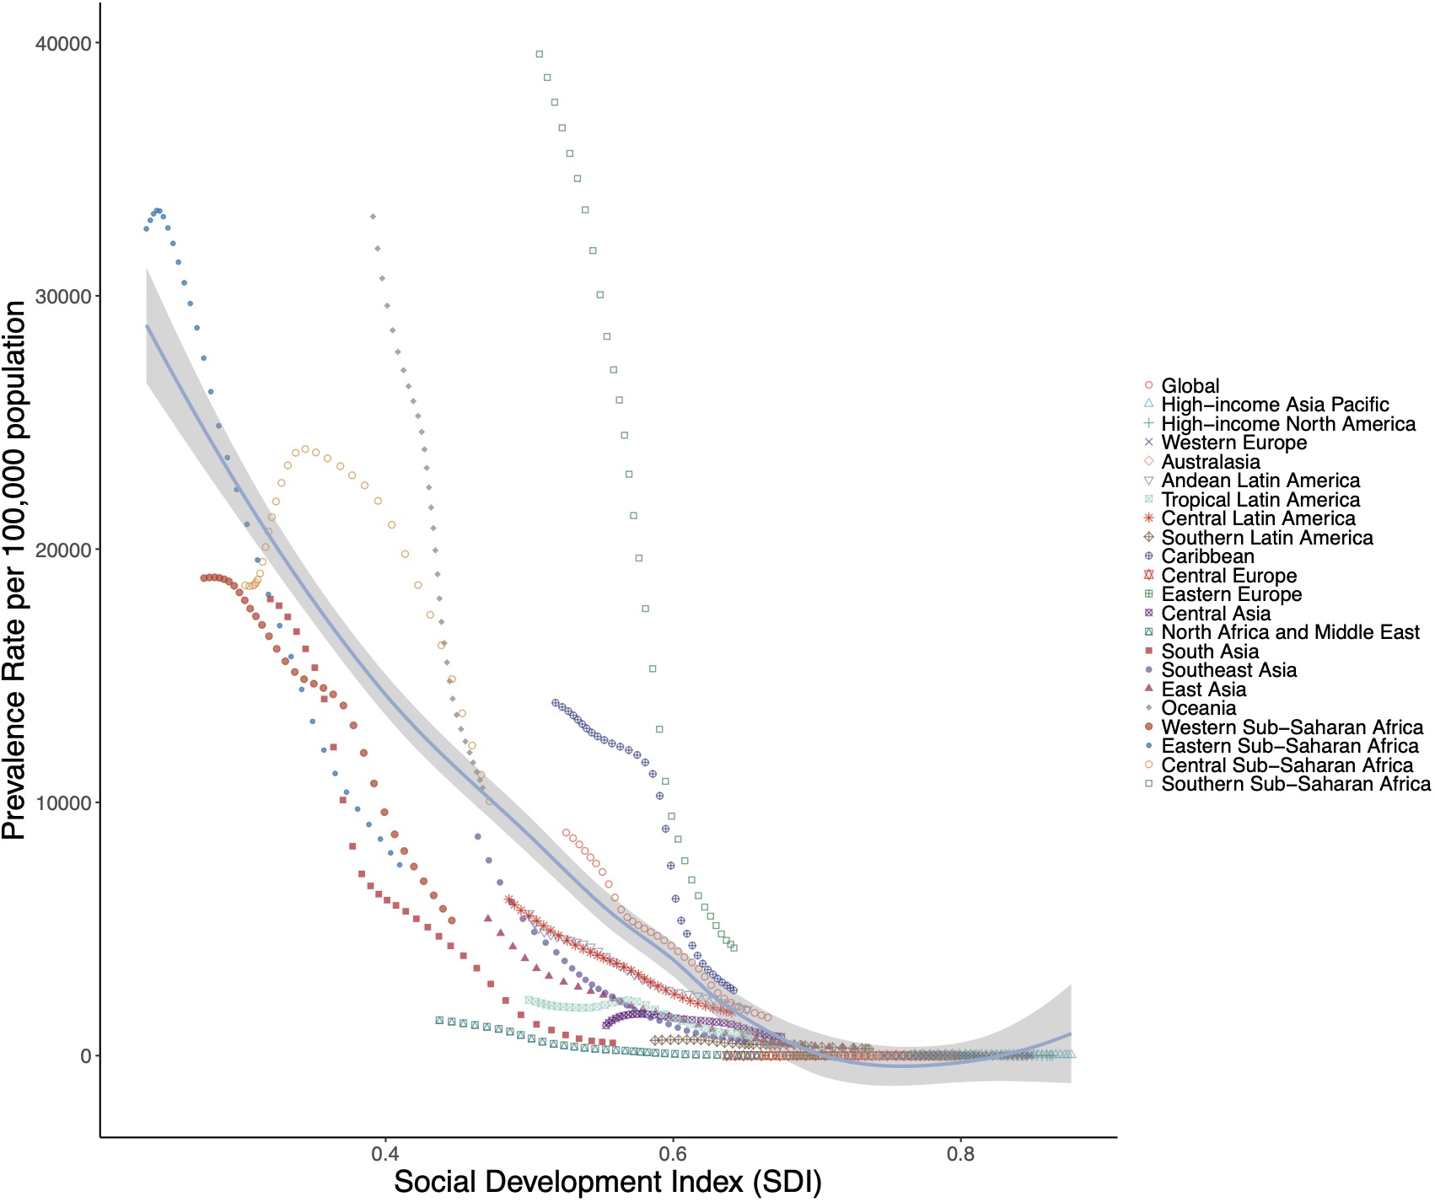
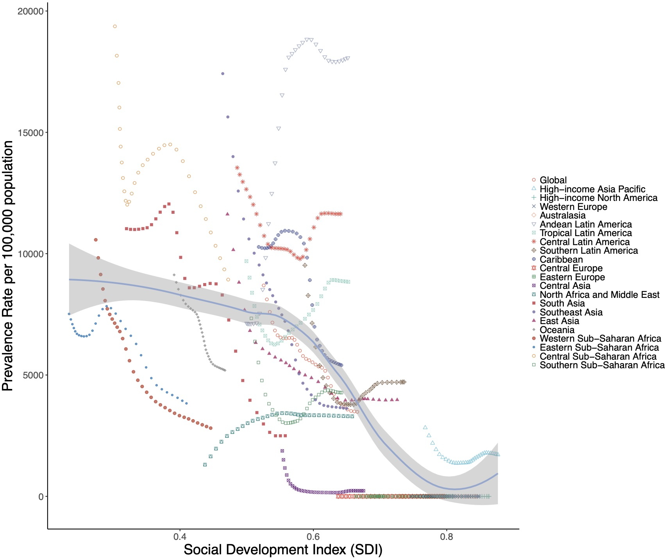
a
b
Notes:
Supplementary Figure 3 ASPR of ascariasis, hookworm disease, and trichuriasis in 21 GBD regions by SDI, 1990–2021

