Slide 1
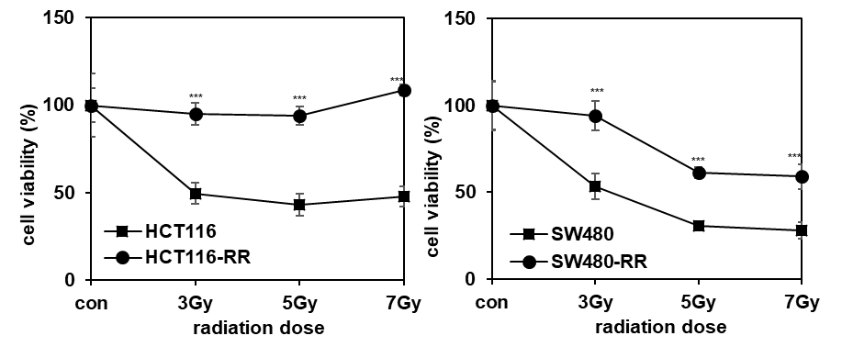
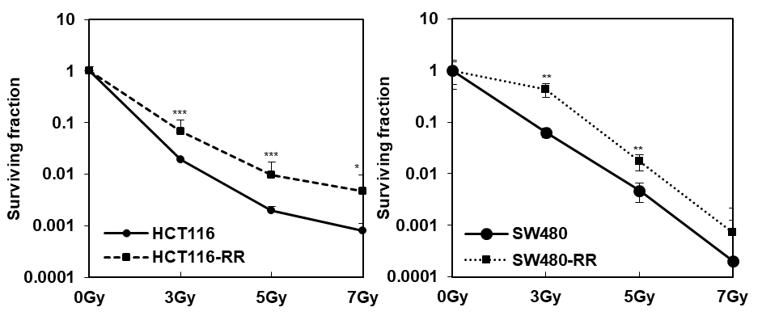
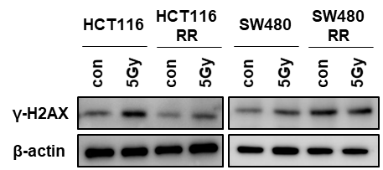
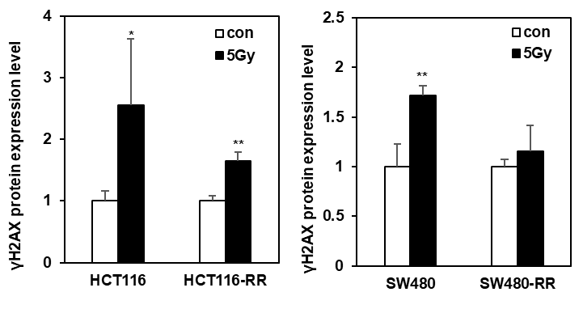
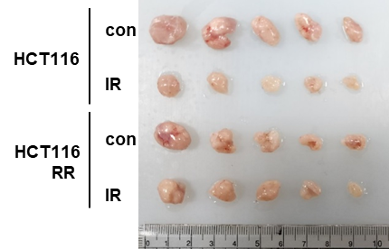
Supplemental Fig. 1
A
B
C
D
*
Tumor size (mm³)
HCT116
HCT116
RR
Supplemental Fig. 1 Characterization of established radioresistant CRC cell lines, HCT116 and SW480. A After indicated cells were exposed to various radiation doses for 96 hours, cell viability was measured using WST-8 assay. B Using clonogenicity assay, the colony formation ability of parental cells and radioresistant cells by various radiation doses was analyzed. C Expression of γ-H2AX was confirmed by Western blot analysis in the indicated cells (left) and quantified graphically (right). D HCT116 and HCT116-RR cells were injected subcutaneously into the flanks of Balb/c nude mice (n = 4; 1x10⁷ cells/mouse). Radiation (5 Gy) was irradiated to tumors of 150-200 mm³. At two weeks after radiation exposure, tumor tissues were harvested from sacrificed mice. Images of the entire tumor (left) and tumor volume (right) are shown. Scale bar is 1 cm. The experiment was repeated with triplicates and representative Western blot images are shown. The data are presented as the mean ± S.D. after triplicate. *P < 0.05; **P < 0.01; ***P < 0.001. Student`s t-test.

Slide 2
Supplemental Fig. 2
SW480
***
***
*
*
Supplemental Fig. 2 Expression of miR-1226-5p is enhanced in radioresistant SW480 cells. The expression of six candidate miRNAs (miR-3529-3p, miR-522-3p, miR-4706, miR-3184-3p, miR-1237, and miR-1226-5p) was measured by qRT-PCR in SW480 and SW480-RR cells. The data are presented as the mean ± S.D. after triplicate. *P < 0.05; ***P < 0.001. Student`s t-test.

Slide 3
Supplemental Fig. 3
A
HCT116
B
SW480
***
***
***
***
*
***
Supplemental Fig. 3 Accumulated irradiation increases the expression of miR-1226-5p. The expression of miR-1226-5p was measured by qRT-PCR at various passages during the generation of radioresistant HCT116 (A) and SW480 (B) cells. The data are presented as the mean ± S.D. after triplicate. *P < 0.05; ***P < 0.001. Student`s t-test.

Slide 4
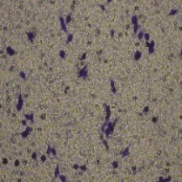
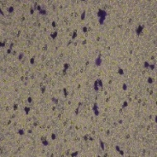
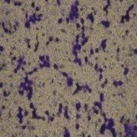
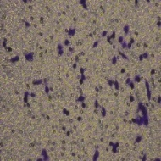
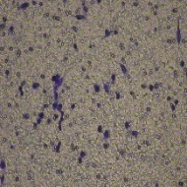
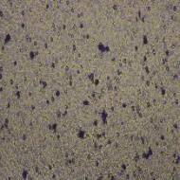
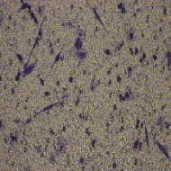
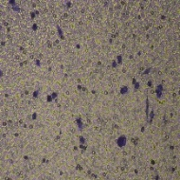
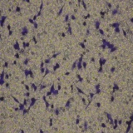
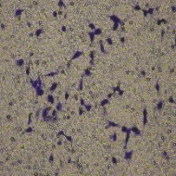
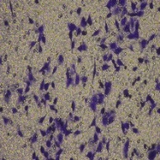
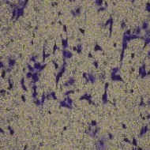
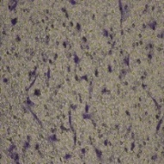
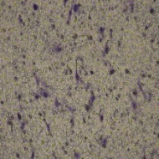
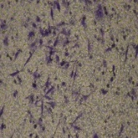
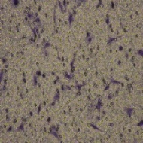
Supplemental Fig. 4
A
Transwell migration
NC
si ZEB1
miR-1226-5p
miR+si ZEB1
HCT116
SW480
B
Invasion
NC
si ZEB1
miR-1226-5p
miR+si ZEB1
HCT116
SW480
Supplemental Fig. 4 miR-1226-5 promotes cell mobility and invasiveness by inducing ZEB1. HCT116 and SW480 cells were transfected with siRNA against Zeb1 and miR-1226-5p alone or together. HCT116 and SW480 cells were co-transfected with miR-1226-5p in the presence and absence of siRNA targeting ZEB1. Transwell migration (A) and matrigel-coated invasion assays (B) were performed on the indicated cells and representative images of the graphs in Fig. 1P and Q are shown.

Slide 5
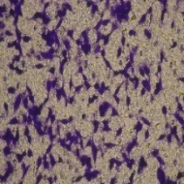
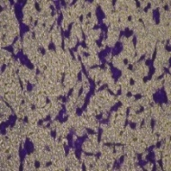
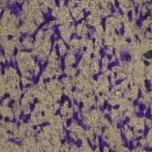
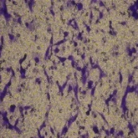
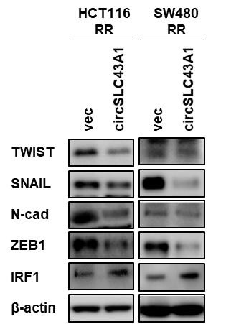
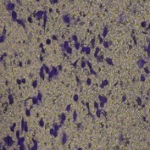
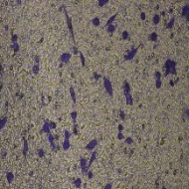
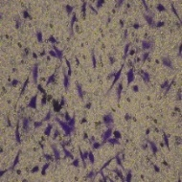
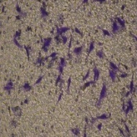
Supplemental Fig. 5
A
B
Transwell migration
C
Invasion
vec
circSLC43A1
vec
circSLC43A1
HCT116
RR
HCT116 RR
SW480
RR
SW480
RR
**
**
*
*
Supplemental Fig. 5 Overexpression of circSLC43A1 suppresses EMT, mobility and invasiveness in radioresistant CRC cells. A-C HCT116-RR and SW480-RR cells were transfected with circSLC43A1 overexpression vector. A The expression of TWIST, SNAIL, N-cadherin, ZEB1, and IRF1 in the indicated cells was confirmed through Western blot analysis. The indicated cells of HCT116-RR and SW480-RR were subjected to transwell migration (B) and matrigel-coated invasion assays (C). The experiment was repeated triplicates and representative Western blot images are shown. The data are presented as the mean ± S.D. *P < 0.05; ** P< 0.01. Student`s t-test.

Slide 6
Supplemental Fig. 6
A
THP-1 MΦ
B
THP-1 MΦ
***
**
***
***
HCT116 CM
SW480 CM
Supplemental Fig. 6 Inhibition of miR-1226-5p by circSLC43A1 in CRC cells prevents M2 polarization of macrophages. THP-1-derived macrophages were treated with conditioned media from HCT116 (A) and SW480 (B) cells overexpressing miR-1226-5p and circSLC43A1. The mRNA expression of TGF-β in the indicated cells was measured by qRT-PCR. The data are presented as the mean ± S.D. **P < 0.01; ***P < 0.001. One-way ANOVA followed by bonferroni comparison test.

Slide 7
Supplemental Fig. 7
THP-1 MΦ
***
***
Supplemental Fig. 7 miR-1226-5p induces the expression of TGF-β through increasing STAT6 in THP-1-derived macrophages. After THP-1-derived macrophages were transfected with miR-1226-5p and siRNA targeting STAT6, TGF-β expression was measured by qRT-PCR. The data are presented as the mean ± S.D. ***P < 0.001. One-way ANOVA followed by bonferroni comparison test.

