Slide 1
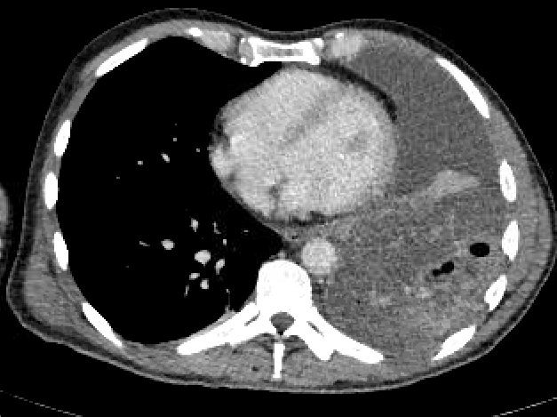
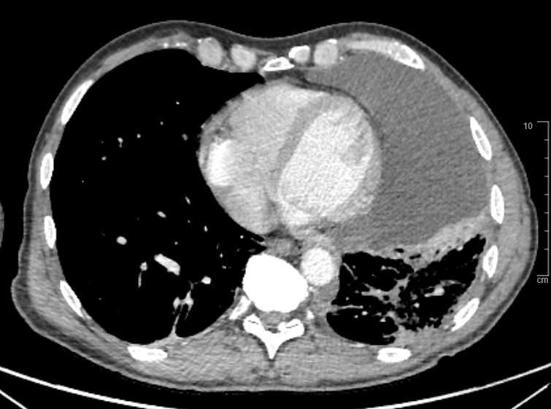
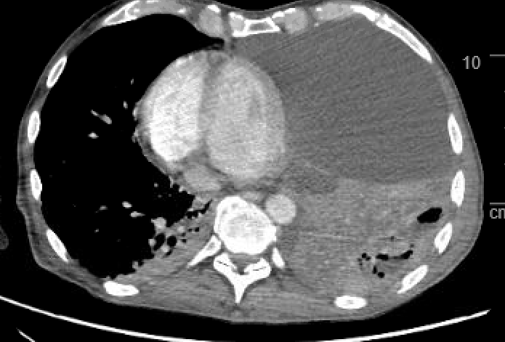
ST1056, Lung adenocarcinoma
Baseline erdafitinib
Erdafitinib response
Erdafitinib PD
WES/RNA-seq
on pleural effusion
FGFR2::TACC2
FGFR2 N550K
FGFR2 V565L
Supplementary Figure S1. Clinico-radiological and molecular evolution of patient ST1056,
suffering from a FGFR2-rearranged lung adenocarcinoma.
The ctDNA findings are reported as variant allele frequency (VAF, %).
PD: Progressive disease.

