Slide 1
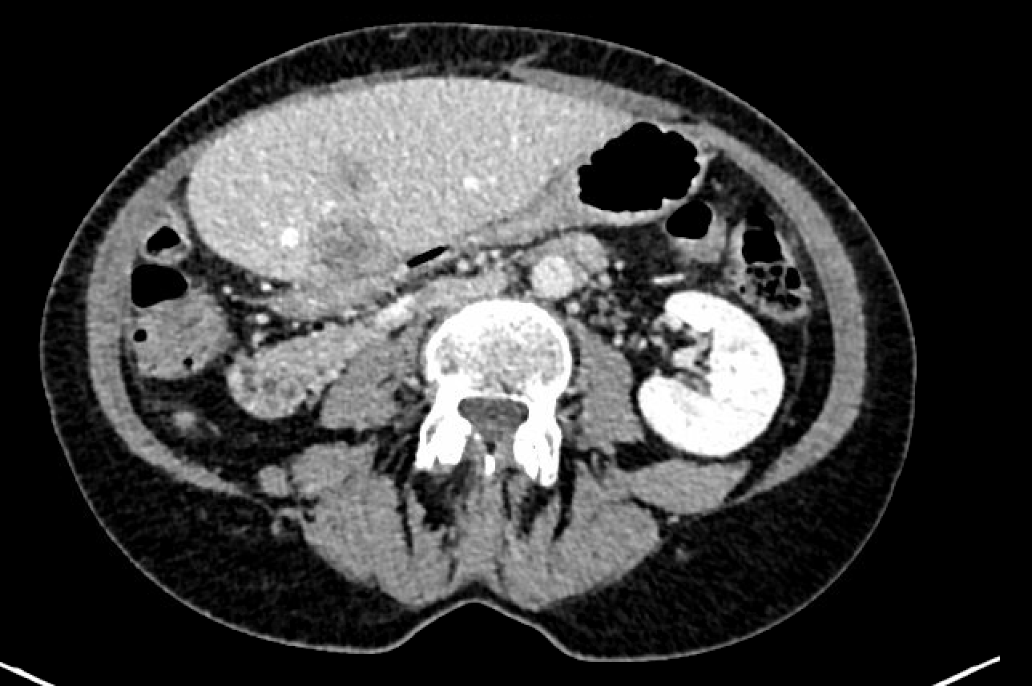
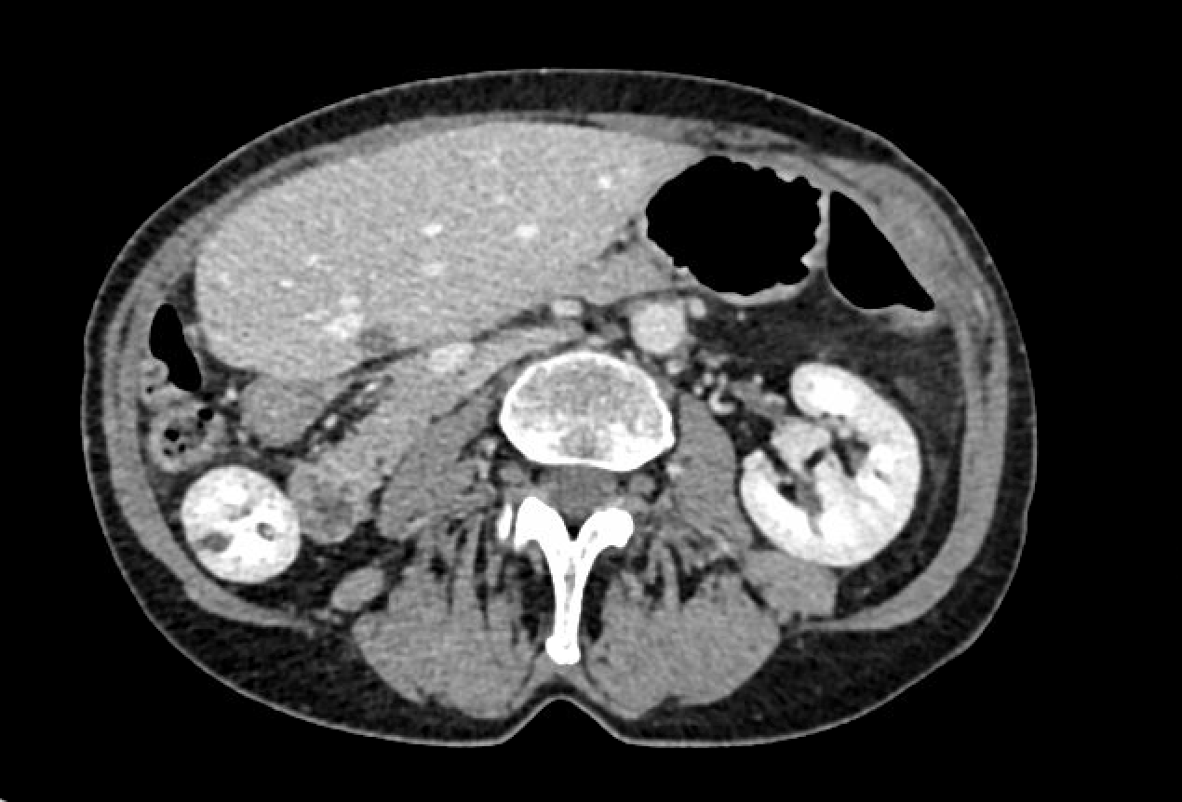
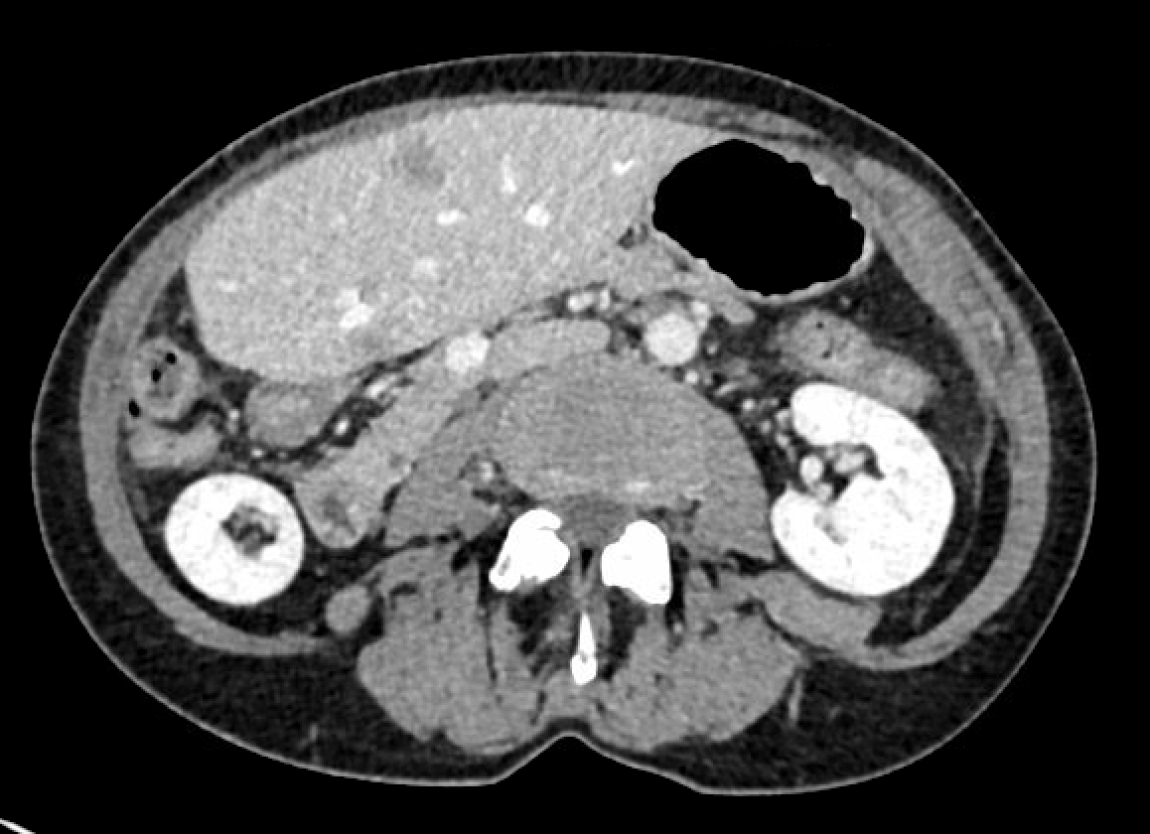
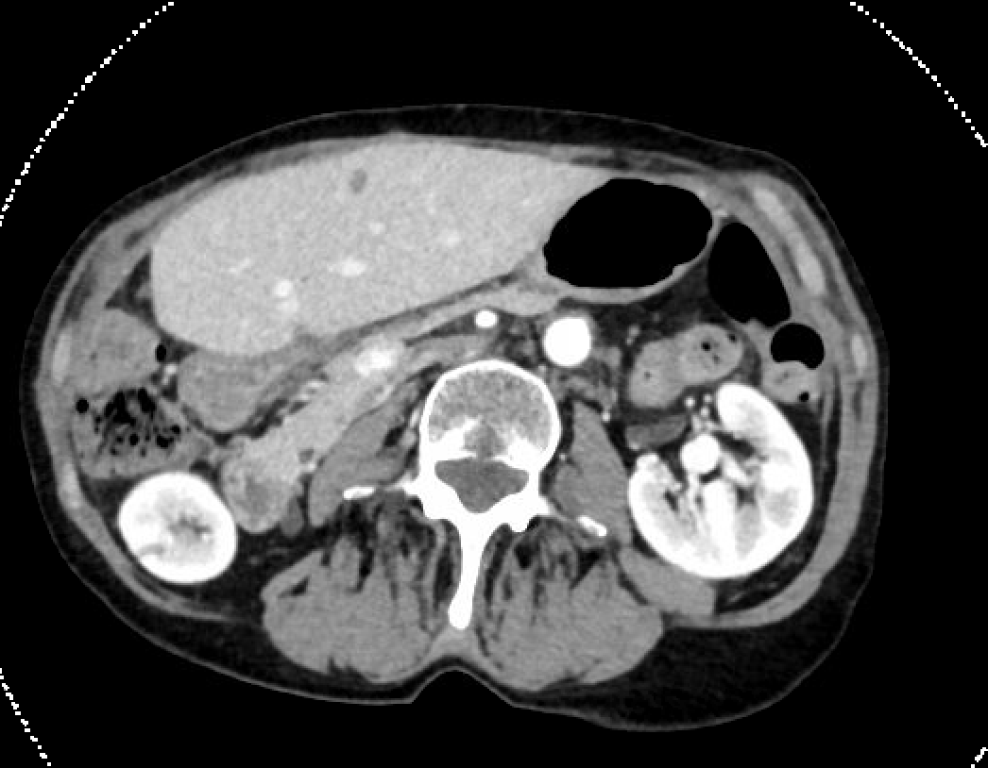
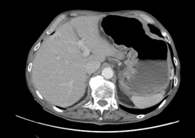
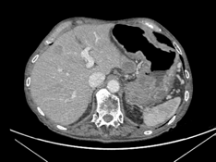
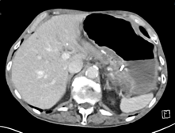
A. MR822, Intrahepatic cholangiocarcinoma
Baseline pemigatinib
Pemigatinib PR
Pemigatinib PD
Lirafugratinib PR
B. MR1154, Pancreatic ductal adenocarcinoma
Futibatinib PD
Futibatinib
beyond PD
Lirafugratinib PR
WES/RNA-seq
FGFR2::CCSER2
Supplementary Figure S4. Clinico-radiological and molecular evolution of patients MR822 (A, FGFR2-rearranged intrahepatic cholangiocarcinoma) and MR1154 (B, FGFR2-rearranged pancreatic ductal adenocarcinoma).
The ctDNA findings are reported as variant allele frequency (VAF, %).
PR: Partial response; PD: Progressive disease; SD: Stable disease.

