Slide 1
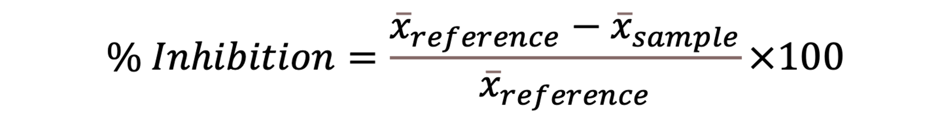
Supplemental formula 1

Slide 2
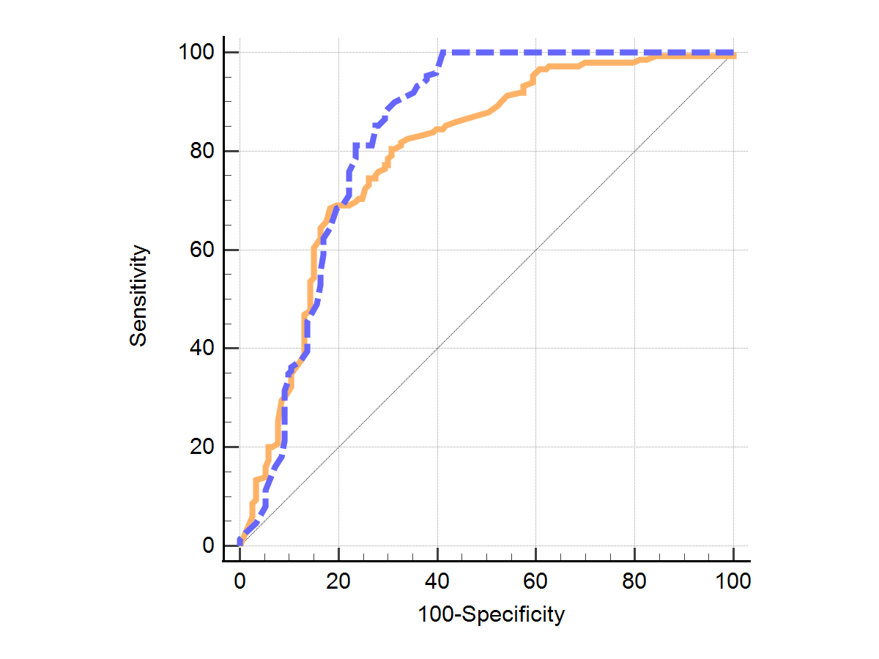
Supplemental figure 1

Slide 3
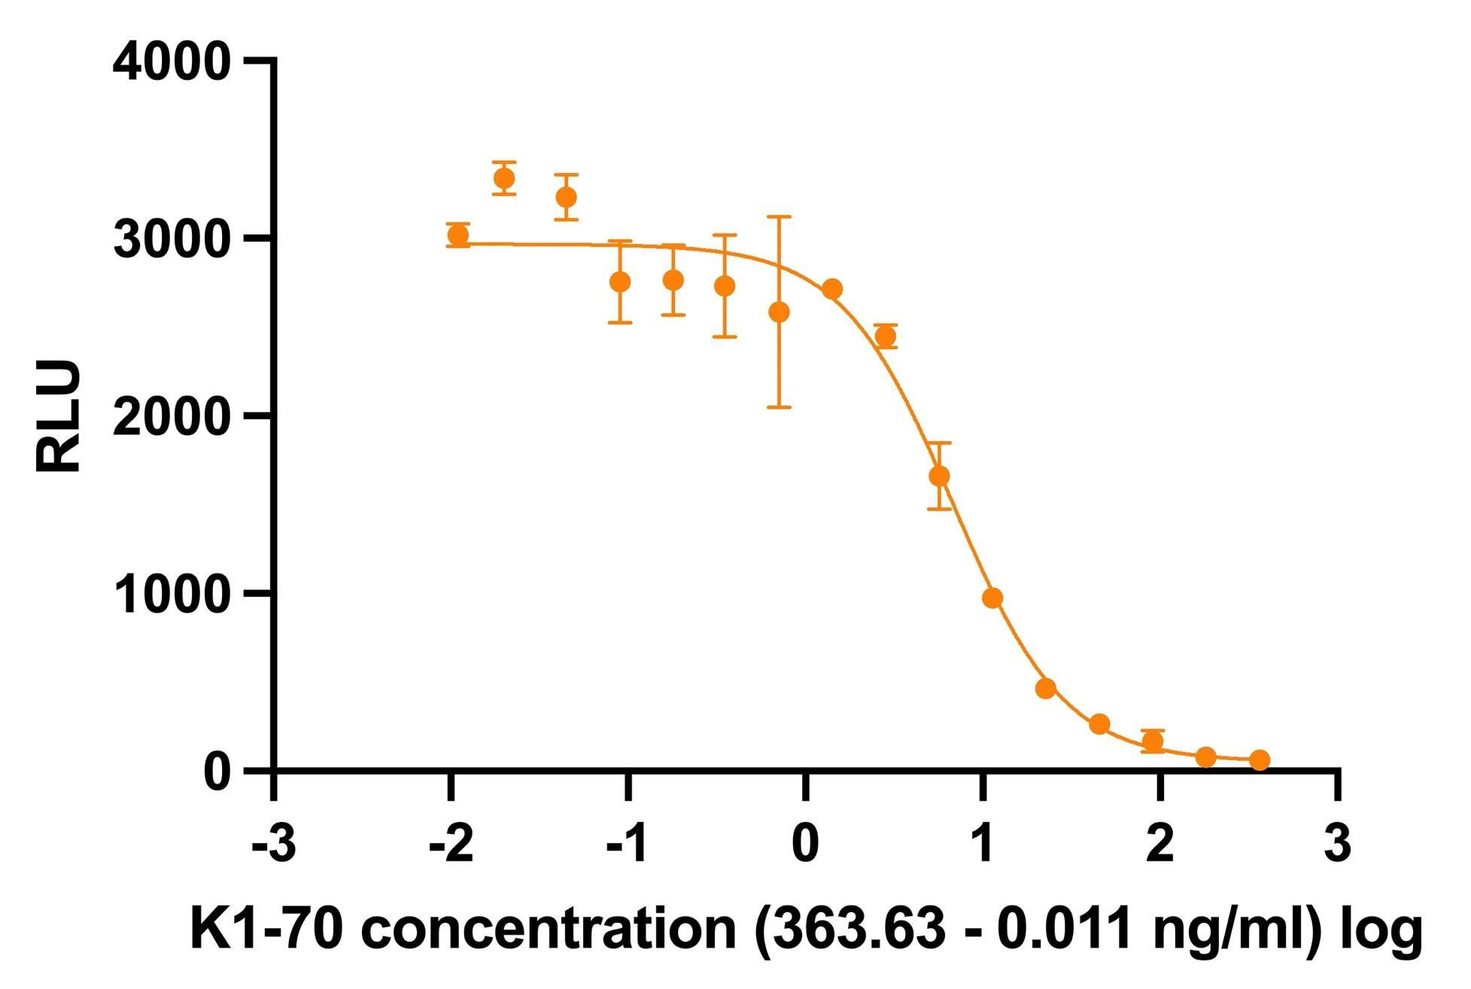
Supplemental figure 2 (A)

Slide 4
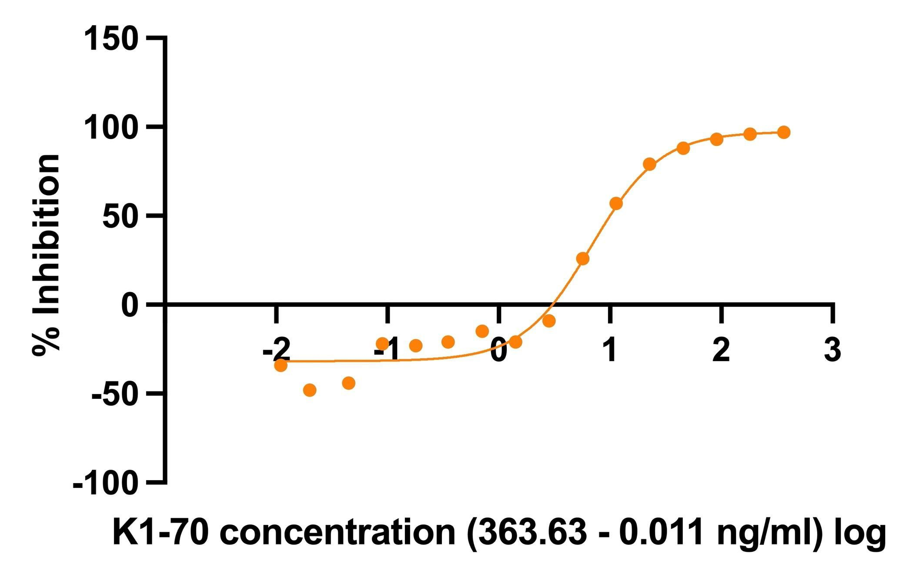
Supplemental figure 2 (B)

Slide 5
Sample | Turbo™ TBI measurements user 1 (% Inhibition) |  |  |  | Average | CV %
 | Day 1 | Day 2 | Day 3 | Day 4
1 | 35 | 30 | 29 | 25 | 29.75 | 13.8
2 | 55 | 58 | 57 | 63 | 58.25 | 5.8
3 | 68 | 61 | 63 | 62 | 63.50 | 4.9
4 | 68 | 71 | 69 | 67 | 68.75 | 2.5
5 | 76 | 75 | 79 | 78 | 77.00 | 2.4
Supplemental table 1

Slide 6
Sample | Turbo™ TBI measurements user 2 (% Inhibition) |  |  |  | Average | CV %
 | Day 1 | Day 2 | Day 3 | Day 4
1 | 23 | 29 | 29 | 35 | 29.00 | 16.9
2 | 54 | 41 | 55 | 60 | 62.25 | 15.4
3 | 53 | 54 | 52 | 53 | 53.00 | 1.5
4 | 66 | 66 | 67 | 62 | 65.25 | 3.4
5 | 72 | 69 | 70 | 73 | 71.00 | 2.6
Supplemental table 2

Slide 7
Sample | Turbo™ TBI measurements Lot 2 (% Inhibition) |  |  |  | Average | CV %
 | Day 1 | Day 2 | Day 3 | Day 4
1 | 23 | 23 | 27 | 22 | 23.75 | 9.3
2 | 45 | 47 | 47 | 50 | 47.25 | 4.4
3 | 45 | 48 | 50 | 50 | 48.25 | 4.9
4 | 54 | 56 | 55 | 54 | 54.75 | 1.8
5 | 71 | 71 | 71 | 71 | 71.00 | 0.0
Supplemental table 3

Slide 8
Turbo TBI Reporter Bioassay inhibition range (% inhibition) | 40 - 50 | 51 - 60 | 61 - 70 | 71 -100 | Total
TPO-Ab positive | 18 / 28 | 16 / 25 | 39 / 51 | 63 / 79 | 136 / 183
 | (64.3%) | (64.0%) | (76.5%) | (79.7%) | (74.3%)
Tg-Ab positive | 12 / 37 | 14 / 32 | 16 / 42 | 28 / 68 | 70 / 179
 | (32.4%) | (43.8%) | (38.1%) | (42.2%) | (39.1%)
Supplemental table 4 (A)

Slide 9
Thyretain TBAb inhibition range (% inhibiton) | 34 - 50 | 51 - 60 | 61 - 70 | 71 - 100 | Total
TPO positive | 10 / 19 | 15 / 22 | 15 / 23 | 86 / 96 | 113 / 139
 | (52.6%) | (68.2%) | (65.2%) | (89.6%) | (81.3%)
Tg-Ab positive | 7 / 21 | 6 / 21 | 8 / 21 | 32 / 72 | 53 / 135
 | (33.3%) | (28.6%) | (38.6%) | (44.4%) | (39.3%)
Supplemental table 4 (B)

