Slide 1
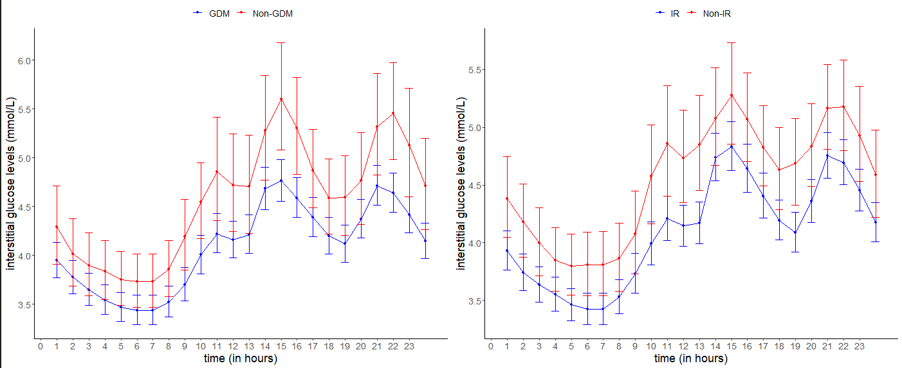
a
b
Additional file 4. The predicted 24-hour interstitial glucose levels for women with at least 10 days of CGM readings by (a) IR (GMR 1.12; 95% CI 1.03, 1.21) and (b) GDM status (1.09; 0.99, 1.20). Red represents the women with GDM or IR status and blue represents the women with non-GDM or non-IR status. The circle markers and capped vertical lines represent the predicted mean glucose levels and the respective 95% CI based on the exponentiated log-transformed hourly median glucose values. CI, confidence intervals; GDM, gestational diabetes mellitus based on 2013 World Health Organization criteria; GEE, generalized estimating equations; GMR, geometrical mean ratio; IR, insulin resistance based on HOMA2-IR of at least 1.22.

