Slide 1
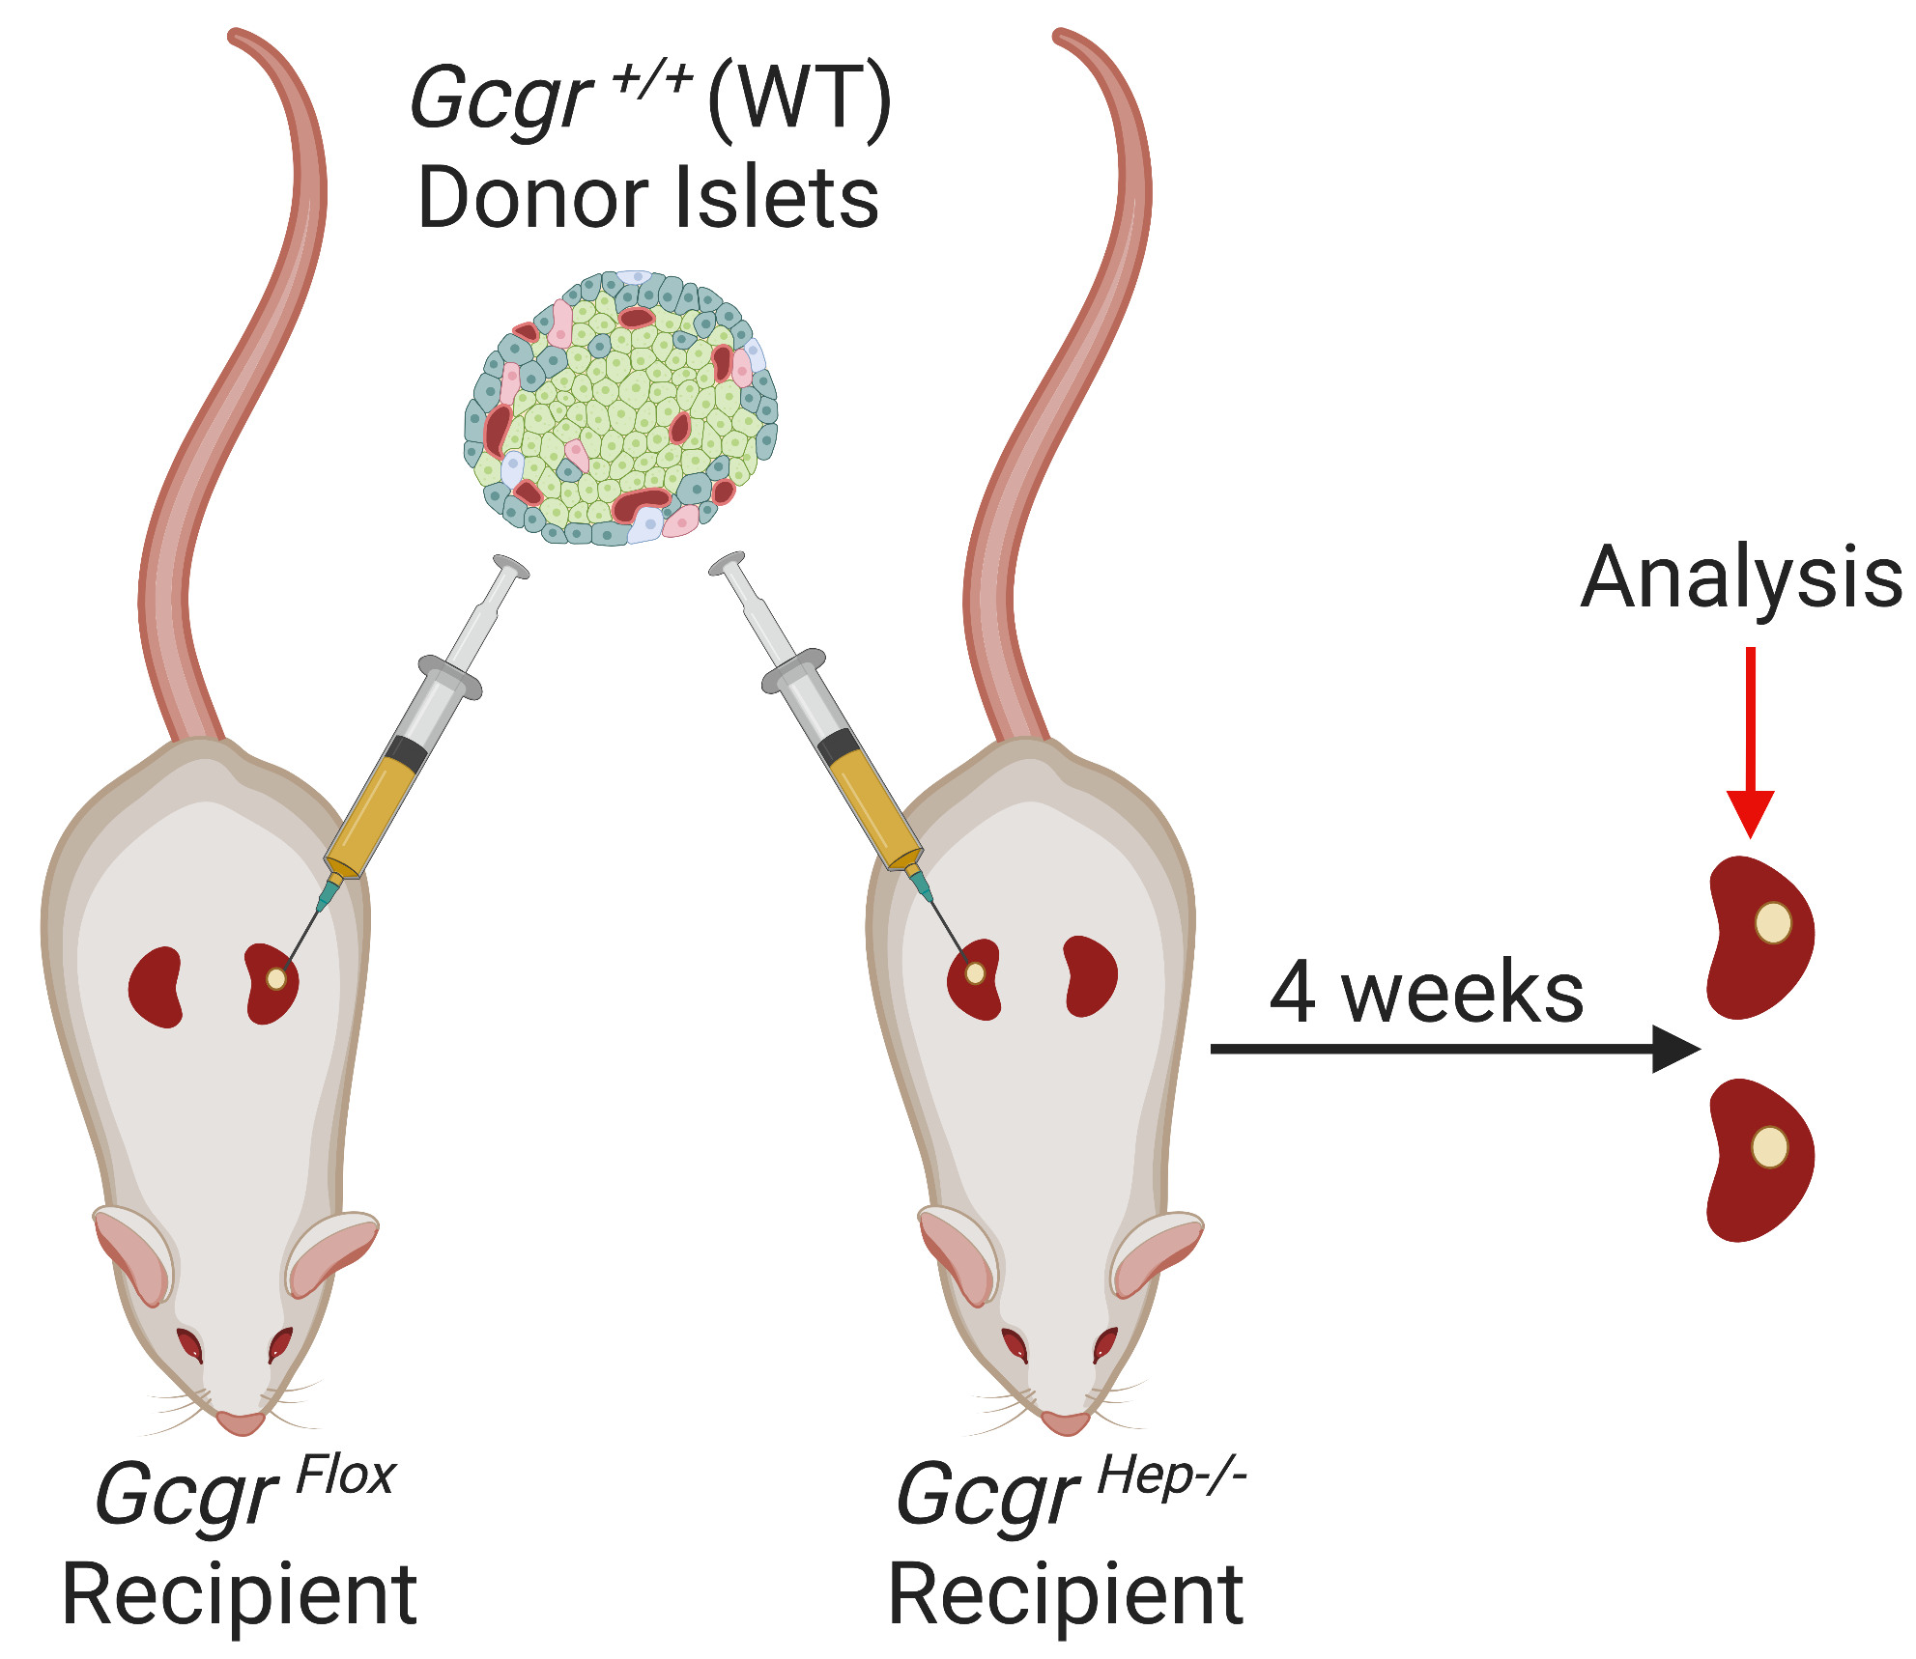
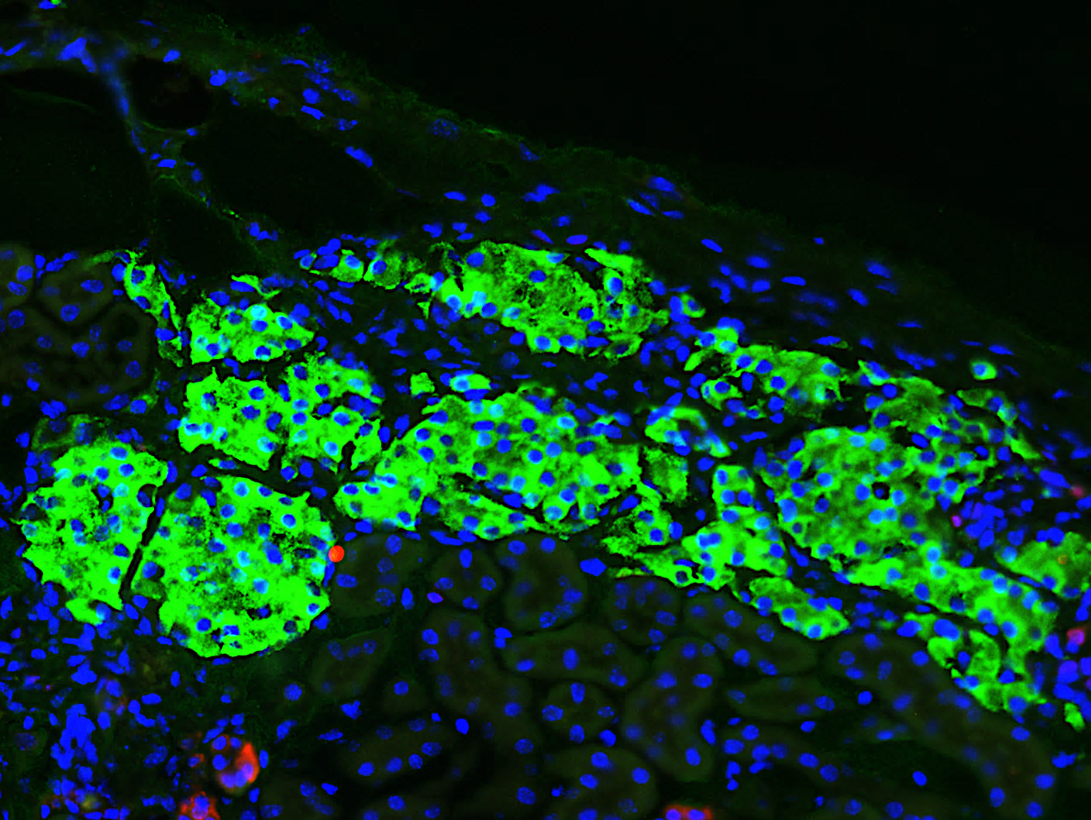
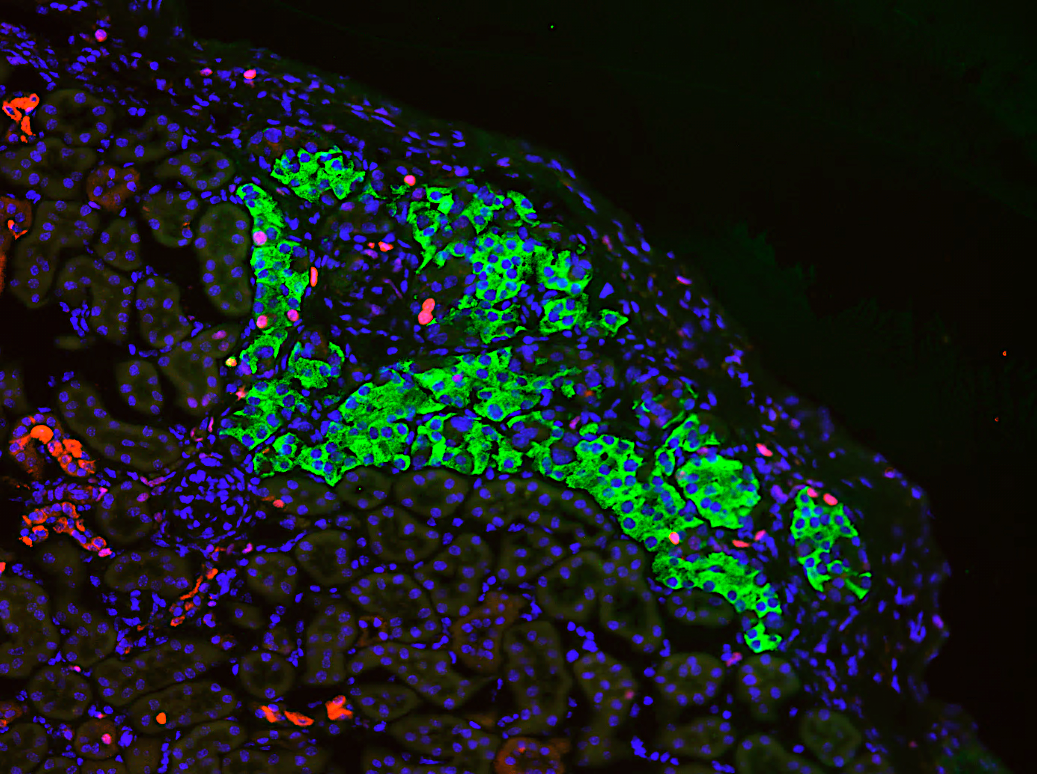
Supplemental Figure 1
A
B
C
D
Insulin / Ki67 / DAPI
E
WT to Flox
WT to Hep^{-/-}

Slide 2
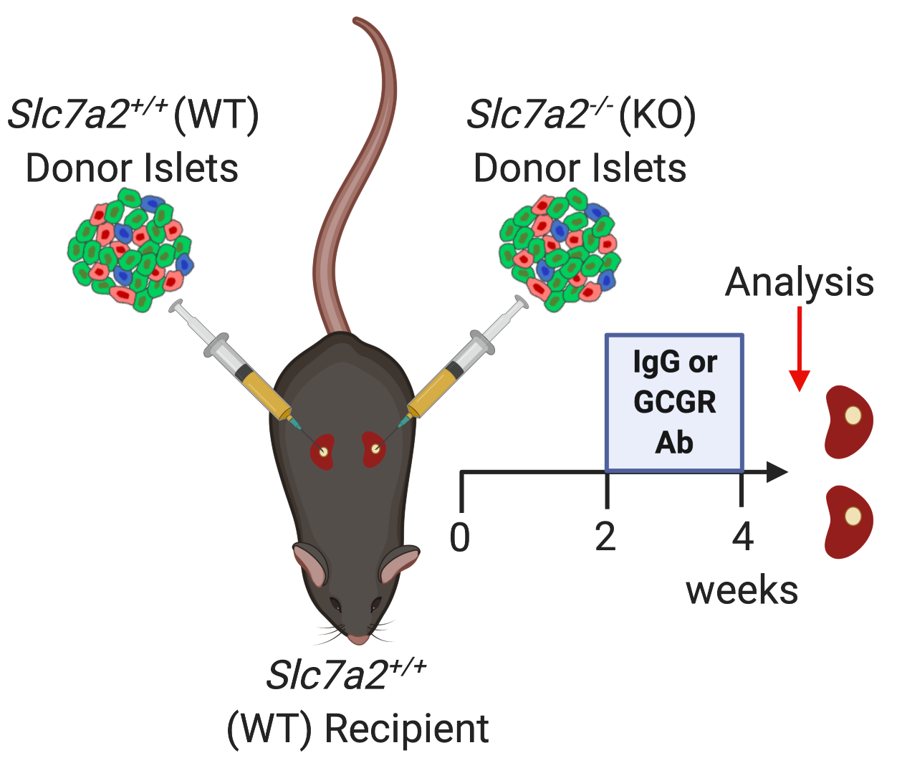
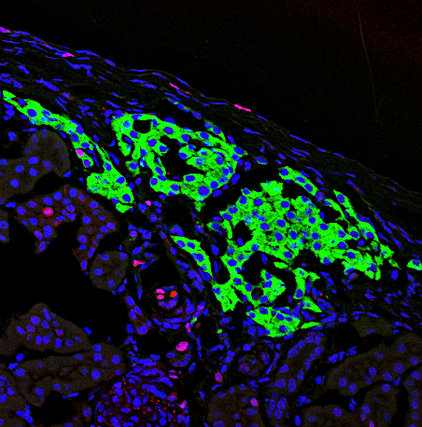
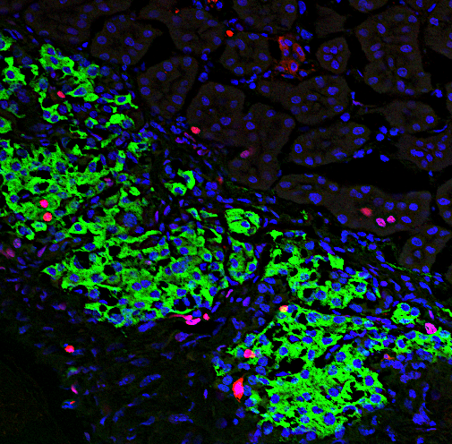
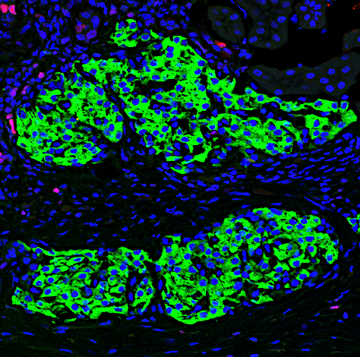
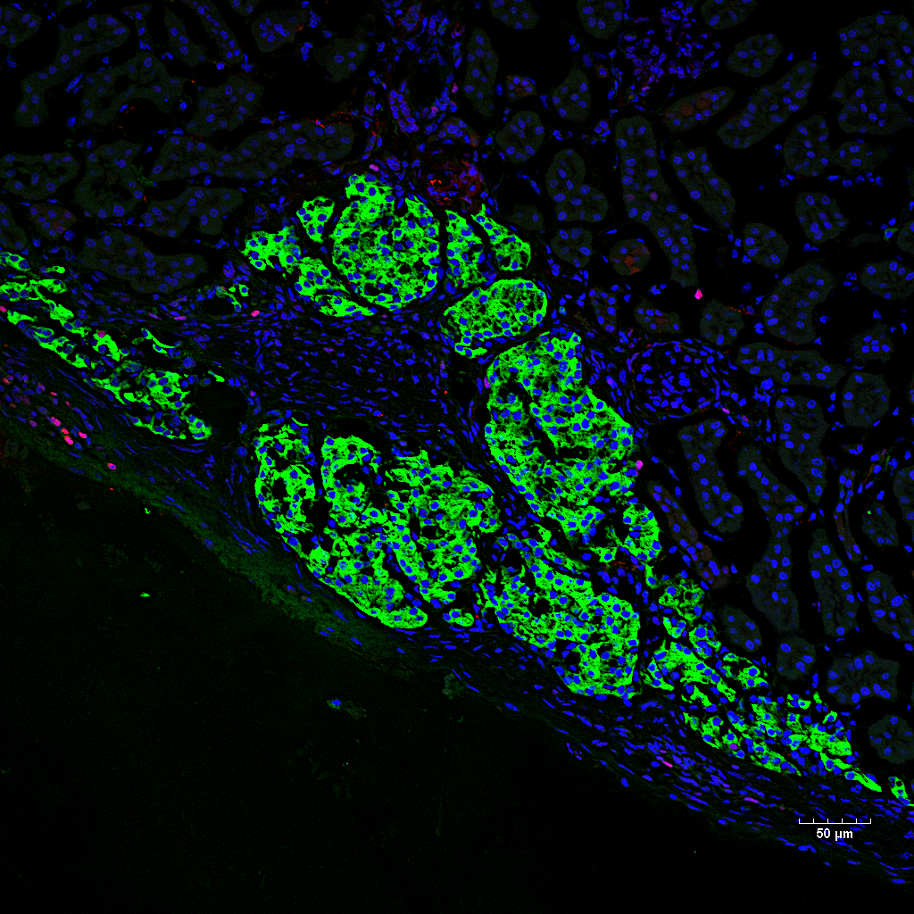
Supp Fig 2: Slc7a2 is required for Gcgr-Ab-induced beta cell proliferation in
transplanted mouse islets
A
B
Insulin / Ki67 / DAPI
IgG
GCGR-Ab
Slc7a2^{+/+}
IgG
GCGR-Ab
C
Slc7a2^{-/-}
100 μm
D

