Slide 1
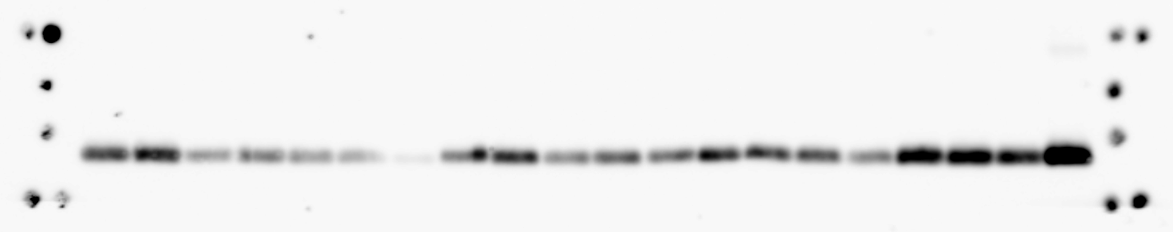
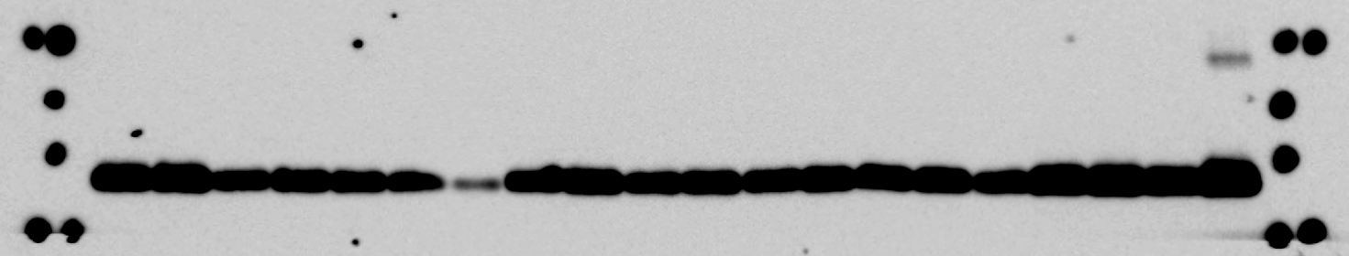
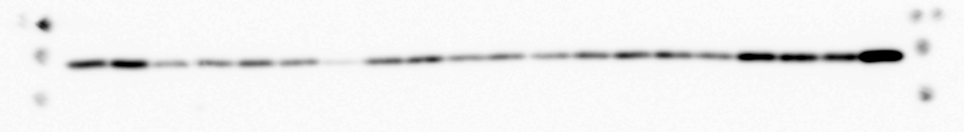
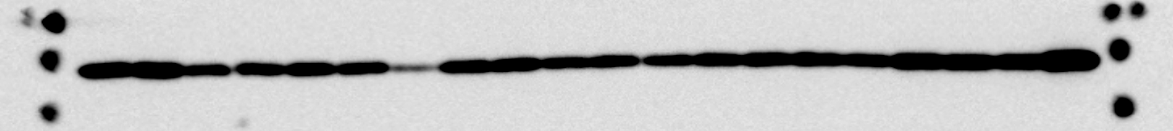
Figure 1
1 2 3 4 5 6 7 8 9 10 11 12 13 14 15 16 17 18 19 20
COX1
short
37
long
37
25
COX2
short
25
long

Slide 2
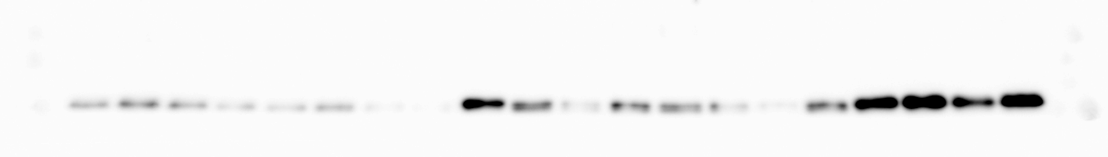
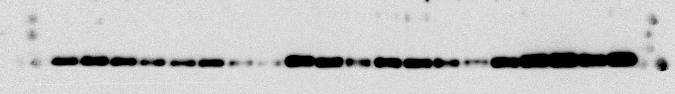
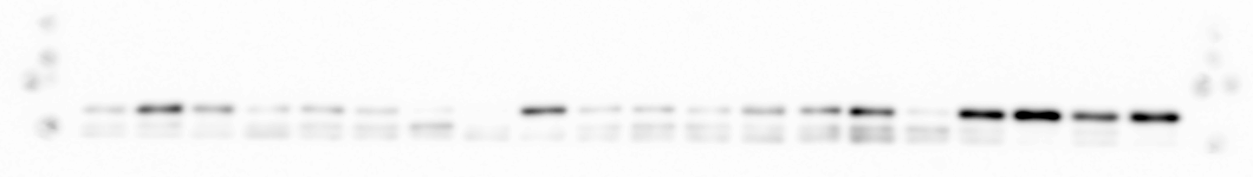
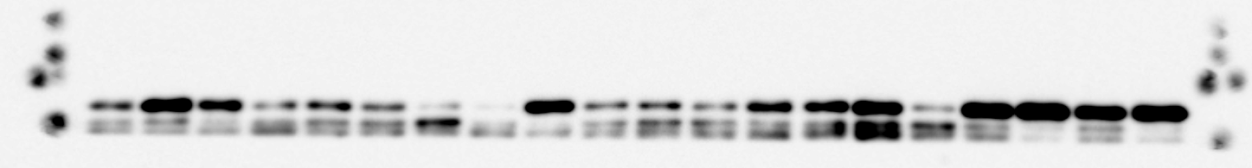
Figure 1
1 2 3 4 5 6 7 8 9 10 11 12 13 14 15 16 17 18 19 20
DRP1
short
75
long
75
GLS1
short
75
75
long

Slide 3
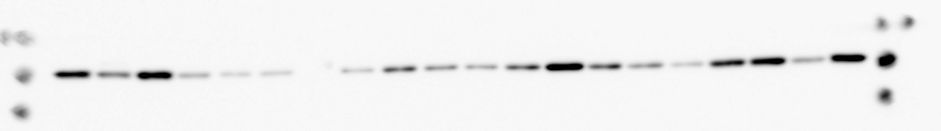
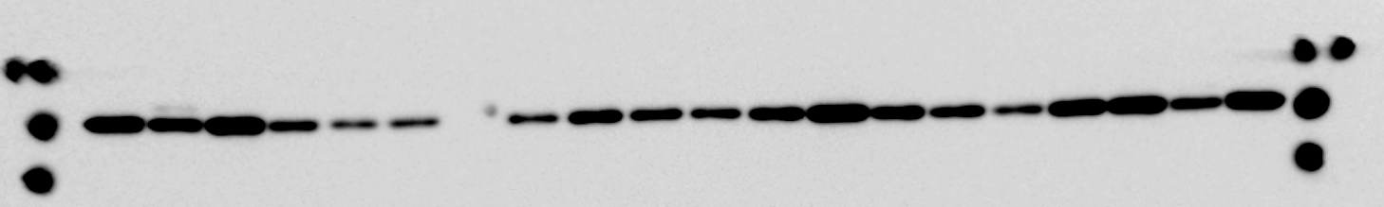
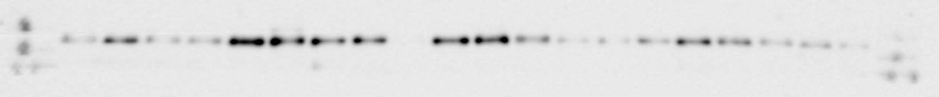
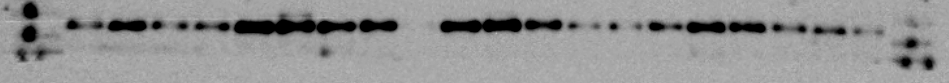
Figure 1
1 2 3 4 5 6 7 8 9 10 11 12 13 14 15 16 17 18 19 20
GLDH
Short
50
long
50
HK2
Short
100
long
100

Slide 4
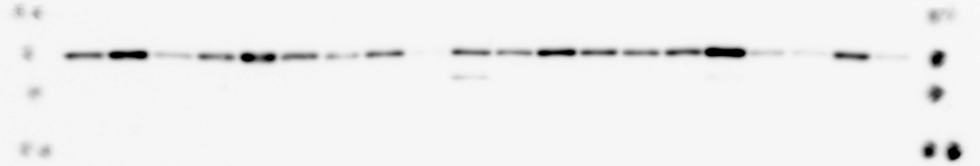
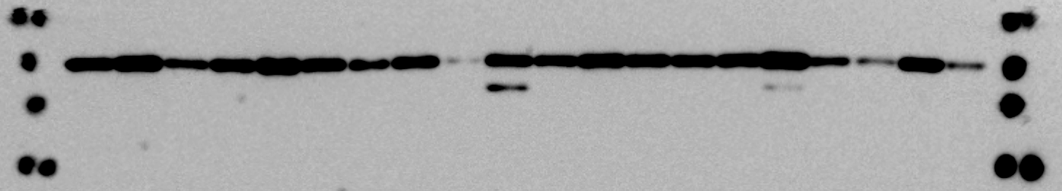
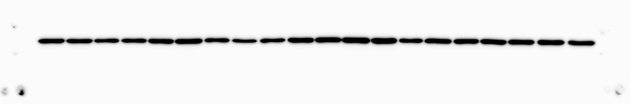
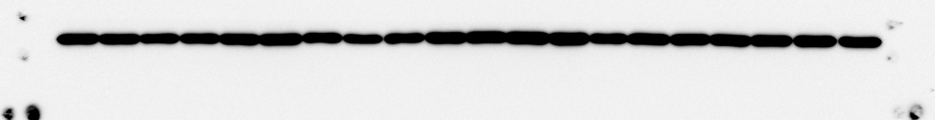
Figure 1
1 2 3 4 5 6 7 8 9 10 11 12 13 14 15 16 17 18 19 20
SHMT2
50
short
long
50
βactin
37
short
long
37

Slide 5
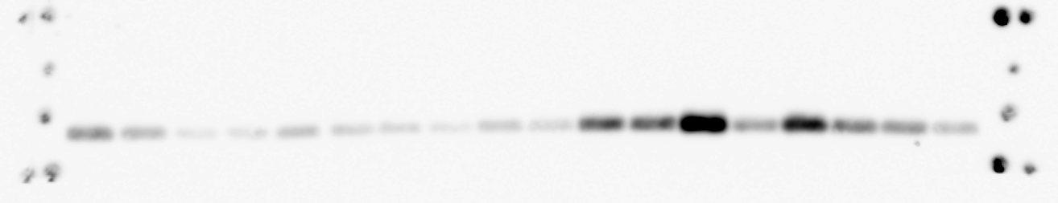
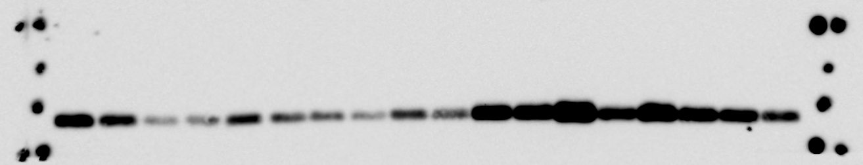
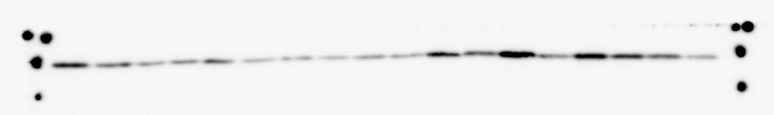
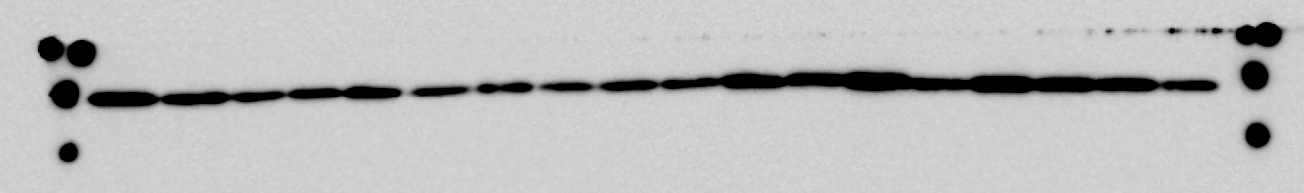
Figure 3
1 21 22 23 24 25 26 27 28 29 30 31 32 33 34 35 36 37
COX1
short
37
long
37
25
COX2
short
25
long

Slide 6
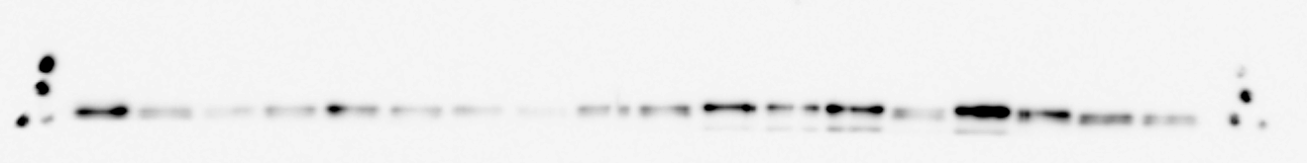
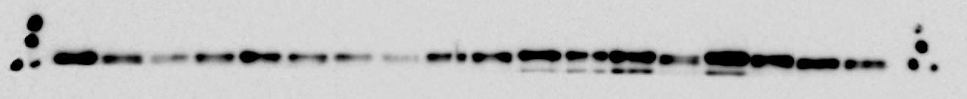
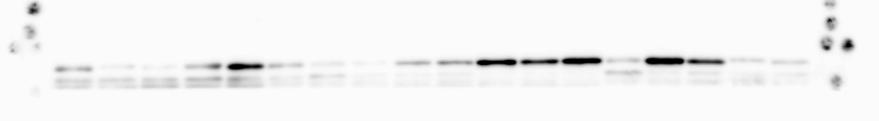
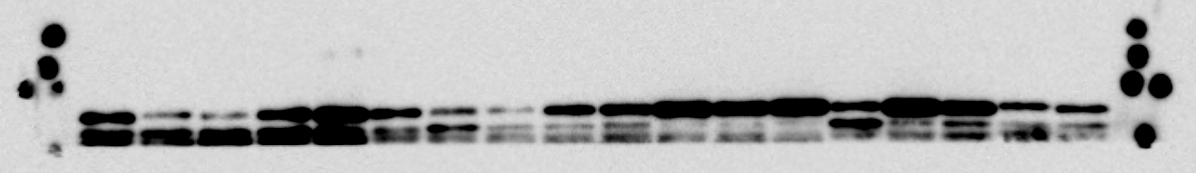
Figure 3
1 21 22 23 24 25 26 27 28 29 30 31 32 33 34 35 36 37
DRP1
short
75
long
75
GLS1
75
short
long
75

Slide 7
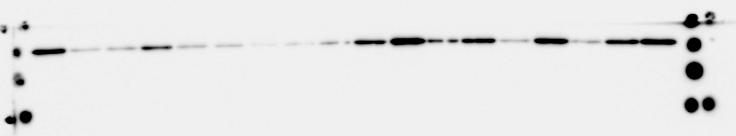
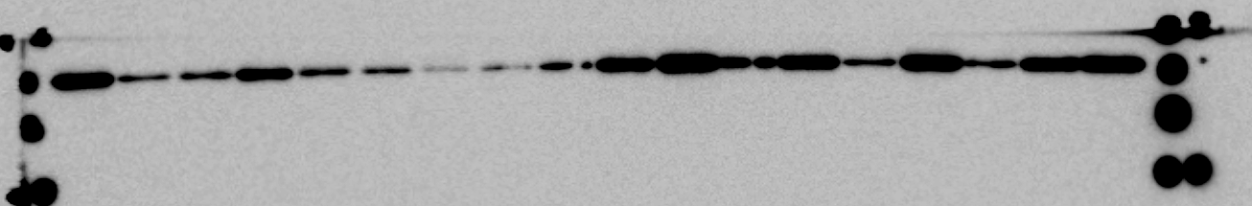
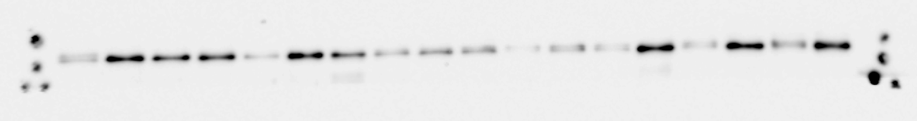
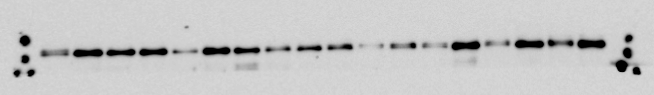
Figure 3
1 21 22 23 24 25 26 27 28 29 30 31 32 33 34 35 36 37
GLDH
50
short
long
50
HK2
short
100
long
100

Slide 8
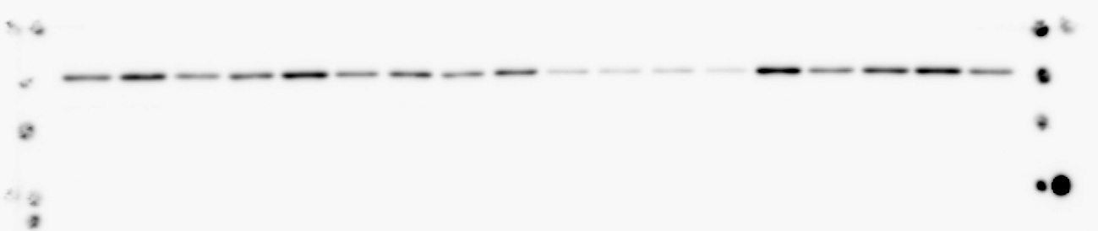
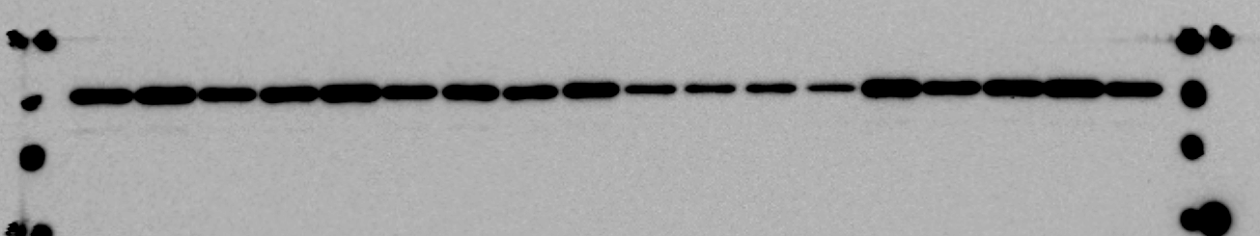
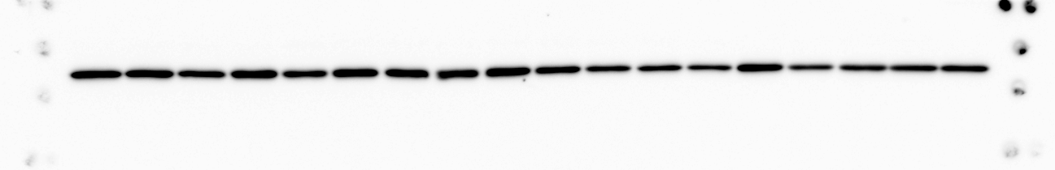
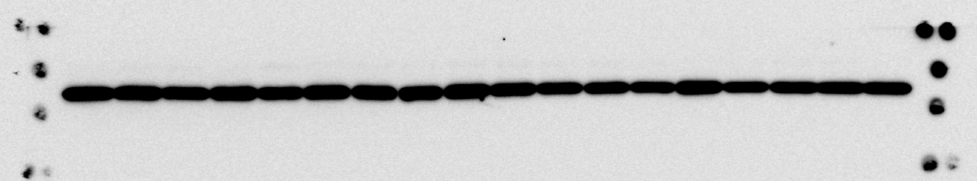
Figure 3
1 21 22 23 24 25 26 27 28 29 30 31 32 33 34 35 36 37
SHMT2
50
short
long
50
βactin
37
short
37
long

Slide 9

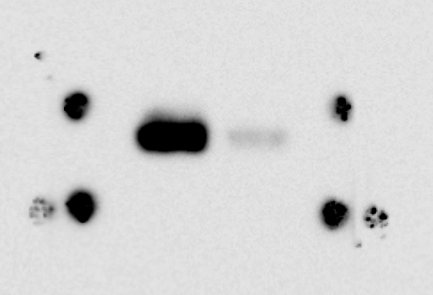
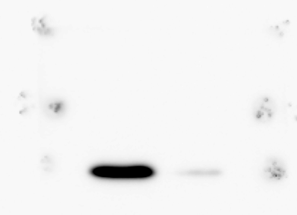
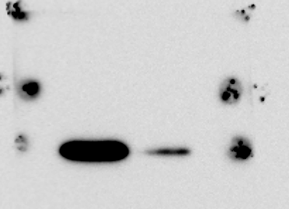
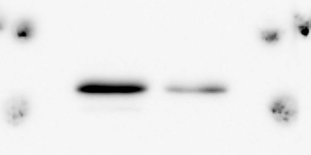
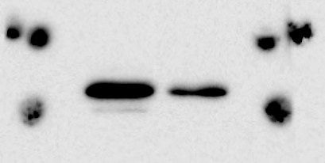
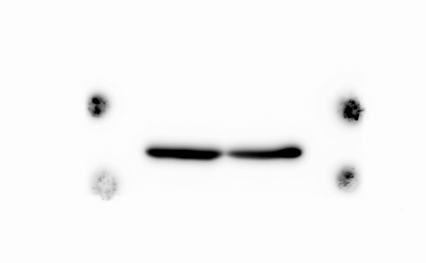
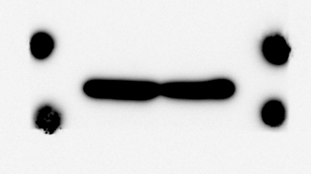
Figure 4
short
100 4500
long
100 4500
U373
U373
Glucose
(mg/L)
37
Glucose
(mg/L)
37
d
COX1
COX1
COX2
COX2
20
20
GLDH
GLDH
50
50
βactin
βactin
37
37

Slide 10
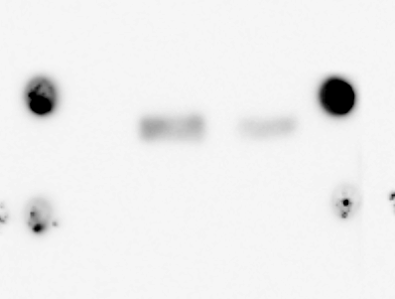
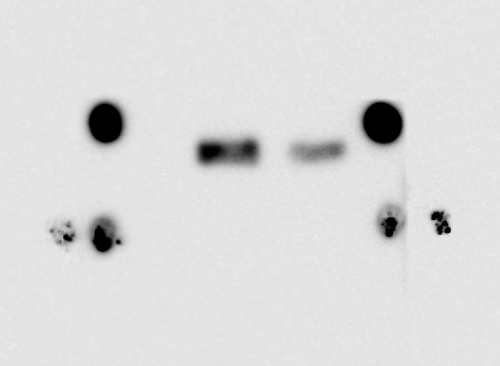
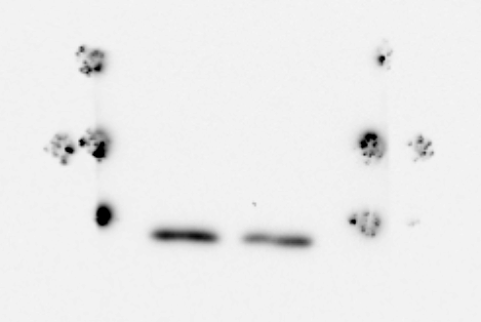
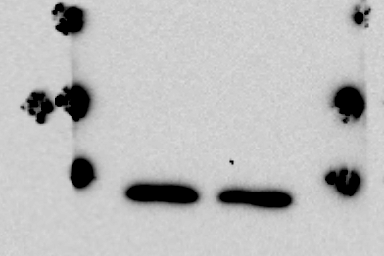
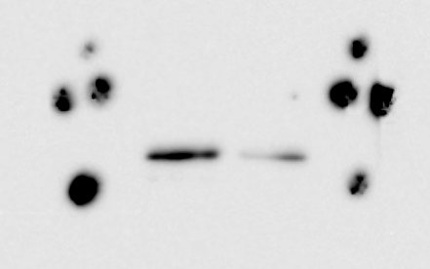
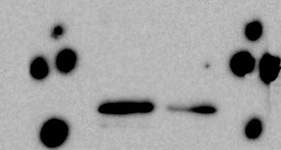
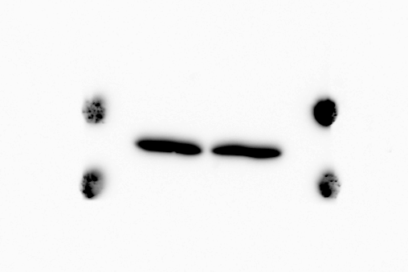
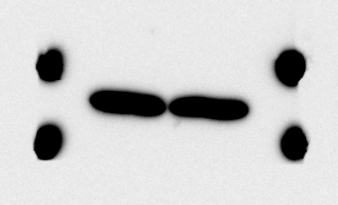
Figure 4
KNS1451
short
100 4500
KNS1451
long
100 4500
h
37
37
Glucose
(mg/L)
Glucose
(mg/L)
COX1
COX1
COX2
COX2
20
20
GLDH
GLDH
50
50
βactin
βactin
37
37

Slide 11
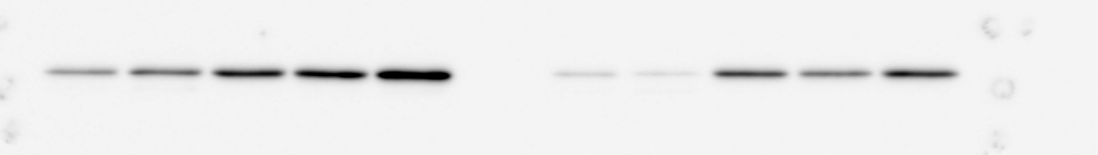
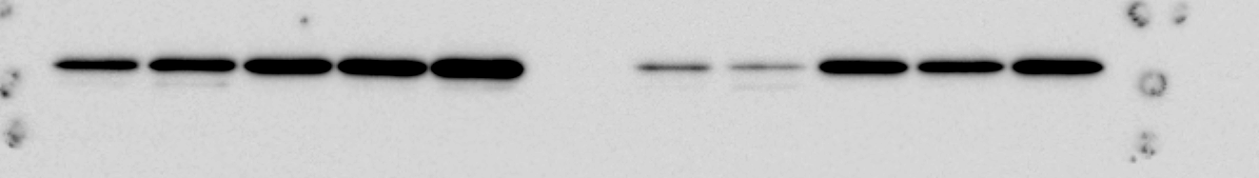
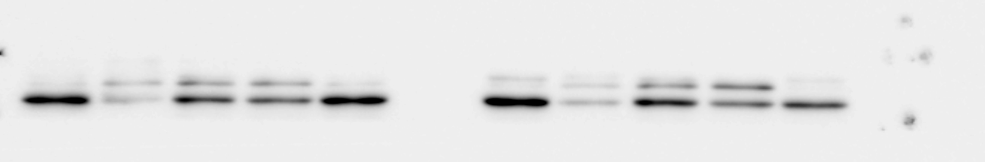

Figure 5
U87 LN229 U373 T98G
GLDH
short
50
long
50
GLS1
short
50
long
50

Slide 12


Figure 5
U87 LN229 U373 T98G
βactin
short
37
long
37

Slide 13




Sfigure 1
1 2 3 4 5 6 7 8 9 10 11 12 13 14 15 16 17 18 19 20
MTHFD1
100
short
100
long
TFAM
short
long
25

Slide 14






S Figure 3
a
short
long
U87
Glucose(mg/L)
U87
Glucose(mg/L)
100 1000 4500
100 1000 4500
100 1000 4500
100 1000 4500
100 1000 4500
100 1000 4500
37
37
COX1
COX1
GLDH
GLDH
50
50
βactin
50
50
βactin

Slide 15








KNS1435
short
KNS1435
long
S Figure 3
100 4500
S Figure 3
100 4500
Glucose
(mg/L)
Glucose
(mg/L)
37
37
d
d
COX1
COX1
25
25
COX2
COX2
GLDH
GLDH
50
50
37
37
βactin
βactin

Slide 16




SFigure5
U87 LN229 U373 T98G
COX1
short
37
37
long
COX2
25
short
25
long

