Slide 1
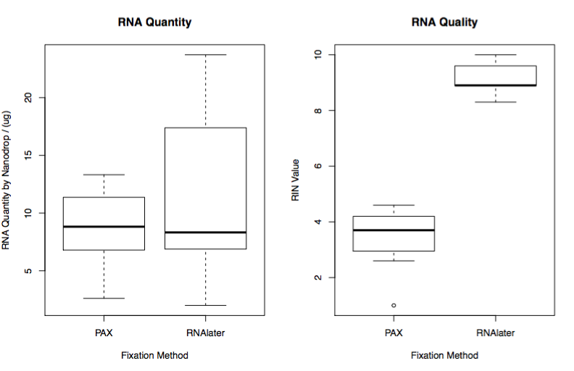
RNA Quantity (ug)
Ideal: RIN>10
RNA Integrity Number (RIN)
Degraded: RIN<2
PAXgene RNAlater PAXgene RNAlater
Supplementary Figure S1. Measurement of RNA Quantity and Quality using PAXgene tissue container vs. RNAlater.
Notes:
Supplemental Figure B. Measurement of RNA quantity and Quality using PAX vs. RNAlater

