Slide 1
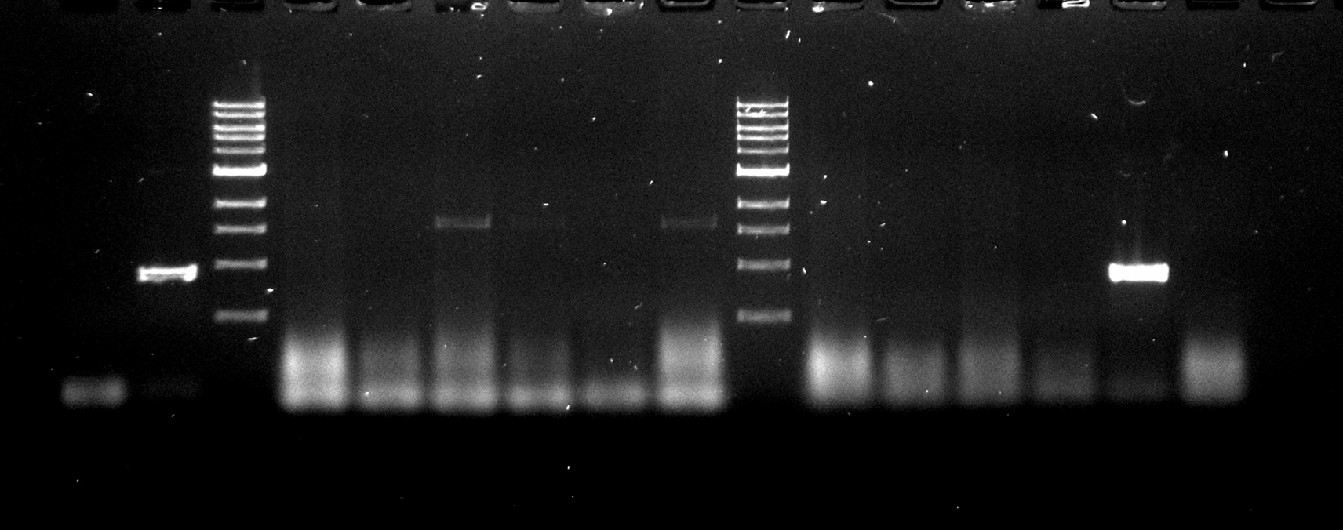
Fig 1A
DNA
RNA
Uninf.
Inf.
Inf.
Supernatant
Supernatant
Supernatant
Pellet
Pellet
Pellet
Marker

Slide 2
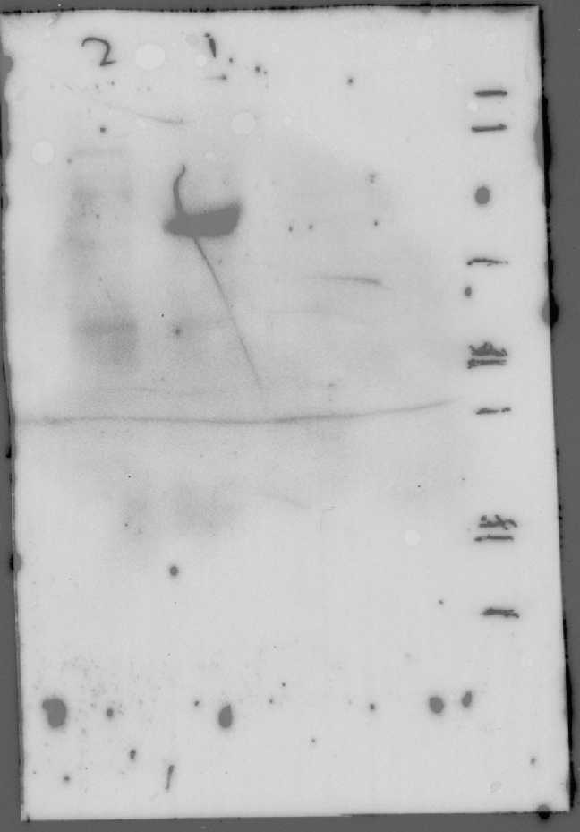
Fig 1C
Cellfectin only
Untransfected
Marker lane
Bac-RV-G
Bac-Null
kDa
100
75
50
Anti-His

Slide 3
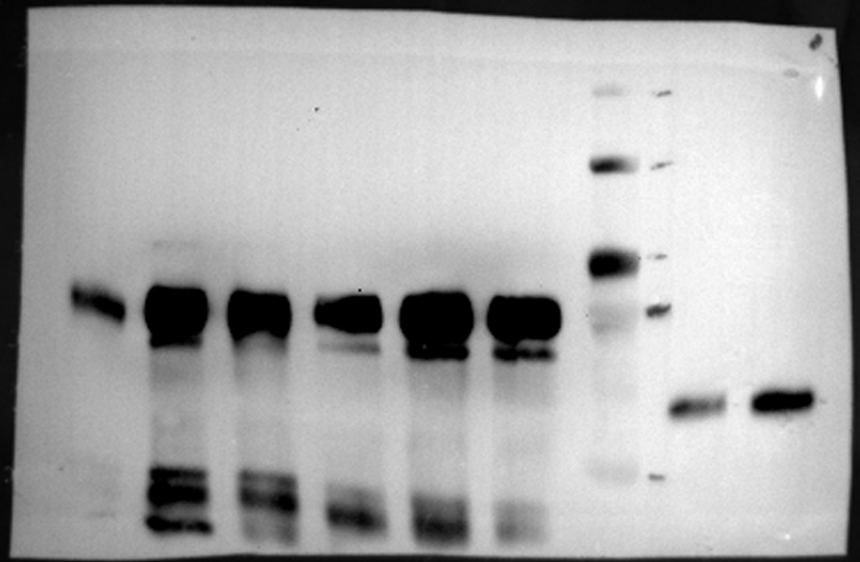
Fig 2B
Pooled fractions
MW kDa
2-4
5-8
kDa
100
75
50
Western Anti-His

Slide 4
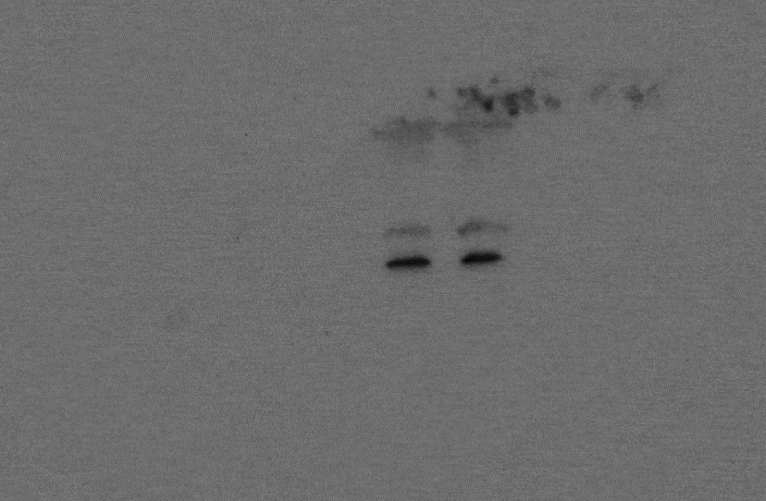
Fig 2C
Non-Immune
Non-Immune
Marker
Immune
Immune

