Slide 1
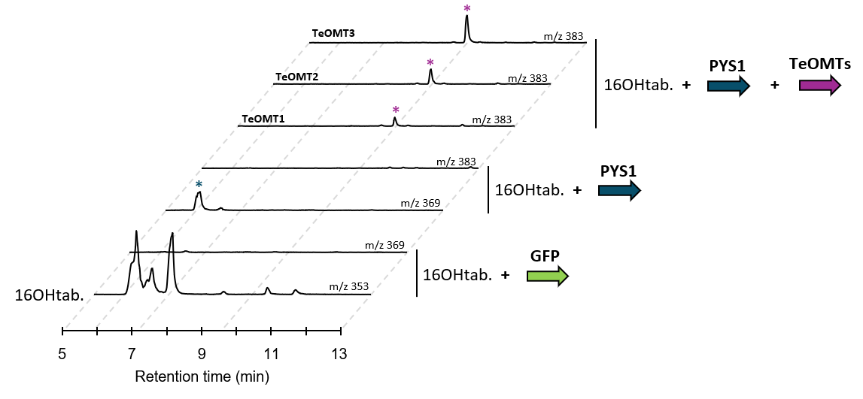
Figure S19: Biosynthesis of 16-methoxypachysiphine in tobacco by using the TeT16H, PYS1 and the three Te16OMTs. PYS1, the three characterized Te16OMT genes and GFP were transiently overexpressed in tobacco leaves in presence of 16-hydroxytabersonine produced by the TeT16H before extraction and concentration compound. Reaction products were analyzed by LC-MS. Positive differential mass chromatograms of each enzymatic step product are compared to GFP (negative control). Blue and purple asterisks indicate the 16-hydroxypachysiphine (m/z 369) and the 16-methoxypachysiphine (m/z 383), respectively. 16OHtab: 16-hydroxytabersonine.

