Slide 1
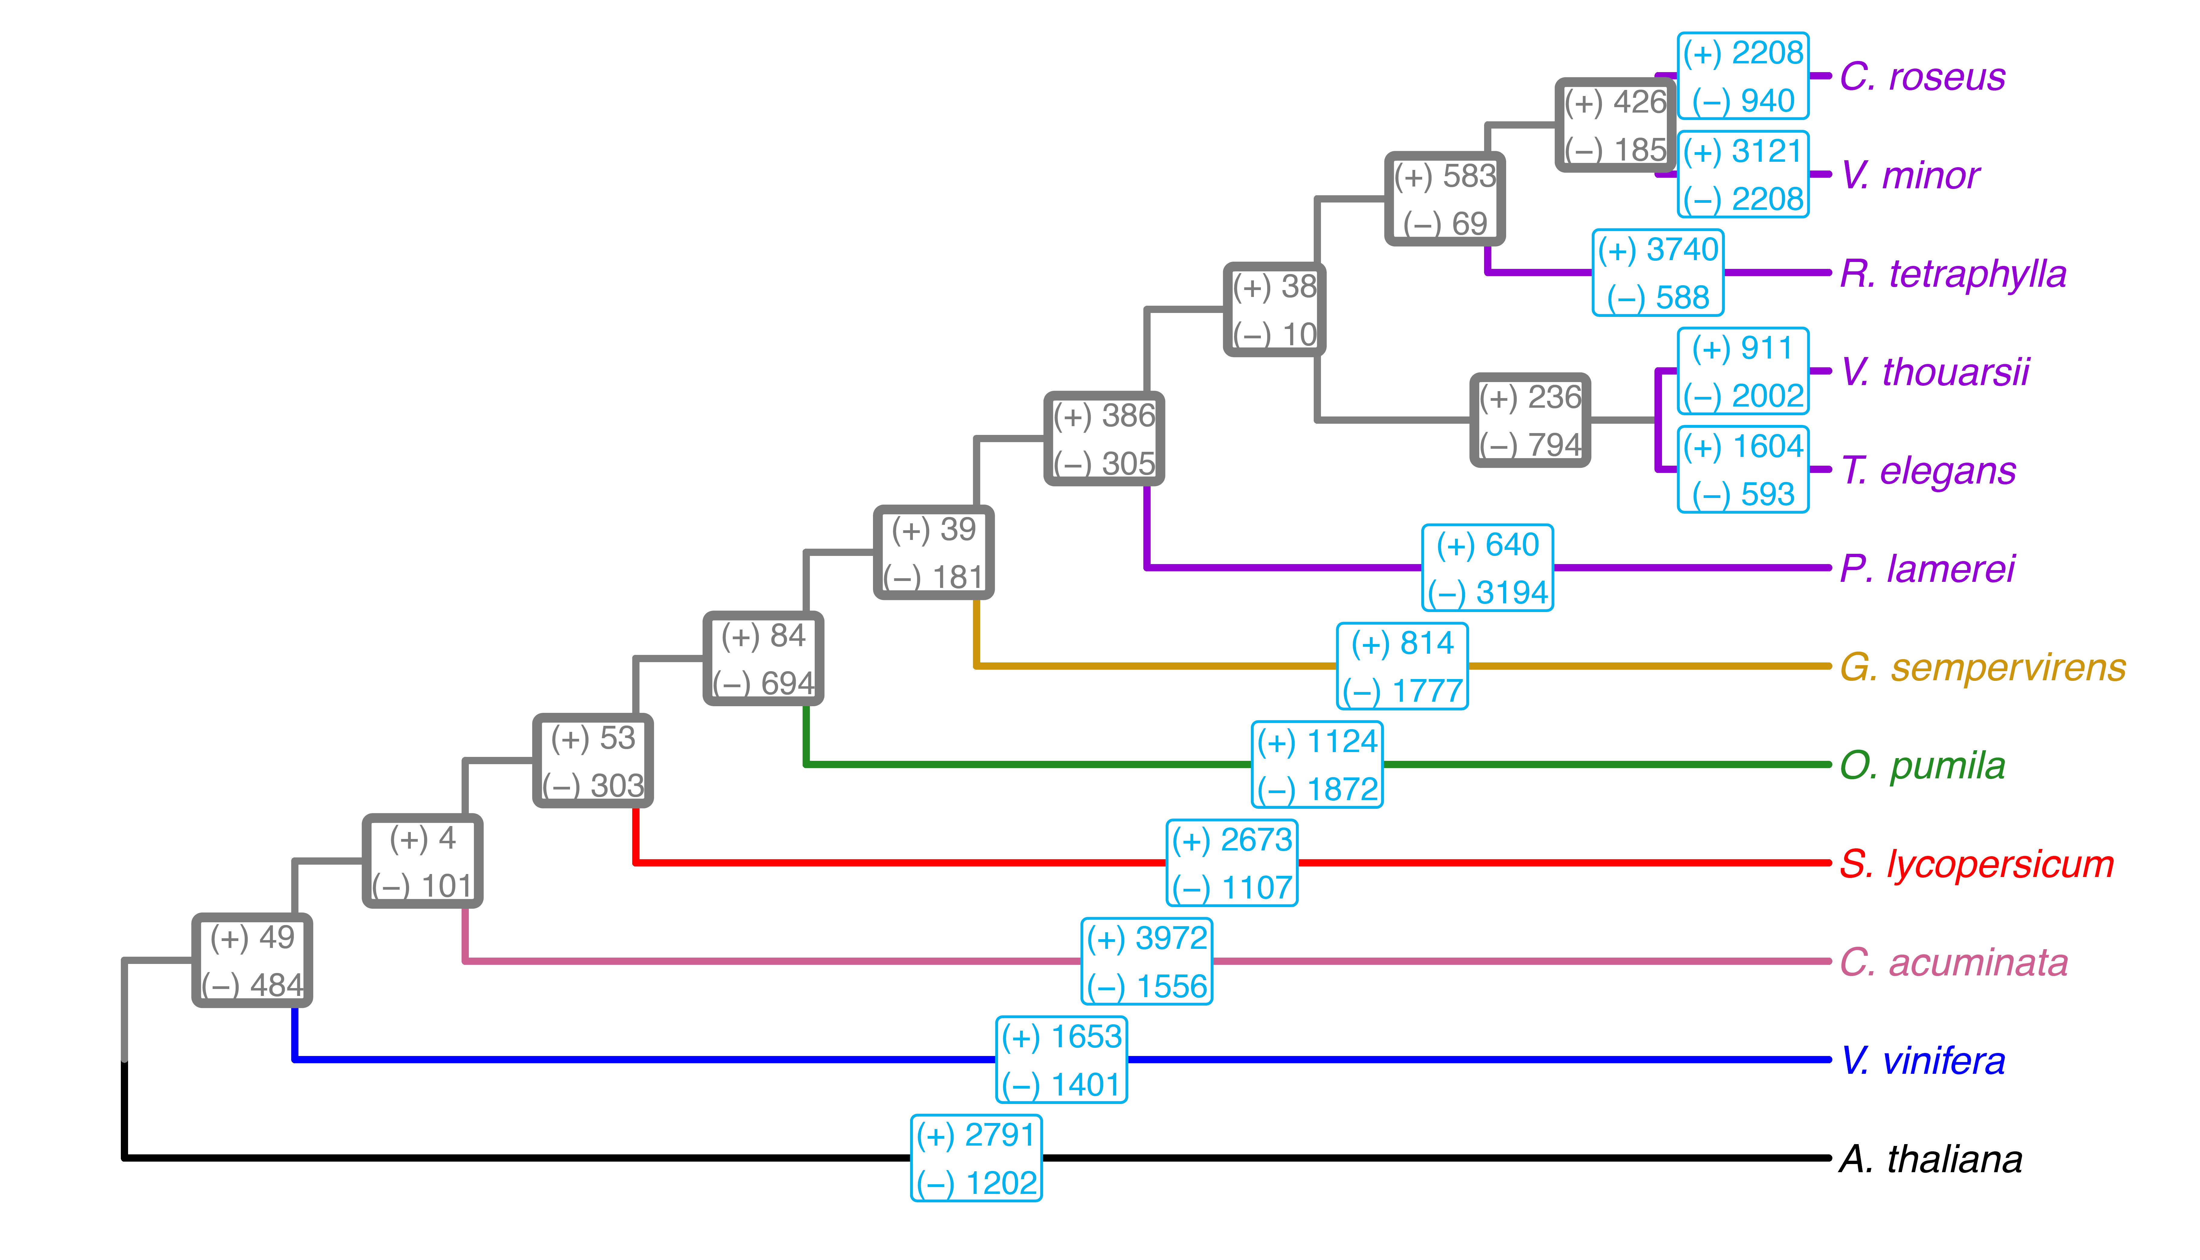
Figure S1: Phylogenetic tree of T. elegans and eleven other species, including five Apocynaceae (purple: C. roseus, V. minor, R. tetraphylla, V. thouarsii and P. lamerei), one Gelsemiaceae (yellow: G. sempervirens), one Rubiaceae (green: O. pumila), one Solanaceae (red: S. lycopersicum), one Nyssaceae (pink: C. acuminata), one Vitaceae (blue: V. vinifera) and one Brassicaceae (black: A. thaliana). Gene family expansion (+) and contraction (−) were calculated using Cafe5 in each lineage (light bordered blue boxes) and in internal nodes of ancestral population for each taxon (thick bordered grey boxes).

