Slide 1
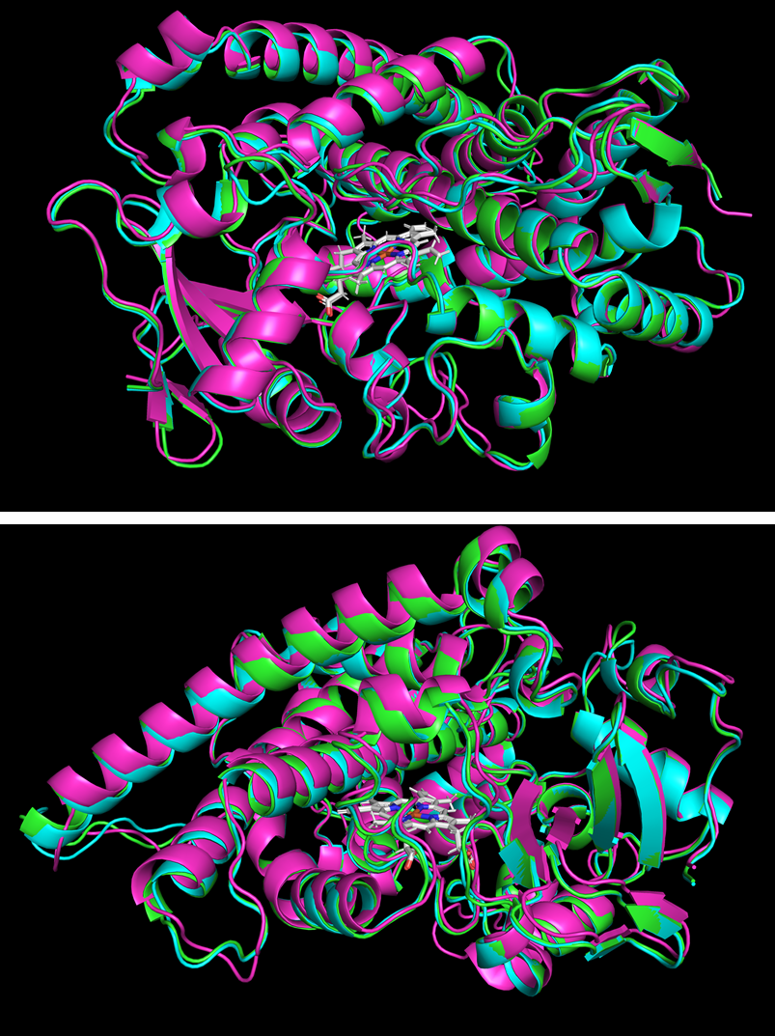
A
 | TM- score | Clashscore | Poor rotamers | Ramachandran outliers | Bad bonds | Bad angles | Cis Prolines
PYS1 | 0,918 | 2,33 | 0% | 0,39% | 0,10% | 0,16% | 0%
PYS2 | 0,936 | 1,11 | 0% | 0,59% | 0,12% | 0,20% | 0%
T3O | 0,928 | 1,59 | 0% | 0,40% | 0,10% | 0,21% | 0%
B
B
Figure S11: PSY1, PSY2 and T3O best homology-based three dimensional structure prediction from TrRosetta. (A) Qualitative assessments of models. (B) Superimposition of models with catalytic heme (white). PYS1 (green), PYS2 (blue) and T3O (pink). The transmembrane domain was removed as low confidence prediction parts of the proteins.

