Slide 1
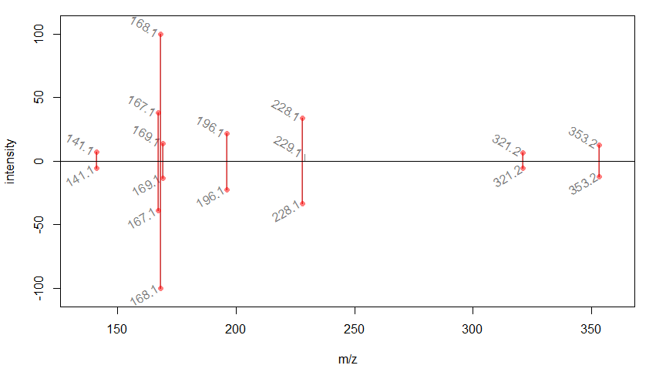
Supplemental Figure S6: MS/MS comparison of authentic standard of pachysiphine [M+H]⁺ 353.1863 (top) and PSY2 product at m/z 353.1874 (bottom). Correlation score (GNPS-like score) of 0.98.

