Slide 1
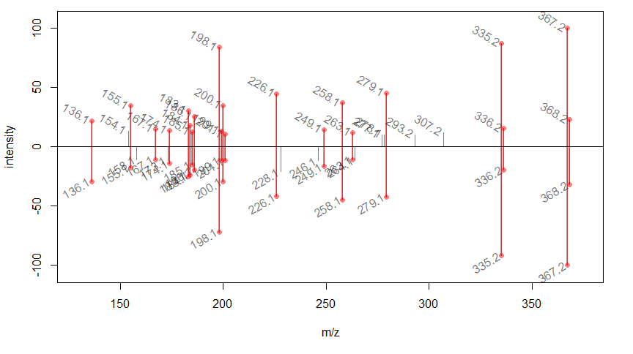
Figure S16: MS/MS comparison of authentic standard of 16-methoxytabersonine [M+H]⁺ 367.2021 (top) and TeT16H + Te16OMT1 product at m/z 367.2023 (bottom). Correlation score (GNPS-like score) of 0.91.

