Slide 1
Human colonic organoids for understanding early events of Familial Adenomatous Polyposis pathogenesis
N Laborde, A Barusseaud et al. J Pathol https://doi.org/10.1002/path.6366
Supplementary Figures S1–S5

Slide 2
Figure S1A
Figure S1B

Slide 3
Figure S1C
Figure S1D

Slide 4
Figure S1E

Slide 5
Figure S1E (cont.)
Figure S1. Transcriptomic study of FAP crypts and organoids. (A) At D7 of culture, mRNA from A crypts compared to HC and/or NA crypts were enriched in markers of CBC stem cells (EPHB2, LGR5), β-catenin transcriptional targets (AXIN2, CCND1), marker of cell proliferation (MKI67), β-catenin interacting partners (NOTCH1, TROP2). Compared to HC, NA crypts were characterized by both an increase of MKI67 mRNA and a decrease of LGR4 and SPINT1 mRNA, two guardians of crypt integrity. (B) Unlike A crypts, in A organoids the mRNA of ITGB2, NOTCH2, PROM1, TNF, and VIM were increased compared to HC and/or NA. Conversely, ITGB1 mRNA was decreased in FAP organoids compared to HC. (C) Some variations of gene expression found in FAP crypts were lost in FAP organoids: both in NA and A organoids (CDX2, IL33, MUC2, MYC), in A organoids (CD166, CLDN1, DUSP6, FZD4, ITGA6, ITGB4, MUC5A, PI3, TIMP1, TIMP2), and in NA organoids (ALDH1A1, ATOH1, BMI1, ETS2, SOX9). (D) Main relationships between genes whose expression varied in FAP compared to HC after transcriptomic analysis in crypts and organoids. (E) Genes whose expression did not differ between FAP crypts/organoids and HC. n patients: crypts, HC = 4, NA/A = 5; organoids, HC = 3–6, NA/A = 3–7. ANOVA comparison between HC and NA/A: *p<0.05 **p<0.01 ***p<0.001, paired t-test comparison between NA and A: *p<0.05 **p<0.01.

Slide 6
Figure S2

Slide 7
Figure S2 (cont.)
Figure S2. Impact of EGF starvation on gene transcription in FAP organoids. After EGF starvation from D2 of culture, the expression of genes at D7, which did not vary in FAP organoids (NA, A) compared to HC, is shown. n patients = 3–6 (HC), 3–7 (NA/A), ANOVA comparison between HC and NA/A: *p<0.05 **p<0.01, paired t-test comparison between NA and A, NA and NA w/o EGF, A and A w/o EGF, HC and HC w/o EGF: *p<0.05 **p<0.01.

Slide 8
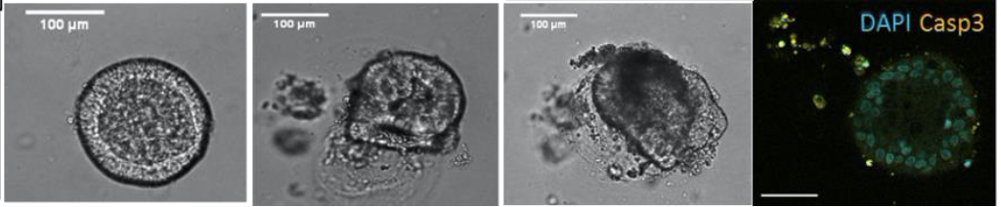
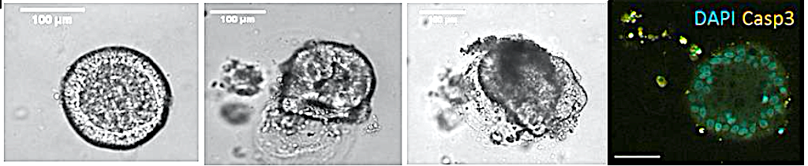
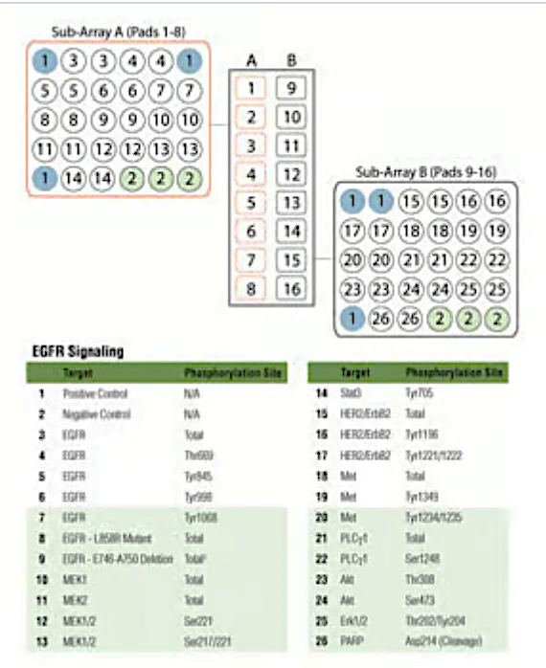
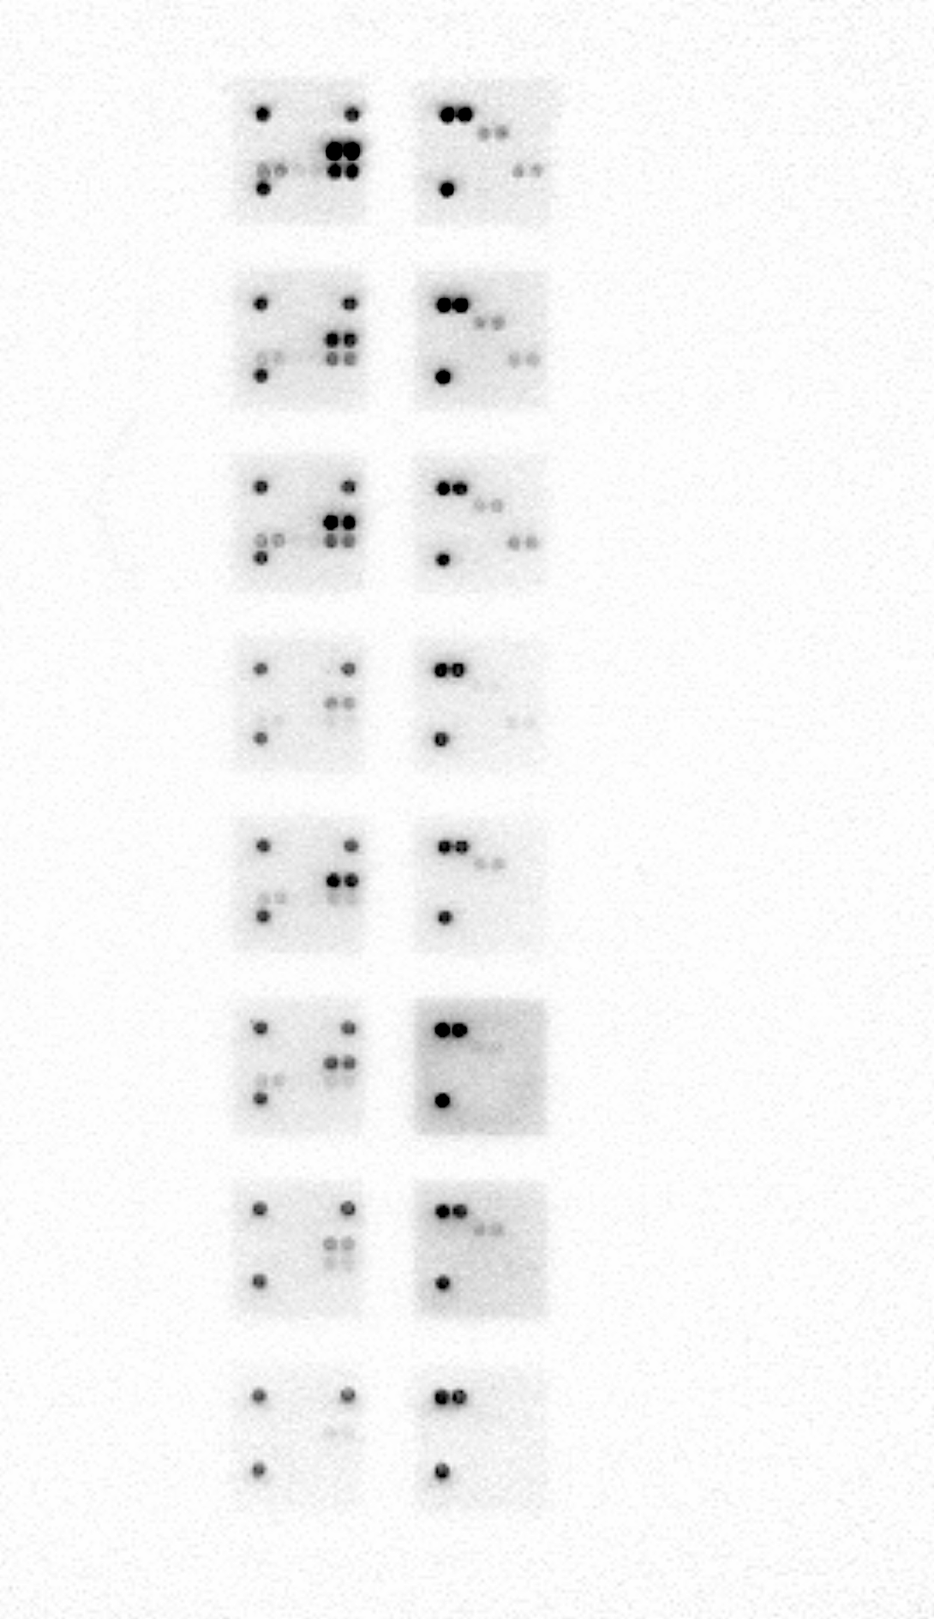
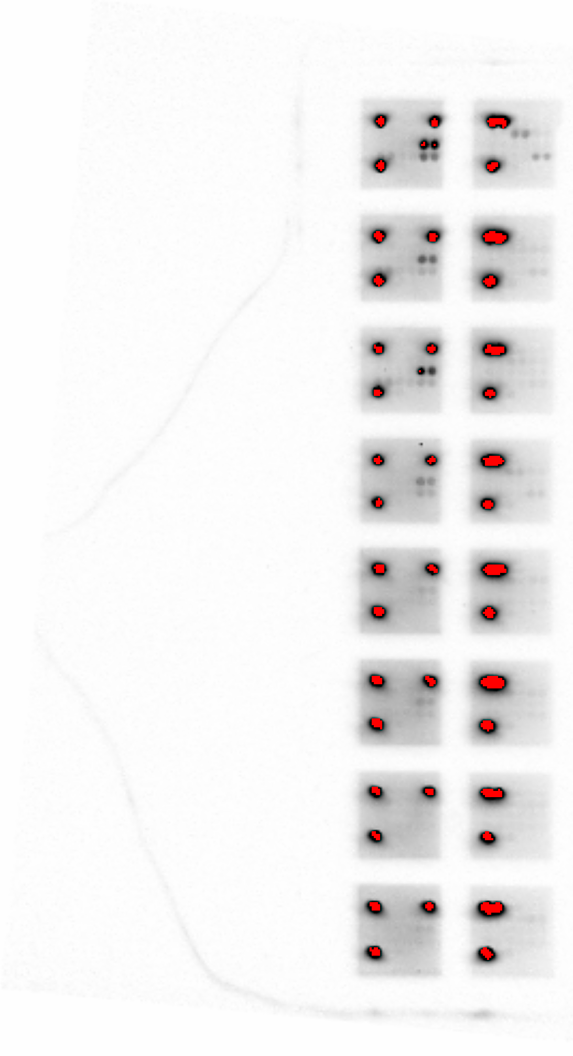
Figure S3A
HC organoids
D2
D5
D7
100 μm
D9
EGF starvation
Figure S3B
A
B
1–n°23-HC
A
B
1–n°6–NA
2–n°24–HC
2–n°6–NA
w/o EGF
3–n°25–HC
3–n°6–A
4–n°25–HC
w/o EGF
4–n°6–A
w/o EGF
5–n°5–NA
5–n°7–NA
6–n°5–NA
w/o EGF
6–n°7–NA
w/o EGF
7–n°5–A
7–n°7–A
w/o EGF
8–n°5–A
w/o EGF
8–n°7–A

Slide 9
Figure S3C
Figure S3D
Figure S3. EGF-dependent ERK and AKT activation in FAP organoids. From D2 of culture, EGF was excluded from the medium and organoids from HC and FAP tissues (NA, A) were studied for their ERK and AKT activities. (A) Representative images showing that EGF starvation does not have a significant impact on HC organoid growth (brightfield) and survival (active Caspase 3 labeling, Casp3; nuclei labeling, DAPI). (B) At D7, raw data obtained with the Pathscan EGFR signaling antibody array (Ref. 12622 Cell Signaling). n = 3 patients HC, 2 patients FAP (NA/A). (C) Quantification of the active form of ERK (Pthr202/tyr204-ERK1/2, P-ERK) and total ERK after western blotting in FAP organoids of patient 2 analyzed using Pathscan. (D) At D7, analysis of AKT activity in organoids cultured in the presence or absence of EGF, through the quantification of the active form of AKT (Pser473-AKT, P-AKT) using immunofluorescence. n = 2 patients HC, 2 patients FAP (NA/A). ANOVA comparison: *p<0.05 ***p<0.001. Scale bar, 100 μm.

Slide 10
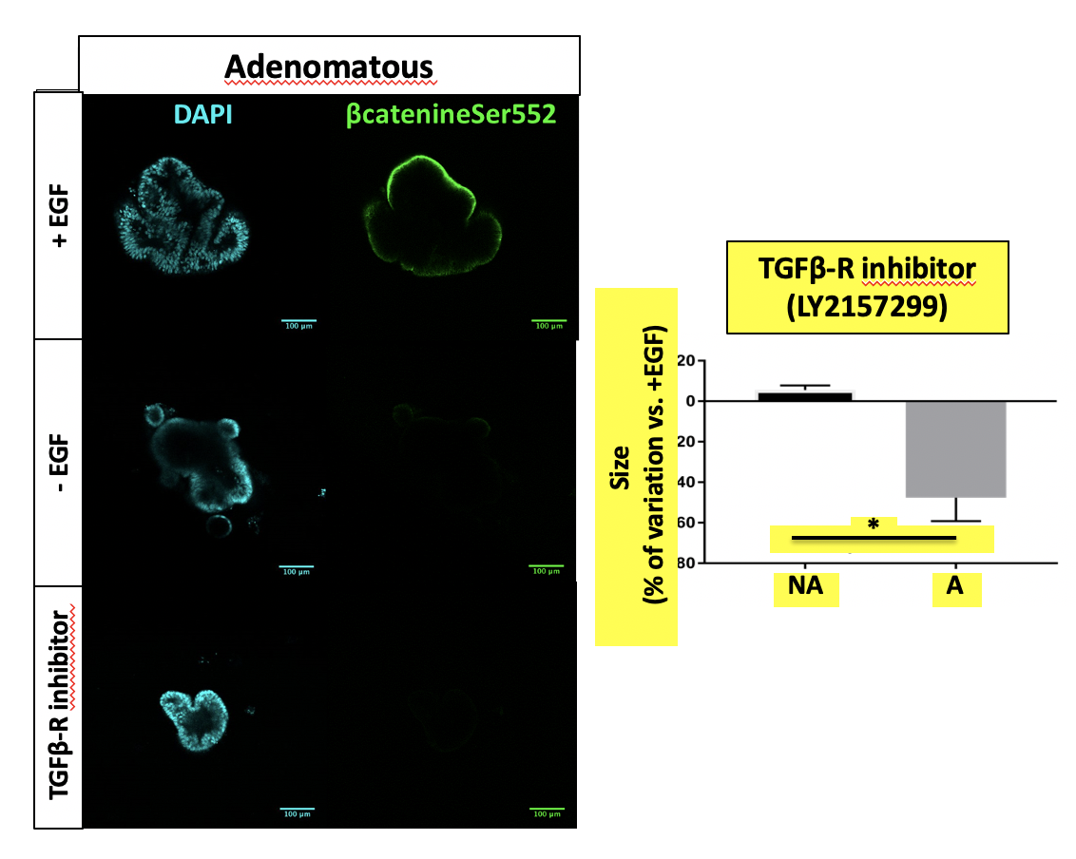
Figure S4
TGFβ-dependent regulation
A organoids
w/ TGFβ receptor inhibitor
DAPI
P-β CATENIN
Figure S4. Implication of TGFβ receptor in activation of β-catenin in adenomatous organoids. Addition of the TGFβ receptor I inhibitor LY2157299 (0.5 μM) along the culture of FAP organoids induced a decrease of the activated form of β-catenin (Ser552-phosphorylated β-catenin, P-β-CATENIN) in adenomatous (A) organoids. IF: Labeling of Pser552-β-catenin (green) and nuclei by DAPI at D7 of culture under TGFβ receptor inhibition is shown. IF quantification at D7 of culture: n patients A = 1, t-test comparison **p<0.01.

Slide 11
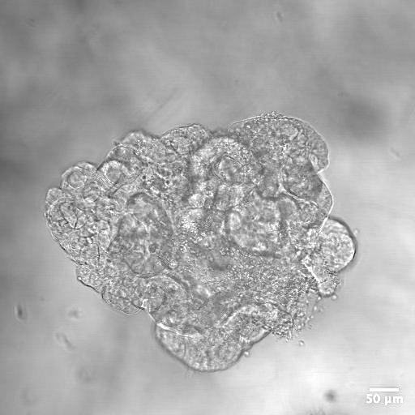
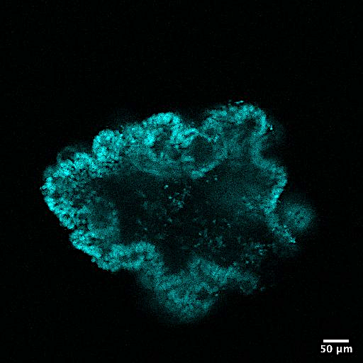
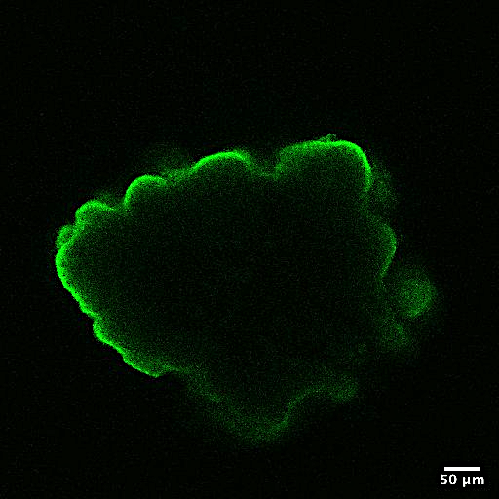
Figure S5A
A-organoid
DAPI
p85
Figure S5B
p1
10 isoform inhibition
600
=0.
05
=0.
06
)
m
μ
(
e
400
z
i
s
d
i
o
n
a
g
r
200
O
0
1
1
1
1
1
1
2
2
2
2
2
2
3
3
3
3
3
3
o
6
D
o
6
D
o
6
D
o
6
D
o
6
D
o
6
D
s
6
Z
s
6
Z
s
6
Z
s
6
Z
s
6
Z
s
6
Z
m
A
A
m
A
A
m
A
A
m
A
A
m
A
A
m
A
A
d
A
A
d
A
A
d
A
A
d
A
A
d
A
A
d
A
A
A
N
N
A
A
N
N
A
A
N
N
A
N
N
N

Slide 12
Figure S5C
A organoids
100
)
s
s
80
d
d
i
i
o
o
n
n
a
a
g
g
60
r
r
o
o
g
l
a
n
t
i
o
40
d
t
d
f
u
o
B
%
20
(
0
CTL
PA
R
1
PA
R
2
a. p.
a. p.
a. p.
Figure S5. Impact of p110s and PAR modulation on FAP organoid development. (A) The expression of the regulatory subunit p85 of PI3K was studied using immunofluorescence in non adenomatous (NA) and adenomatous (A) organoids from one FAP patient. The impact of pharmacological inhibitors of p110α (A66) and p110β (AZD6482) compared to control DMSO (Ctl) is shown as well as an example of p85 labeling in A organoid. Brightfield image of the organoid and labeling of nuclei by DAPI are shown. Scale bar, 50 μm. (B) Pharmacological inhibition of p110α (A66, 0.5 μM) and p110β (AZD6482, 0.5 μM) was performed and growth (diameter size) of organoids was measured at D7 of culture (n FAP patients NA/A = 3. ANOVA comparison *p<0.05 **p<0.01 ****p<0.0001. (C) PAR1 and PAR2 agonist peptides (respectively TFLLR-NH2 and SLIGRL-NH2, 100 μM) or control peptides (Ctl, mixture of reversed sequences, 100 μM) were added daily from D2 to D5 of adenomatous (A) organoid culture and organoids with buds were counted and expressed as percentage compared to total organoids. n patients A = 2, mean ± SEM, unpaired t-test comparison between Ctl peptide and PAR2 peptide assays p=0.05.

