Slide 1
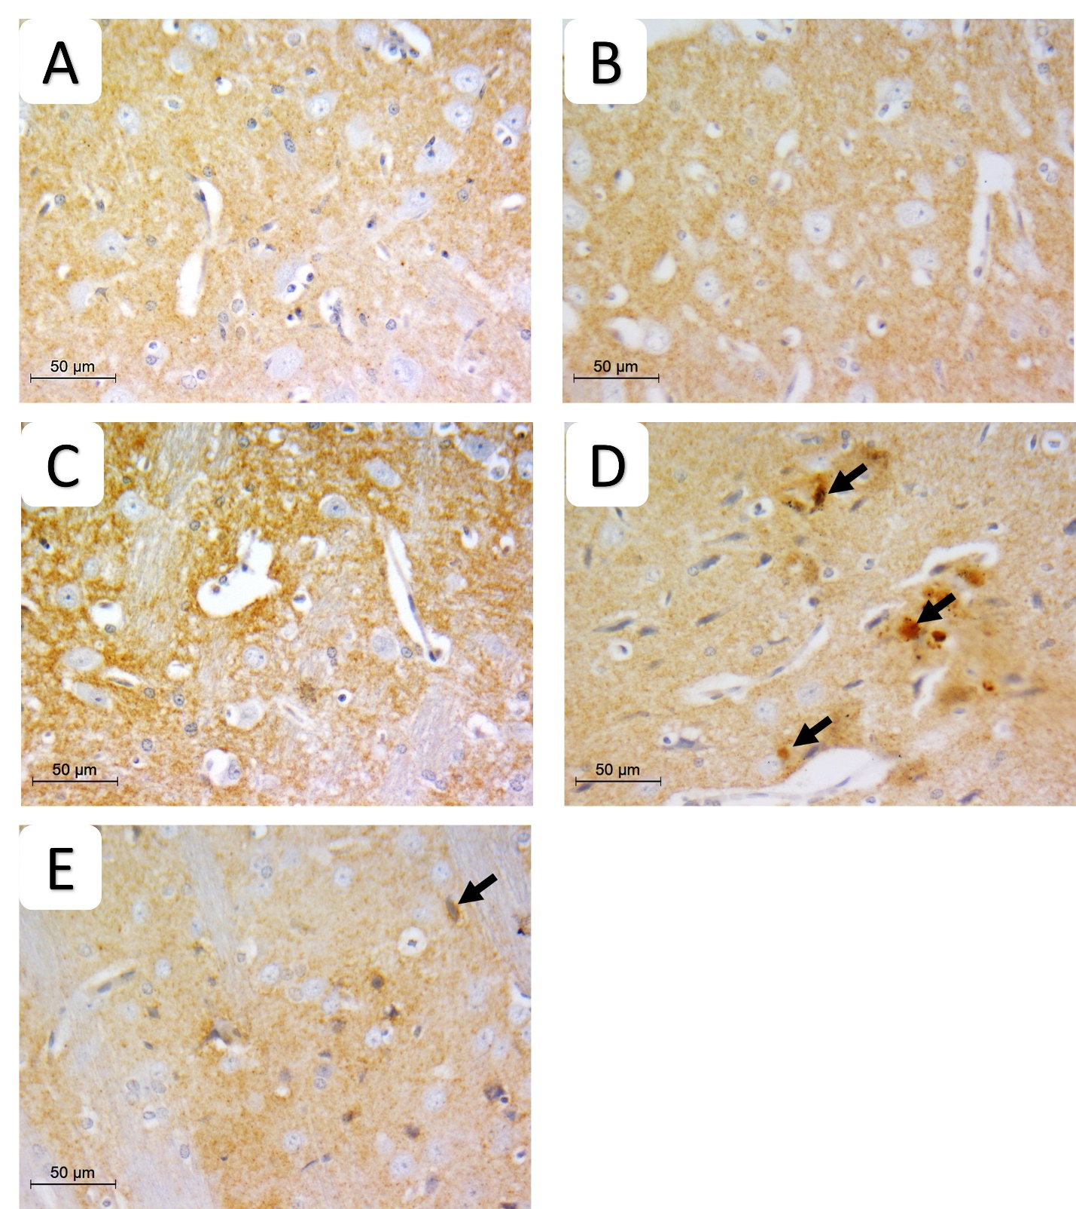
Supplementary Figure 5
S5 Fig: Pathologic assessment of alpha synuclein stained sections of striatum in different studied groups highlighting positive neurons in each group. negative staining of neurons is seen in A) normal, B) DSMO, C) Gonadal extract groups. D) rotenone group showing multiple positive alpha synuclein neurons (arrows) E) gonadal extract treated rotenone group decrease expression. (IHC, x400, scale bar 50 microns)

