Slide 1
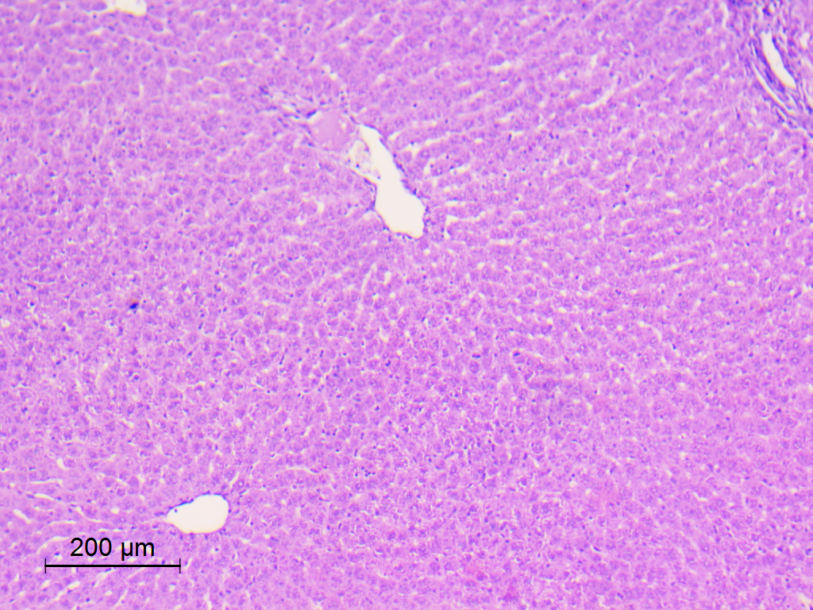
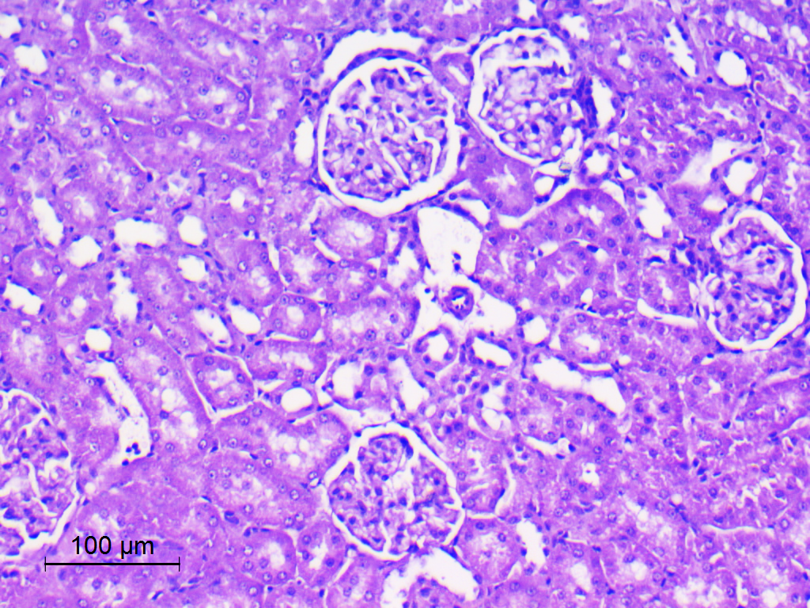
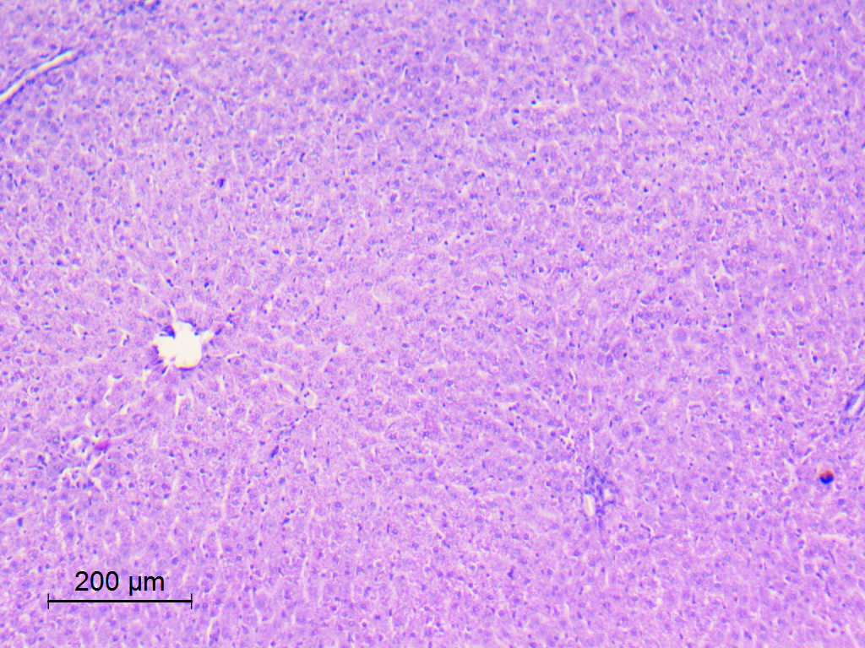
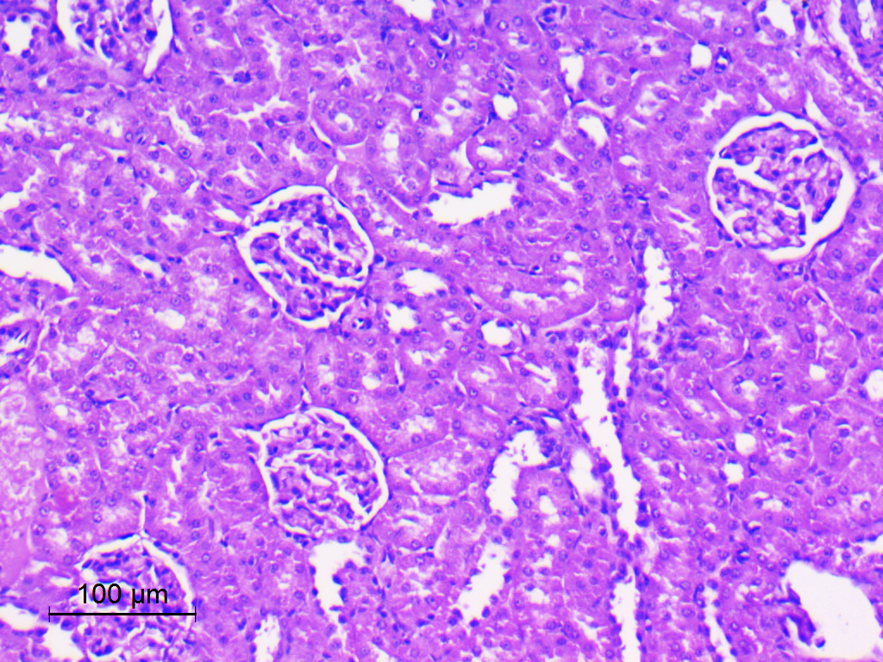
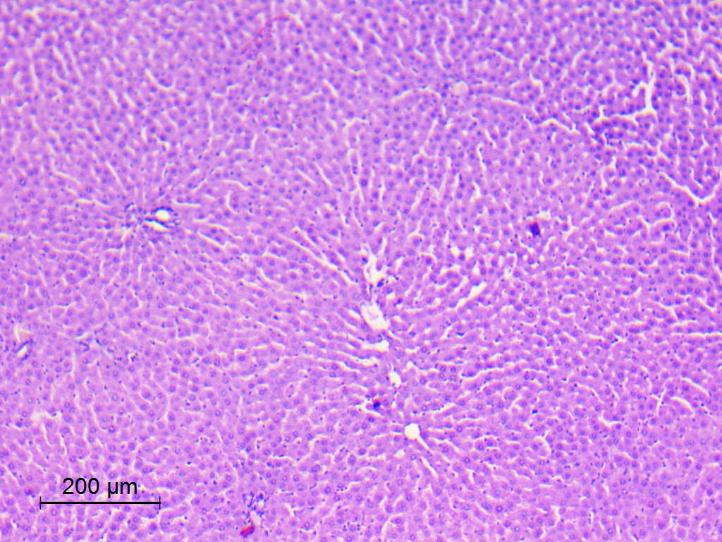
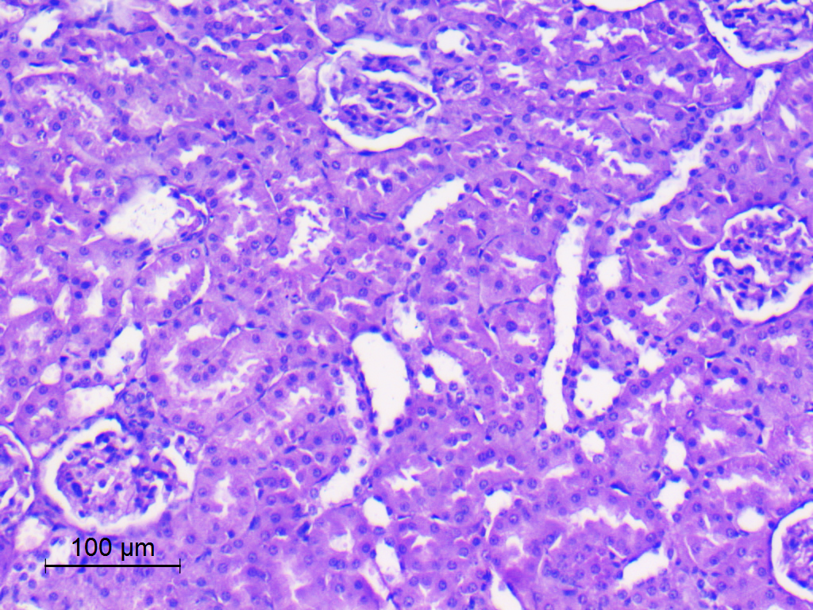
Liver Kidney
A
B
Control
C
D
DMSO
E
F
P. lividus extract
S8 Fig: H&E stained sections of liver (first column, x100) and kidney (second column, x200) of different studied groups. A,B control, C,D DMSO, E,F P. lividus gonadal extract. No pathologic changes were detected in both organs in all studied rats.

