Slide 1
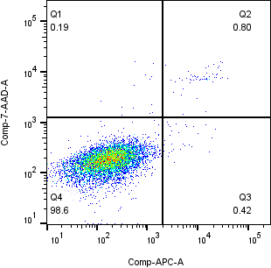


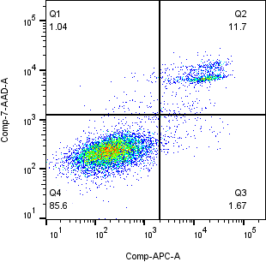
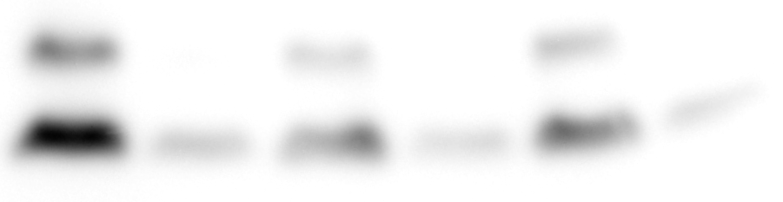
A
C
GALNTL5-GFP/GC-2spd
F
Cumate (-)
GALNTL5 cDNA
2
***
Mouse testis
GC-2spd(ts)
Cumate (-)
Cumate (+)
***
1.5
GALNTL5
Absorbance
***
1
GAPDH
0.5
0
7-AAD
B
0h
24h
48h
72h
D
Annexin V
-APC
GALNTL5-GFP/GC-2spd
GALNTL5-GFP/GC-2spd
28
1
2
3
(day)
Cumate (+)
Cumate (-)
*
Cumate
-
+
-
+
-
+
24
(kDa)
Cumate (+)
75
GFP
20
Cell number (✕ 10⁴)
16
15
LC3
12
E
8
*
**
**
0
0h
24h
48h
72h
Relative Intensity
LC3
Cumate
-
+
-
+
-
+
↑ Supplementary Figure 1
1
2
3
(day)

Slide 2
A
Sup.
IP (Flag)
B
D
Control
GALNTL5
Flag
Control
GALNTL5
GALNTL5
w/o TM
Flag
(kDa)
Calnexin
75
w/o TM-GFP
Calnexin
C
GALNTL5
w/o TM
75
BiP
(kDa)
100
60
HSP90
75
DAPI
Merge
75
50
HSP70
anti-Flag
75
HSC70
60
↑ Supplementary Figure 2
Flag
50

Slide 3
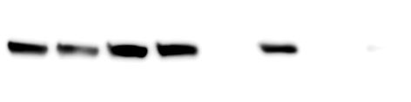
A
NetNGlyc 1.0: predicted N-glycosylation sites in Sequence
C
IP Sup.
anti-Flag IP
N-glycosylation potential
hGALNTL5
hGALNTL5
Control
hw/oM
Control
hw/oT
hN87K
hN87K
1
2
3
4
5
6
7
8
(kDa)
anti-Calnexin
Sequence position
75
B
75
anti-BiP
hGALNTL5
Flag
N87
anti-Flag
45
hw/oTM
Flag
hN87K
Flag
N87K
↑ Supplementary Figure 3

Slide 4
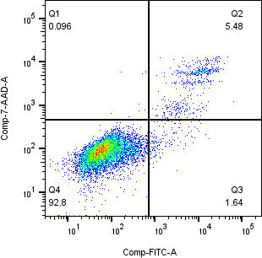
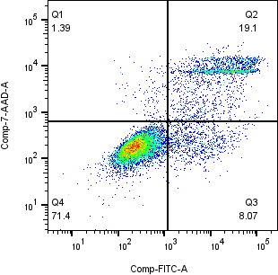

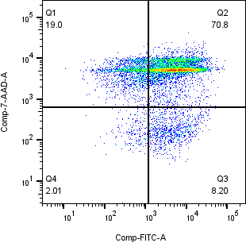
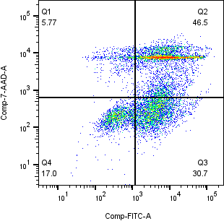
A
C
28
GALNTL5 (-)
24
GALNTL5 (+)
Control
7-AAD
GALNTL5Quad. (-)
20
GALNTL5Quad. (+)
***
Annexin V
-FITC
***
16
Cell number (✕ 10⁴)
D
E
12
GALNTL5-Flag/GC-2spd
GALNTL5Quad.-Flag/GC-2spd
8
4
0
Cumate (-)
Cumate (-)
0h
24h
48h
72h
B
GALNTL5-Flag/GC-2spd
GALNTL5Quad.-Flag/GC-2spd
Cumate (-)
***
Cumate (-)
***
1.6
Cumate (+)
1.6
Cumate (+)
1.2
1.2
***
Absorbance
Absorbance
Cumate (+)
Cumate (+)
0.8
***
0.8
***
0.4
***
0.4
0
0
↑ Supplementary Figure 4
0h
24h
48h
72h
0h
24h
48h
72h

Slide 5
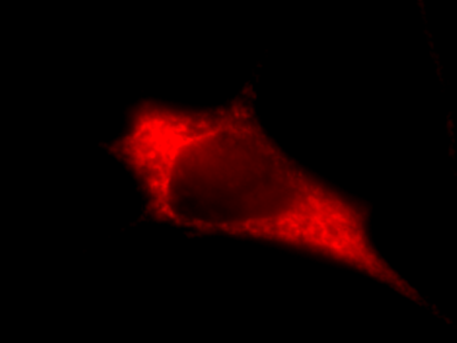
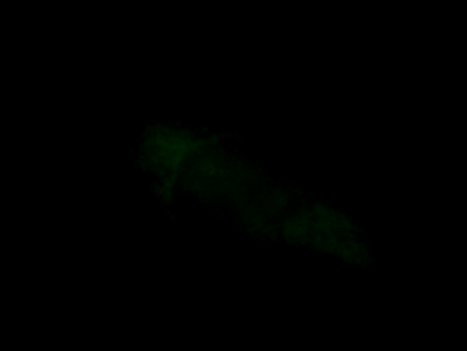
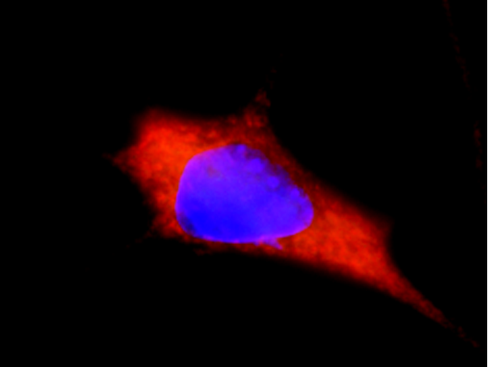

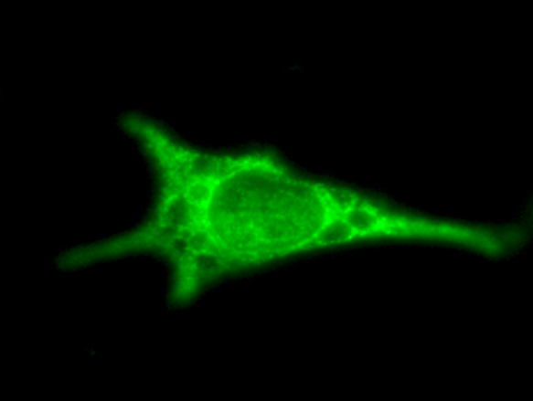
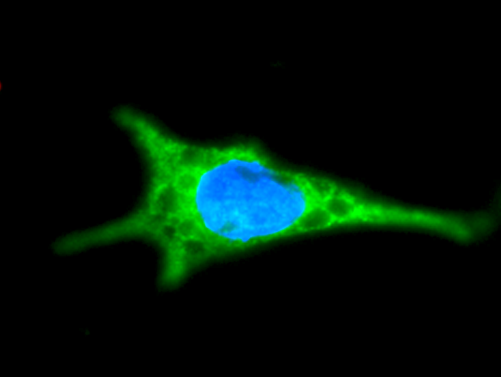
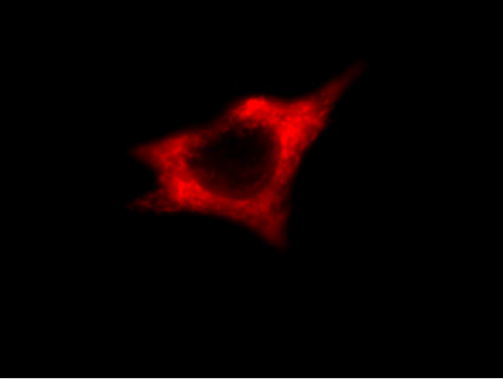
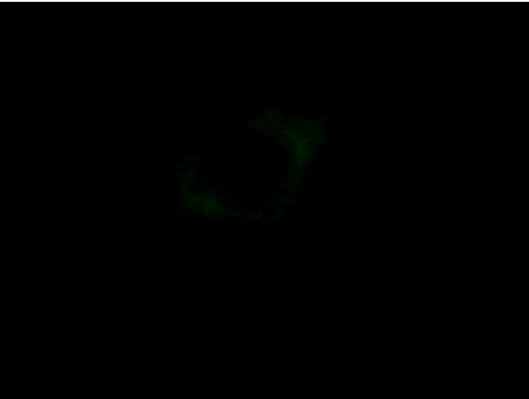
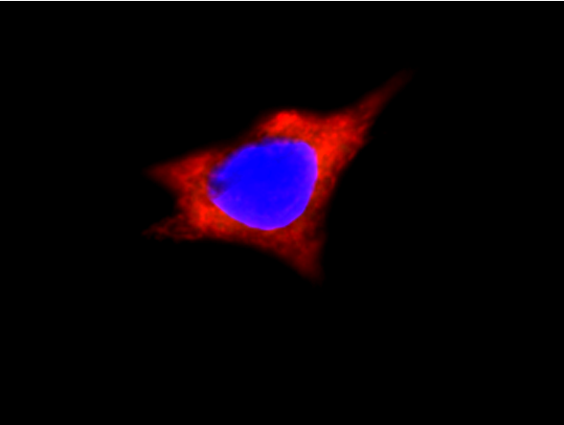
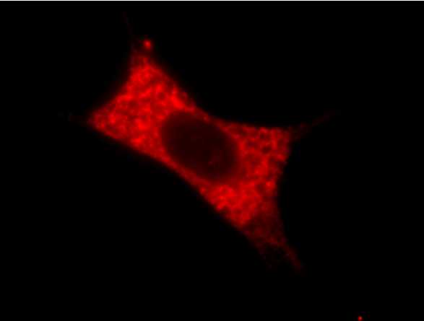
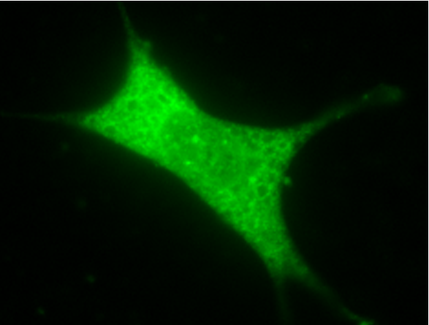
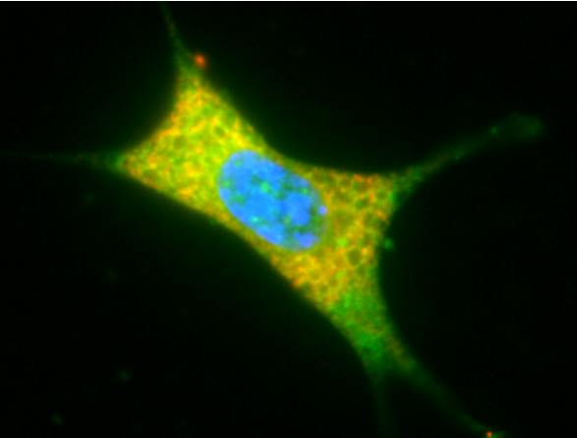
A
NHK-DsRed
Flag
Merge
GALNTL5
GALNTL5Quad.
1
2
(day)
1
2
(day)
D
Cumate
-
+
-
+
-
+
-
+
GALNTL5
Cumate (-)
(kDa)
50
Flag
E
20
Histone-H3
GALNTL5
Cumate (+)
75
NHK-DsRed
B
C
F
1
**
1
GALNTL5Quad.
Cumate (-)
0.8
0.8
Relative Intensity
Relative Intensity
0.6
0.6
0.4
0.4
G
0.2
0.2
GALNTL5Quad.
Cumate (+)
Cumate
-
+
-
+
Cumate
-
+
-
+
1
2
(day)
1
2
(day)
↑ Supplementary Figure 5

Slide 6
D
ER
C
siRNA
A
GALNTL5
B
GALNTL5Quad.
ER membrane
1
2
3
(day)
1
2
3
(day)
Control
Calnexin
Cumate
+
+
+
+
+
+
BiP
-
-
-
-
-
-
140
IRE1α
ERAD
GALNTL5
BiP
100
OS9
70
HSP70
(kDa)
Calnexin
Calnexin cycle
Secretion
GALNTL5
↑ Supplementary Figure 6

Slide 7
A
IRE1α
OS9
CREB3L4
UBE2J1
GM130
HSP70
HSC70
β-actin
1
***
1
***
***
1
***
***
**
1
*
***
***
1
***
***
***
1
**
*
***
1
**
*
***
1
***
***
GALNTL5
Relative Intensity
Relative Intensity
Relative Intensity
Relative Intensity
Relative Intensity
Relative Intensity
Relative Intensity
Relative Intensity
0.5
0.5
0.5
0.5
0.5
0.5
0.5
0.5
+
+
+
+
+
+
+
+
+
+
+
+
+
+
+
+
+
+
+
+
+
+
+
+
-
-
-
-
-
-
-
-
-
-
-
-
-
-
-
-
-
-
-
-
-
-
-
-
Cumate
1
2
3
(day)
Cumate
1
2
3
(day)
Cumate
1
2
3
(day)
Cumate
1
2
3
(day)
Cumate
1
2
3
(day)
Cumate
1
2
3
(day)
Cumate
1
2
3
(day)
Cumate
1
2
3
(day)
B
IRE1α
OS9
CREB3L4
UBE2J1
GM130
HSP70
HSC70
β-actin
1
***
1
***
1
***
1
***
*
1
***
***
***
1
*
***
1
***
***
1
*
*
***
GALNTL5Quad.
Relative Intensity
Relative Intensity
Relative Intensity
Relative Intensity
Relative Intensity
Relative Intensity
Relative Intensity
Relative Intensity
0.5
0.5
0.5
0.5
0.5
0.5
0.5
0.5
+
+
+
+
+
+
+
+
+
+
+
+
+
+
+
+
+
+
+
+
+
+
+
+
-
-
-
-
-
-
-
-
-
-
-
-
-
-
-
-
-
-
-
-
-
-
-
-
Cumate
1
2
3
(day)
Cumate
1
2
3
(day)
Cumate
1
2
3
(day)
Cumate
1
2
3
(day)
Cumate
1
2
3
(day)
Cumate
1
2
3
(day)
Cumate
1
2
3
(day)
Cumate
1
2
3
(day)
C
IRE1α
OS9
CREB3L4
UBE2J1
GM130
HSP70
HSC70
β-actin
*
***
***
***
***
*
***
***
***
***
***
**
***
*
***
***
1
1
1
1
1
1
1
1
siRNA
Relative Intensity
Relative Intensity
Relative Intensity
Relative Intensity
Relative Intensity
Relative Intensity
Relative Intensity
Relative Intensity
0.5
0.5
0.5
0.5
0.5
0.5
0.5
0.5
Control
BiP
Control
BiP
Control
BiP
Control
BiP
Control
BiP
Control
BiP
Control
BiP
Control
BiP
Calnexin
Calnexin
Calnexin
Calnexin
Calnexin
Calnexin
Calnexin
Calnexin
siRNA
siRNA
siRNA
siRNA
siRNA
siRNA
siRNA
siRNA
↑ Supplementary Figure 7

