Slide 1
Table S1. Sampling information for the Impatiens samples in this study.
Section | Species | Accession number in GenBank | Locality
Impatiens | Impatiens bodinieri | PQ452959 | QingchuanCounty,Guanyuan,Sichuan,China
Impatiens | Impatiens maculifera | PQ452960 | MalipoCounty,Wenshan,Yunnan,China
Impatiens | Impatiens jinpingensis | PQ452961 | MalipoCounty,Wenshan,Yunnan,China
Impatiens | Impatiens niamniamensis | PQ452962 | Horticulture and Landscape Architecture of the Southwest Forestry University,Yunnan,China
Impatiens | Impatiens lemeei | PQ452964 | EbianCounty,Leshan,Sichuan,China
Impatiens | Impatiens duclouxii var. | PQ516714 | YanbianCounty,Panzhihua,Sichuan,China
Impatiens | Impatiens undulate | PQ452969 | BaoyingCounty,Yaan,Sichuan,China
Impatiens | Impatiens soulieana | PQ452968 | BaoyingCounty,Yaan,Sichuan,China
Impatiens | Impatiens pingxiangensis | PQ452963 | PingxiangCounty,Chongzuo,Guangxi,China
Impatiens | Impatiens gasterocheila | PQ452965 | JinkouCounty,Leshan,Sichuan,China
Impatiens | Impatiens morsei | PQ452966 | LongzhouCounty,Chongzuo,Guangxi,China
Impatiens | Impatiens longialata | PQ452967 | Meishan,Sichuan,China

Slide 2
Table S2. The ω values of 40 protein-coding genes.
Sequence | Impatiens alpicola | Impatiens arguta | Impatiens balsamina | Impatiens bodinieri | Impatiens conchibracteata | Impatiens cyanantha | Impatiens duclouxii | Impatiens gasterocheila | Impatiens jinpingensis | Impatiens lemeei | Impatiens longialata | Impatiens maculifera | Impatiens morsei | Impatiens niamniamensis | Impatiens omeiana | Impatiens pingxiangensis | Impatiens soulie | Impatiens stenosepala | Impatiens undula
atpF | 0.269159 | 0.43009 | 0.549672 | 0.269159 | 0.41209 | 0.270947 | 0.376488 | 0.267346 | 0.672576 | 0.253658 | 0.162854 | 0.364975 | 0.281153 | 0.764658 | 0.484304 | 0.211814 | 0.469872 | 0.340406 | 0.212527
rps11 | 0.18382 | 0.20747 | 0.181863 | 0.170422 | 0.0824299 | 0.0889774 | 0.110271 | 0.137521 | 0.197072 | 0.208046 | 0.107339 | 0.0970758 | 0.275395 | 0.110408 | 0.0970758 | 0.1302 | 0.239133 | 0.0828478 | 0.157216
ndhC | 0.089767 | 0.17156 | 0.190501 | 0.089767 | 0.197455 | 0.124545 | 0.177572 | 0.220179 | 0.0817566 | 0.0547021 | 0.110378 | 0.151949 | 0.235602 | 0.190501 | 0.154179 | 0.043852 | 0.12386 | 0.318138 | 0.049039
ndhK | 0.127985 | 0.247577 | 0.120216 | 0.135848 | 0.127094 | 0.172341 | 0.131282 | 0.427715 | 0.173461 | 0.0973796 | 0.146426 | 0.142584 | 0.233548 | 0.187348 | 0.142584 | 0.0989979 | 0.177514 | 0.204736 | 0.130978
atpA | 0.158341 | 0.135715 | 0.179792 | 0.16184 | 0.15965 | 0.403099 | 0.178916 | 0.149694 | 0.752475 | 0.157891 | 0.155031 | 0.210762 | 0.727289 | 0.20354 | 0.204467 | 0.17257 | 0.183031 | 0.183128 | 0.166818
rpl22 | 0.569201 | 0.544213 | 0.496759 | 0.60612 | 0.544819 | 0.27304 | 0.577859 | 0.596598 | 0.386477 | 0.608474 | 0.498649 | 0.816331 | 0.336078 | 0.44935 | 0.629918 | 0.597078 | 0.653767 | 0.574739 | 0.555379
ndhI | 0.30566 | 0.262582 | 0.334009 | 0.309097 | 0.594974 | 0 | 0.68491 | 0.318175 | 0 | 0.290994 | 0.402536 | 0.182992 | 0.0608601 | 0.402207 | 0.494845 | 0.409831 | 0.542015 | 0.474256 | 0.358323
psbC | 0.0397161 | 0.0521876 | 0.0511762 | 0.0383801 | 0.0535879 | 0.39608 | 0.0199953 | 0.0495452 | 0.305165 | 0.0486251 | 0.0635685 | 0.0215332 | 0.431378 | 0.0480676 | 0.0239202 | 0.075601 | 0.031251 | 0.0437851 | 0.0651228
atpE | 0.302835 | 0.381383 | 0.313567 | 0.302835 | 0.402504 | 0.20004 | 0.324033 | 0.40032 | 0.446206 | 0.302835 | 0.429531 | 0.518804 | 0.354858 | 0.290475 | 0.498856 | 0.302835 | 0.382432 | 0.286177 | 0.466906
ndhB | 0.273451 | 0.574653 | 0.647093 | 0.273451 | 0.446206 | 0.507079 | 0.618778 | 0.673967 | 0.194071 | 0.341558 | 0.273451 | 0.309709 | 0.367794 | 0.933659 | 0.309709 | 0.273451 | 0.273737 | 0.790744 | 0.273451
rps4 | 0.226102 | 0.58079 | 0.339695 | 0.226102 | 0.339695 | 0.183974 | 0.435375 | 0.535619 | 0.461528 | 0.206345 | 0.406553 | 0.500025 | 0.228237 | 0.30078 | 0.450646 | 0.226102 | 0.272668 | 1.08474 | 0.351449
clpP | 0.28757 | 0.43409 | 0.527258 | 0.28757 | 0.373985 | 0.671125 | 0.449787 | 0.333794 | 0.26796 | 0.303693 | 0.304678 | 0.147956 | 2.01911 | 0.437053 | 0.158147 | 0.357446 | 1.51693 | 0.326011 | 0.304678
rps18 | 0.657828 | 0 | 0.62758 | 0.657828 | 1.98127 | 0.601729 | 2.22764 | 0.465057 | 0.105836 | 0.521641 | 0.92454 | 0 | 0.490999 | 1.01958 | 0 | 0.349084 | 0.249316 | 0.812335 | 0.510973
psaC | 0 | 0.425111 | 0 | 0 | 0 | 0.611927 | 0 | 0 | 0.517961 | 0 | 0 | 0.377882 | 0.629691 | 0 | 0.410556 | 0 | 1.57871 | 0 | 0
ccsA | 0.452033 | 0.441819 | 0.358375 | 0.452033 | 0.463109 | 0.202757 | 0.426739 | 0.460935 | 0.314273 | 0.416806 | 0.301617 | 0.48023 | 0.368149 | 0.424672 | 0.48023 | 0.374488 | 0 | 0.583835 | 0.418929
rpl20 | 0.345452 | 0.347663 | 0.275691 | 0.345452 | 0.289882 | 0.0661117 | 0.40369 | 0.393394 | 0.347663 | 0.345452 | 0.251854 | 0.602365 | 0.0838252 | 0.314273 | 0.602365 | 0.345452 | 0.357409 | 0.392784 | 0.310612
rpl33 | 0.281697 | 0.0591864 | 0.37032 | 0.282212 | 0.213061 | 0.0883663 | 0.251968 | 0.349598 | 0.0548432 | 0.361444 | 0.295605 | 0.0463123 | 0.245751 | 0.343978 | 0.0463123 | 0.370802 | 0.393394 | 0.329933 | 0.295605
psbD | 0.0578215 | 0.11324 | 0.051145 | 0.0578215 | 0.0536856 | 0.425403 | 0.0536214 | 0.0288863 | 0.207278 | 0.0612807 | 0.0492482 | 0.0883663 | 0.411229 | 0.0473474 | 0.0883663 | 0.051145 | 0.393243 | 0.0288863 | 0.0612807
ycf2 | 0.821843 | 0.0965782 | 0.537324 | 0.787401 | 0.871964 | 0.338372 | 0.669211 | 0.765768 | 0.0402248 | 0.992271 | 0.953892 | 0.0450556 | 0.308768 | 0.520649 | 0.0450556 | 0.933771 | 0.349578 | 0.731535 | 1.01208
psaA | 0.0683993 | 0.242742 | 0.0440596 | 0.0683993 | 0.0694484 | 0.0867266 | 0.0520788 | 0.0623833 | 0.280076 | 0.0462567 | 0.0433724 | 0.282488 | 0.438039 | 0.0520983 | 0.267518 | 0.0418648 | 0.589224 | 0.122162 | 0.0521685
ndhJ | 0.164766 | 0.249871 | 0.190342 | 0.187466 | 0.0968854 | 0 | 0.186011 | 0.222877 | 0.297301 | 0.188707 | 0.156133 | 0.170465 | 0.255363 | 0.187267 | 0.170465 | 0.150322 | 0.391157 | 0.294005 | 0.157034
rps16 | 0.0625498 | 0.26687 | 0.303618 | 0.0625498 | 0.281143 | 0.259656 | 0.282384 | 0.307643 | 0.171586 | 0.0625498 | 0.091791 | 0.26687 | 0 | 0.271137 | 0.26687 | 0.139161 | 0.10885 | 0.224445 | 0.10174
psbF | 0.26687 | 0 | 0.291976 | 0.26687 | 0.26687 | 0.417176 | 0.26687 | 0.26687 | 0 | 0.26687 | 0.26687 | 0 | 0.194721 | 0.291976 | 0 | 0.26687 | 0.146506 | 0.26687 | 0.26687
psaJ | 0 | 0.269499 | 0 | 0 | 0 | 0.302149 | 0 | 0.119002 | 0.231712 | 0.233214 | 0 | 0.230397 | 0.642027 | 0 | 0.247176 | 0.122069 | 0.26687 | 0 | 0
petA | 0.22973 | 0.840899 | 0.224846 | 0.22973 | 0.215825 | 0.20913 | 0.270723 | 0.146308 | 0.542911 | 0.491235 | 0.176546 | 0.60603 | 0.341979 | 0.259236 | 0.721141 | 0.283045 | 0 | 0.223895 | 0.188986
rps8 | 0.747562 | 0.379441 | 0.563121 | 0.881646 | 0.515117 | 0.264852 | 0.648654 | 0.38286 | 0.395859 | 0.369626 | 0.516826 | 0.28048 | 1.48211 | 0.615623 | 0.281537 | 0.56085 | 0.153272 | 0.500978 | 0.516826
rpoC2 | 0.318565 | 0.186164 | 0.334653 | 0.323468 | 0.28775 | 0.459843 | 0.320831 | 0.37281 | 0.209061 | 0.498609 | 0.30378 | 0.984197 | 0.45081 | 0.331061 | 0.984197 | 0.315679 | 0.397062 | 0.380275 | 0.301851
rpl2 | 0.498609 | 0.304405 | 0.328886 | 0.498609 | 0.209061 | 0.174727 | 0.209061 | 0.251409 | 0.344313 | 0.276201 | 0.498609 | 0.297957 | 0.489508 | 0.328886 | 0.244468 | 0.498609 | 0.340244 | 0.236107 | 0.498609
ycf4 | 0.262398 | 0.14567 | 0.343637 | 0.262398 | 0.442319 | 0 | 0.370341 | 0.292712 | 0.450288 | 0.112377 | 0.262579 | 0.150052 | 0.197928 | 0.328688 | 0.474277 | 0.285973 | 0.325343 | 0.372576 | 0.222741
matK | 0.415467 | 0.0992405 | 0.167758 | 0.165086 | 0.184377 | 0.129704 | 0.162825 | 0.535124 | 0.132067 | 0 | 0.382188 | 0 | 0.0884647 | 0.127316 | 0.142484 | 0.497337 | 0.279676 | 0.210078 | 0.386394
psbB | 0.148624 | 0.141743 | 0 | 0 | 0 | 0.337965 | 0 | 0.18904 | 0 | 0.116514 | 0.137221 | 0.181944 | 0.2306 | 0 | 0 | 0.139076 | 0.470356 | 0.287843 | 0.142119
psbE | 0 | 0.13823 | 0.169738 | 0.116514 | 0.0775615 | 0.0290958 | 0.0775615 | 0.134283 | 0.119875 | 0.167141 | 0 | 0.162505 | 0.252808 | 0.141978 | 0.207232 | 0.181539 | 0.171269 | 0.187205 | 0
ycf3 | 0.116514 | 0.121179 | 0.296689 | 0.227803 | 0.336626 | 0.195146 | 0.2153 | 0.313723 | 0.137828 | 0.0200125 | 0.116514 | 0.0820055 | 0.105125 | 0.150015 | 0.123614 | 0.140705 | 0 | 0.191845 | 0.116514
rpl14 | 0.204882 | 0.241668 | 0.024448 | 0.0552541 | 0.0533789 | 0.336747 | 0.0225479 | 0.169023 | 0.0281258 | 0.233843 | 0.167141 | 0.235415 | 0.342973 | 0.0519343 | 0.0723612 | 0.167141 | 0.129021 | 0.0761457 | 0.167141
accD | 0.648407 | 0 | 0.0754877 | 0.0432078 | 0.077909 | 0.05916 | 0.0768008 | 0.0564858 | 0.0915591 | 0.150356 | 0.731052 | 0 | 0 | 0.098297 | 0.200887 | 0.616877 | 0 | 0.150356 | 0.759377
rbcL | 0.0432078 | 0.0963697 | 0.324143 | 0.150356 | 0.234676 | 0.101132 | 0.234676 | 0.150356 | 0.324143 | 0 | 0.0665308 | 0.0767924 | 0.0537727 | 0.324143 | 0 | 0.0616947 | 0.531967 | 0 | 0.0850517
petG | 0.150356 | 0.0787595 | 0 | 0 | 0 | 0.0290783 | 0 | 0 | 0 | 0.0455887 | 0.150356 | 0.0848906 | 0.101646 | 0 | 0.0544608 | 0.150356 | 0.0868991 | 0.0838878 | 0.150356
atpH | 0 | 0.0233391 | 0.0447646 | 0.0502926 | 0.0590385 | 0 | 0.0544315 | 0.0718361 | 0.0700198 | 0.110219 | 0 | 0.0941847 | 0.178843 | 0.0404914 | 0.0771399 | 0 | 0.150356 | 0.119756 | 0
psbA | 0.0502926 | 0 | 0.183768 | 0.115301 | 0.118106 | 0.160702 | 0.126166 | 0.106689 | 0.106991 | 0.0400098 | 0.0598865 | 0 | 0.256991 | 0.108983 | 0.0941847 | 0.0655968 | 0 | 0.0680404 | 0.0564525
ndhH | 0.106601 | 0.173122 | 0.0213527 | 0.0207214 | 0.0454091 | 0.828473 | 0.0383898 | 0.0233832 | 0.0438297 | 0 | 0.0956865 | 0.166577 | 0.683656 | 0.0222415 | 0 | 0.108208 | 0.0395856 | 0 | 0.0937515

Slide 3
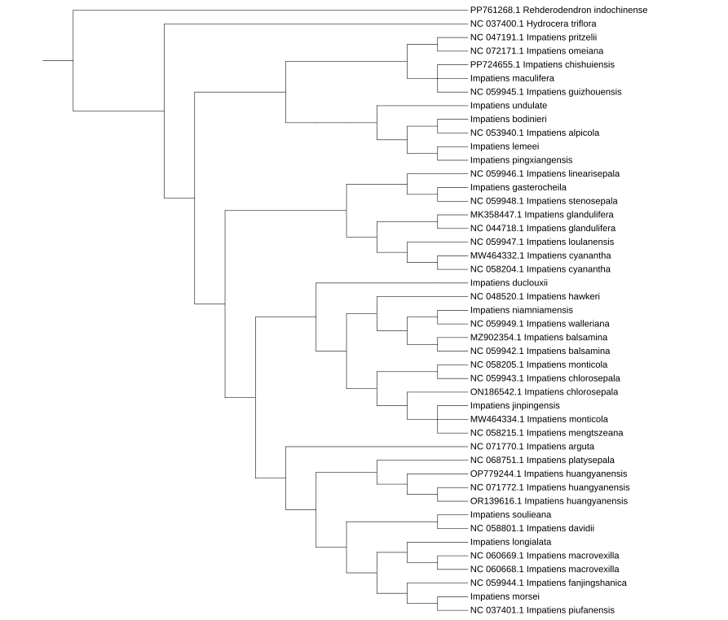
Fig S1 maximum parsimony phylogenetic tree based on complete chloroplast genoes

Slide 4
Table S3. Coding of the six morphological characters of 46 Balsaminaceaespecies
 | Capsule Shape | Sepal Number | Habit | Spur Length | Flower Colour | Morphology and Number of Aperture
Hydrocera triflora | 2 | 1 | 1 | 1 | 0 | 1
Impatiens chishuiensis | 0 | 1 | 1 | 2 | 0 | 1
Impatiens maculifera | 0 | 1 | 1 | 2 | 0 | 1
Impatiens guizhouensis | 0 | 1 | 1 | 2 | 3 | 1
Impatiens pritzelii | 0 | 1 | 1 | 2 | 0 | 1
Impatiens omeiana | 0 | 0 | 0 | 2 | 0 | 1
Impatiens linearisepala | 0 | 1 | 1 | 2 | 0 | 1
Impatiens gasterocheila | 1 | 1 | 1 | 1 | 1 | 1
Impatiens stenosepala | 2 | 1 | 1 | 1 | 2 | 1
Impatiens glandulifera | 0 | 0 | 0 | 2 | 1 | 1
Impatiens glandulifera | 0 | 0 | 0 | 2 | 1 | 1
Impatiens loulanensis | 0 | 0 | 0 | 2 | 0 | 1
Impatiens cyanantha | 0 | 0 | 0 | 2 | 2 | 1
Impatiens cyanantha | 0 | 0 | 0 | 2 | 2 | 1
Impatiens jinpingensis | 2 | 0 | 1 | 1 | 0 | 0
Impatiens undulate | 0 | 0 | 0 | 1 | 0 | 0
Impatiens lemeei | 0 | 0 | 0 | 2 | 2 | 0
Impatiens pingxiangensis | 3 | 1 | 1 | 1 | 2 | 0
Impatiens bodinieri | 0 | 0 | 0 | 1 | 0 | 0
Impatiens alpicola | 0 | 0 | 0 | 1 | 0 | 0
Impatiens platysepala | 1 | 0 | 1 | 2 | 2 | 0
Impatiens huangyanensis | 1 | 0 | 1 | 2 | 2 | 0
Impatiens huangyanensis | 1 | 0 | 1 | 2 | 2 | 0
Impatiens huangyanensis | 2 | 0 | 1 | 2 | 2 | 0
Impatiens soulieana | 1 | 0 | 0 | 2 | 0 | 0
Impatiens davidii | 1 | 1 | 1 | 2 | 0 | 0
1 Impatiens fanjingshanica | 0 | 0 | 0 | 2 | 2 | 0
Impatiens morsei | 3 | 0 | 1 | 2 | 1 | 0
Impatiens piufanensis | 1 | 0 | 0 | 2 | 1 | 0
Impatiens longialata | 1 | 0 | 0 | 2 | 0 | 0
Impatiens macrovexilla | 1 | 0 | 0 | 2 | 0 | 0
Impatiens macrovexilla | 1 | 0 | 0 | 2 | 0 | 0
Impatiens arguta | 2 | 1 | 1 | 2 | 2 | 0
Impatiens duclouxii | 2 | 0 | 0 | 2 | 1 | 0
Impatiens conchibracteata | 2 | 0 | 1 | 1 | 0 | 0
Impatiens hawkeri | 2 | 0 | 1 | 2 | 3 | 0
Impatiens balsamina | 2 | 0 | 0 | 2 | 1 | 0
Impatiens balsamina | 2 | 0 | 0 | 2 | 1 | 0
Impatiens niamniamensis | 2 | 0 | 1 | 2 | 0 | 0
Impatiens walleriana | 2 | 0 | 1 | 2 | 1 | 0
Impatiens monticola | 2 | 0 | 1 | 2 | 0 | 0
Impatiens chlorosepala | 2 | 0 | 1 | 2 | 0 | 0
Impatiens chlorosepala | 2 | 0 | 1 | 2 | 0 | 0
Impatiens monticola | 2 | 0 | 1 | 2 | 0 | 0
Impatiens mengtszeana | 2 | 0 | 1 | 2 | 0 | 0

