Slide 1

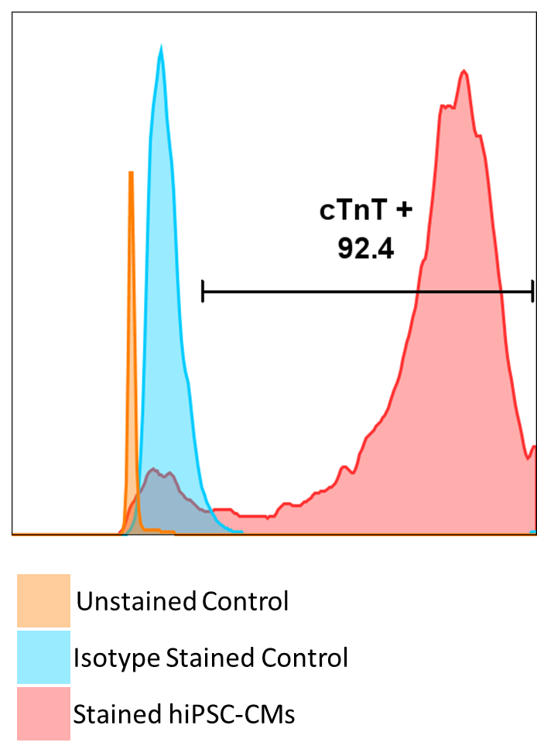



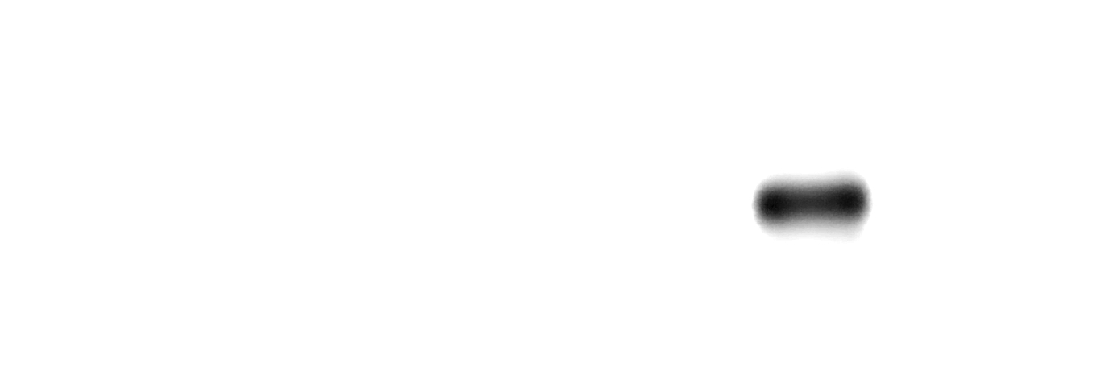


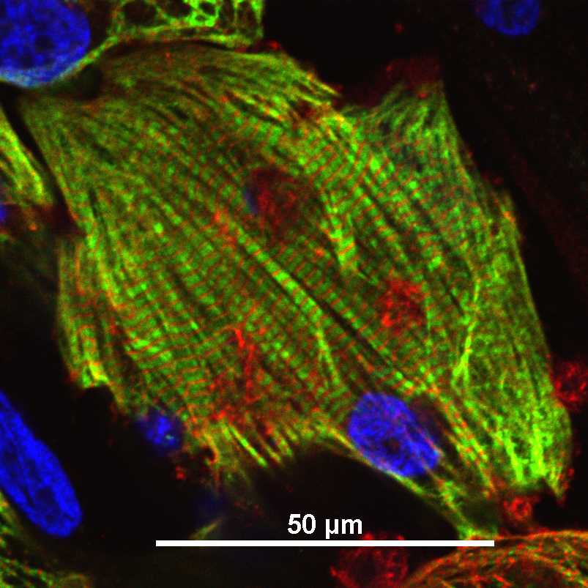
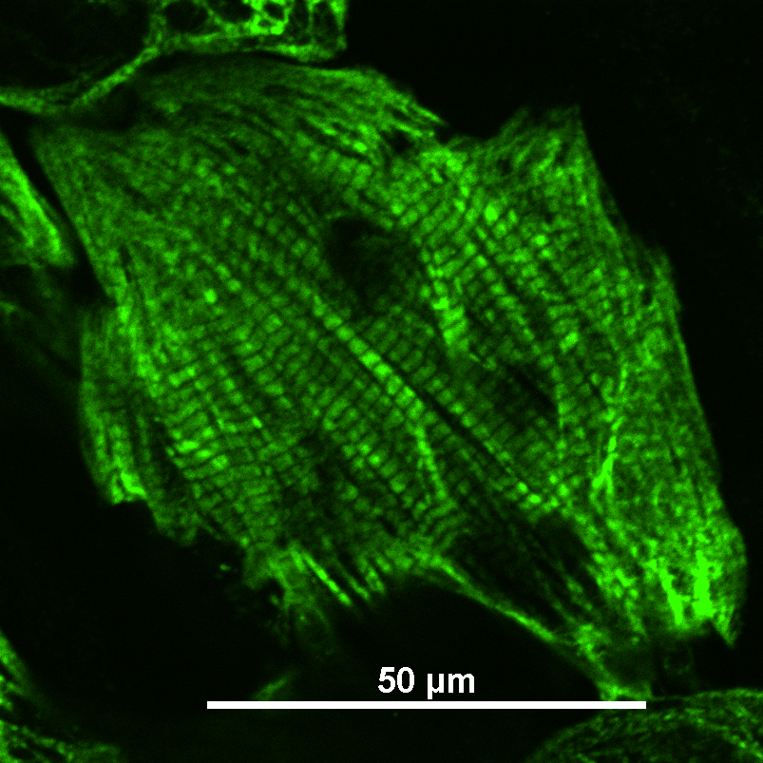
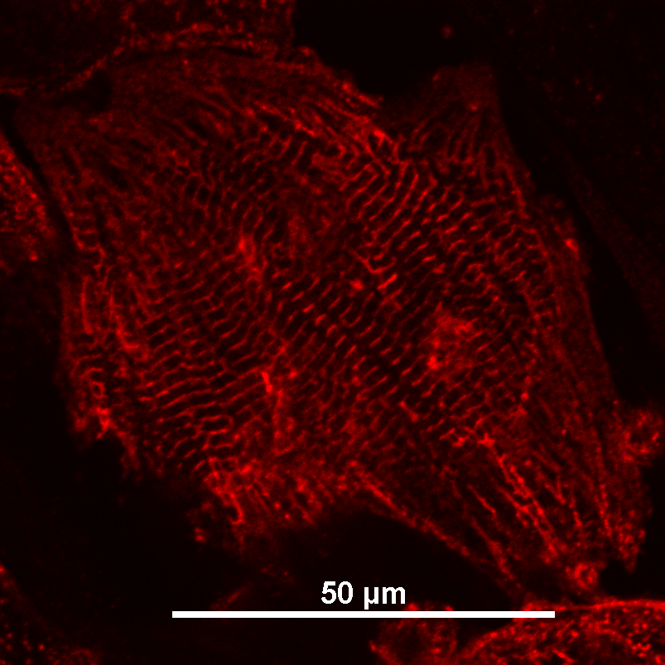
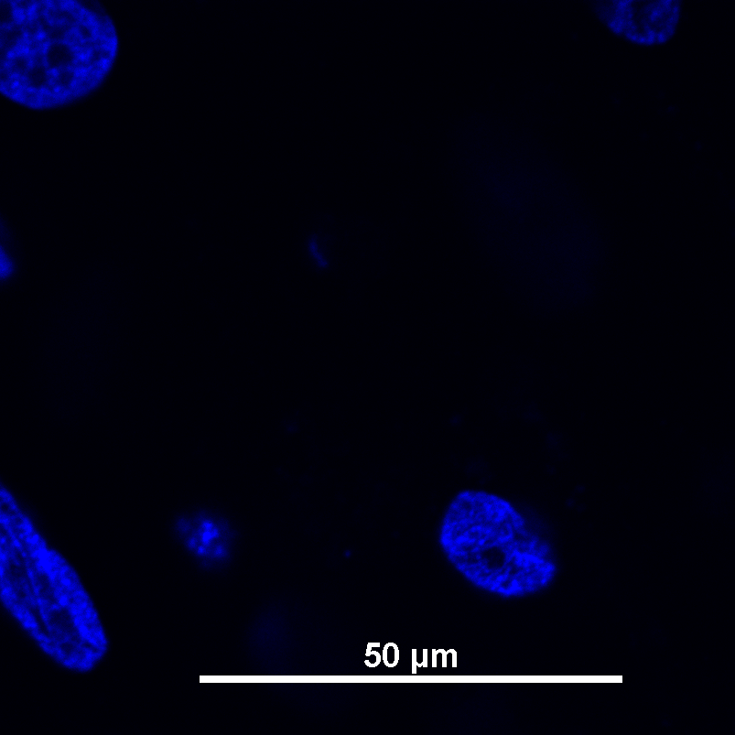
A
Protein Name
Molecular Weight
B
α-actinin
(hiPSC-CM Marker)
100 kDa
cTnT
(hiPSC-CM Marker)
36 kDa
NANOG
(hiPSC Marker)
38 kDa
OCT4
(hiPSC Marker)
40 kDa
SOX2
(hiPSC Marker)
40 kDa
Unstained Control
Vimentin
(Fibroblast Marker)
57 kDa
Isotype-Stained Control
cTnT-Stained hiPSC-CMs
GAPDH
(Loading Control)
37 kDa
hiPSC
Line
Differentiated
hiPSC-CMs
C
50 μm
50 μm
50 μm
50 μm
Supplemental Figure 2: hiPSC-CM Purity
A) Western blot for lineage specific markers for iPSCs (NANOG, OCT4, SOX2), day 14 post-differentiation hiPSC-CMs (cTnT, α-actinin), and iPSC-fibroblasts (vimentin) and GAPDH control. Lysate sample source indicated below Western blot.
B) Flow cytometry staining for cTnT—PE on day 14 post-differentiated hiPSC-CMs. Unstained control (orange), isotype stained control (blue), stained hiPSC-CMs (red).
C) Immunocytochemistry staining of day 24 post-differentiation hiPSC-CMs for cTnT (red), α-actinin (green), counterstained with DAPI (blue). Merged image in the left panel.

