Slide 1
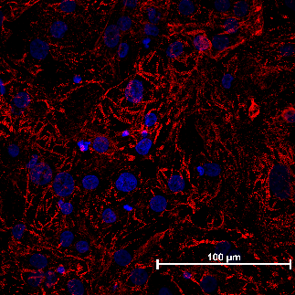
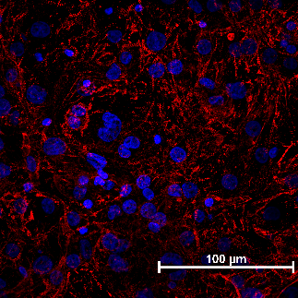
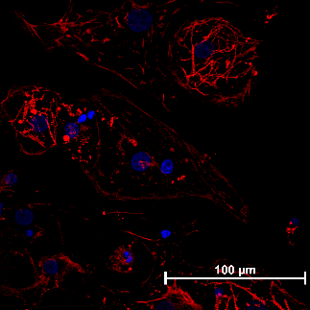
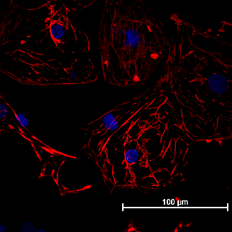
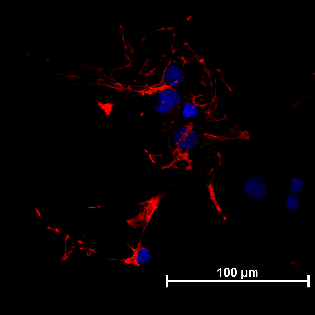
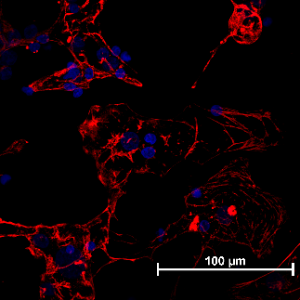
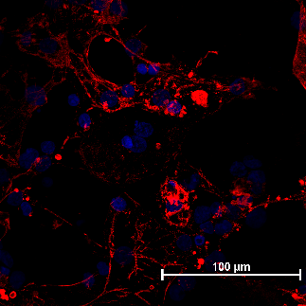
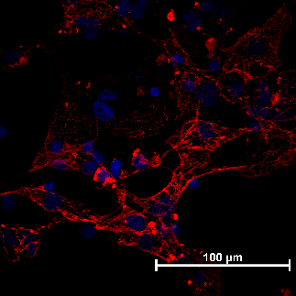
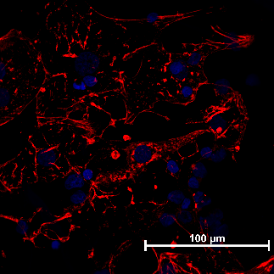
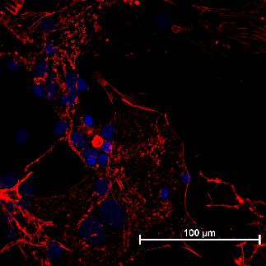
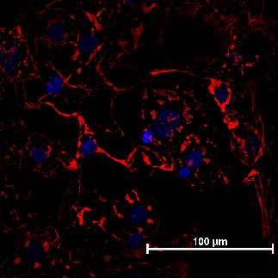
A
B
C
100µm
100µm
100µm
D
E
F
100µm
100µm
100µm
G
H
I
100µm
100µm
100µm
J
K
L
100µm
100µm
100µm
cTnT
DAPI

Slide 2
Supplemental Figure 4: impact of tissue culture myocarditis on sarcomere morphology
Sarcomere analysis for hiPSC-CMs across a range of myocarditis conditions. ICC for cTnT (Red) AND DAPI (Blue) to assess the impact on sarcomere morphology induced by indicated ratios of hPBMCs and the concentration of αCD3/CD28 mAbs.
A. CM (-) control. B. PBMC + Checkpoint. C. 3:1 15 ng Isotype. D. 3:1 15 ng Checkpoint. E. 3:1 30 ng Isotype. F. 3:1 30 ng Checkpoint. G. 4:1 15 ng Isotype. H. 4:1 15 ng Checkpoint. I. 4:1 30 ng Isotype. J. 4:1 30 ng Checkpoint. K. 5:1 15 ng Isotype. L. 5:1 15 ng Checkpoint.
Ratio indicates PBMC numbers relative to hiPSC-CM numbers. Amount of αCD3/CD28 mAbs indicated by “ng”. ‘Isotype’ refers to isotype control mAbs, while ‘Checkpoint’ refers to ICI biosimilars.
Experiments performed >10 times.

