Slide 1
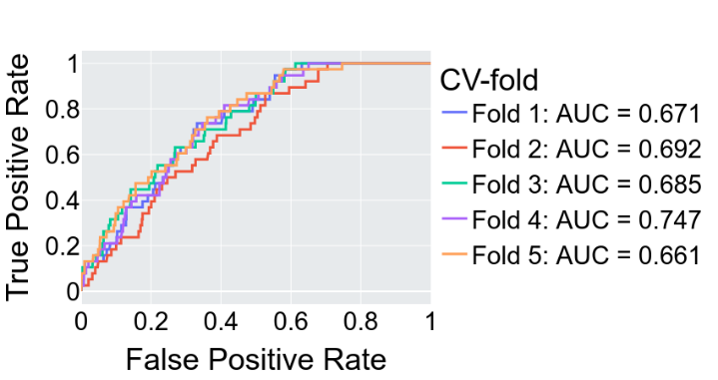
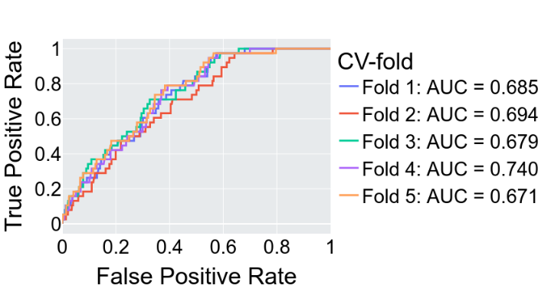
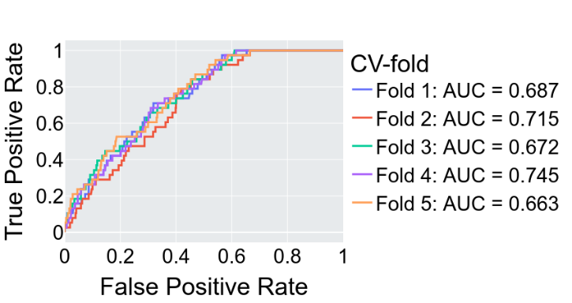
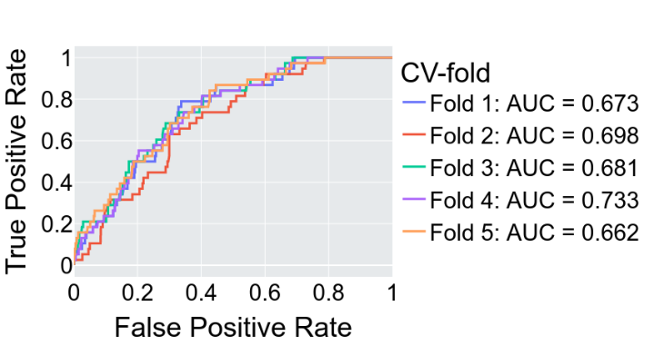
Logistic Regression
(Bernoulli) Naïve Bayes
Random Forest
Extreme Gradient Boosting
S1 Fig. ML model test performance (area under the receiver operating characteristic, AUROC). Only the test set AUCs evaluated from the 5-fold cross-validation for the four best-performing ML models are shown.

