Slide 1
Figure 2I
Nlrp3
106kDa
Pro-IL1β
37kDa
IL1β
17kDa
Pro-Caspase1
45kDa
Caspase1 p20
20kDa
ACTB
42kDa

Slide 2
Figure 4A
Nlrp3
106kDa
Pro-IL1β
37kDa
IL1β
17kDa
Pro-Caspase1
45kDa
Caspase1 p20
20kDa
ACTB
42kDa
IL1β
17kDa
Caspase1 p20
20kDa

Slide 3
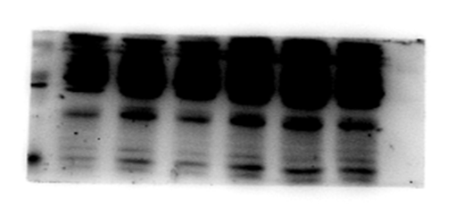
Figure 4B
106kDa
Nlrp3
Pro-IL1β
37kDa
IL1β
117kDa
Pro-Caspase1
45kDa
Caspase1 p20
20kDa
ACTB
42kDa
17kDa
IL1β
Caspase1 p20
20kDa

Slide 4
Figure 6C
Nlrp3
106kDa
CEBPB
36kDa
ACTB
42kDa

Slide 5
Figure 6E
CEBPB
36kDa
Lamin B
66kDa

Slide 6
Figure 7B
Nlrp3
106kDa
Caspase1
45kDa
PYCARD
25kDa
ACTB
42kDa

Slide 7
Figure 7D
MYC
106kDa
Flag
55kDa
ACTB
42kDa

Slide 8
Figure 7D
MYC
106kDa
Flag
110kDa
ACTB
42kDa

Slide 9
Figure 7D
MYC
106kDa
Flag
40kDa
ACTB
42kDa

Slide 10
Figure 7D
MYC
45kDa
Flag
55kDa
ACTB
42kDa

Slide 11
Figure 7D
MYC
25kDa
Flag
55kDa
ACTB
42kDa

Slide 12
Figure 7F
Flag
55kDa
106kDa
MYC
70kDa
Flag
55kDa
ACTB
42kDa

Slide 13
Figure 7G
Nlrp3
106kDa
USP14
54kDa
Caspase1
45kDa
PYCARD
25kDa
ACTB
42kDa

Slide 14
Figure 7H
Nlrp3
106kDa
Caspase1
45kDa
PYCARD
25kDa
USP14
54kDa
ACTB
42kDa

Slide 15
Figure 7I
106kDa
Nlrp3
USP14
54kDa
Caspase1
45kDa
25kDa
PYCARD
ACTB
42kDa

Slide 16
Figure 7J
Nlrp3
106kDa
Caspase1
45kDa
PYCARD
25kDa
USP14
54kDa
ACTB
42kDa

Slide 17
Figure 9C
P-MTOR
289kDa
MTOR
289kDa
P-AKT
56kDa
AKT
56kDa
P-PI3K
85kDa
PI3K
85kDa
ACTB
42kDa

Slide 18
Figure 9D
P-MTOR
289kDa
MTOR
289kDa
P-AKT
56kDa
AKT
56kDa
P-PI3K
85kDa
PI3K
85kDa
ACTB
42kDa

Slide 19
Figure 9E
P-MTOR
289kDa
MTOR
289kDa
P-AKT
56kDa
AKT
56kDa
P-PI3K
85kDa
PI3K
85kDa
ACTB
42kDa

Slide 20
Supplementary Figure 3A
NLRP3
106kDa
Flag
54kDa
ACTB
42kDa

