Slide 1
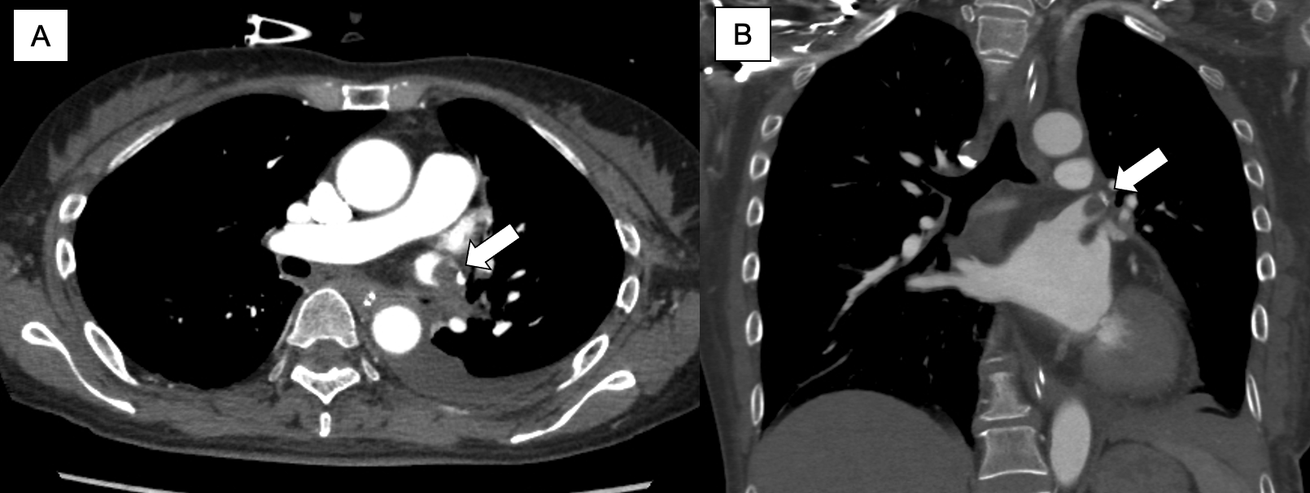
Supplemental Figure 1: Contrast-enhanced computed tomography shows a pulmonary vein stump thrombosis (arrow) developed two months after left upper lobectomy without intrapericardial superior pulmonary vein ligation [axial view (A), and coronal view (B)].

