Slide 1
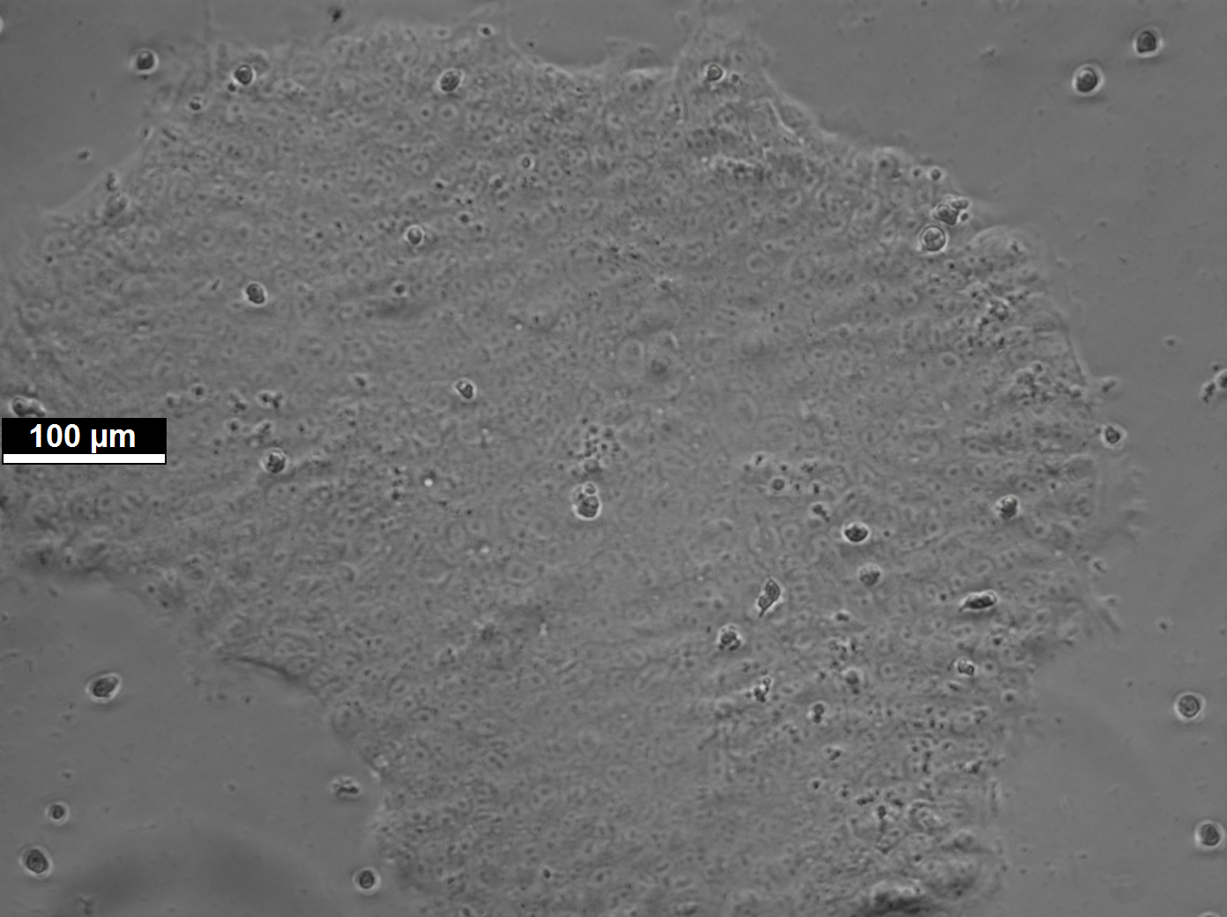
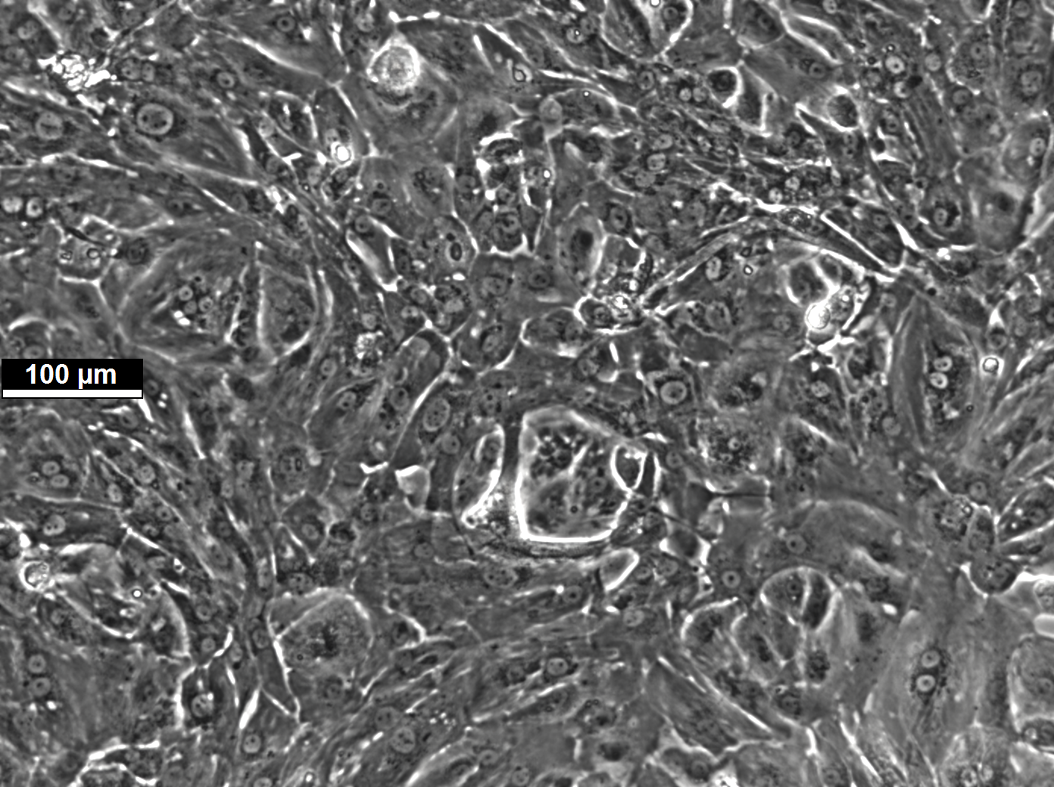
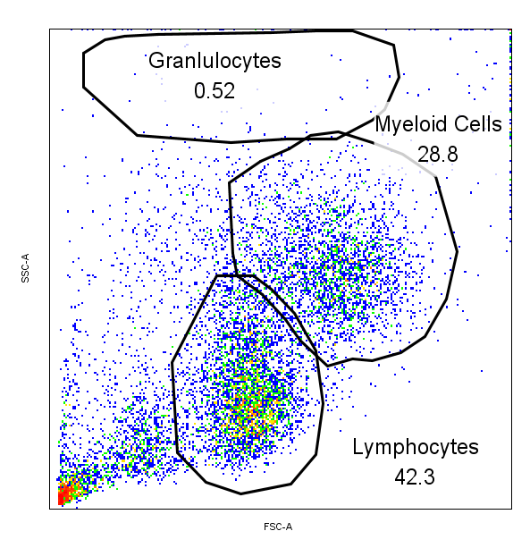
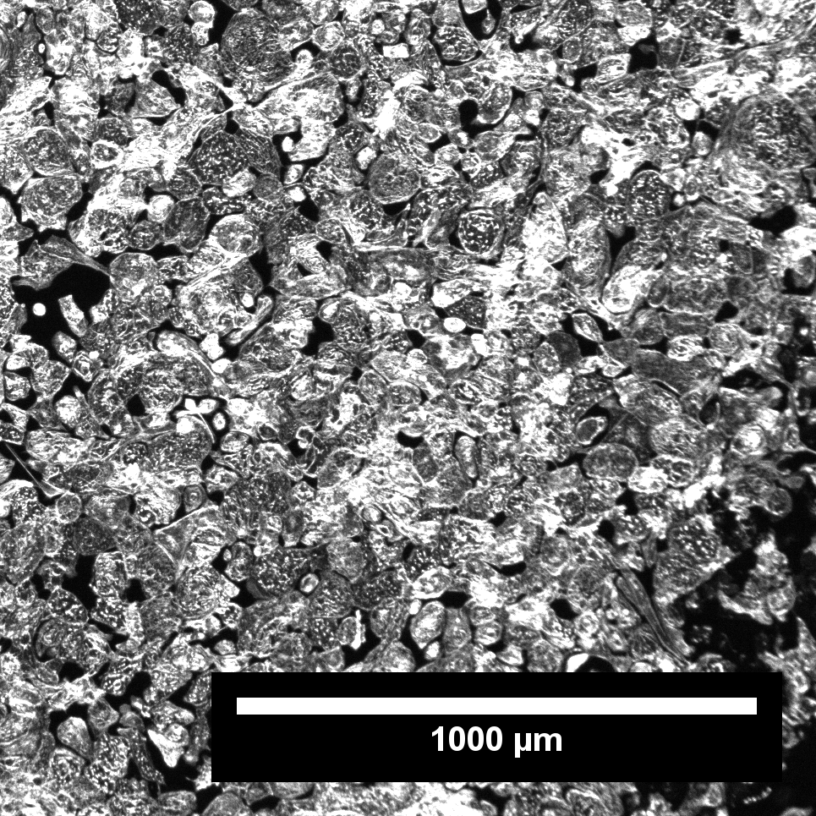
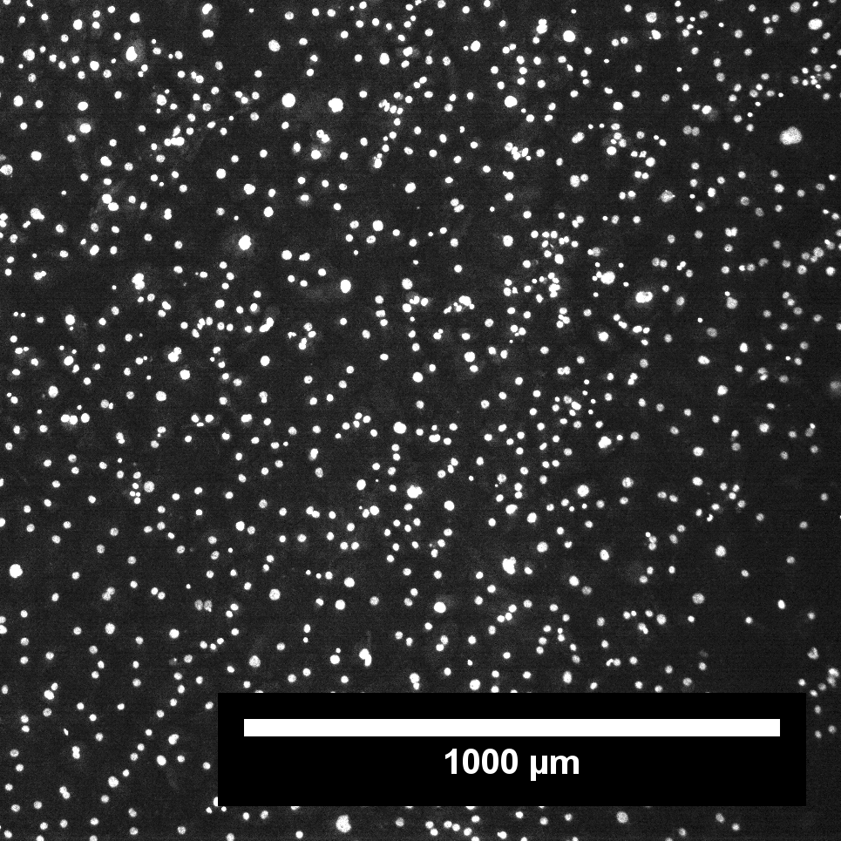
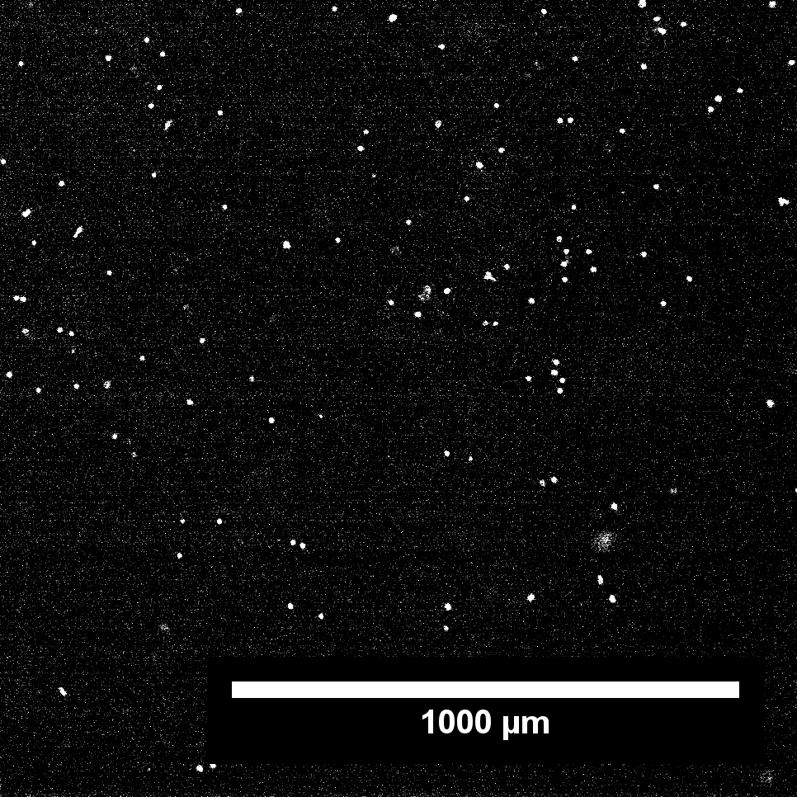
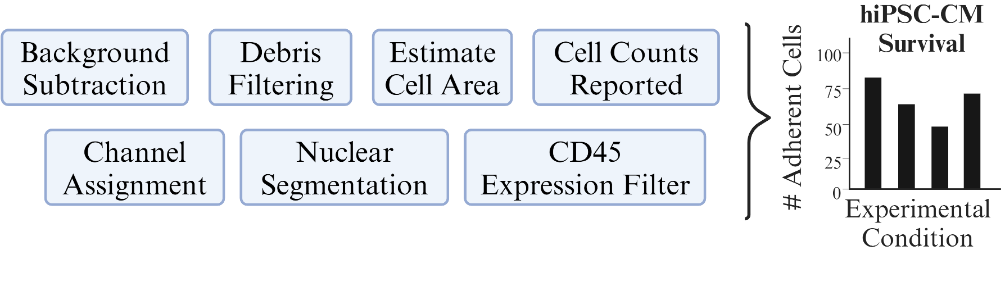
A
B
C
D
1000 μm
1000 μm
1000 μm
Supplemental Figure 1: Validation of hiPSC-CM differentiation and hPBMC isolation
Brightfield images demonstrating visual iPSCs (A) and differentiated hiPSC-CMs (B).
C) Representative SSC x FSC plot for unstained flow cytometric evaluation of hPBMCs.
D) Representative Phalloidin (left), DAPI (middle) and αCD45 (right) stained images used for visual viability analysis pipeline. Graphical overview of hiPSC-CM viability analysis pipeline
Experiments repeated 10 times for (A, B, C, D).

