Slide 1
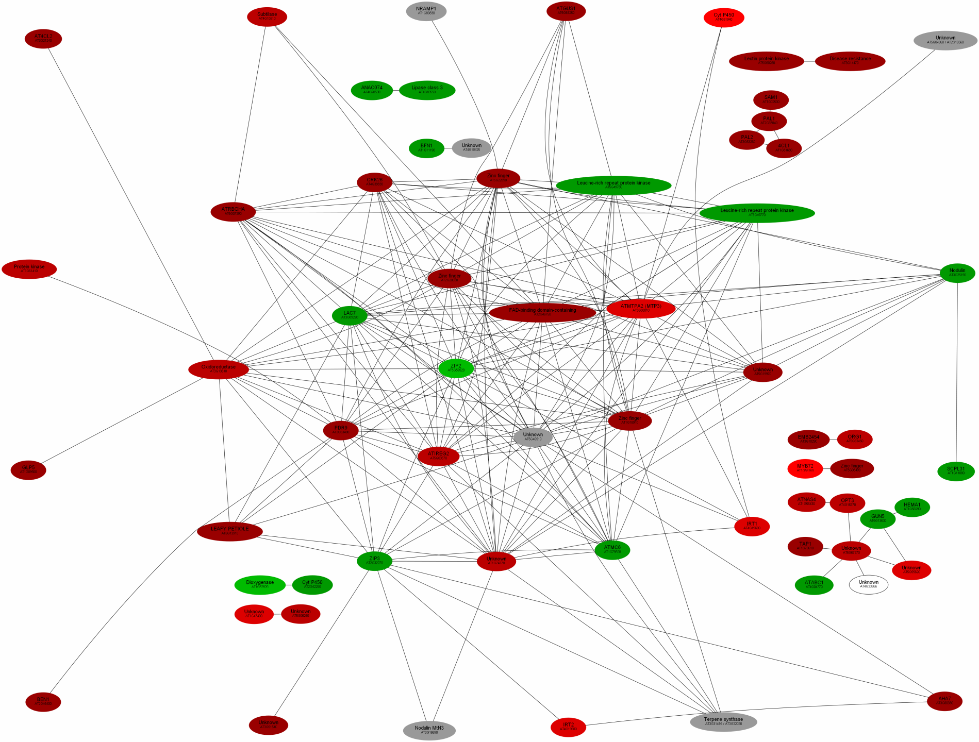
Supplemental Figure 2. Co-expression-based clustering of Fe-responsive genes. Genes were clustered on the basis of the expression patterns in
1436 microarray experiments (See Material and Methods for details). Red symbols represent up-regulated genes, green symbols denote down
regulation. Lighter color indicate higher regulation. Grey symbols represent genes that are not clustered when co-expression was based on
root-related microarray data.

