Slide 1
Supplementary Figure 1. Western blot analysis of SA-4-1BBL-Ova conjugates. Protein samples were run on an SDS-PAGE without heating. Half of the samples were run in the last 3 lanes for quantification purposes. Polyclonal antibodies against SA were used to detect SA-4-1BBL.
Anti-SA
Anti-OVA
Anti-OVA
OVA
SA-4-1BBL-OVA
SA-4-1BBL
OVA
SA-4-1BBL-OVA
SA-4-1BBL
OVA
SA-4-1BBL-OVA
SA-4-1BBL

Slide 2
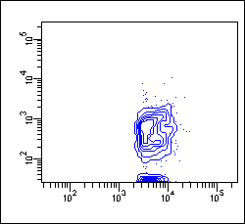

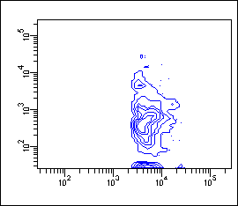
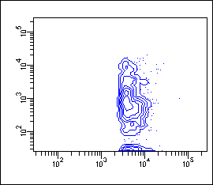
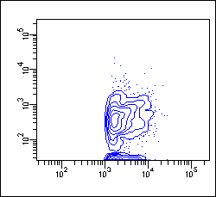
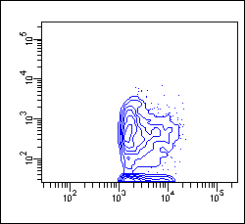
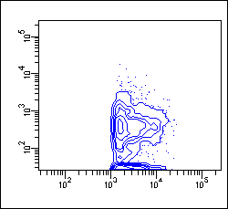
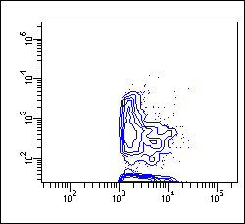
Supplementary Figure 2. Vaccination with SA-4-1BBL-Ova conjugates results in increased and sustained antigen cross-presentation by lymphoid DCs. C57BL/6 mice were vaccinated as in Fig. 1C, and draining LNs were harvested 4 and 7 days later to assess antigen cross-presentation as in Fig. 1C.
Naive
Ova
SA-4-1BBL+Ova
SA-4-1BBL-Ova conj
0.4%
3.9%
8.1%
16.8%
Day 4
Lymphoid DCs
0.3%
1.5%
2.1%
5.3%
Day 7

Slide 3
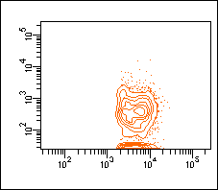
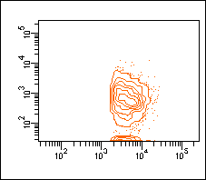
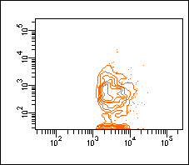
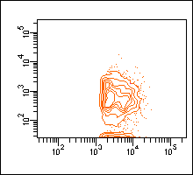
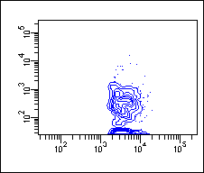
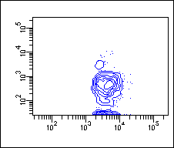
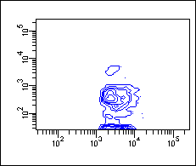
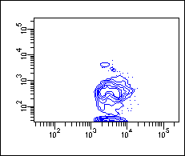
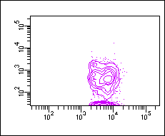
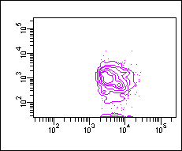
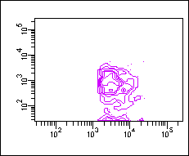
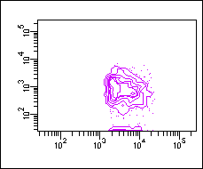
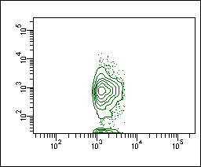

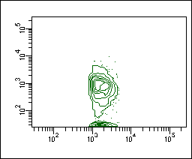
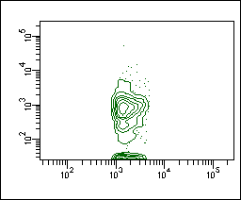
Supplementary Figure 3. Increased antigen cross-presentation is strictly dependent on 4-1BB expression. C57BL/6 4-1BB^{-/-} mice were vaccinated and analyzed as in Fig. 1C.
Naive
Ova
SA-4-1BBL+Ova
SA-4-1BBL-Ova conj
0.3%
4.5%
4.2%
4.4%
CD11c^{high} DCs 4-1BB^{-/-}
Lymphoid DCs
4-1BB^{-/-}
0.4%
5.3%
5.5%
5.1%
0.2%
2.1%
1.7%
2.3%
Myeloid DCs
4-1BB^{-/-}
K^{b}-SIINFEKL
0.9%
0.8%
0.6%
0.8%
Plasmacytoid DCs 4-1BB^{-/-}
CD11c
Notes:
3

Slide 4
Supplementary Figure 4. Vaccination with SA-4-1BBL-Ova conjugates results in increased antigen presentation to OT-II CD4⁺ T cells in vivo. C57BL/6.SJL (CD45.1⁺) mice were immunized s.c. with Ova (10 µg) conjugated or nonconjugated with 5 µg of SA-4-1BBL as indicated. Two million flow sorted OT-II T cells (CD45.2⁺) were labeled with CFSE and injected i.v. 24 h later. Proliferation was assessed using flow cytometry 3 days later.
Naive
OVA (10 µg)
60
60
40
7.48%
40
8.74%
20
20
0
10
0
10
1
10
2
10
3
10
4
0
10
0
10
1
10
2
10
3
10
4
Relative cell number
SA-4-BBL+ OVA (5+10 µg)
SA-4-1BBL-OVA conj (5-10 µg)
80
60
80
13.1%
60
44.8%
40
40
20
20
0
10
0
10
1
10
2
10
3
10
4
0
10
0
10
1
10
2
10
3
10
4
CFSE

Slide 5
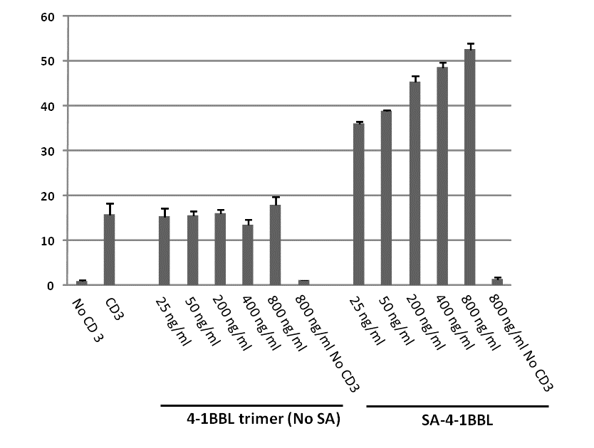
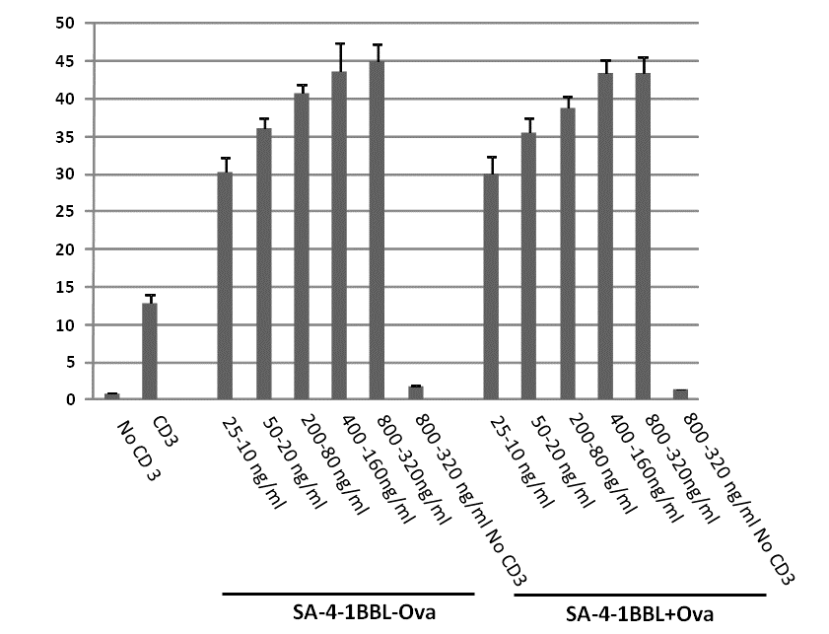
Supplementary Figure 5. The potent costimulatory activity of SA-4-1BBL requires SA as the structural component of the molecule. A, a trimeric form of 4-1BBL without SA does not have costimulatory activity. Splenocytes were cultured (1 x 10⁵/well) with various doses of soluble 4-1BBL trimer (no SA) or SA-4-1BBL in the presence of soluble anti-CD3 Ab (0.05 µg/mL) for 3 days in complete MLR medium. Cultures were pulsed with [³H]-thymidine during the last 16 hrs of the culture, and harvested on a Tomtec Harvester 96 (Tomtec Inc., Hamden, CT) for quantification of incorporated radioactivity. Results expressed as mean ±SD cpm of triplicate wells. 4-1BBL trimer lacks costimulatory activity, while SA-4-1BBL demonstrates potent costimulatory activity. B, conjugating antigens to SA-4-1BBL does not increase the costimulatory activity of SA-4-1BBL. Experimental conditions were as in (A), except the indicated doses of SA-4-1BBL conjugated or nonconjugated to Ova were used for stimulation. There is no statistical difference between conjugated and nonconjugated SA-4-1BBL costimulatory activity at all concentrations tested.
A
B
Proliferation (cpm x 10³)
Proliferation (cpm x 10³)

Slide 6
Supplementary Material and Methods
Cloning, expression, and purification of HPV16 E7 and mouse survivin.
The E7 antigen is a modified recombinant protein from HPV-16. The E7 cDNA was reported previously (1). To alleviate concerns of native E7 oncogenicity, a mutated version of the protein was constructed by site-directed mutagenesis (XL-QuickChange; Stratagene). It has been demonstrated that a mutation at E7 position 24 and/or 26 disrupts the Rb binding site of E7, abolishing the capacity of E7 to transform cells (2). Therefore a double mutant was made by replacing Cys24 and Glu26 with glycines. Mouse survivin cDNA was purchased from OriGene Technologies, Inc. For both constructs, the cDNAs were amplified by PCR and the products were subcloned into pTWIN-1 (New England Biolabs) bacterial expression vectors using NdeI and BamHI or BamHI sites. The E7 and survivin constructs also contain a 6X-histidine tag for purification. C2566 competent E. coli cells (New England Biolabs) were transfected with pTWIN-E7 or pTWIN-survivin cDNA for protein expression and purification.
Protein expression was induced with IPTG in the presence of 10 µM ZnCl₂ to assist with proper folding. Inclusion bodies were harvested, washed extensively by resuspending in lysis buffer containing 1% Triton X-100, and solubilized in 6M Guanidine-HCl. Soluble proteins were loaded on IMAC columns and washed with 6M Guanidine-HCl containing 0.1% Triton X-114 to remove endotoxin. Columns were washed with lysis buffer containing decreasing amounts of urea (6M-0M; 2M steps), with the first 2 steps (6M and 4M) containing 0.1% Triton X-114. Proteins were eluted with elution buffer (20 mM Tris, pH 7.0, 250 mM imidazole, 5 mM β-ME, 10 µM ZnCl₂) at room temperature. Proteins were dialyzed against PBS, concentrated using an Amicon Ultra filter unit, sterile filtered using a 0.22 µm filtration device, and tested for endotoxin (E7 = 0.021 EU/µg protein; survivin = 0.066 EU/µg protein). Proteins concentration was measured using BCA and Bradford methods (Pierce), aliquoted into single-use aliquots, and stored at -80°C.

Slide 7
Supplemental References
Gomez-Gutierrez,J.G., Elpek,K.G., Montes,d.O.-L., Shirwan,H., Sam,Z.H., and McMasters,K.M. 2007. Vaccination with an adenoviral vector expressing calreticulin-human papillomavirus 16 E7 fusion protein eradicates E7 expressing established tumors in mice. Cancer Immunol. Immunother. 56:997-1007.
Munger,K., Basile,J.R., Duensing,S., Eichten,A., Gonzalez,S.L., Grace,M., and Zacny,V.L. 2001. Biological activities and molecular targets of the human papillomavirus E7 oncoprotein. Oncogene 20:7888-7898.

