Slide 1
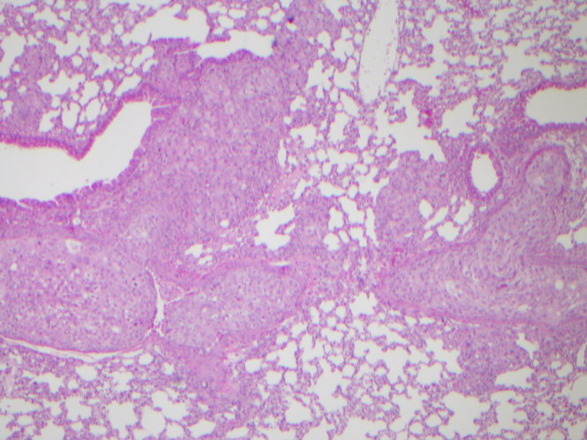
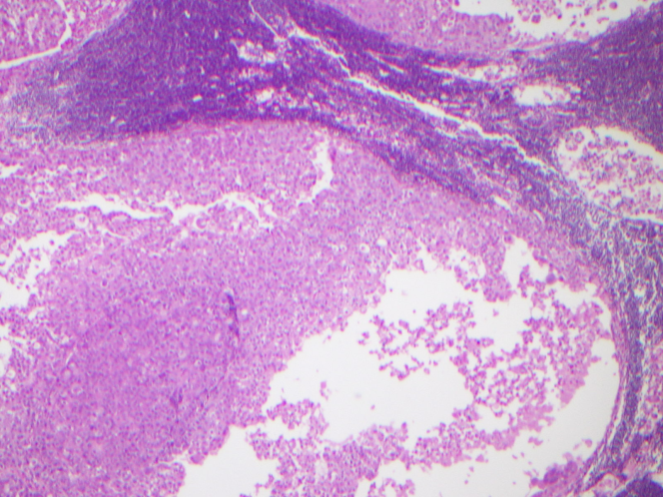
SUPPLEMENTARY FIGURE 3
Lungs
Lymph Nodes

