Slide 1
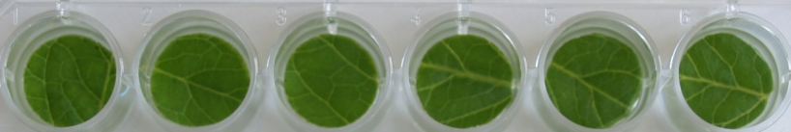
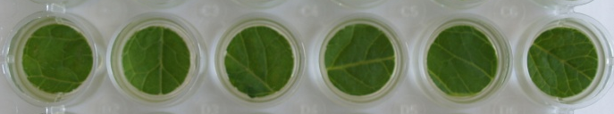
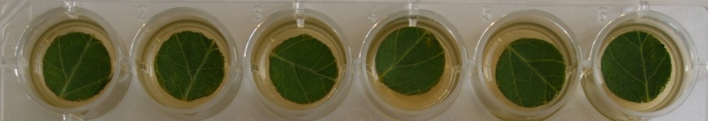
wild type sitiens
0 U mL⁻¹
100 U mL⁻¹
1000 U mL⁻¹

