Slide 1
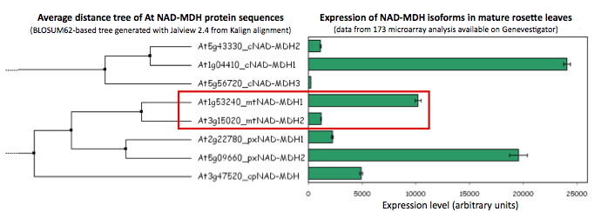
Suppl Figure S1. mMDH genes in At and t-DNA mutant characterization.
(A) Relative expression of MDH gene isoforms in rosette leaves in Arabidopsis. (B) T-DNA insertion lines available for At1g53240 and At3g15020. (C) PCR amplification of intact genes and t-DNA inserts in single and double mutants. (D) Plant growth of single mmdh1-2, mmdh2-1 and mmdh1-2mmdh2 and mmdh1-1mmdh2 plants compared to wildtype under short day conditions. (E) Plant growth of single mmdh1-2, mmdh2-1 and mmdh1-2mmdh2 plants compared to wildtype under grown under controlled medium day conditions with elevate atmospheric CO2 (5000 parts per million) (F) Total MDH activity in isolated mitochondria, showing activity in intact mitochondria and activity after organelle rupture with Triton X-100. Bars are mean ± s.e. (n=3) (G) Malate-dependent respiratory rate of isolated intact mitochondria at pH 6.5 to maximize NAD-ME activity, and at pH 7.5 to maximize MDH activity. Bars are mean ± s.e. (n=3)
A) MDHs in Arabidopsis
B) T-DNA insertions available
At1g53240
mMDH1
0 400 800 1200 1600 2000
mmdh 1-2
mmdh1-1
GABI_540F04
GABI_097C10
At3g15020
mMDH2
0 400 800 1200 1600 2000
mmdh 2-1
SALK_126994

Slide 2
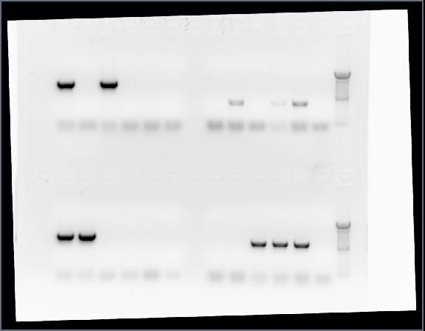
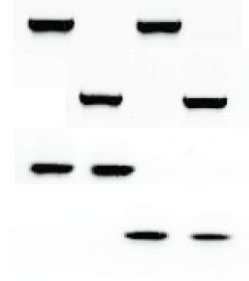
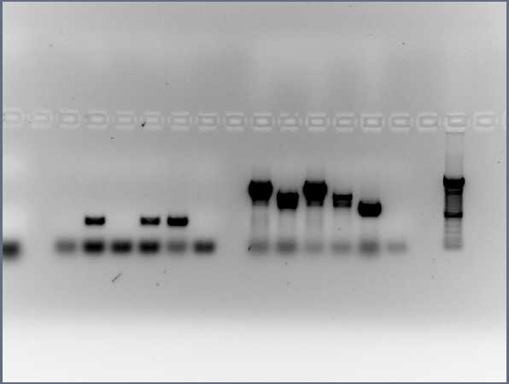
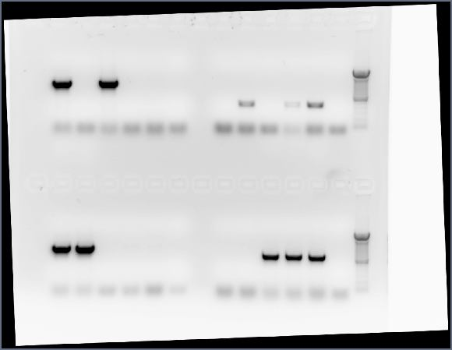
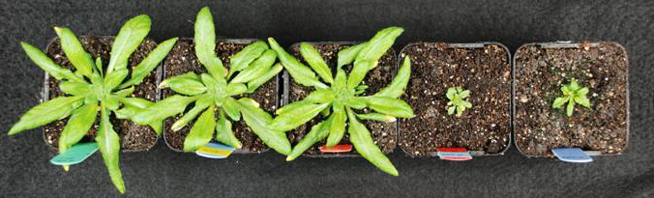
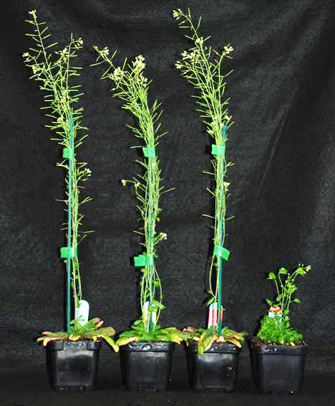
C) PCR on DNA for insertions and wildtype MMDH genes in mutants
mmdh1-1mmdh2
mmdh1-2mmdh2
WT
mmdh1-1
mmdh2-1
WT
mmdh1-2
mmdh2-1
Primer combination
mMDH1-2 OR mMDH1-1 LB + RB
Gabi LB + mMDH1-2 OR mMDH 1-1 RB
mMDH2-1 LB + RB
SALK Lba1 + mMDH2-1 RB
D) Plant growth of mmdh knockout plants under short day conditions
40 days
Wt
mmdh1-2
mmdh2
mmdh1-2
mmdh2
mmdh1-1
mmdh2
E) Plant growth of mmdh knockout plants under medium day conditions in a high (5000ppm) CO₂ atmosphere
42 days
Wt
mmdh1-2
mmdh2
mmdh1-2
mmdh2

Slide 3
(F) Total MDH activity in isolated mitochondria
(G) Malate-dependent respiratory rate of isolated intact mitochondria

Slide 4
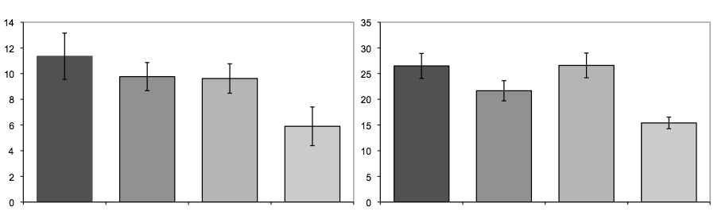
Suppl. Figure S2. Additional phenotypic characterization of mmdh mutants.
(A) Germination assays of mutants
(A) Germination rate of wildtype and mmdh1mmdh2 mutant seeds with or without MS media over a 7 day period. (B) Average seed production per plant in outside growth Wt, mmdh1-2, mmdh2-1 and mmdh1mmdh2 mutants. (C) Rosette size (diameter) and leaf number in 6 week old plants in Wt, mmdh1-2, mmdh2-1 and mmdh1mmdh2 mutants.
100
80
WT MS+
60
WT MS-
Germination Frequency (%)
40
mmdh1mmdh2 MS+
20
0
mmdh1mmdh2 MS-
Day 0
Day 1
Day 2
Day 3
Day 4
Day 5
Day 6
Day 7
(B) Seed production outside
Genotype seeds per plant
Wt 2087±213 (n=40)
mmdh1-2 878±73 (n=40, p-value 1.278 e-07)
mmdh2-1 1686±236 (n=40, p-value 0.2095))
mmdh1mmdh2 all plants died (n=30)
(C) Rosette size and leaf number measurements at 6 weeks
Rosette diameter (cm)
Leaf number
Wt
mmdh1-2
mmdh2-1
mmdh1
mmdh2
Wt
mmdh1-2
mmdh2-1
mmdh1
mmdh2

Slide 5
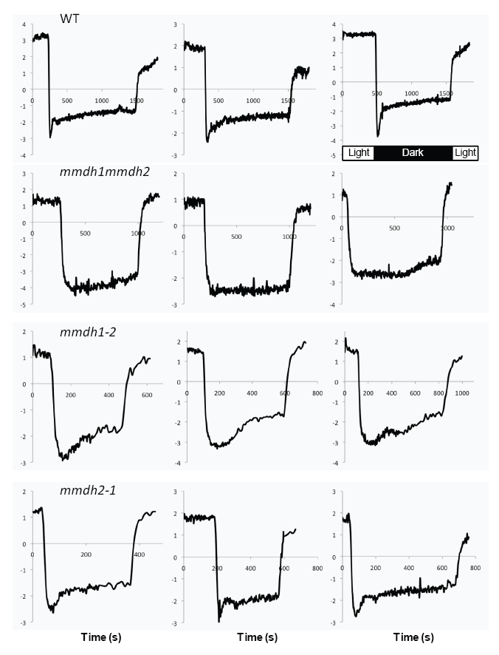
Suppl. Figure S3: Kinetics of CO₂ evolution during the post-illumination period in mmdh mutants.
Leaves were kept under photorespiratory conditions (PPFD = 1000 μmol.m⁻².s⁻¹; 100 ppm CO₂) and were then shifted to the dark. The light was turned on again when a steady-state was reached. The transient peak measured in the first seconds of the dark period results from the decarboxylation of the large glycine pool built up under photorespiratory conditions, a phenomenon known as the post-illumination burst (PIB). After the peak, the rate of CO₂ evolution increases slowly and reaches a steady-state after several minutes. The period of increased respiration is termed light-enhanced dark respiration (LEDR). The rate of CO₂ evolution was recorded every two seconds. Three representative kinetics are shown for each genotype.

Slide 6
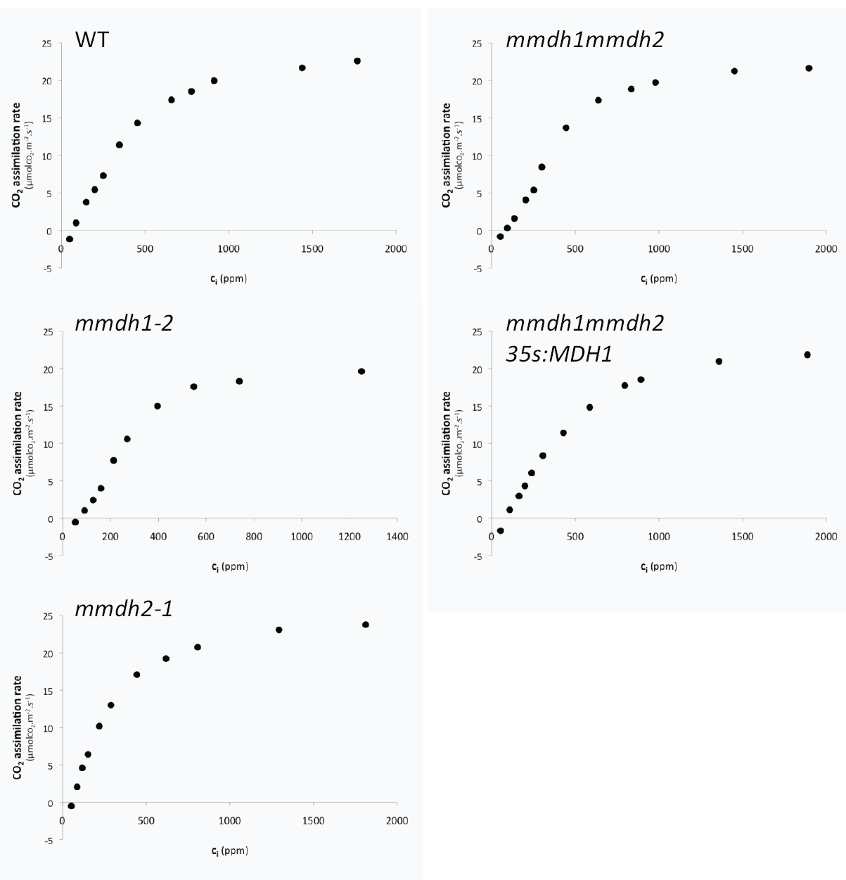
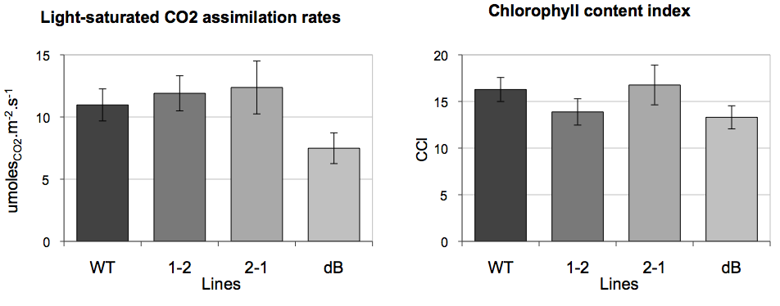
Suppl. Figure S4.
A/Ci curves for mmdh mutants, light saturated CO₂ assimilation rates and chlorophyll content index measurements. (A) Graphs showing the break in A/Ci curves for Wt, mmdh1-2, mmdh2, mmdh1mmdh2, and mmdh1mmdh2 35S:mMDH1 . (B) Light-saturated CO₂ assimilation in wildtype compared to mmdh1-2, mmdh2 and mmdh1mmdh2, (C) chlorophyll content index in wildtype compared to mmdh1-2, mmdh2 and mmdh1mmdh2.
A
B
C
Wt
mmdh1-2
mmdh2
mmdh1
mmdh2
Wt
mmdh1-2
mmdh2
mmdh1
mmdh2

Slide 7
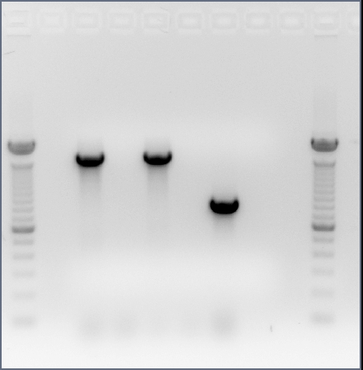
Supplemental Figure S5. PCR amplification of intact genes, t-DNA inserts and inserted mMDH1 cDNA in single and double mutants and the complemented mutant, used in Figure 7 and 8 experiments.
mmdh1mmdh2
35S:mMDH1
mmdh1-2
mmdh1mmdh2
WT
mmdh2-1
Primer combination
a) mMDH1-2 LB + RB
b) Gabi LB + mMDH1-2 RB
c) mMDH2-1 LB + RB
d) SALK Lba1 + mMDH2-1 RB
e) mMDH1-2 full length genomic fragment
1.611 bp
800 bp
mMDH1 cDNA

