Slide 1
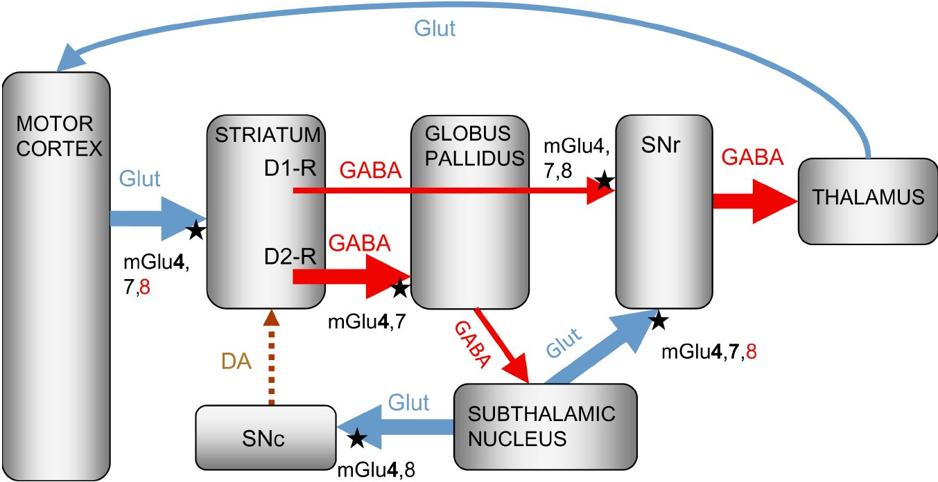
From S Duty Br J Pharmacol 2010 doi:10.1111/j.1476-5381.2010.00882.x/bph.882
British Journal of Pharmacology © 2010 The British Pharmacological Society

Slide 2
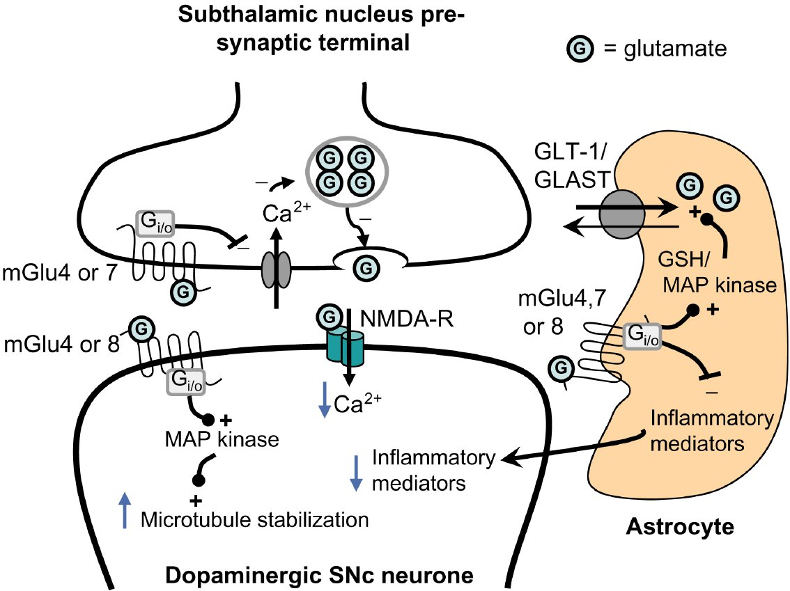
From S Duty Br J Pharmacol 2010 doi:10.1111/j.1476-5381.2010.00882.x/bph.882
British Journal of Pharmacology © 2010 The British Pharmacological Society

