Slide 1
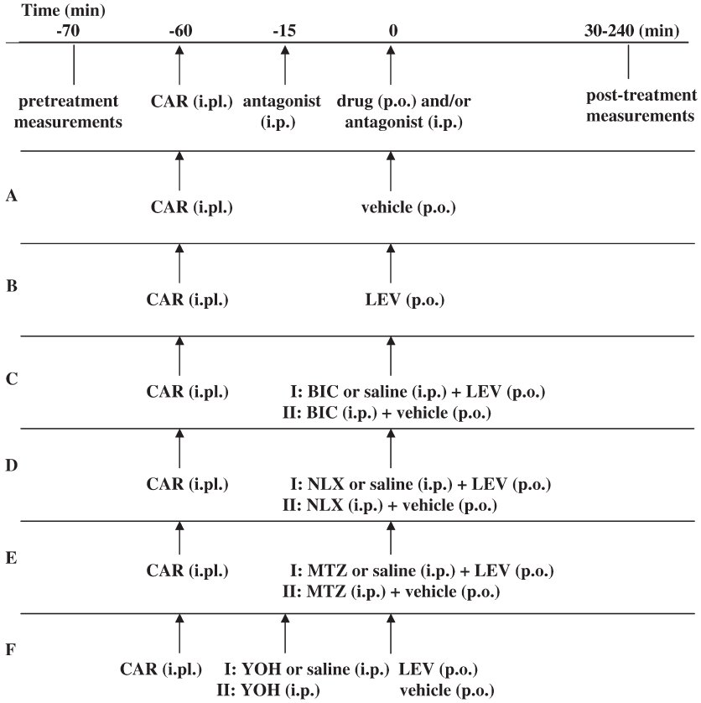
From A Micov et al. Br J Pharmacol 2010 doi:10.1111/j.1476-5381.2010.00877.x/bph.877
British Journal of Pharmacology © 2010 The British Pharmacological Society

Slide 2
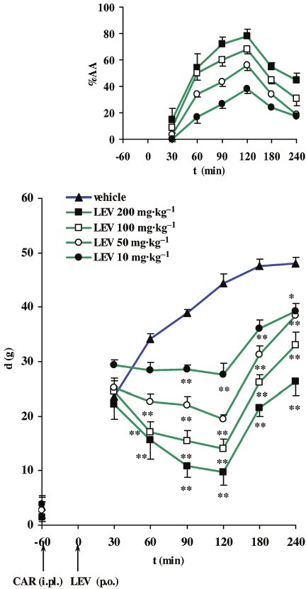
From A Micov et al. Br J Pharmacol 2010 doi:10.1111/j.1476-5381.2010.00877.x/bph.877
British Journal of Pharmacology © 2010 The British Pharmacological Society

Slide 3
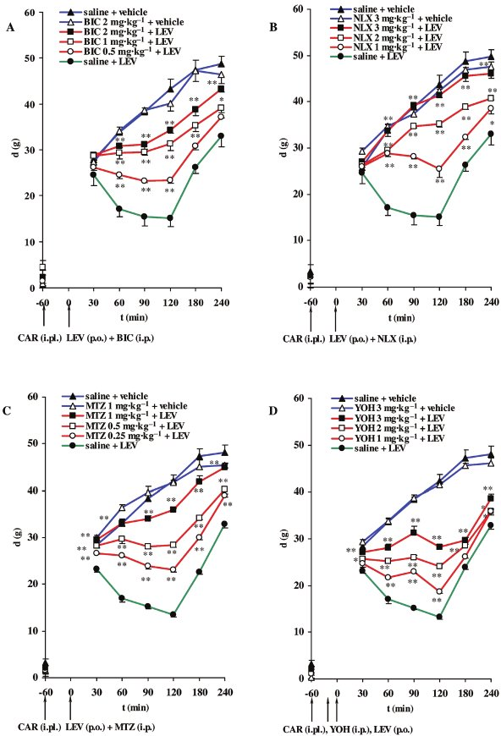
From A Micov et al. Br J Pharmacol 2010 doi:10.1111/j.1476-5381.2010.00877.x/bph.877
British Journal of Pharmacology © 2010 The British Pharmacological Society

Slide 4
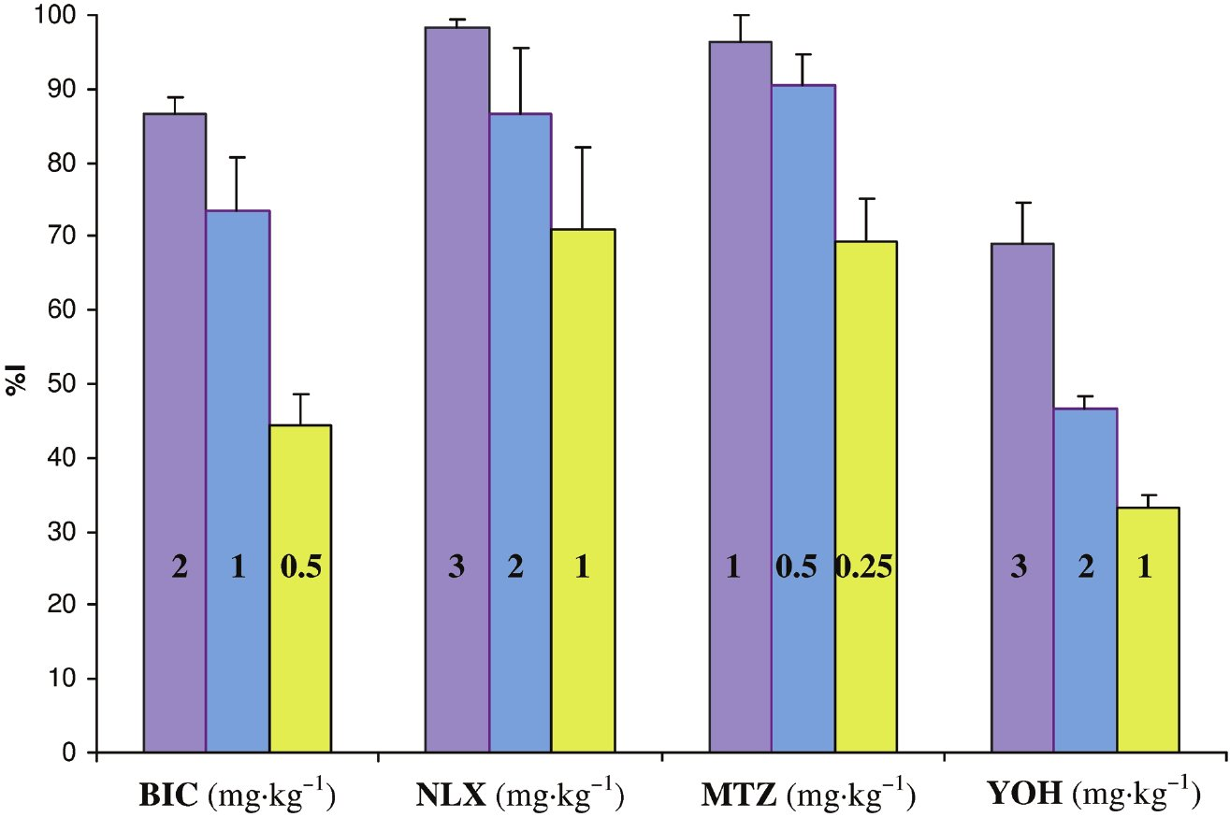
From A Micov et al. Br J Pharmacol 2010 doi:10.1111/j.1476-5381.2010.00877.x/bph.877
British Journal of Pharmacology © 2010 The British Pharmacological Society

