Slide 1
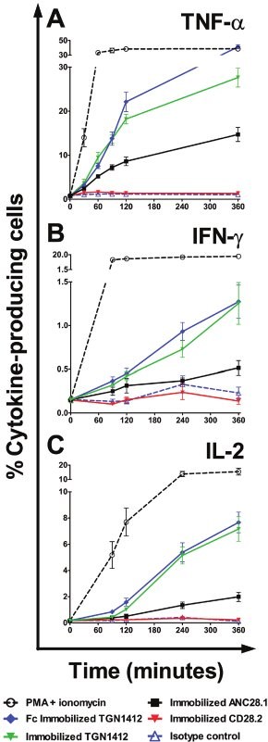
From D Eastwood et al. Br J Pharmacol 2010
doi:10.1111/j.1476-5381.2010.00922.x/bph.922
British Journal of Pharmacology © 2010 The British Pharmacological Society

Slide 2
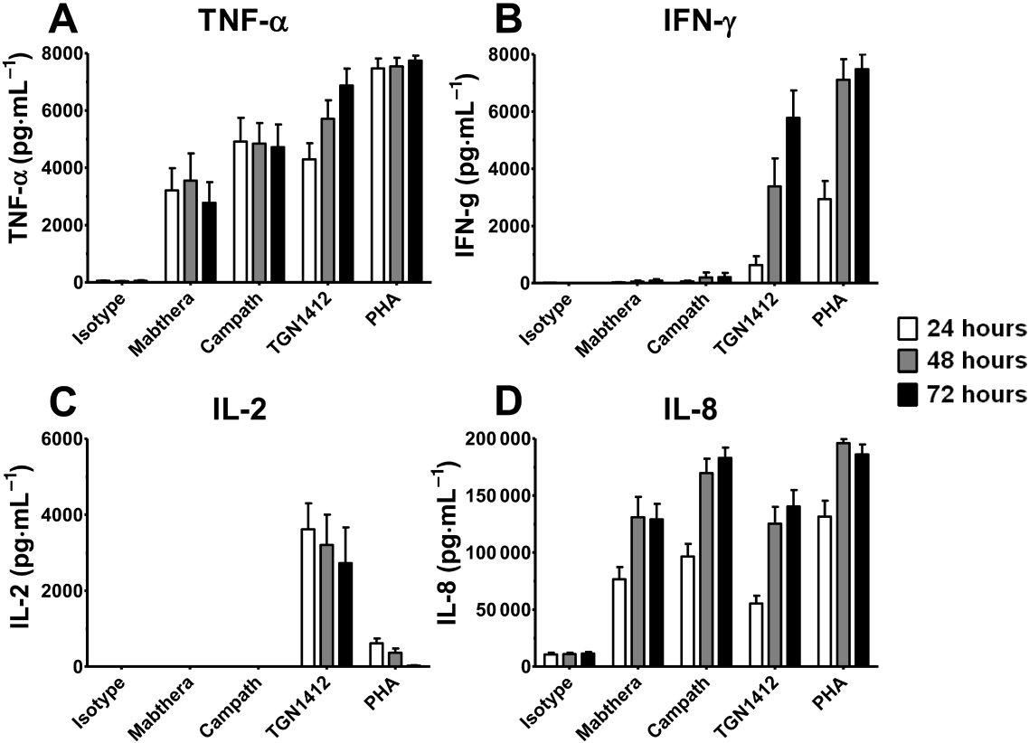
From D Eastwood et al. Br J Pharmacol 2010
doi:10.1111/j.1476-5381.2010.00922.x/bph.922
British Journal of Pharmacology © 2010 The British Pharmacological Society

Slide 3
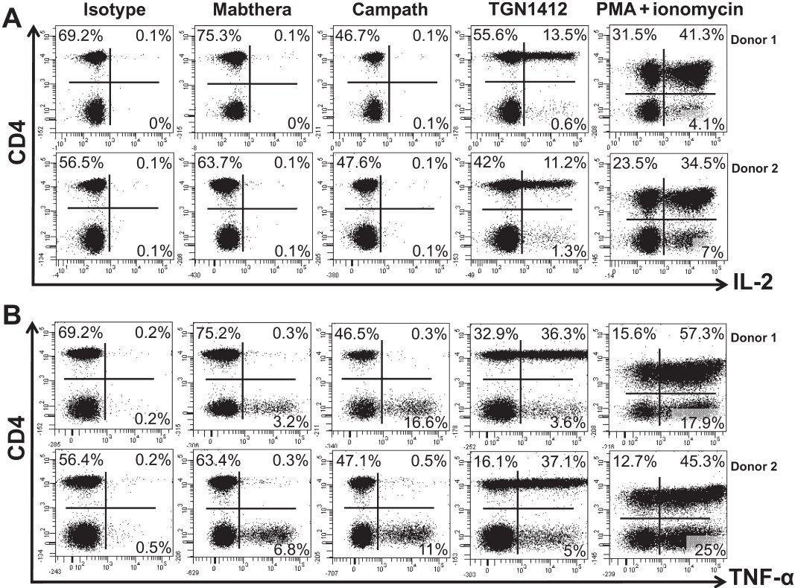
From D Eastwood et al. Br J Pharmacol 2010
doi:10.1111/j.1476-5381.2010.00922.x/bph.922
British Journal of Pharmacology © 2010 The British Pharmacological Society

Slide 4
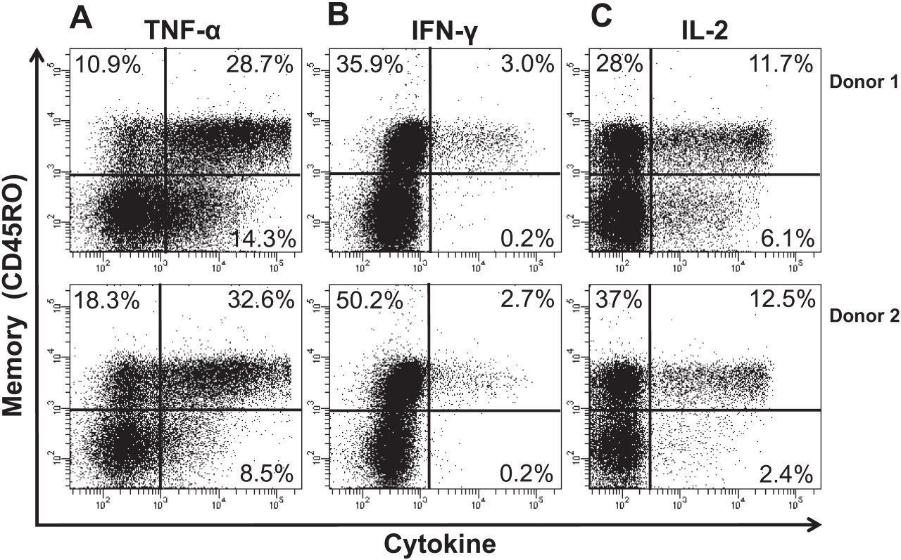
From D Eastwood et al. Br J Pharmacol 2010
doi:10.1111/j.1476-5381.2010.00922.x/bph.922
British Journal of Pharmacology © 2010 The British Pharmacological Society

Slide 5
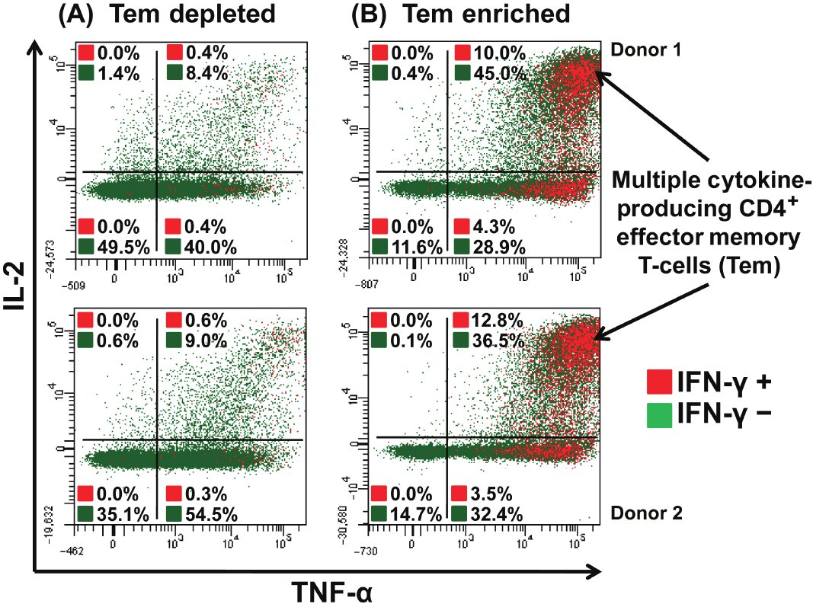
From D Eastwood et al. Br J Pharmacol 2010
doi:10.1111/j.1476-5381.2010.00922.x/bph.922
British Journal of Pharmacology © 2010 The British Pharmacological Society

Slide 6
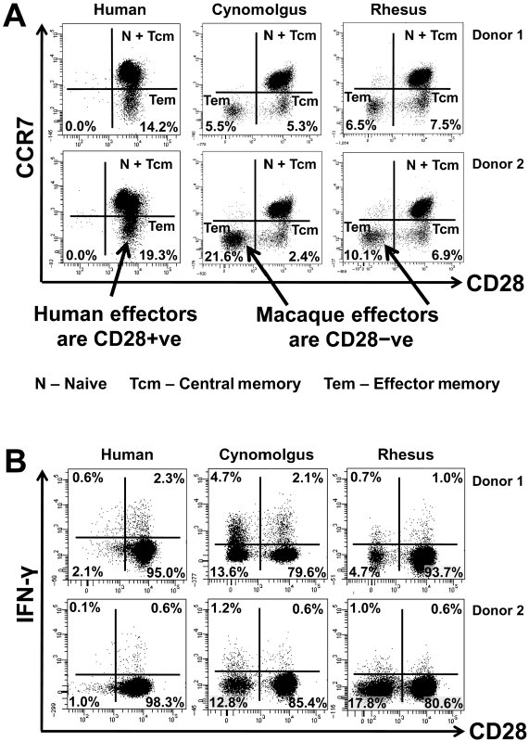
From D Eastwood et al. Br J Pharmacol 2010
doi:10.1111/j.1476-5381.2010.00922.x/bph.922
British Journal of Pharmacology © 2010 The British Pharmacological Society

