Slide 1
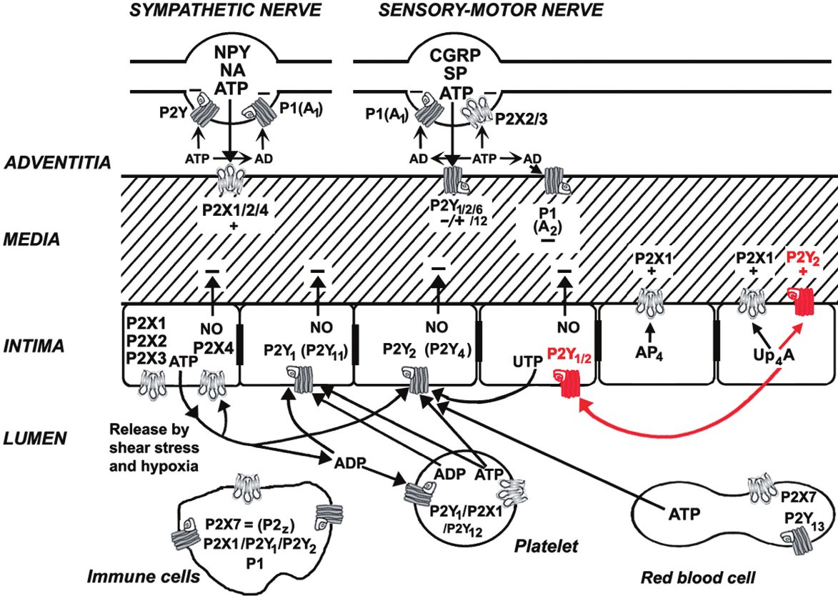
From G Burnstock Br J Pharmacol 2010 doi:10.1111/j.1476-5381.2010.00937.x/bph.937
British Journal of Pharmacology © 2010 The British Pharmacological Society

