Slide 1
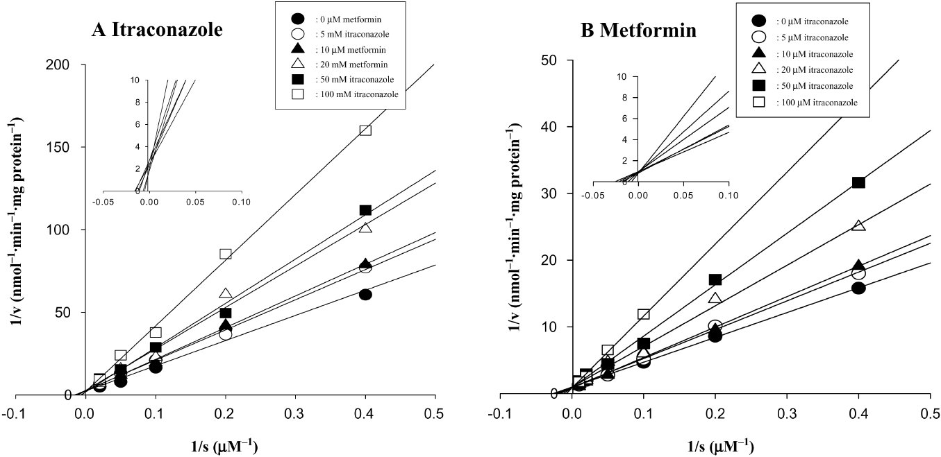
From YH Choi et al. Br J Pharmacol 2010 doi:10.1111/j.1476-5381.2010.00913.x/bph.913
British Journal of Pharmacology © 2010 The British Pharmacological Society

Slide 2
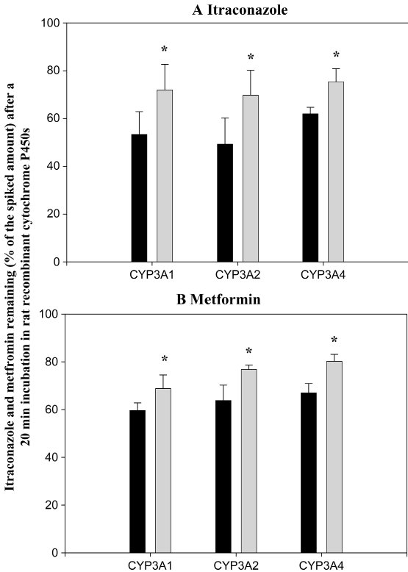
From YH Choi et al. Br J Pharmacol 2010 doi:10.1111/j.1476-5381.2010.00913.x/bph.913
British Journal of Pharmacology © 2010 The British Pharmacological Society

Slide 3
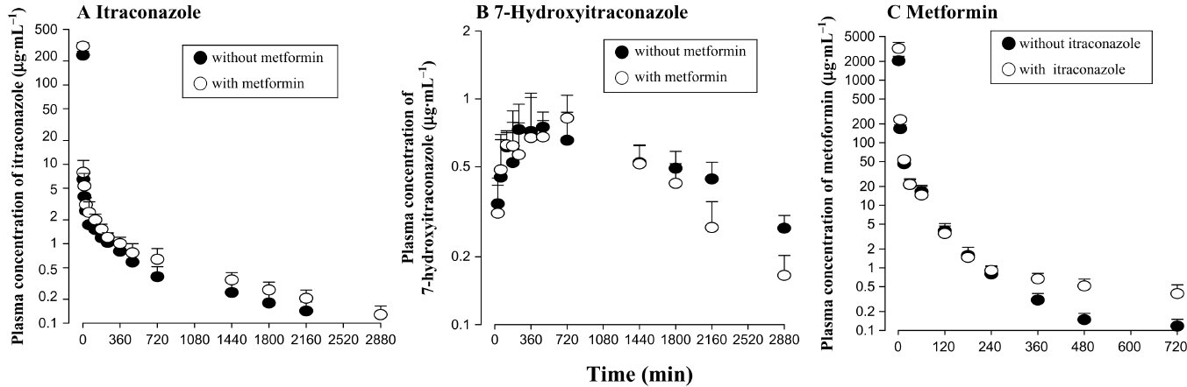
From YH Choi et al. Br J Pharmacol 2010 doi:10.1111/j.1476-5381.2010.00913.x/bph.913
British Journal of Pharmacology © 2010 The British Pharmacological Society

Slide 4
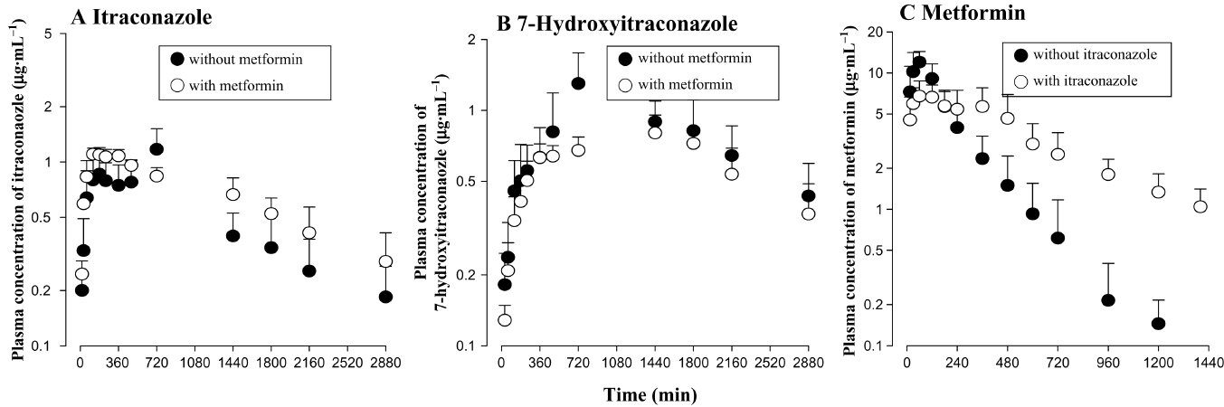
From YH Choi et al. Br J Pharmacol 2010 doi:10.1111/j.1476-5381.2010.00913.x/bph.913
British Journal of Pharmacology © 2010 The British Pharmacological Society

